Slide 1
What is in Store for the UW-System?
This powerpoint provides an introduction to the issues for the University System as of Feb. 7, 2015 (our thanks to the UW-Madison TAA for creating the original ppt file, which we adapted this one from).
The information comes from the Governor’s budget proposal for UW-System, and describes the process of decision making this spring.
Check back for updates as we get them.

Slide 2
Two Proposals
Massive Budget Cut: $300 million
Restructuring the University System as a “Public Authority”

Slide 3
Proposed Budget (UW-System):
$300 million in cuts to UW-System
﻿

Slide 4
$300 million in cuts to UW-System:
$150 million annual cuts in 2015 and 2016
Equivalent to the entire operating budget of UW-Green Bay
Base funding will drop further in 2017. Costs to continue that are being provided in the 2015-2017 biennium ($21 million) will be removed from the budget starting in FY 2018.
Base funding will come from sales tax
Comes after 40 years of declining state aid to University System
﻿

Slide 5
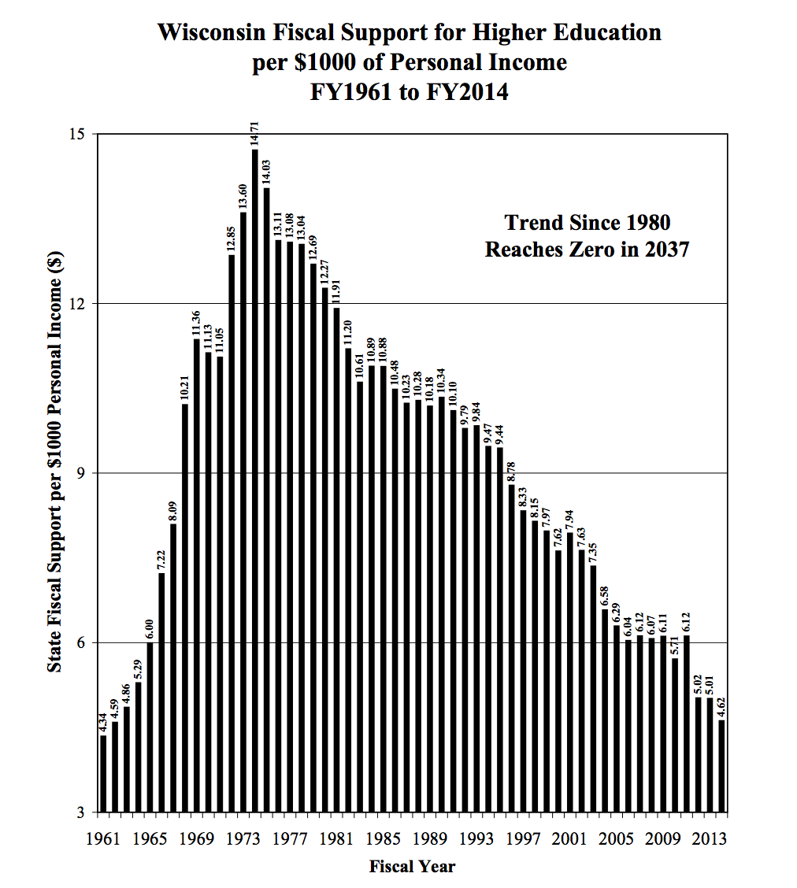
Source: PostSecondary Education Opportunity, January 2014, http://www.postsecondary.org/statereportslist.asp?subcat2=WI​

Slide 6
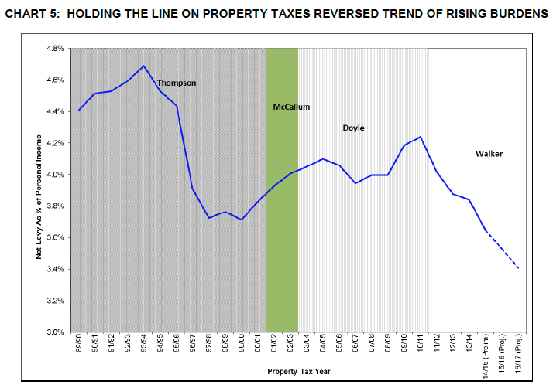
Source: 2015-17, State of Wisconsin: “Budget in Brief”

Slide 7
Proposed Budget (UW-System):
$300 million in cuts to UW-System (13% of current state appropriation); translates to a $40.8 million UW-Milwaukee cut (15.7% of current state appropriation) if traditional UW-System formulas are used for allocating this cut.
﻿Effective July 1, 2016, create the new public authority for the System that has greater independence

Slide 8
Proposed Budget (UW-System):
$300 million in cuts to UW-System; translates to a $40.8 million UW-Milwaukee cut
﻿Effective July 1, 2016, create the new public authority for the System that has greater independence
Transfer all assets, liabilities, and employees to the public authority

Slide 9
Proposed Budget (UW-System):
$300 million in cuts to UW-System; translates to a $40.8 million UW-Milwaukee cut
﻿Effective July 1, 2016, create the new public authority for the System that has greater independence
Transfer all assets, liabilities, and employees to the public authority
As is the case currently, the public authority will control tuition rates after the proposed legislative freeze for the 2015-2017 biennium expires, beginning with the 2017-18 school year.

Slide 10
Proposed Budget (UW-System):
$300 million in cuts to UW-System; translates to a $40.8 million UW-Milwaukee cut
﻿Effective July 1, 2016, create the new public authority for the System that has greater independence
Transfer all assets, liabilities, and employees to the public authority
As is the case currently, the public authority will control tuition rates after the proposed legislative freeze for the 2015-2017 biennium expires, beginning with the 2017-18 school year.
Provide the public authority with control over managing construction projects that are built with non-general fund supported borrowing

Slide 11
Proposed Budget (UW-System):
$300 million in cuts to UW-System; translates to a $40.8 million UW-Milwaukee cut
﻿Effective July 1, 2016, create the new public authority for the System that has greater independence
Transfer all assets, liabilities, and employees to the public authority
As is the case currently, the public authority will control tuition rates after the proposed legislative freeze for the 2015-2017 biennium expires, beginning with the 2017-18 school year.
Provide the public authority with control over managing construction projects that are built with non-general fund supported borrowing
Provide public authority with ability to issue bonds for construction projects that are not paid for by “public debt”

Slide 12
Proposed Budget (UW-System):
$300 million in cuts to UW-System; translates to a $40.8 million UW-Milwaukee cut
﻿Effective July 1, 2016, create the new public authority for the System that has greater independence
Transfer all assets, liabilities, and employees to the public authority
As is the case currently, the public authority will control tuition rates after the proposed legislative freeze for the 2015-2017 biennium expires, beginning with the 2017-18 school year.
Continues tuition freeze for in-state undergraduate tuition until 2017; out-of-state tuition could be raised to offset cuts
Provide the public authority with control over bidding and managing construction projects that are built with non-general fund supported borrowing
Provide public authority with ability to issue bonds for construction projects that are not paid for by “public debt”
Provide the public authority with control over revenues and interest earnings related to certain auxiliaries operations earned by the authority, including discretion to deposit net cash balances, except for gift and grant funds, in the local government investment pool
Provide the public authority with control over all procurement , printing , and fleet policies
Provide the public authority with full control over approving pay plans (no State OSER/JCOER oversight). However, the public authority would also be removed from the State Compensation Reserve, which would likely have additional budgetary impacts.

Slide 13
Restructuring the UW-System

Slide 14
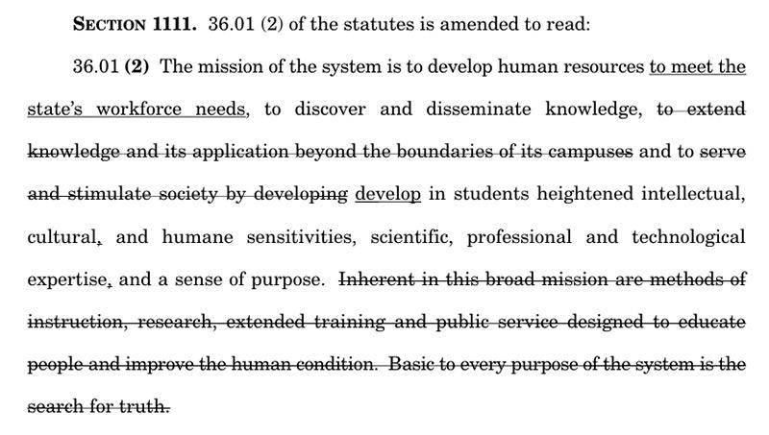
Struck (originally) WI Idea/Search for truth from System mission (now restored)

Slide 15
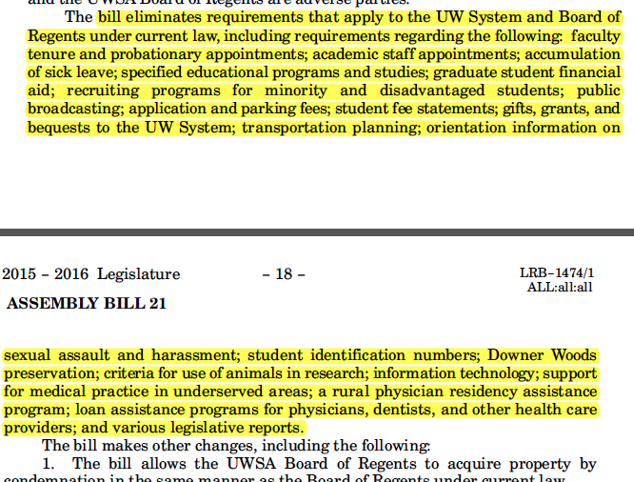
Budget Eliminates State Law Protections of:

Slide 16
Budget Eliminates State Law Protections of:
Faculty tenure
Faculty/Staff/Student Shared Governance

Slide 17
Budget Eliminates State Law Protections of:
Faculty tenure
Faculty/Staff/Student Shared Governance
Accumulation of sick leave

Slide 18
Budget Eliminates State Law Protections of:
Faculty tenure
Faculty/Staff/Student Shared Governance
Accumulation of sick leave
Graduate student financial aid

Slide 19
Budget Eliminates State Law Protections of:
Faculty tenure
Faculty/Staff/Student Shared Governance
Accumulation of sick leave
Graduate student financial aid
Specified education programs and studies

Slide 20
Budget Eliminates State Law Protections of:
Faculty tenure
Faculty/Staff/Student Shared Governance
Accumulation of sick leave
Graduate student financial aid
Specified education programs and studies
Recruitment programs for minority and disadvantaged students

Slide 21
Budget Eliminates State Law Protections of:
Faculty tenure
Faculty/Staff/Student Shared Governance
Accumulation of sick leave
Graduate student financial aid
Specified education programs and studies
Recruitment programs for minority and disadvantaged students
Public broadcasting

Slide 22
Budget Eliminates State Law Protections of:
Faculty tenure
Faculty/Staff/Student Shared Governance
Accumulation of sick leave
Graduate student financial aid
Specified education programs and studies
Recruitment programs for minority and disadvantaged students
Public broadcasting
Orientation information on sexual assault and harassment

Slide 23
Budget Process
executive legislative committee legislative executive
Joint Finance Committee receives budget
Assembly and Senate receive bill, make changes, and exchange
Gov. reviews, vetoes portions, signs into law
State agencies make requests to Gov.
Committee holds public hearings
Conference Committee meets to reconcile two versions hearings
In rare cases, legislative branches can override Gov. veto
Gov. proposes budget
Committee makes changes and votes

Slide 24
Budget Process
executive legislative committee legislative executive
Joint Finance Committee receives budget
Assembly and Senate receive bill, make changes, and exchange
Gov. reviews, vetoes portions, signs into law
State agencies make requests to Gov.
NOW
JUNE
Committee holds public hearings
Conference Committee meets to reconcile two versions hearings
In rare cases, legislative branches can override Gov. veto
Gov. proposes budget
Committee makes changes and votes

Slide 25
Issues to Address
Question Public Authority
Question Cuts
Question Layoffs

Slide 26
Who Makes the Decisions?
State
Governor
Joint Finance Committee
Legislature
UW Administration
Chancellor(s)
Regents
System President

Slide 27
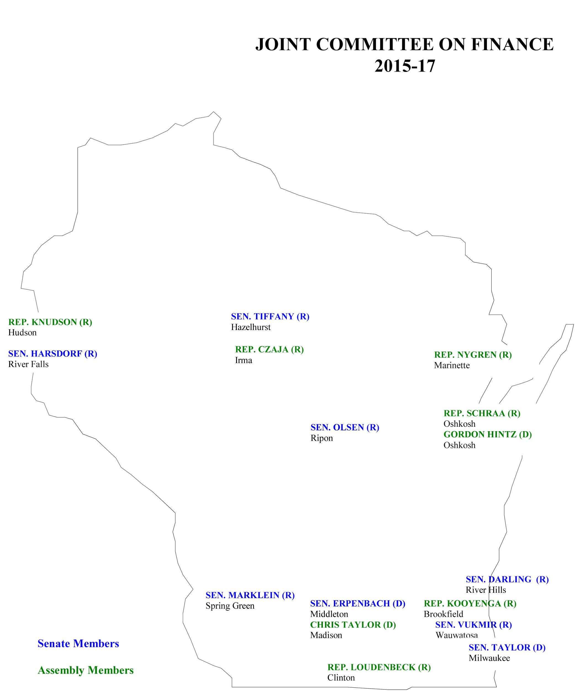
Closest Members (geographically):
Sen. Darling (R) River Hills
Sen. Taylor (D)
Milwaukee
Rep. Kooyenga (R) Brookfield
Sen. Vukmir (R)
Wauwatosa
Rep. Taylor (D)
Madison
Sen. Erpenbach (D)
Middleton

Slide 28
What Actions can UWM Students, Staff , Alumni, and Citizens Take?
Help tell the UWM Story: http://uwm.edu/budget/#stories
Contact Legislators: http://maps.legis.wisconsin.gov/
See the information here: http://uwm.edu/budget/ and here: http://ucnews.uwm.edu
Contact the Board of Regents (next meeting is March 5th in Madison) https://www.wisconsin.edu/regents/
Attend UWM Campus Forums (Next one is Mar. 25th, 10:00-11:00pm, Union Wisconsin Room)

