Slide 1

Student Appropriations Committee (SAC)
Training for the
Spring 2027 Expenditure Grant Process

Slide 2
What is SAC?
Every semester, students pay segregated fees that fund different things on campus (the Union, Resource Centers, Green Fund, etc.) including SAC
This means that the SAC budget is dependent on a variety of factors, most notably how many students enroll and how much funding RSOs use from the prior semester
SAC is the committee, composed of Student Government representatives and RSO members, responsible for allocating funds to RSOs fairly & in accordance with policy
SAC is one place where students have a direct say in how their segregated fees are spent!
2

Slide 3
About SAC Funds
SAC is not and never has been intended to be the SOLE source of funding for student organizations.
Your organization is not guaranteed to receive the full amount you request or even the amount voted on in the hearing.
Your group, even if requesting SAC grants, should continue to pursue and maximize sponsorships and other fundraising opportunities.
Your Student Involvement liaison and faculty/staff advisor can be great resources to help with securing additional funding.
3
Notes:
J

Slide 4
Student Association
Student Appropriations Committee (SAC)
Student Involvement
4

Slide 5

SAC funds are regulated by state policy.
This means that there are rules and procedures that the committee (& RSOs!) must follow throughout the grant process.
5

Slide 6
Guiding policies
Federal Requirements
Viewpoint Neutrality as determined in Board of Regents, University of Wisconsin System v.
Southworth shapes what
information can and
cannot be considered in financial decision making.
State
UW System Administrative Policy 820 defines what student segregated fee funding can and cannot be used for within UW System campuses.
UWM
SAC Bylaws and precedence guide the committee on how to fairly allocate money and ensures a consistent process from semester to semester.
6

Slide 7
1
Grants 101

Slide 8

General Rules
Registration
Your RSO must be registered through student involvement.
Training
At least one OFFICER of your RSO must attend grant training & sign in.
# of Requests
You can submit a request for each type of grant – event, travel, and operations – up to the cap for as many things as you'd like.
Mission
All requests must align with the mission of your RSO.
Disclaimer
SAC Funding cannot be used for academic, personal, political, or commercial gain.
Disclaimer
Fall allocation is between July 1st and December 31st
Spring allocation is between January 1st and June 30th
8

Slide 9
Types of Grants
RSOs can request the following number for each type of grant per semester. There are four types of grants that RSO's can request from SAC...
Event (3 per semester)
Operations (1 per semester)
Travel (1 per semester)
Kick Start ( 1 per semester for new & re-organizing groups only)
9

Slide 10
Event Grants
Funding to support the creation of Events on campus
Overall Cap: $3000
Marketing: $200
Materials: $500 things you’re keeping
Honorarium: $3000*
Housing: $150/day
Flight: $250
Ground transportation: Cap Removed
Food: $500
*Honorariums over $1,000 MUST include a past quote from the performer with their rate listed.
10

Slide 11
Event Grant: Justifications
Justification = a quote or proof of an expense. Must be non-editable and dated.
Important: You only need to provide a quote for a service if you plan to use that service.
Event Justifications must include...
If using Union Event Services: Request a quote by their deadline, including room setup, A/V, etc.
If using Marketing Services: Request a quote by their deadline for promotional materials.
If using UWM Catering: Request a quote by their deadline for catering. Food requests from other vendors will be denied.
If paying an honorarium: Quote from the intended recipient showing their rate.
Honoraria over $1,000: Provide a previous quote from the speaker/performer confirming their rate is appropriate.
If requesting travel: Screenshot of flight or ground transportation prices.
If requesting lodging: Screenshot of the wisconsin.edu travel hotel rate for Wisconsin
Plan Ahead!!! Quote request forms from Marketing, Event Services, & Catering are in PantherOrgs. Their quote request deadlines are BEFORE the Event Grant application deadline. Request your quotes early so you have them when you apply.

Slide 12

Operations Grants
Funds to cover everyday running costs, administrative necessities, and general organizational expenses rather than specific standalone events or travel
Overall Cap: $3000
Marketing: $200
Office Supplies: $60
Justifications must include...
Quote from Union Marketing for general promotional materials
Screenshot of an online shopping cart that includes all items you want to purchase up to $3000 (make sure all items are shown with individual prices!)
** Please do not upload singular items individually – this will significantly slow the process. Screenshots of shopping carts with ALL items are great. **
12

Slide 13
Travel Grants
Funding to assist organizations to cover transportation, lodging, registration for organization-related trips and events
Overall Cap: $2000
Registration: $150 per person
Hotel: $150/night, max. 3 nights per diem calculator ONLY
Flights: $250 per person round trip
Rental Cars: $200 per 4 people traveling plus gas
Ground travel: No separate cap – subject to the overall grant maximum and allowable-cost rules. May include mileage (for personal cars, bus tickets or chartered bus, Amtrak, or rideshares
Tip: travel grants may be used for any event off campus that aligns with your organization’s mission. It does not need to be a conference.
13

Slide 14
Travel Grant: Justifications
Justification = a quote or proof of an expense. Must be non-editable and dated.
You only need to provide a quote for a service if you plan to use that service.
Travel Justifications must include...
If requesting registration fees, or ticket admission costs, include a screenshot of the registration cost or free from the website. If the cost is not yet listed, you may use a screenshot of last year's registration cost as justification
If requesting funds for hotel, you must use the Per Diem Calculator to get a quote for lodging costs. Go to wisconsin.edu/travel and select Per Diem Calculator. Use the tool to create a trip report based on the location and dates of your event. Take a screenshot of the page: while your lodging on the application is capped, this trip report provides the justification of your cost. Even if you know your event will be taking place at a specific hotel---you must use this tool to provide your justification.
If requesting flights: Google flights estimate
If requesting gas (allowable with rental cars): use fueleconomy.gov for your estimate
Rideshare/train/bus: Screenshots of Uber/Lyft/Amtrak/bus quotes
If you are using your own vehicles, you can request mileage costs ($0.76 per mile as of 8/2026) Include googlemap screenshot of your trip (multiply x2 for round-trip)

Slide 15
Kick Start Grants
**For new RSOs or reactivated RSOs ONLY**
Overall Cap: $1500
Caps from the relevant grant type still apply (for example,
$200 for marketing)
Consider requesting for...
Event: Small event to raise awareness on
campus
Operations: General marketing to assist with recruitment
Travel: Funding for a virtual conference
These grants can be submitted after the deadline and are open until the last grant hearing date. Funds will be made available following the subsequent student senate meeting.
Please note that these grants are contingent upon SAC having enough members to
vote. Without enough members, Kick Start grants cannot be allocated.
15

Slide 16
Additional Notes
Keep in mind:
Travel grants that send fewer travelers than the organization originally applied for can receive reduced travel amounts. Grant reductions due to decreased attendance apply when the final # of travelers are fewer than (4). No reduction is applied if the final number of travelers is 4 or more, regardless of the original number of travelers
Giveaways & UWM Property Items purchased with grant funds remain the property of UWM and may not be purchased for personal ownership or use.
    Promotional or branded items may be purchased using approved marketing funds through Union Marketing. Such items should be: be promotional in nature, display organizational or university branding, and have a low individual value (generally less than $5 per item).
    Items may not be distributed as giveaways unless they are low-cost promotional materials or branded items approved for marketing purposes.
Revenue: Organizations using SAC grants to earn revenue must fully repay SAC before they can realize a profit. This is true for Event Grants, Travel Grants, or Operations Grants. Organizations hosting ticketed events must work with Event Services to sell tickets. Revenue earned from ticket sales, donations collected during a SAC-funded event, or sales made by selling items purchased with SAC funds must be repaid to SAC in full. Your liaison or the business office can provide more detail.

Slide 17
SAC cannot fund...
“
Decorations
Prizes
Helium tanks
Honorarium with a conflict of interest
Gifts for UWM faculty or staff
Individual membership dues
Improvement of spaces (ie. Furniture, cleaning products, appliances)
Personal items (t-shirts, business cards, uniforms)
Anything that has a free alternative on campus
Off-campus facilities (unless the group has confirmed with Student Involvement that there are no adequate on-campus spaces for an event)
Old quotes from performers, Event Services, Marketing, etc. The only exception is for Travel Grants, in which you can use last year's conference price as registration justification or honoraria over $1000

Slide 18
Automatic Denials
“
Submitting your grant after the deadline
Failing to attend grant training
Incomplete organization registration with Student Involvement
Partial Denials
Incomplete or insufficient documentation
    All justification must be NON-EDITABLE, follow our published policies, and
    include all items needed for the grant
Incomplete grant application
Request for a non-fundable item

Slide 19
2
Filling out your grants
Step by Step.

Slide 20
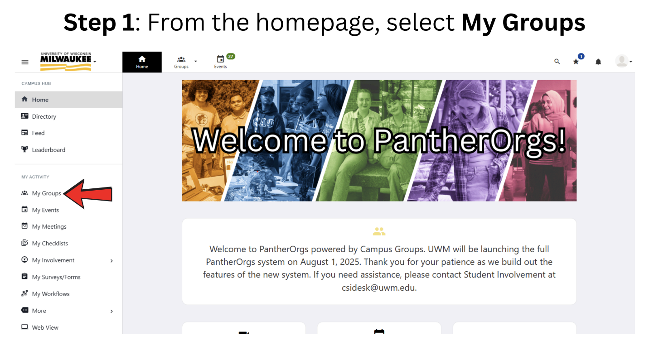

Slide 21
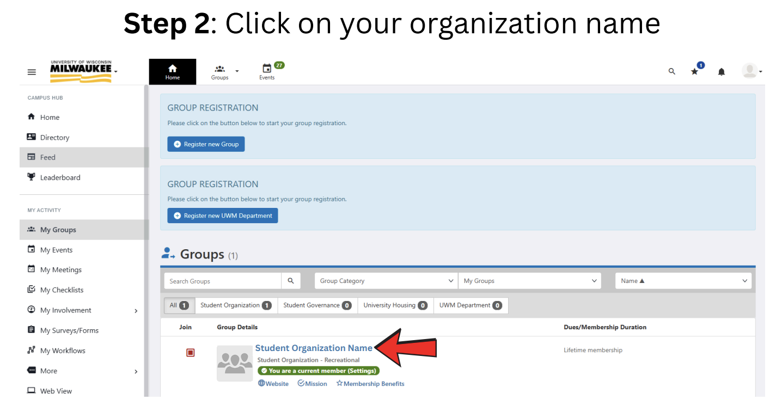

Slide 22
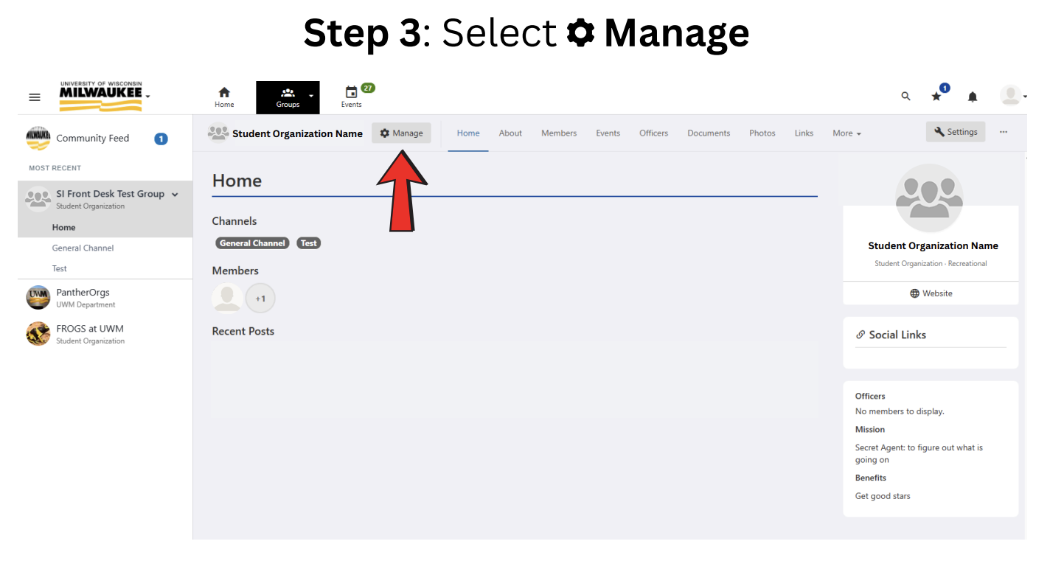

Slide 23
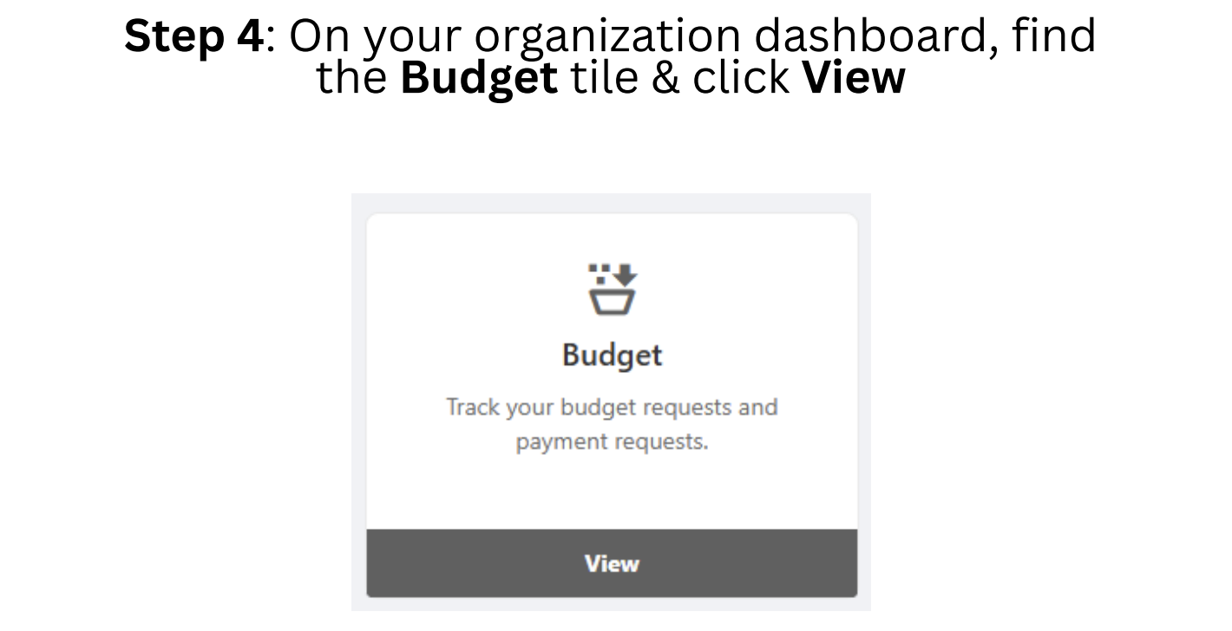

Slide 24
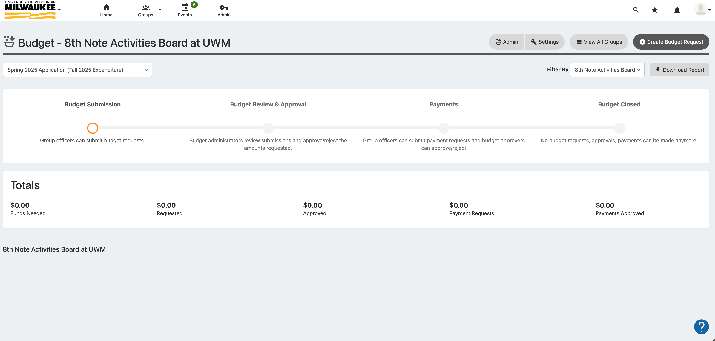
Step 4: Select “Create Budget Request”

Slide 25
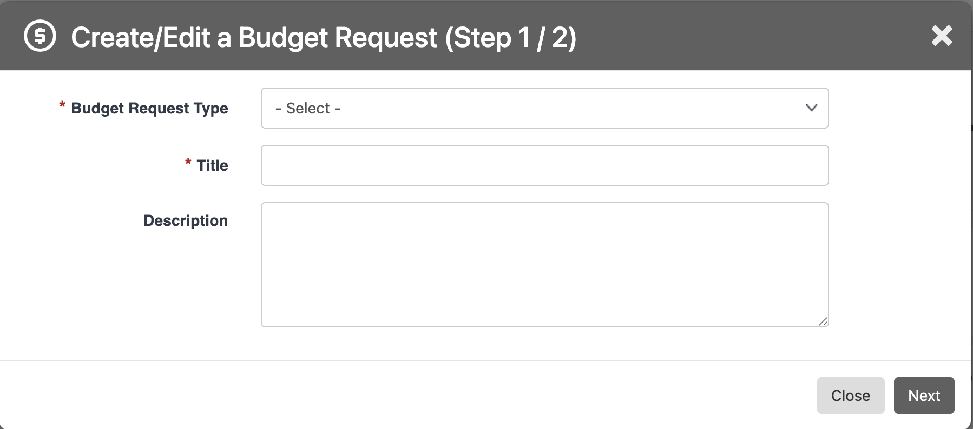
Step 5: Fill out each selection

Slide 26
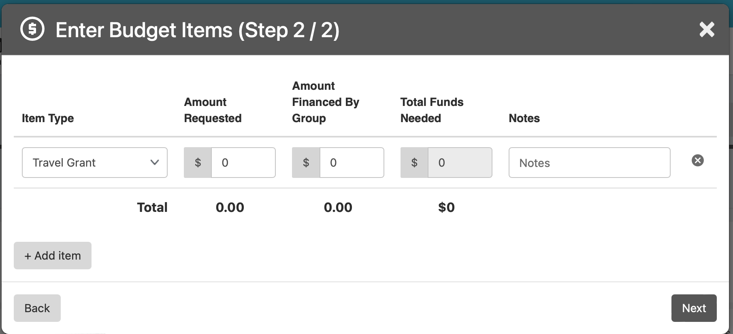
Step 6: Fill out each box, disregard “Amount Financed by Group” section

Slide 27
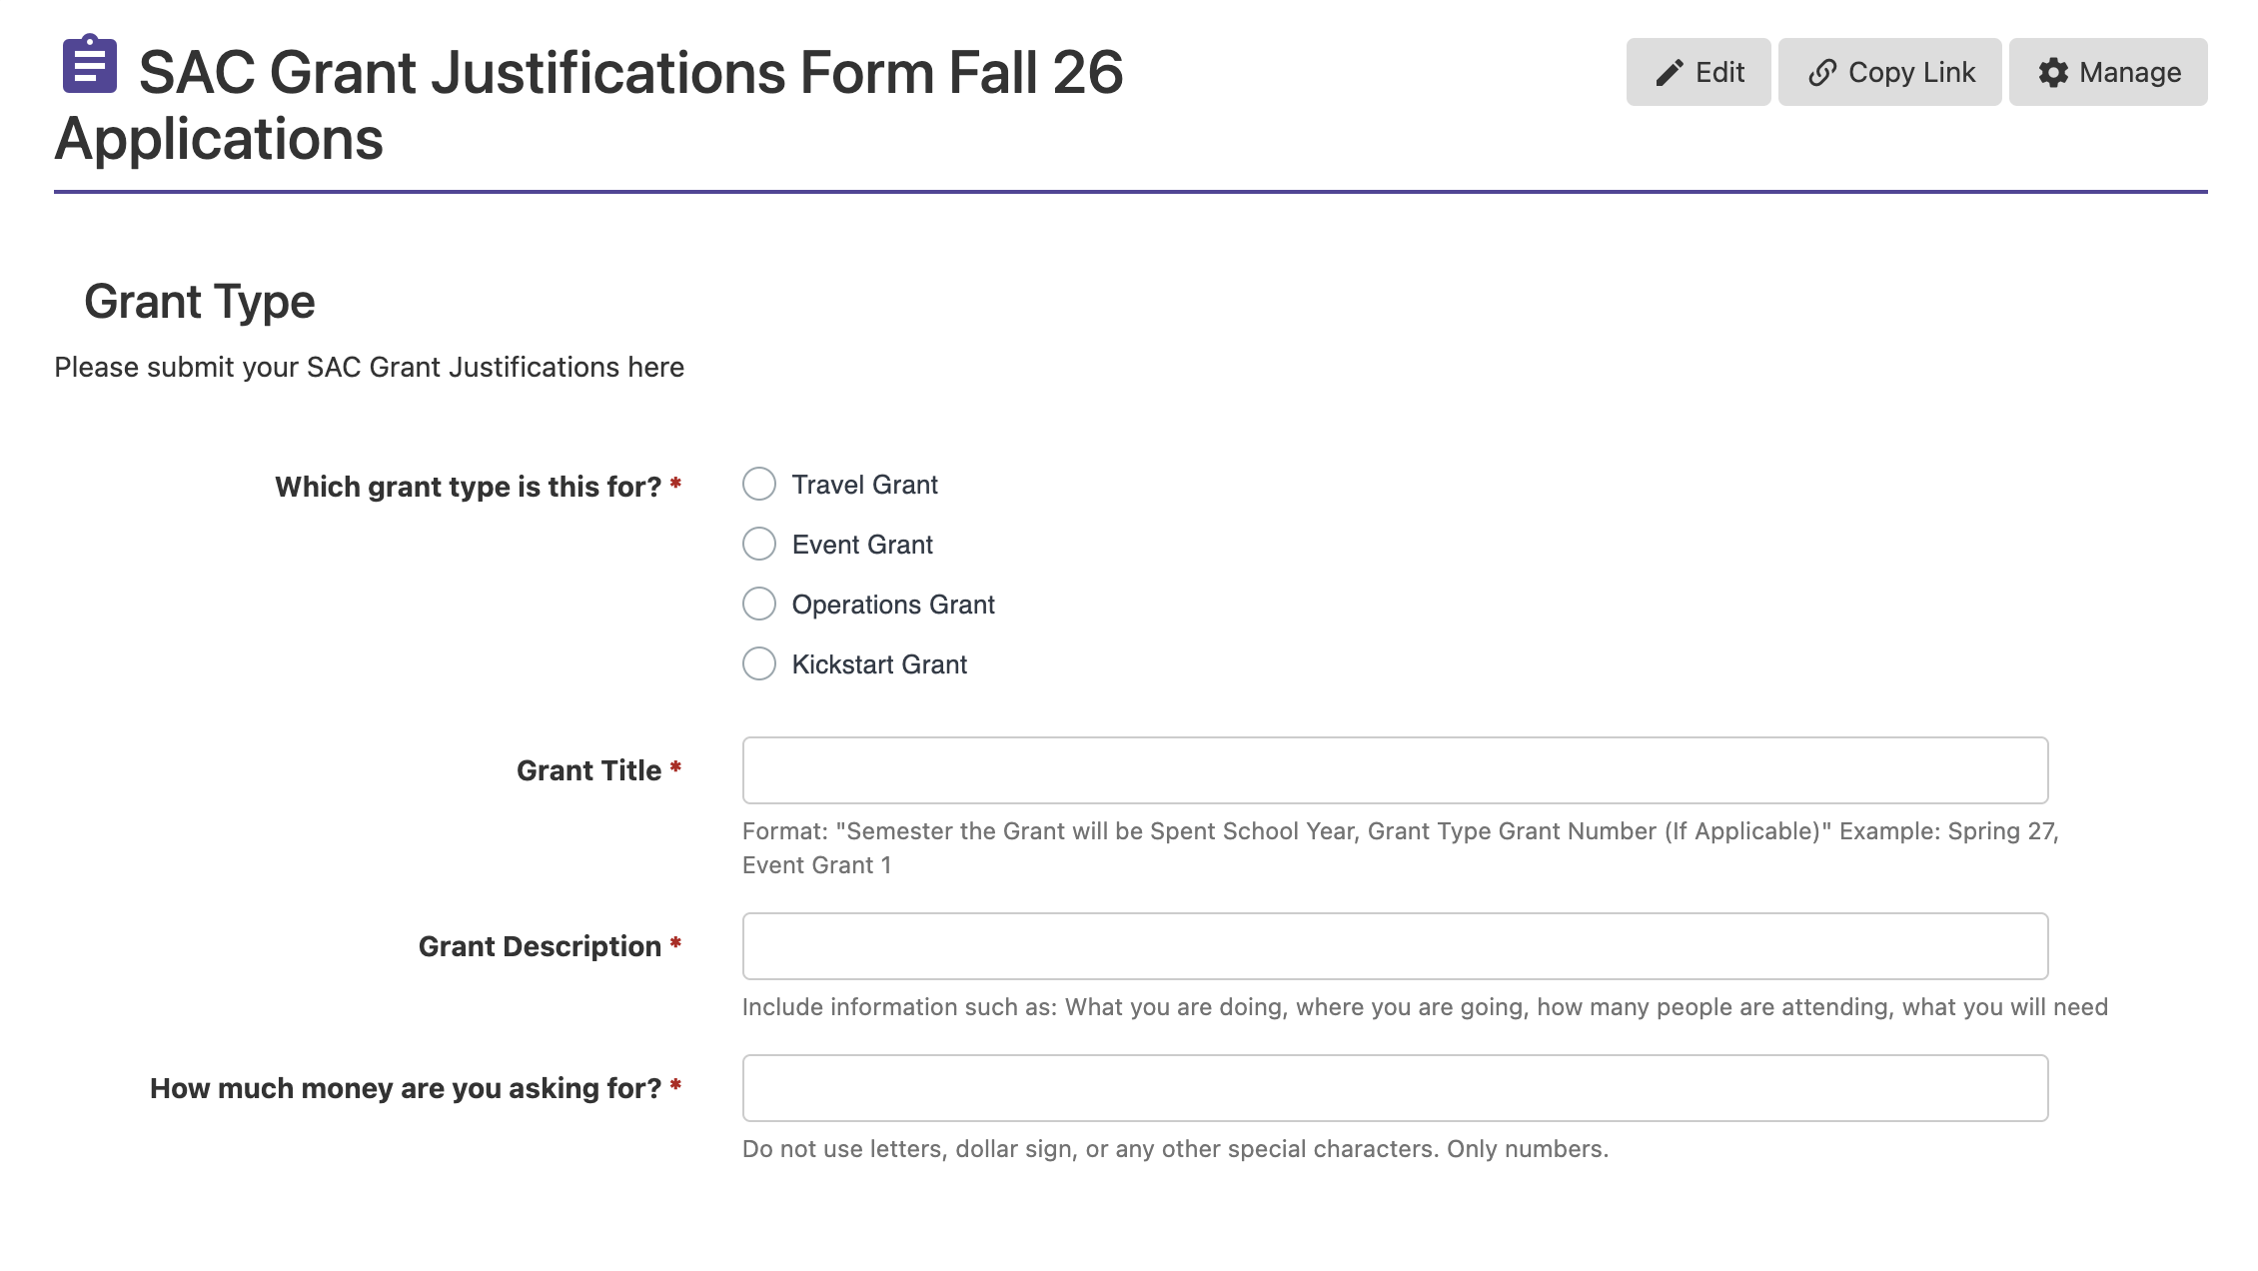
Step 7: Complete the Justifications Form

Slide 28
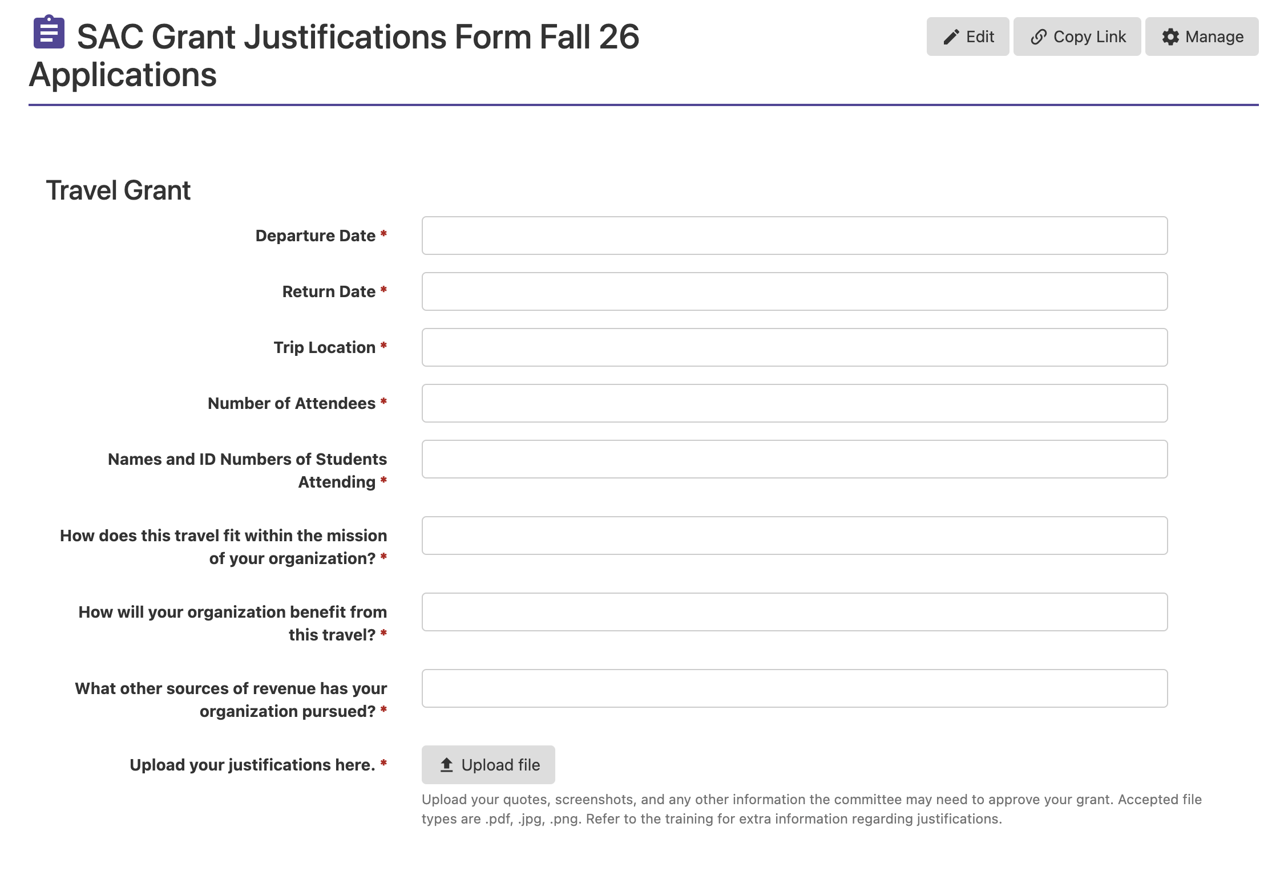
Step 7 cont.

Slide 29
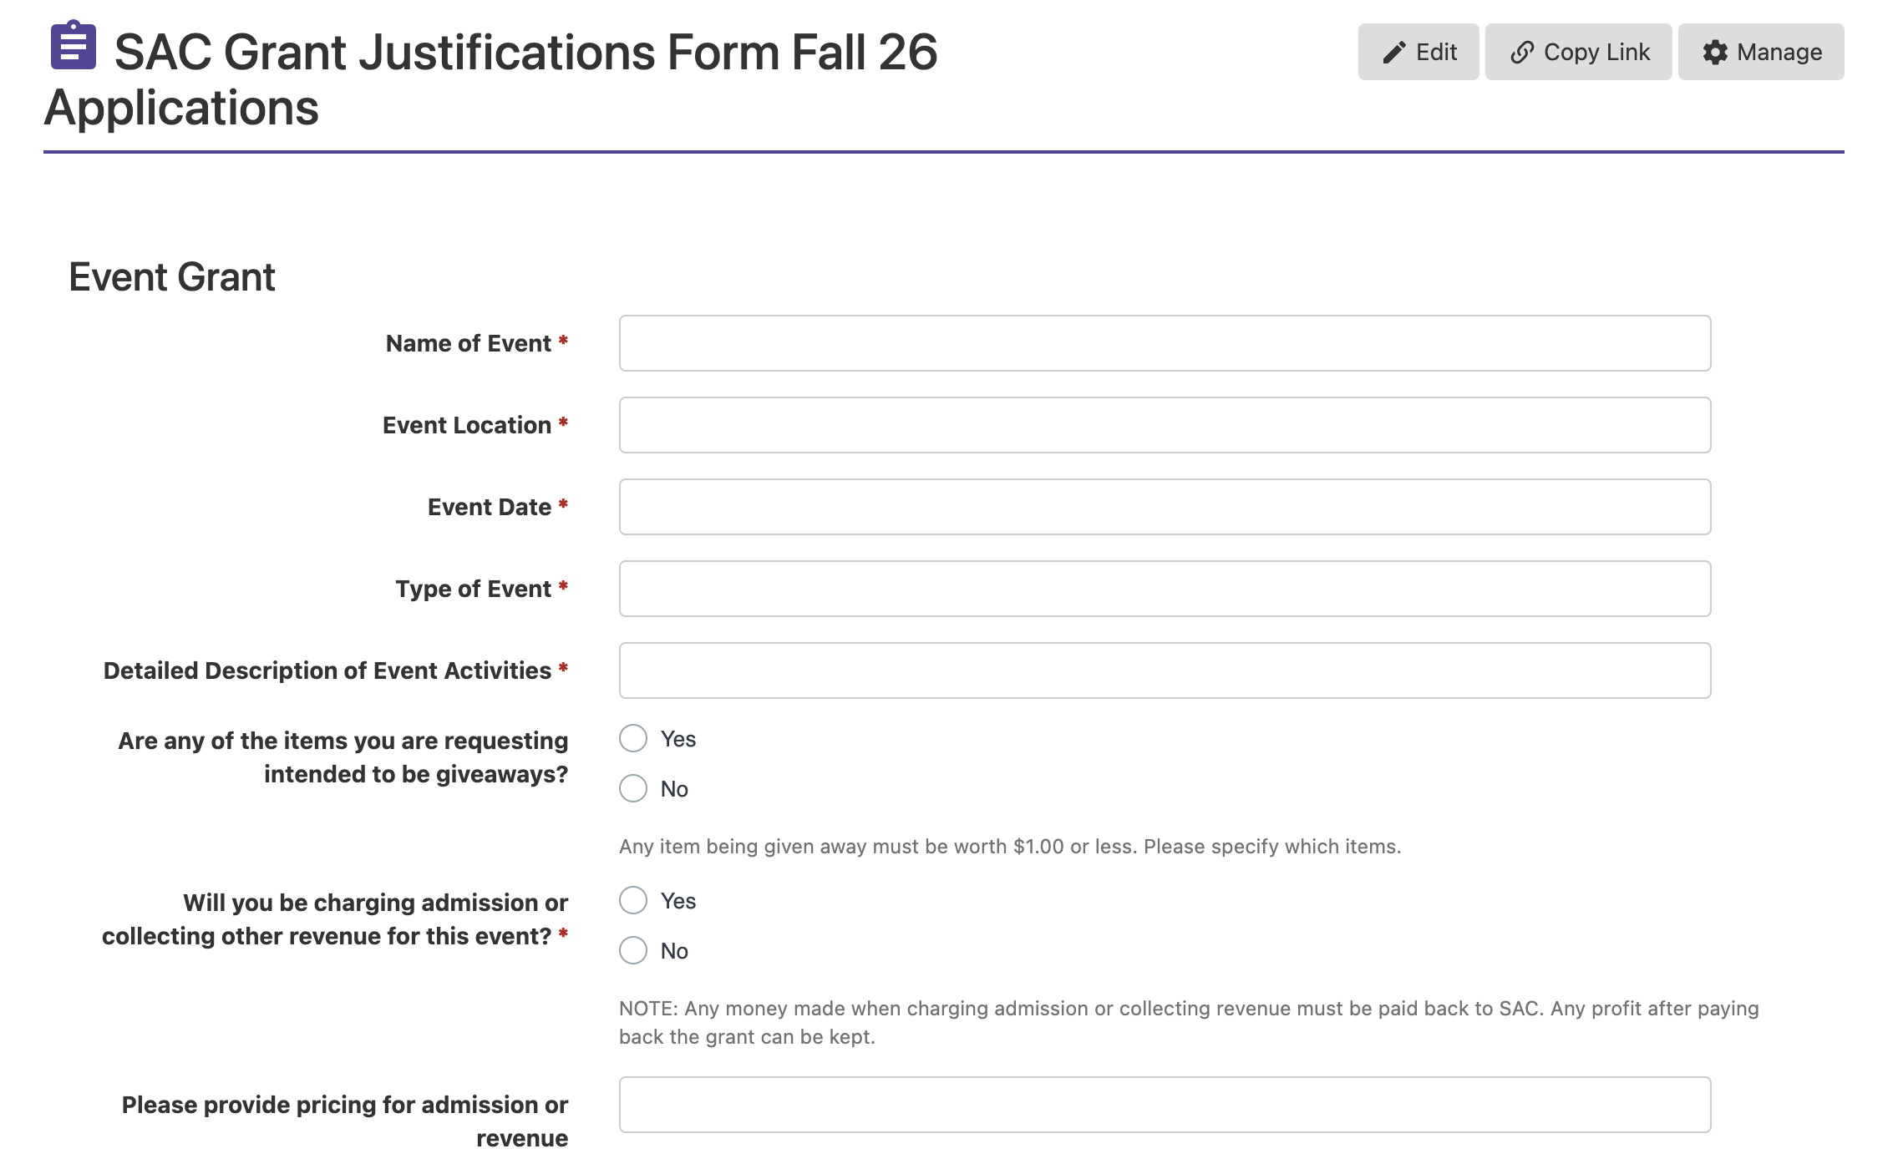
Step 7 cont.

Slide 30
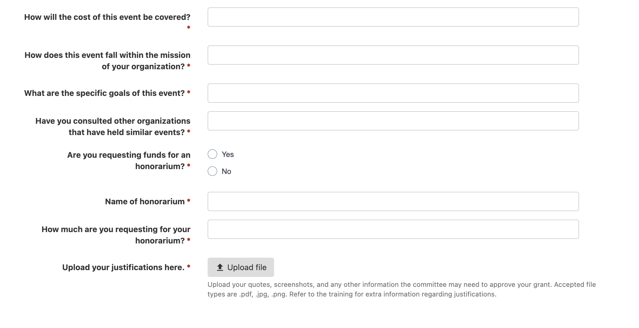
Step 7 cont.

Slide 31
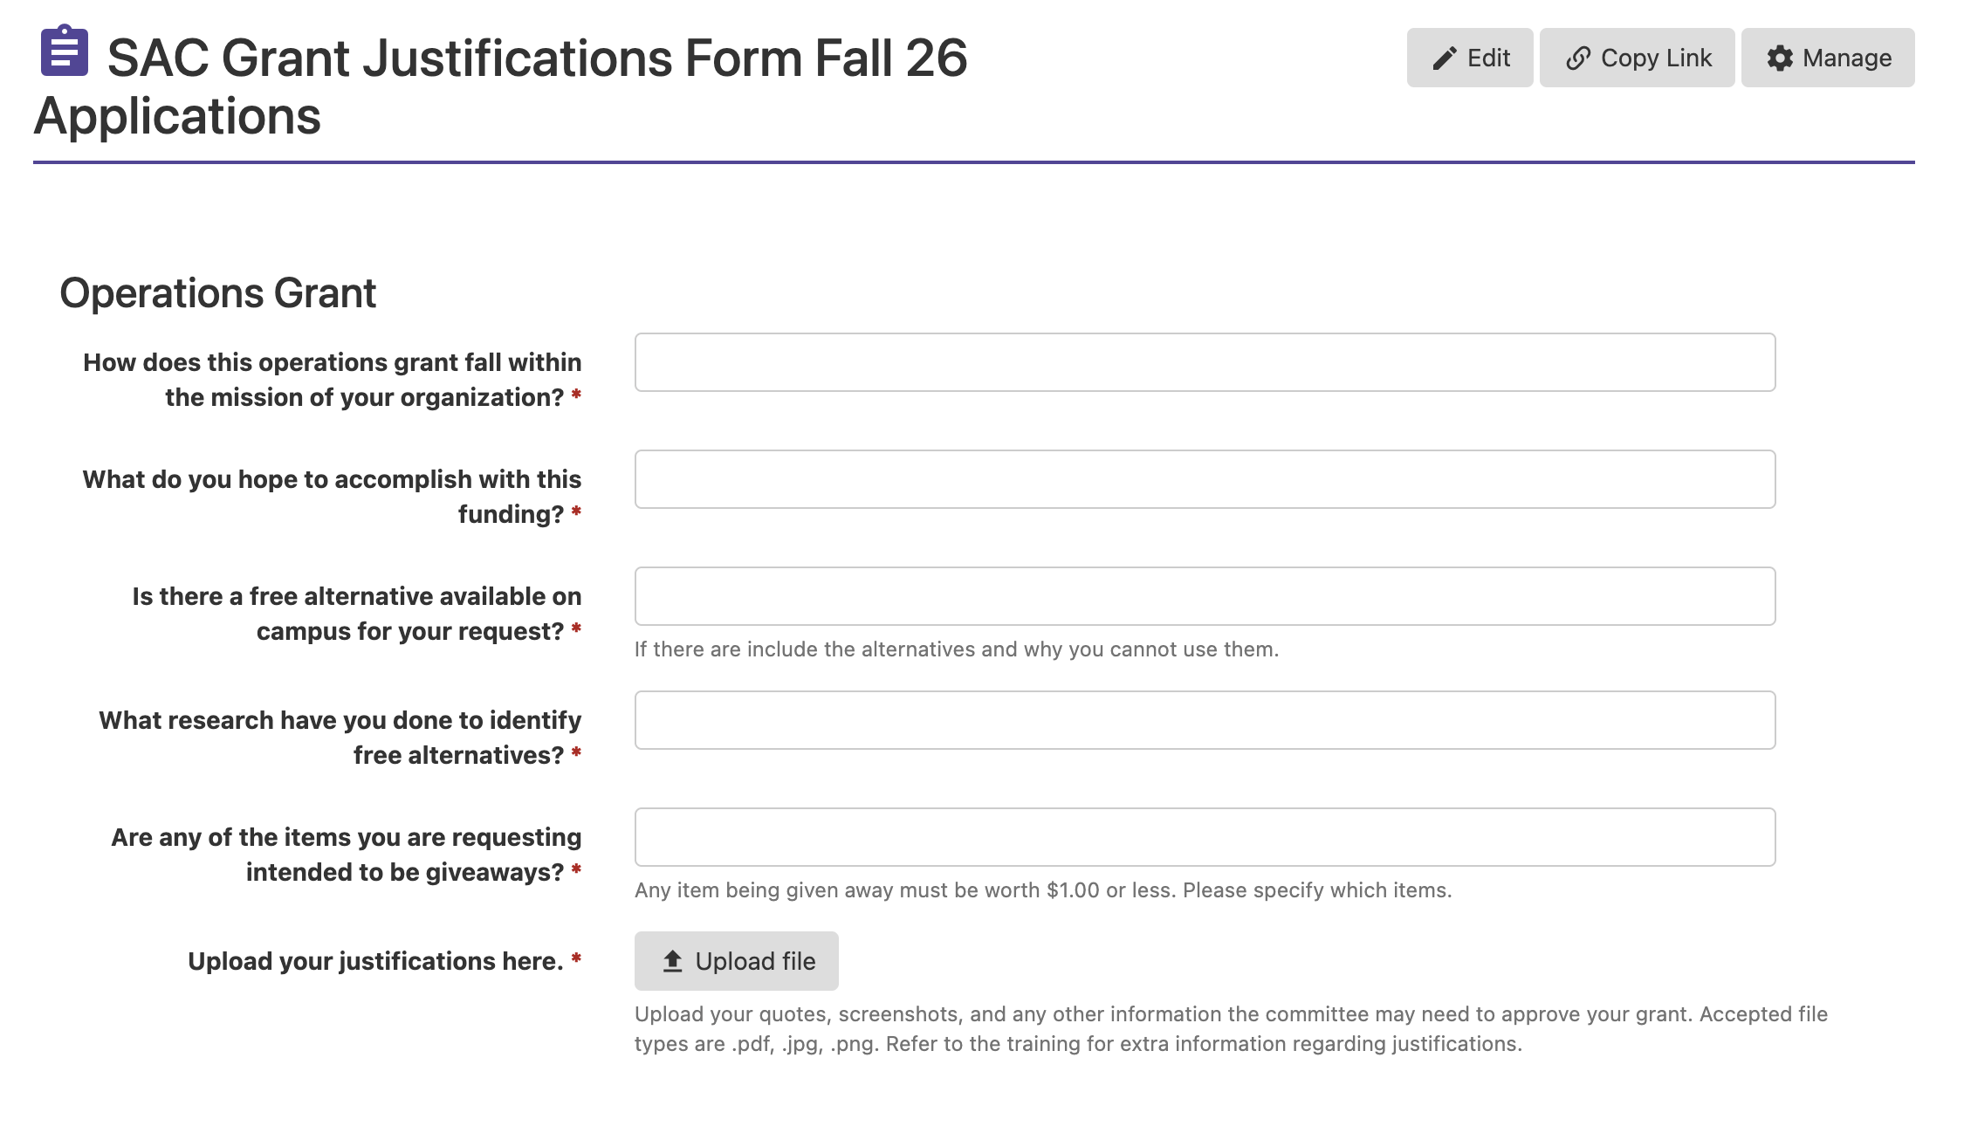
Step 7 cont.

Slide 32

Step 7 cont.

Slide 33
Grant hearings
Each hearing takes about 5 minutes. It is not mandatory to attend, but you are welcome to do so. Hearing dates and times will be posted on the SAC website. SAC will prioritize hearings for officers that would like to attend.
  Be prepared to explain each grant and why it is relevant to your RSOs mission.
  The committee may ask you questions.
The committee will vote on a PRELIMINARY amount, and you are excused.
At the end of the semester, the committee will reevaluate the budget to determine final grant amounts and will make a cut across the board if necessary.
Your RSO will receive an email with the final approved grant amount.
33

Slide 34
After you get the grant
At the end of the semester, you will receive an email with the FINAL grant amount, which may include a cut.
Student Involvement will contact all organizations that received funding at the start of each semester. Included in the email will be instructions to submit an expenditure form. Do not purchase anything yourself. You must work with Student Involvement, who will make all purchases on your behalf. Reimbursements are not allowed.
                Travel: Complete the expenditure at least 3 weeks prior to travel. Once the expenditure has been approved, you will be contacted to set up an in-person meeting, during which all travel arrangements will be booked and paid for directly.
                Operations: Mandatory contracts or vendors are required and proper state purchasing procedures must be followed. The SI office will place all orders and make all payments. Allow at least 2 weeks for most orders to arrive.
                Event: Submit the expenditure form and work with your liaison. Any person being paid for a service, performance, or to speak must be paid by a contract, and the expenditure form will provide next steps. A completed, signed contract must be turned into SI at least 30 days prior to the event. If your event has Catering, reach out to them a minimum 1 month ahead of time.
34

Slide 35
3
Justifications
Show us where your money is going.

Slide 36
Overall Guidelines
All justifications need...
NUMBERS and amounts
Itemized lists of what you are purchasing
To be current (requested this semester)
Unable to edit (PDF, screenshot, etc.)
  Please NO WORD DOCUMENTS
Your key to success: non-editable verifiable third-party justification

Slide 37
Quotes: Marketing, Event Services, and Catering
To get a marketing quote....
Utilize the online request form on Panther Orgs
Found on both the SAC website under “Expenditure Training” and on Panther Orgs under “Forms”

Slide 38
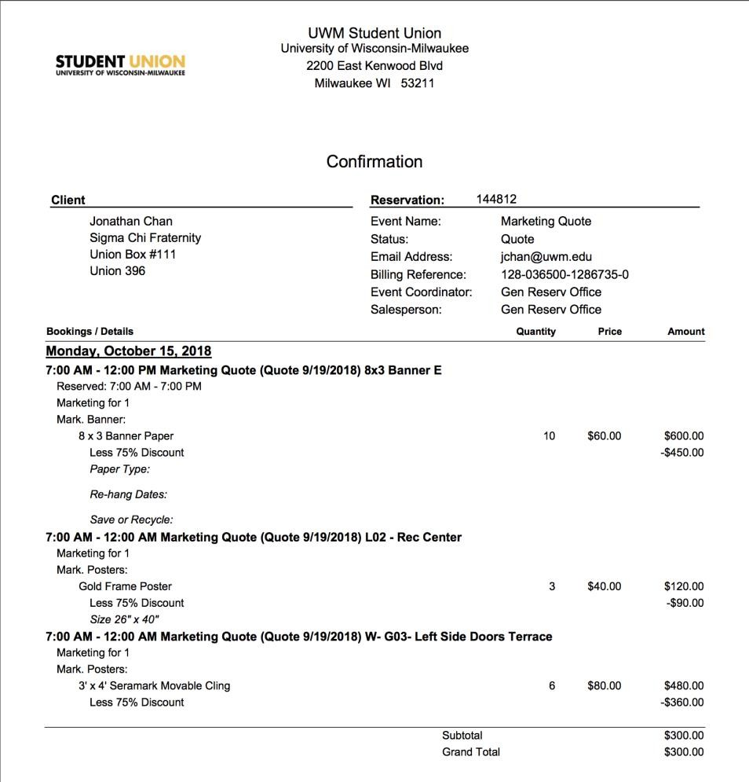
Your name
Your phone number
Your email

Slide 39
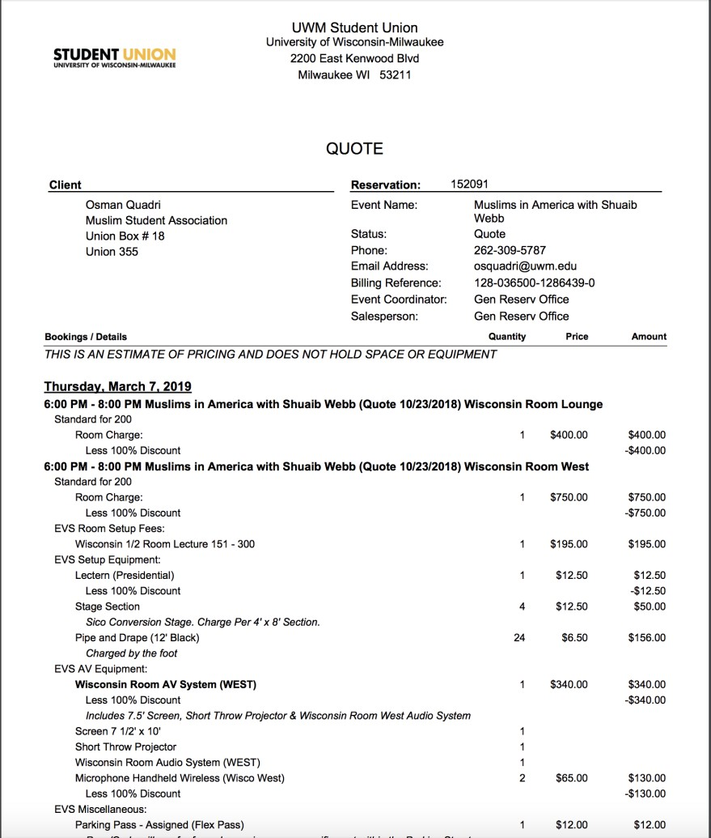
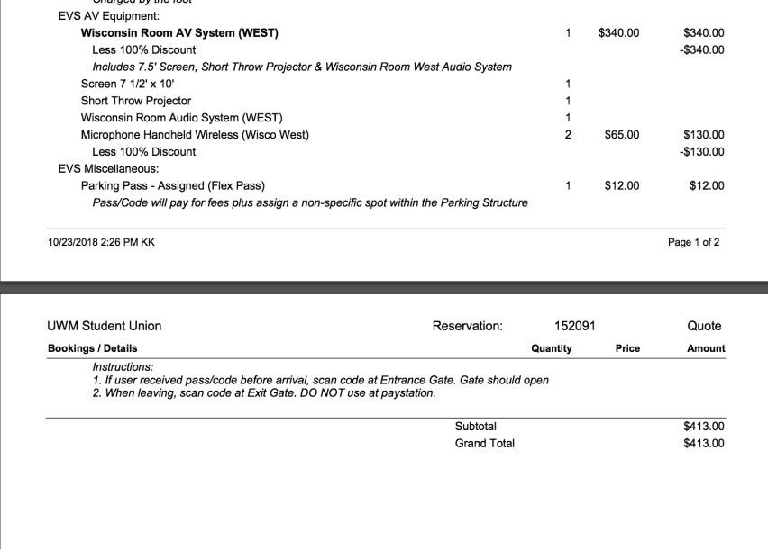
Your name
Your event name
Your phone number
Your email
###

Slide 40
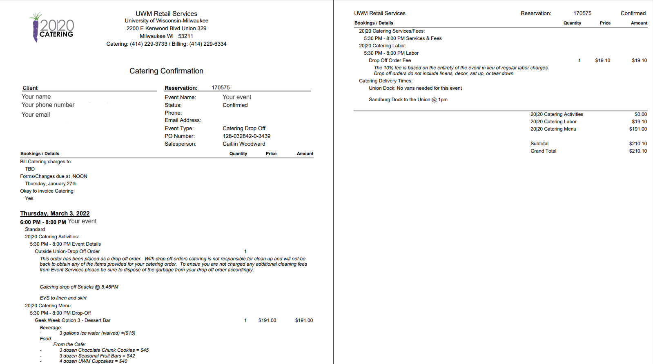

Slide 41
Quotes: Honorariums
To get an honorarium quote....
Email the person you are hoping to have speak (or
their agent)
Work closely with your liaison
Include PDF or screenshot of emails and quotes in grant
submission.
**additional verifications needed for honorarium over $1000**

Slide 42
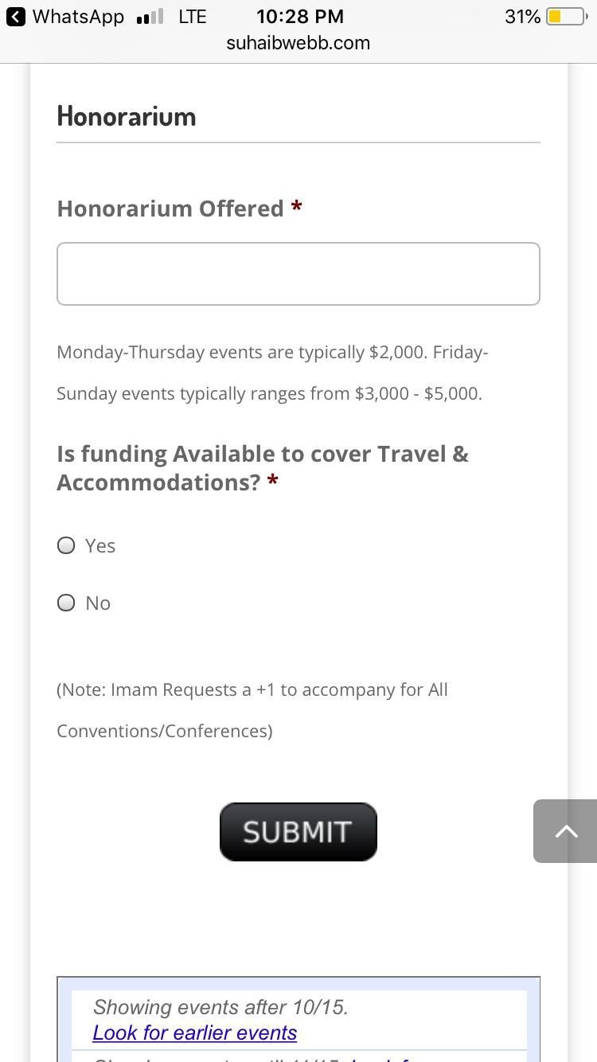
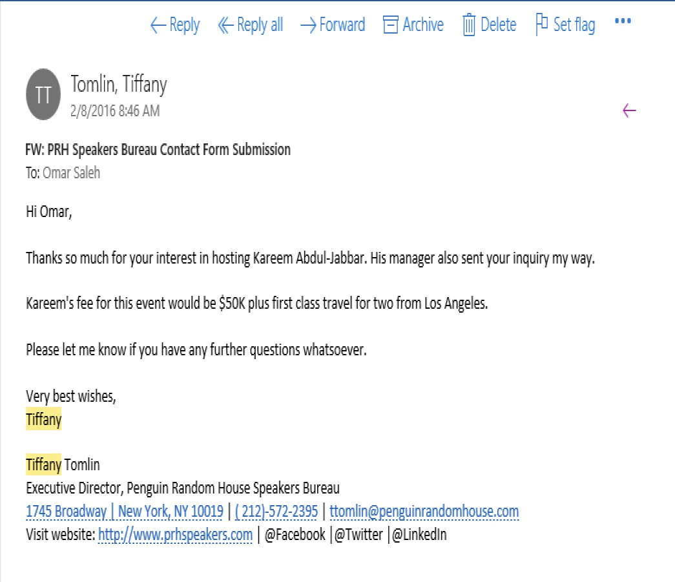
Agent’s name
Your email Your name
VIP’s name
VIP
Agent’s name
Agent’s contact information

Slide 43
Quotes: Hotels
To get a hotel quote:
  Go to wisconsin.edu/travel
  Use the Per Diem Calculator
  Enter your desired location and dates, save location, and then generate trip report
  Submit a screenshot
  Please do not use CONCUR. You must use the Per Diem Calculator to get your quote, regardless of the hotel you will be staying at
  If the site is down, we need a screenshot showing the site is down, and the committee will calculate a price for you.

Slide 44
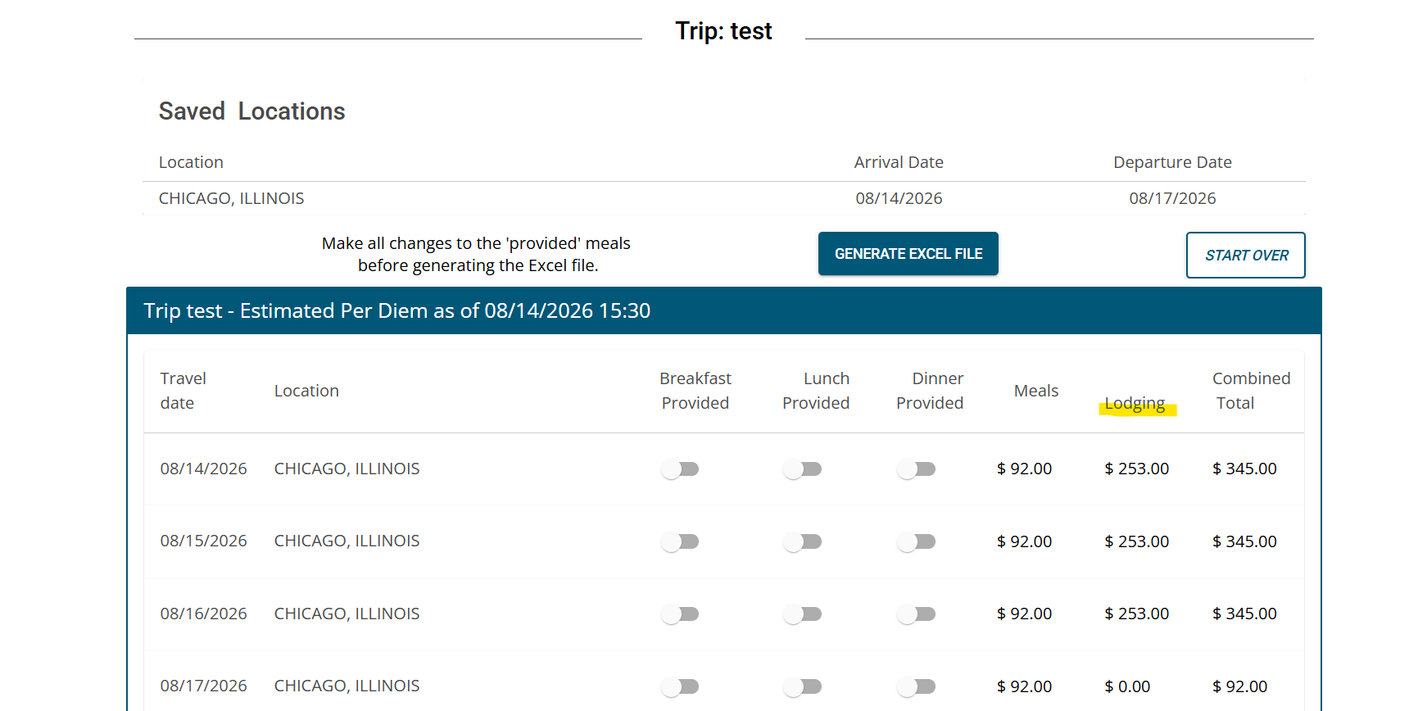

Slide 45
A note on redistributions
Anything that is justified in the original grant can be purchased using
that grant money. For example, if you have a hotel quote in a travel
grant and decide you want to use the FULL travel grant for the hotel; you can do that without a redistribution.
You only need a redistribution if...
  You need to purchase something not justified in your original
grant (for example, you asked for a meditation mat but now you need medicine balls instead)
  There is a name change, such as deciding to go with a different speaker or to a different conference
If you need a redistribution, fill out the Panther Orgs Form
45

Slide 46
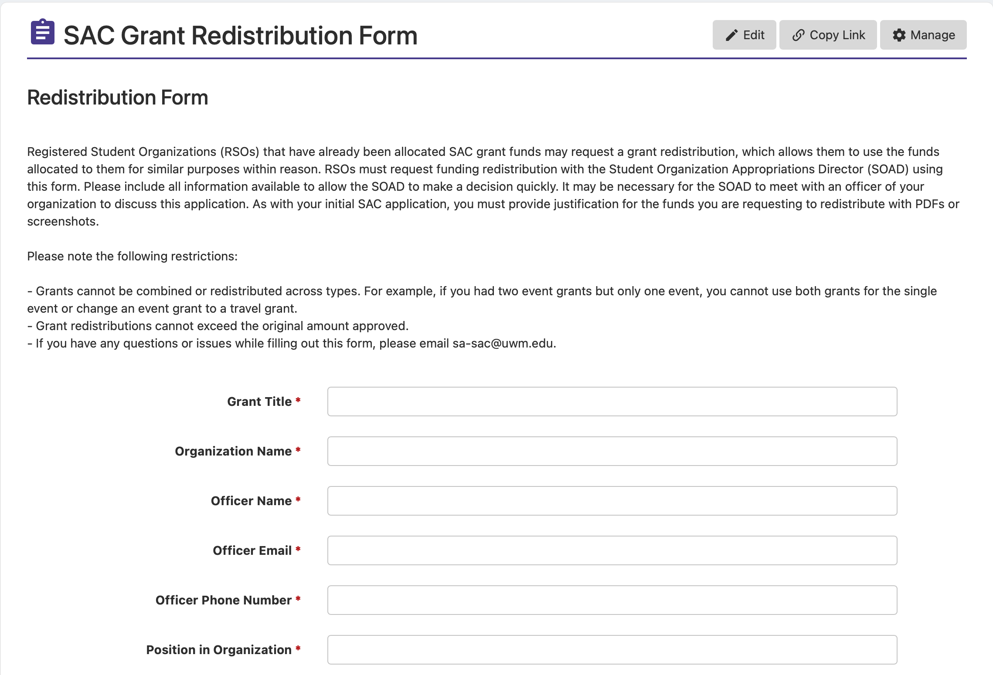

Slide 47
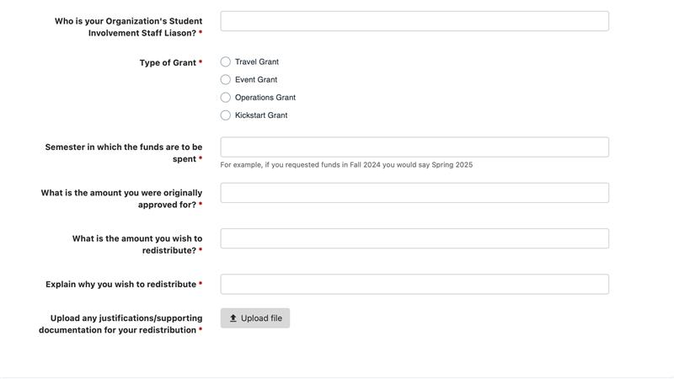

Slide 48
Important Deadlines
“
**All Marketing, Event Services, and Catering Quote REQUESTS are due OCTOBER 9th at noon.**
**OVERALL GRANT DEADLINE IS OCTOBER 16th at noon**
No late submissions accepted.
**HEARINGS WILL BEGIN THE WEEK OF OCTOBER 19th**

Slide 49
Contact Information
“
Student Appropriations Committee: sac-questions@uwm.edu
Student Involvement: si-busoffice@uwm.edu
Union Marketing: markdesk@uwm.edu
Catering: uwm-catering@uwm.edu
Event Services: reservat@uwm.edu
**General questions? Email sac-questions@uwm.edu**

Slide 50
Thanks!
Any questions?
Email us at sac-questions@uwm.edu!

