Slide 1

Student Appropriations Committee (SAC)
Training for the
Fall 2025 Expenditure Grant Process

Slide 2
What is SAC?
Every semester, students pay segregated fees that fund different things on campus (the Union, Resource Centers, Green Fund, etc.) including SAC
This means that the SAC budget is dependent on a variety of factors, most notably how many students enroll and how much funding RSOs use from the prior semester
SAC is the committee, composed of Student Association representatives and RSO members, responsible for allocating funds to RSO's fairly & in accordance with policy
SAC is one place where students have a direct say in how their segregated fees are spent!
2

Slide 3
About SAC Funds
SAC is not and never has been intended to be the SOLE source
of funding for student organizations.
Your organization is not guaranteed to receive the full amount you request or even the amount voted on in the hearing.
Your group, even if requesting SAC grants, should continue to pursue and maximize sponsorships and other fundraising opportunities.
Your Student Involvement liaison and faculty/staff advisor can be great resources to help with securing additional funding.
3

Slide 4
Student Association
Student Appropriations Committee (SAC)
Student Involvement
4

Slide 5

SAC funds are regulated by state policy.
This means that there are rules and procedures that the committee (& RSOs!) have to follow throughout the grant process.
5

Slide 6
Guiding policies
Federal
Viewpoint Neutrality as determined in Board of Regents, University of Wisconsin System v.
Southworth shapes what
information can and
cannot be considered in financial decision making.
State
UW System Administrative Policy 820 defines what student segregated fee funding can and cannot be used for within UW System campuses.
UWM
SAC Bylaws and precedence guide the committee on how to fairly allocate money and ensures a consistent process from semester to semester.
6

Slide 7
1
Grants 101

Slide 8

General Rules
Registration
Your RSO must be registered through student involvement.
Training
At least one OFFICER of your RSO must attend grant training & sign in.
# of Requests
You can submit a request for each type of grant – event, travel, and operations – up to the cap for as many things as you'd like.
Mission
All requests must align with the mission of your RSO.
Disclaimer
SAC Funding cannot be used for academic, personal, political, or commercial gain.
Disclaimer
Fall allocation is between July 1st and December 31st
Spring allocation is between January 1st and June 30th
8

Slide 9
Types of Grants
RSO's can request the following number for each type of grant per semester. There are four types of grants that RSO's can request from SAC...
Event (3 per semester)
Operations (1 per semester)
Travel (1 per semester)
Kick Start ( 1 per semester for new & re-organizing groups only)
9

Slide 10
Event Grants
Overall Cap: $3000
Marketing: $200
Materials: $500 things you’re keeping
Honorarium: $3000*
Housing: $150/day
Flight: $250
Ground transportation: Cap Removed
Food: $500
Justifications to include...
Quote from event services, including room set-up, A/V, etc.
Quote from marketing for promotional materials
Quote from honorarium with their rate listed.
Honoraria of more than $1000 require a previous quote from the speaker/performer
Screenshot of flight cost or ground travel prices
Screenshot of wisconsin.edu/travel hotel rate for Wisconsin
Catering Requests from 2020 Catering
*Honorariums over $1,000 MUST include a past quote from the performer with their rate listed.
10

Slide 11

Operations Grants
Justifications to include...
Quote from marketing for general promotional materials
Screenshot of an online shopping cart that includes all items you want to purchase up to $3000 (make sure all items are shown with individual prices!)
** Please do not upload singular items individually – this will significantly slow the process. Screenshots of shopping carts with ALL items are great. **
Overall Cap: $3000
Marketing: $200
Office Supplies: $60
11

Slide 12
Travel Grants
Overall Cap: $2000
Justifications to include...
Registration: $150 per person
Hotel: $150/night, max. 3 nights per diem calculator ONLY
Flights: $250 per person round trip
Rental Cars: $200 per 4 people traveling.
Ground travel: Cap Removed
Screenshot of registration cost
If the cost is not yet listed, you can use a screenshot of last
year's registration cost as justification
Wisconsin.edu/travel hotel quote
Google flights estimate
Fueleconomy.gov for gas prices
Screenshots of Uber/Lyft/Amtrack quotes
12

Slide 13


Kick Start Grants
**For new RSOs or reactivated RSOs ONLY**
Consider requesting for...
Overall Cap: $1500
Caps from the relevant grant type still apply (for example,
$200 for marketing)
Event: Small event to raise awareness on
campus
Operations: General marketing to assist with recruitment
Travel: Funding for a virtual conference
These grants can be submitted after the deadline and are open until the last grant hearing date. Funds will be made available following the subsequent student senate meeting.
Please note that these grants are contingent upon SAC having enough members to
vote. Without enough members, Kick Start grants cannot be allocated.
13

Slide 14
SAC cannot fund...
“
Decorations
Prizes
Helium tanks
Honorarium with a conflict of interest
Gifts for UWM faculty or staff
Individual membership dues
Improvement of spaces (ie. Furniture, cleaning products, appliances)
Personal items (t-shirts, business cards, uniforms)
Anything that has a free alternative on campus
Off-campus facilities (unless the group has confirmed with Student Involvement that there are no adequate on-campus spaces for an event)
Old quotes from performers, Event Services, Marketing, etc. The only exception is for Travel Grants, in which you can use last year's conference price as registration justification

Slide 15
2
Filling out your grants
Step by Step.

Slide 16
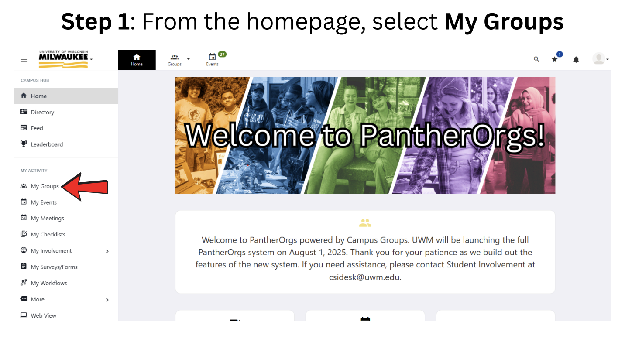

Slide 17
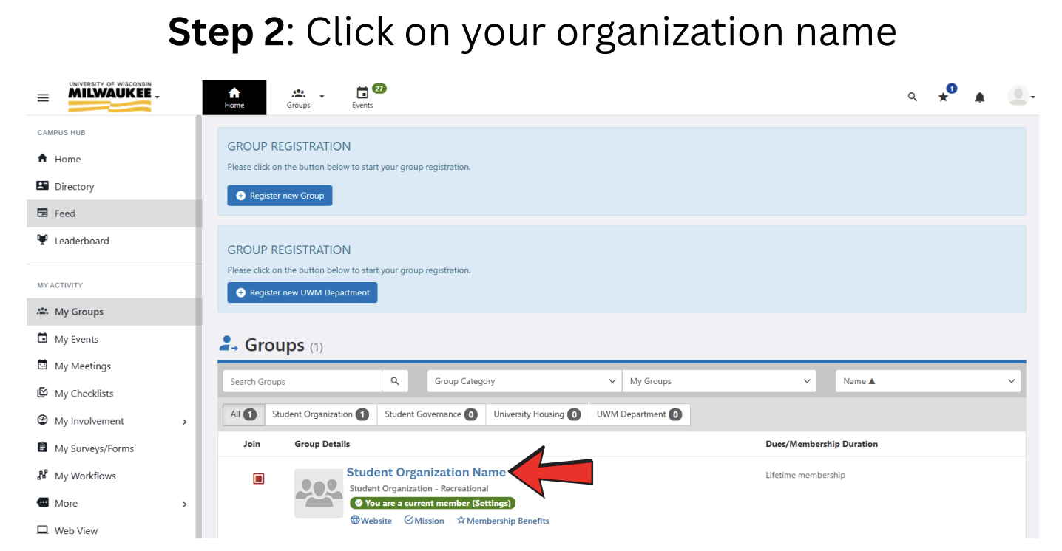

Slide 18
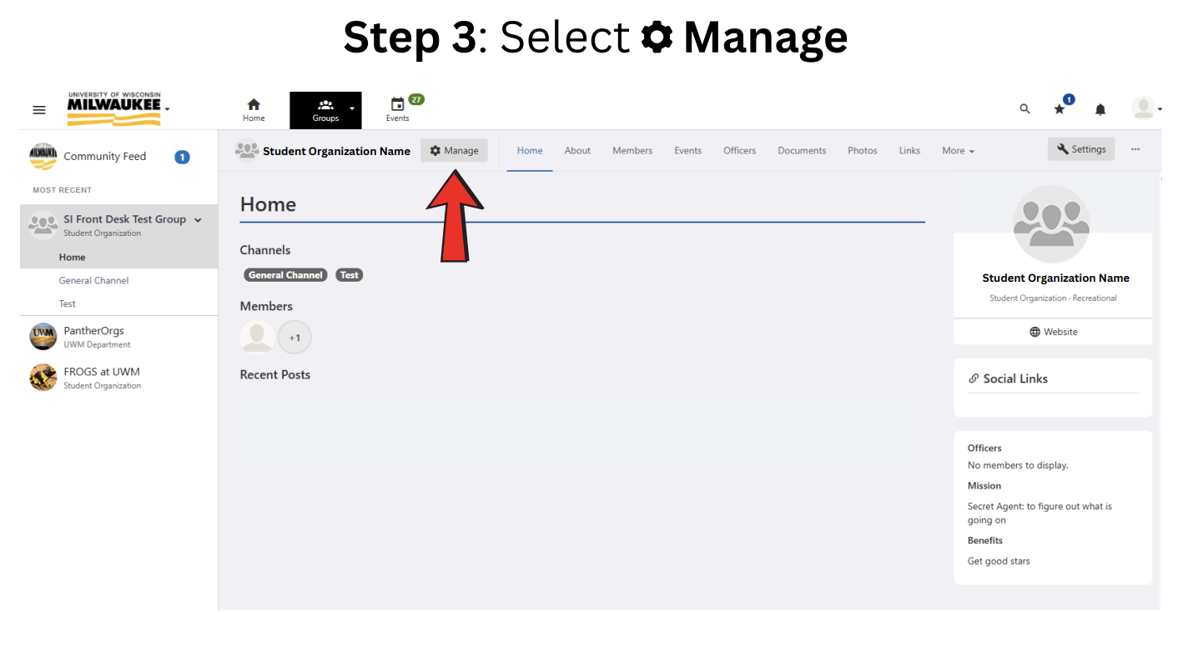

Slide 19
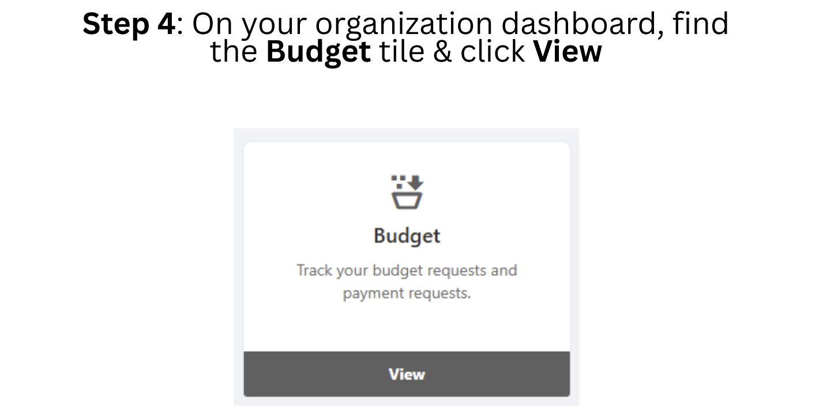

Slide 20
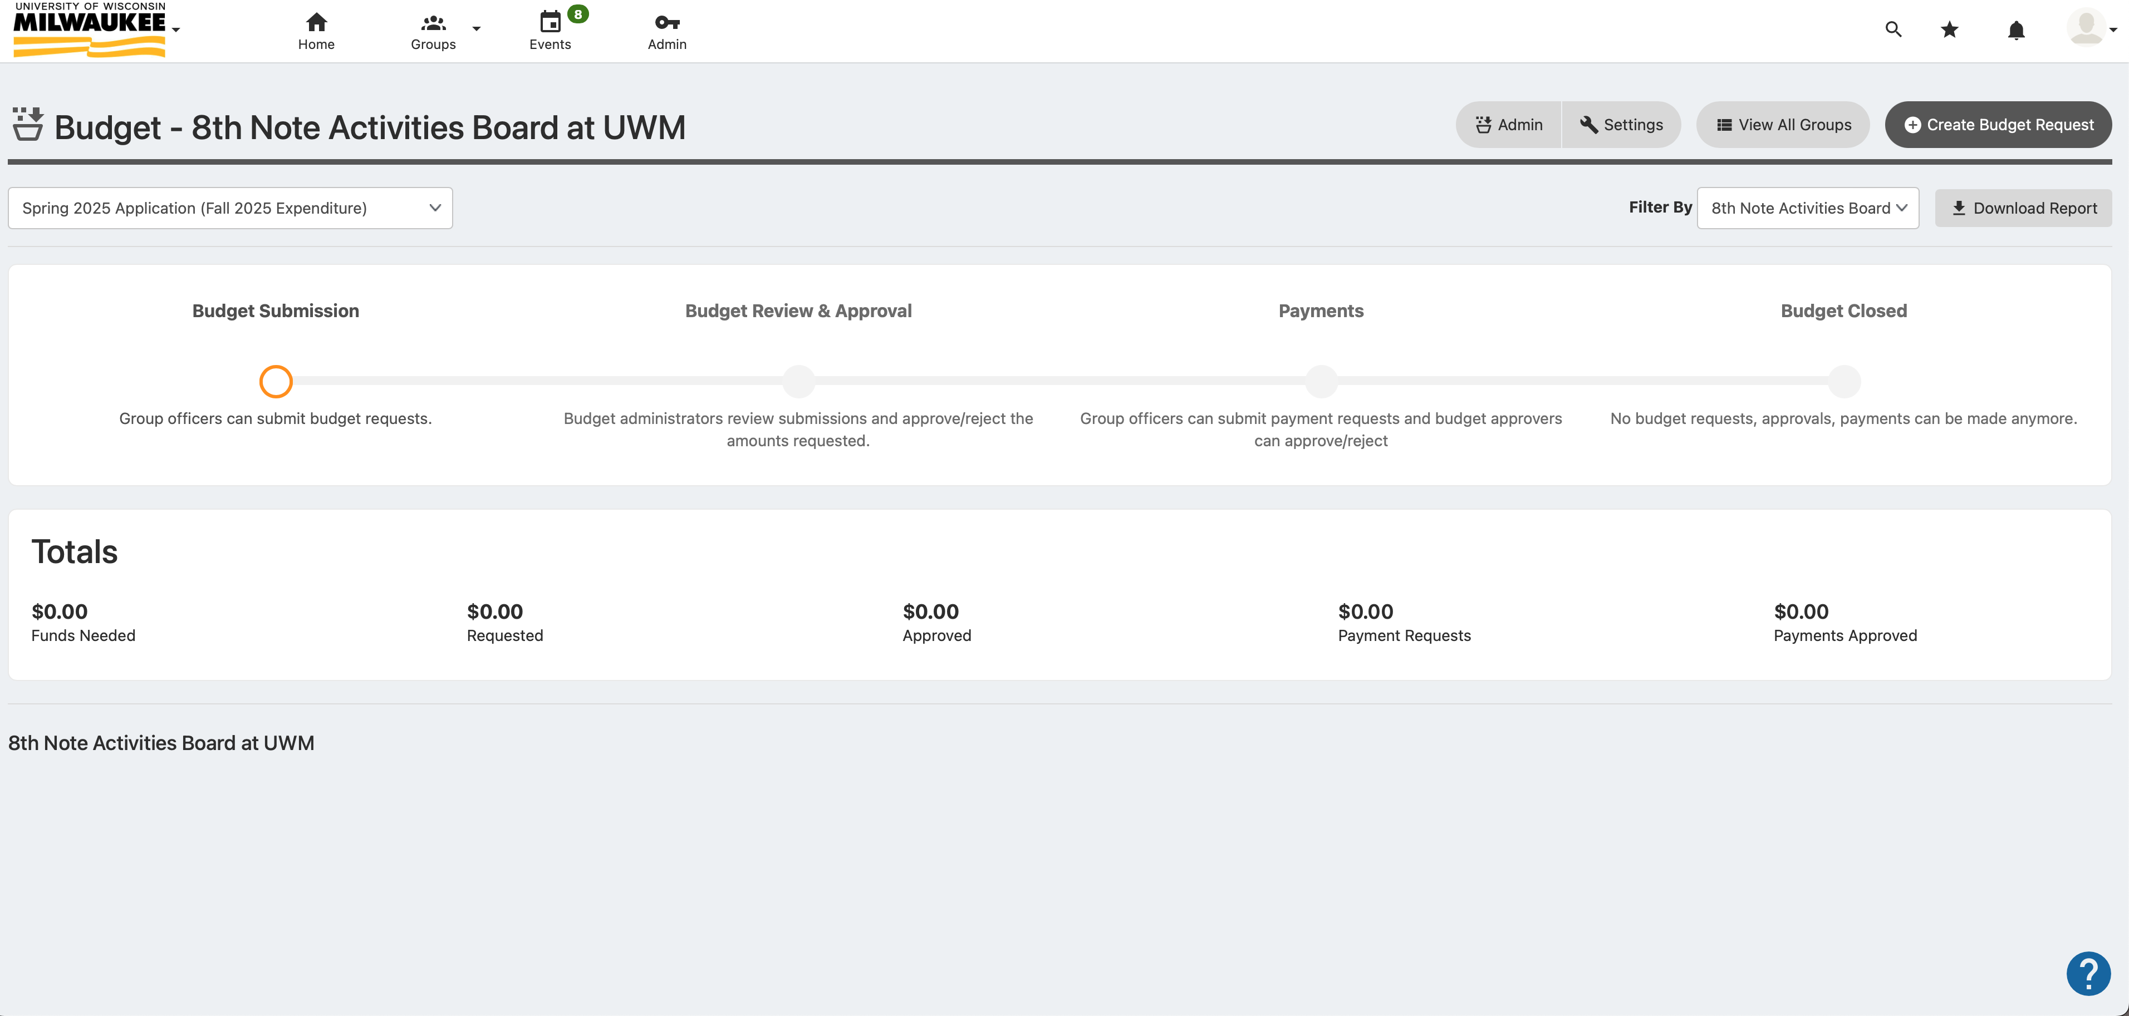
Step 4: Select “Create Budget Request”

Slide 21
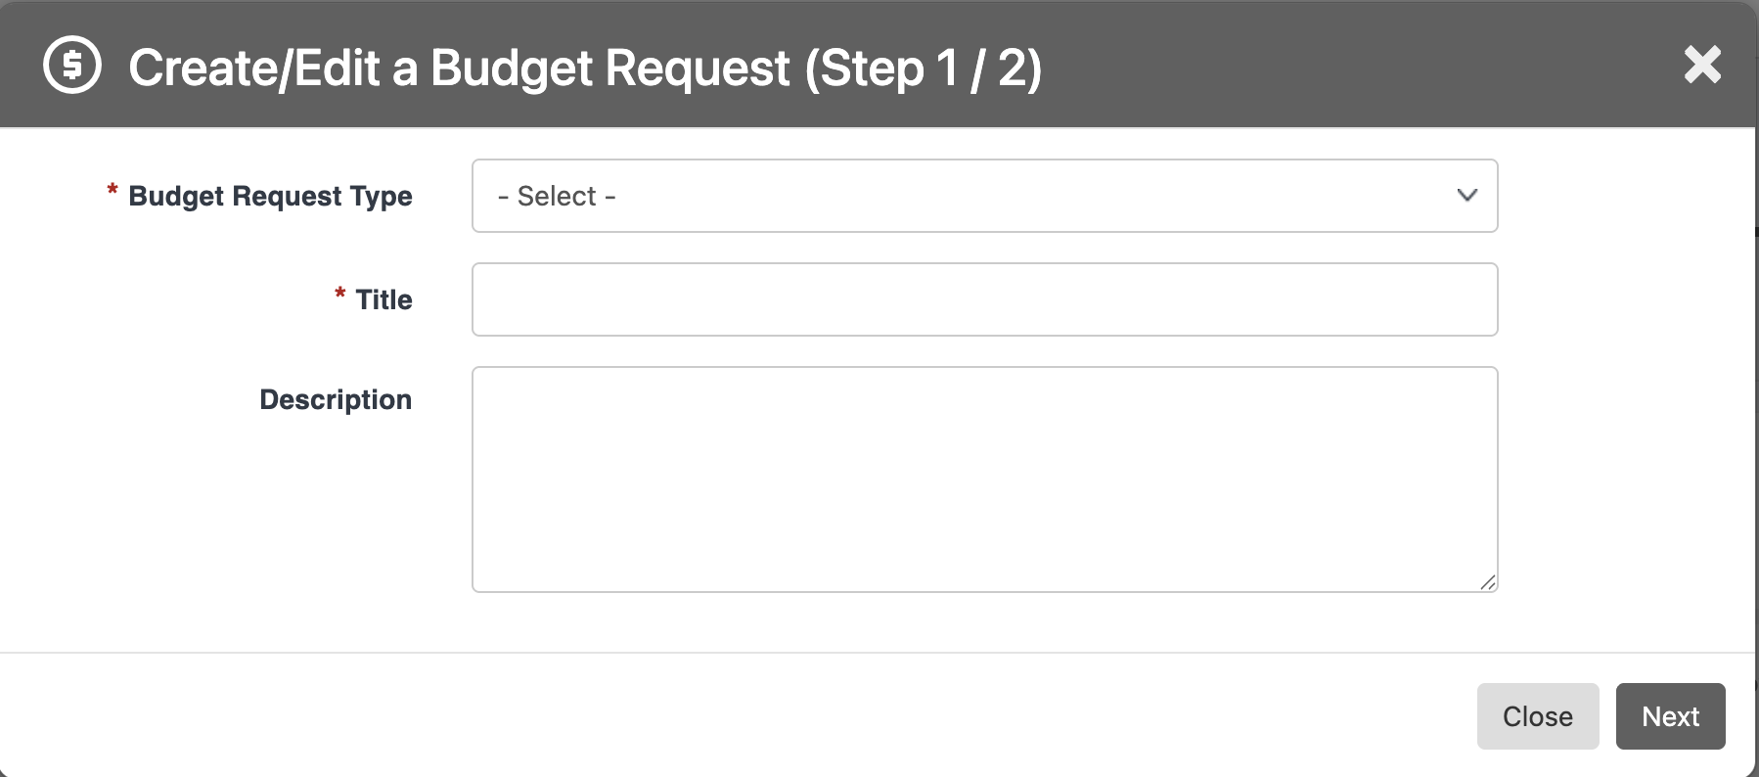
Step 5: Fill out each selection

Slide 22
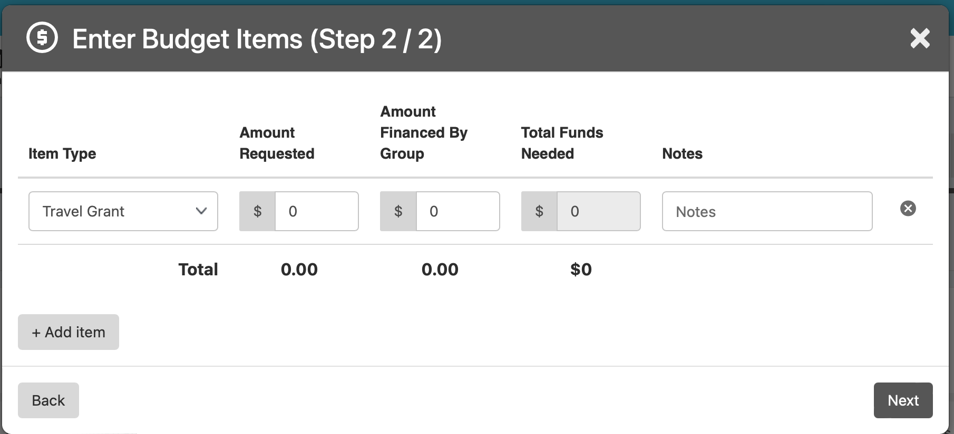
Step 6: Fill out each box, disregard “Amount Financed by Group” section

Slide 23
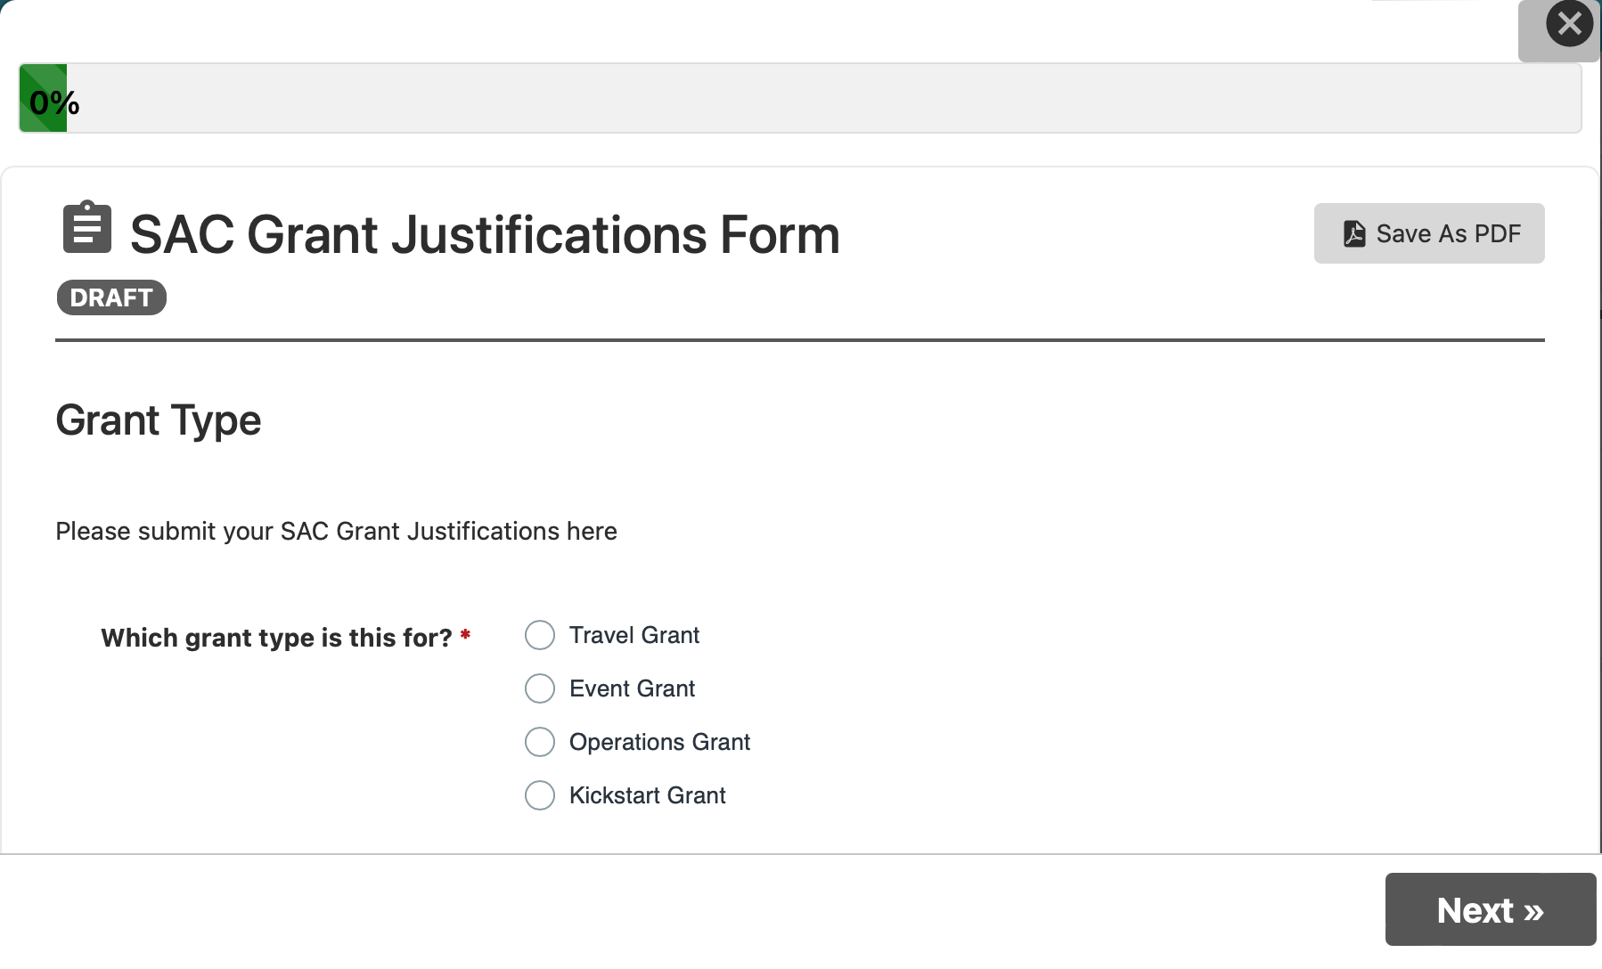
Step 7: Complete the Justifications Form

Slide 24
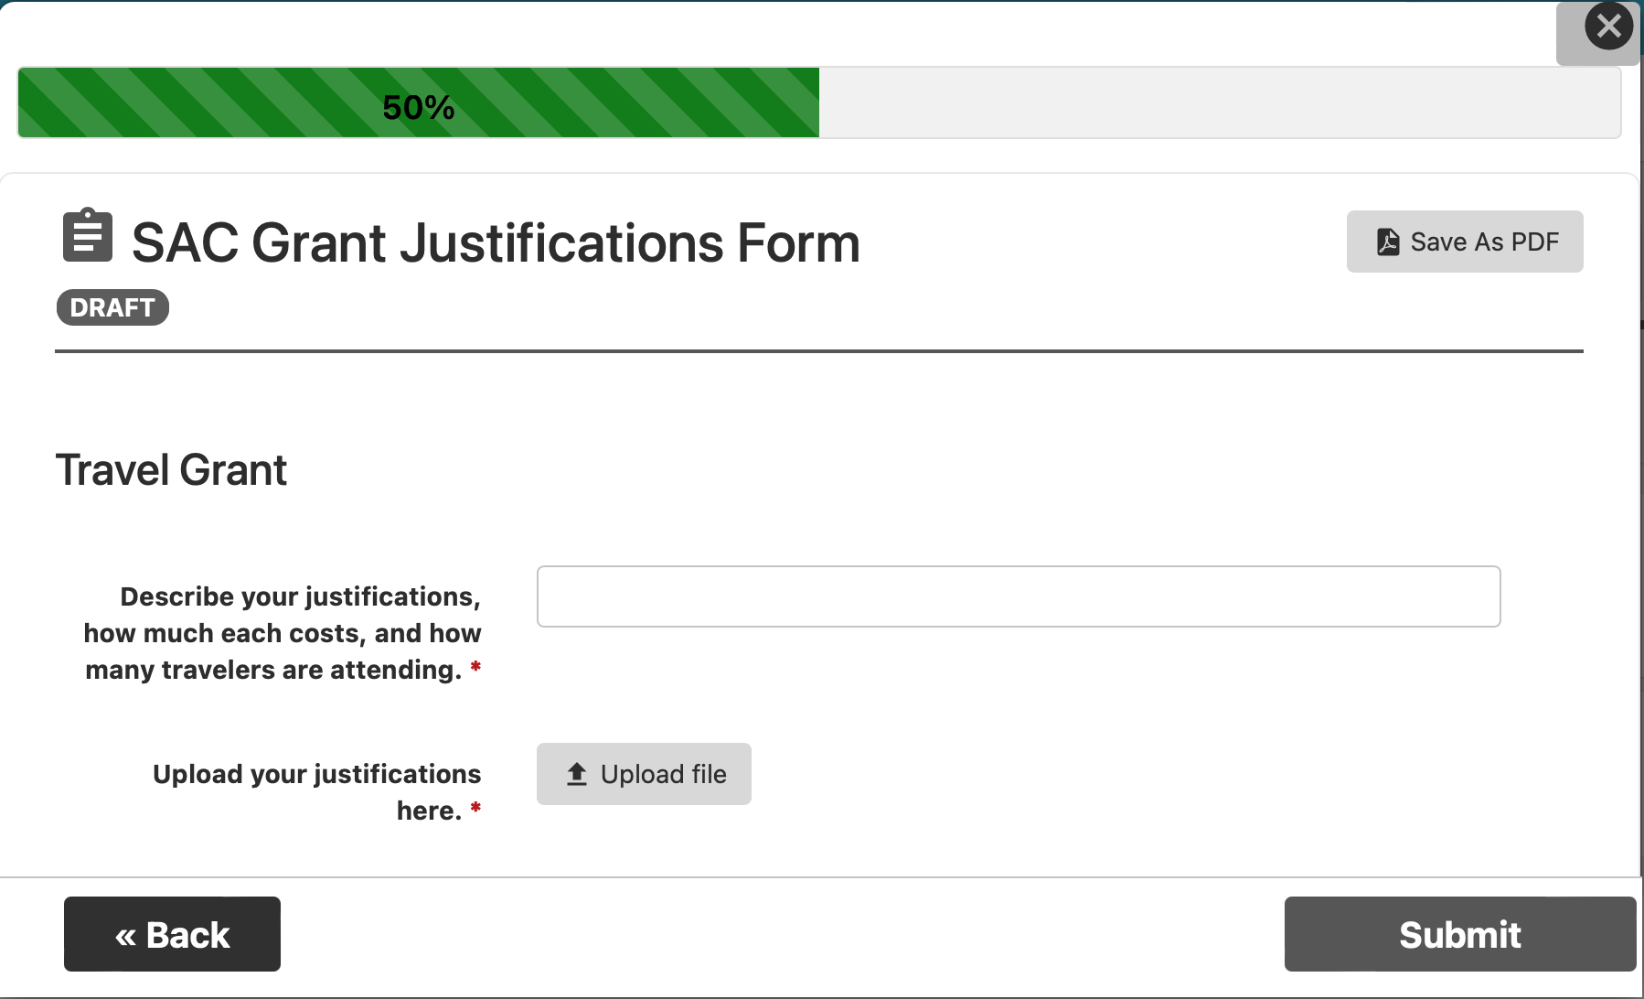
Step 7 cont.

Slide 25
A note on redistributions
Anything that is justified in the original grant can be purchased using
that grant money. For example, if you have a hotel quote in a travel
grant and decide you want to use the FULL travel grant for the hotel, you can do that without a redistribution.
You really only need a redistribution if...
You need to purchase something not justified in your original
grant (for example, you asked for a meditation mat but now you need medicine balls instead)
There is a name change, such as deciding to go with a different speaker or to a different conference
If you need a redistribution, fill out the Panther Orgs Form
25

Slide 26
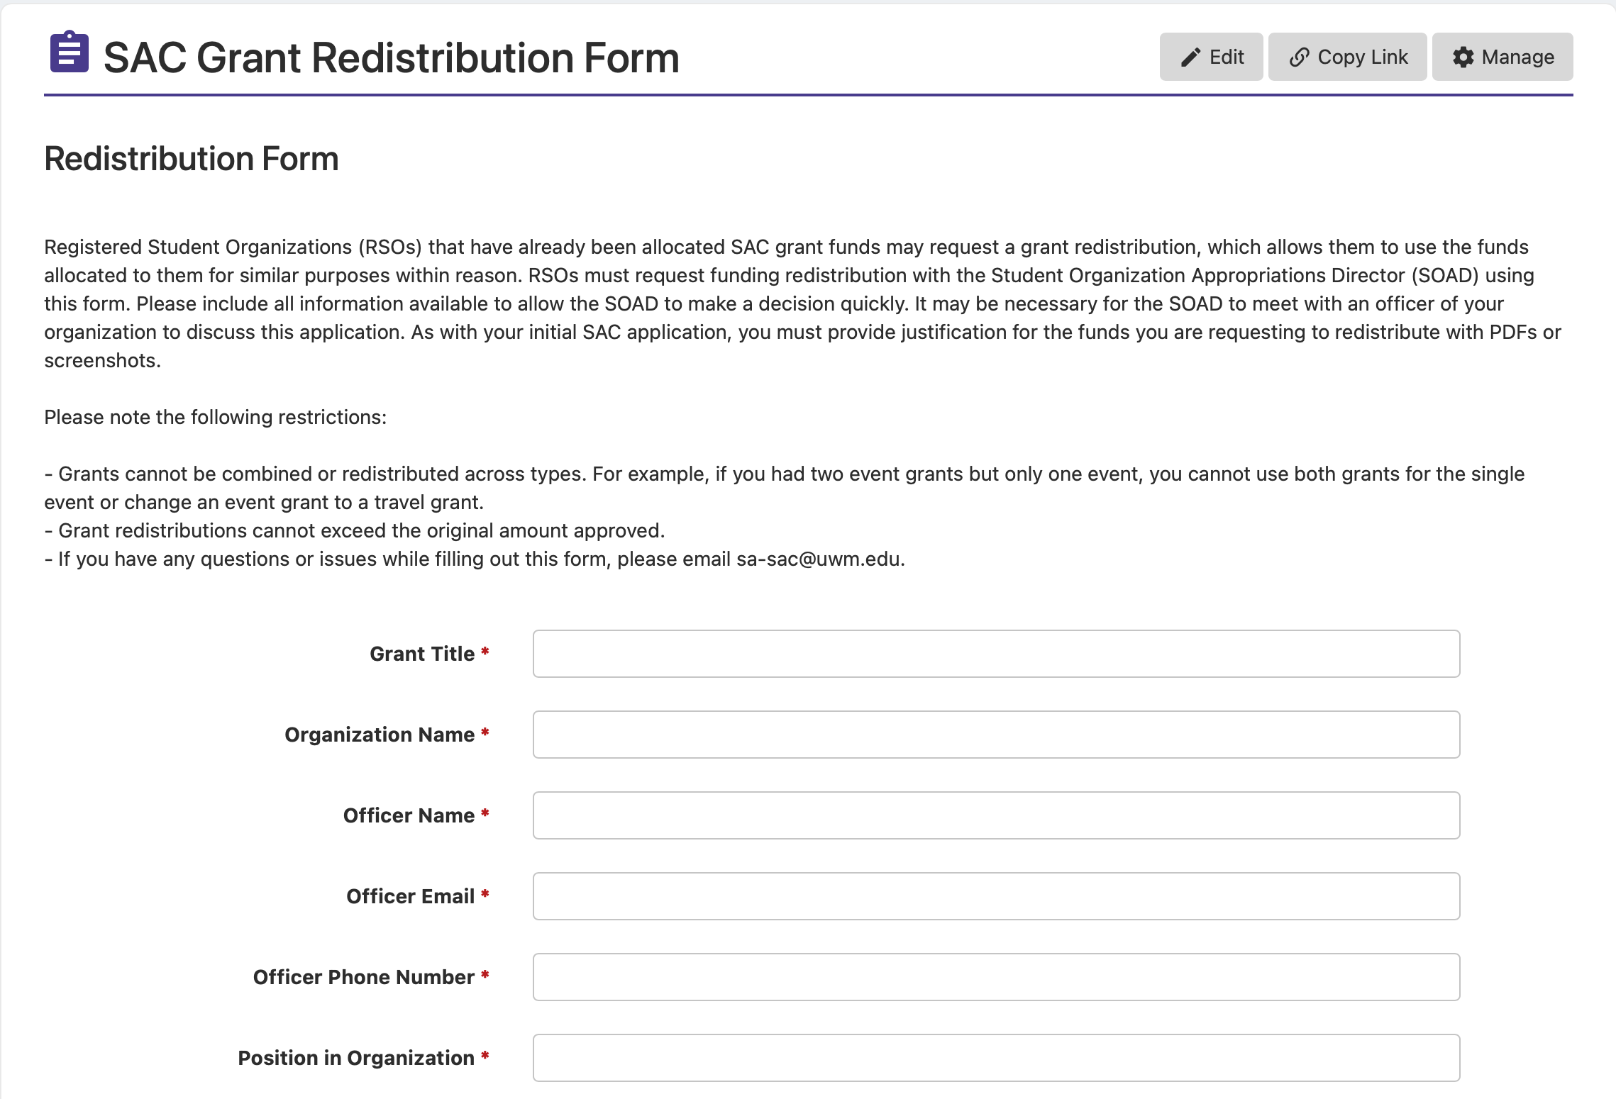

Slide 27
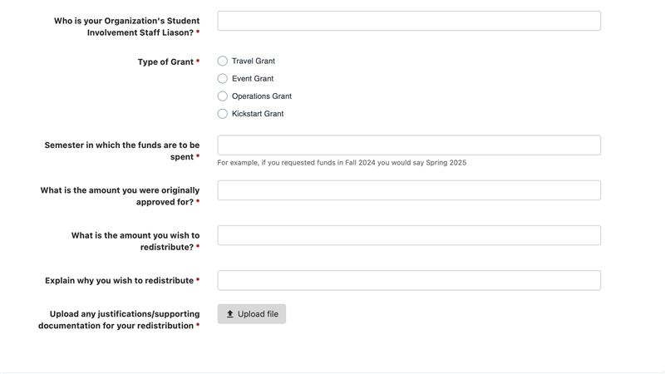

Slide 28
Grant hearings
Each hearing takes about 5 minutes. Plan to arrive early.
Explain each grant and why it is relevant to your RSO's mission.
The committee may ask you questions.
The committee will vote on a PRELIMINARY amount, and you are excused.
At the end of the semester, the committee will reevaluate the budget to determine final grant amounts and will make a cut across the board if necessary.
Your RSO will receive an email with the final approved grant amount.
28

Slide 29
After you get the grant
At the end of the semester, you will receive an email with the FINAL
grant amount, which may include a cut.
You can begin spending this money the first day of the next semester. Set up a meeting with the Center for Student Involvement well in advance.
Travel: Meet at least 3 weeks prior to departure to make travel arrangements. The SI
office will book all travel arrangements directly.
Operations: Mandatory contracts or vendors are required and proper state purchasing procedures must be followed. The SI office will place all orders and
make all payments.
Event: Schedule a meeting with Student Involvement at least 6 weeks prior to the
event date. Any person being paid for a service, performance, or to speak must be paid by a contract. Completed paperwork contract must be turned into SI at least 30 days prior to event. If your event has Catering reach out to them minimum 1 month ahead of time.
**NO REIMBURSEMENTS WILL BE ACCEPTED. DO NOT PURCHASE ANYTHING YOURSELF. YOU MUST GO THROUGH THE CENTER FOR STUDENT INVOLVEMENT.***
29

Slide 30
Automatic Denials
“
Submitting your grant after the deadline
Failing to attend grant training
Incomplete organization registration with Student Involvement
Partial Denials
Incomplete or insufficient documentation
All justification must be NON-EDITABLE, follow our published policies, and
include all items needed for the grant
Incomplete grant application
Request for a non-fundable item

Slide 31
3
Justifications
Show us where your money is going.

Slide 32
Overall Guidelines
All justifications need...
NUMBERS and amounts
Itemized lists of what you are purchasing
To be current (requested this semester)
Unable to edit (PDF, screenshot, etc.)
Please NO WORD DOCUMENTS
Your key to success: non-editable verifiable third-party justification

Slide 33
Quotes: Marketing, Event Services, and Catering
To get a marketing quote....
Utilize the online request form on Panther Orgs
Found on both the SAC website under “Expenditure Training” and on Panther Orgs under “Forms”

Slide 34
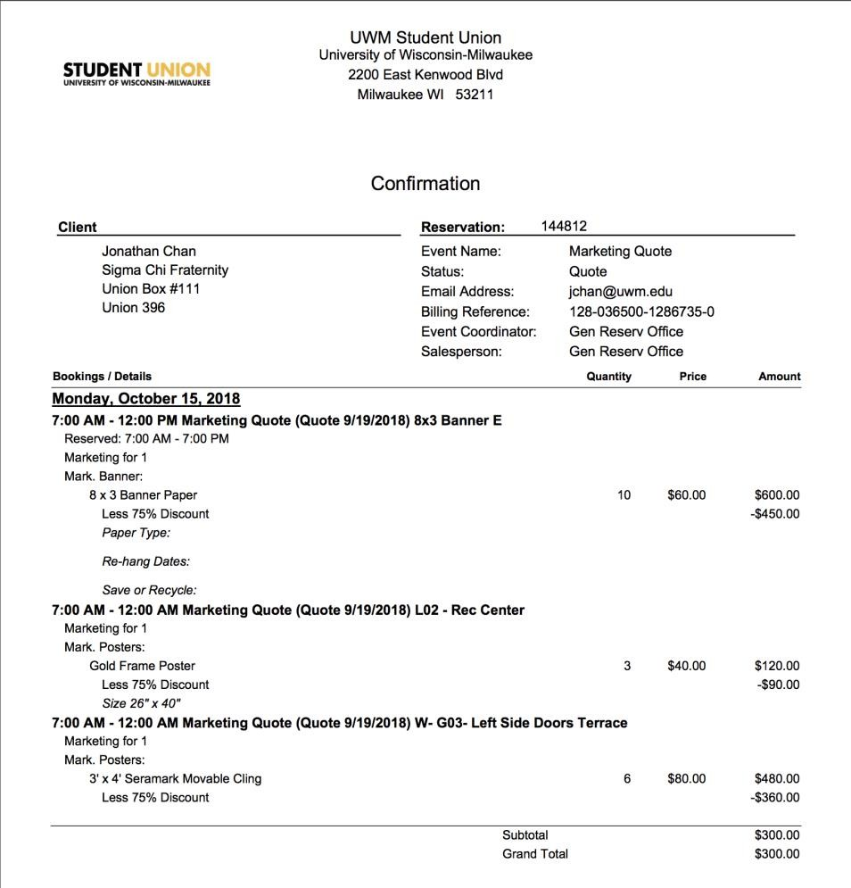
Your name
Your phone number
Your email

Slide 35
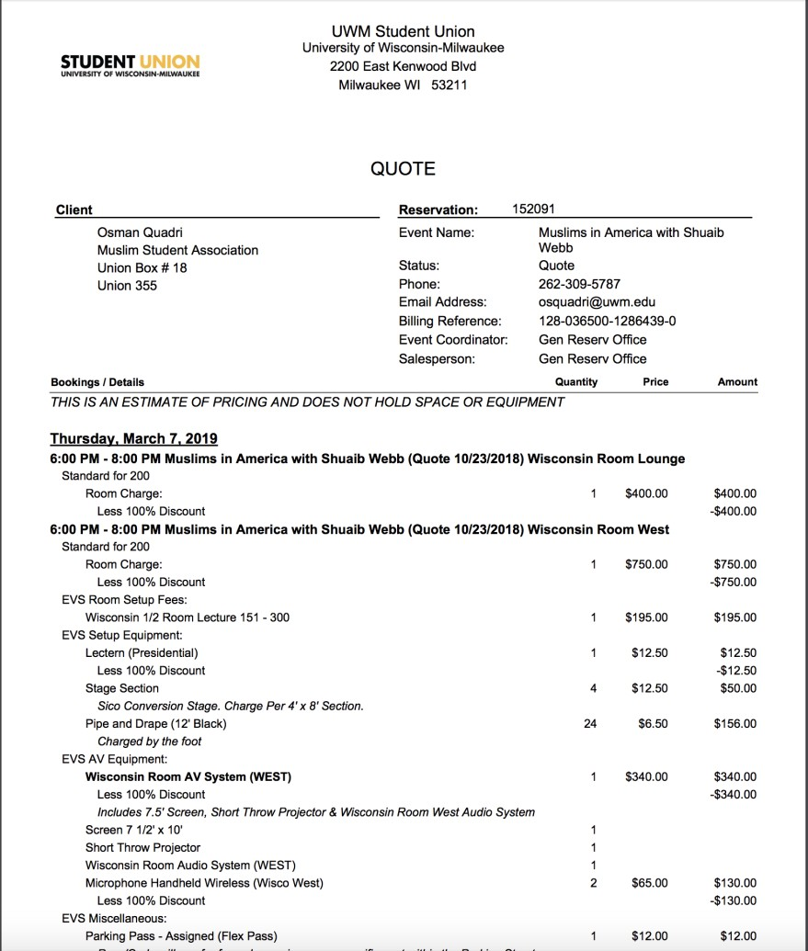
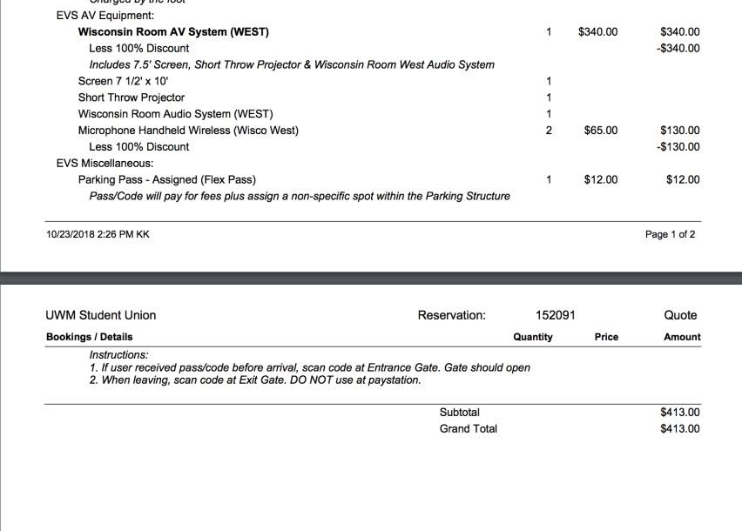
Your name
Your event name
Your phone number
Your email
###

Slide 36
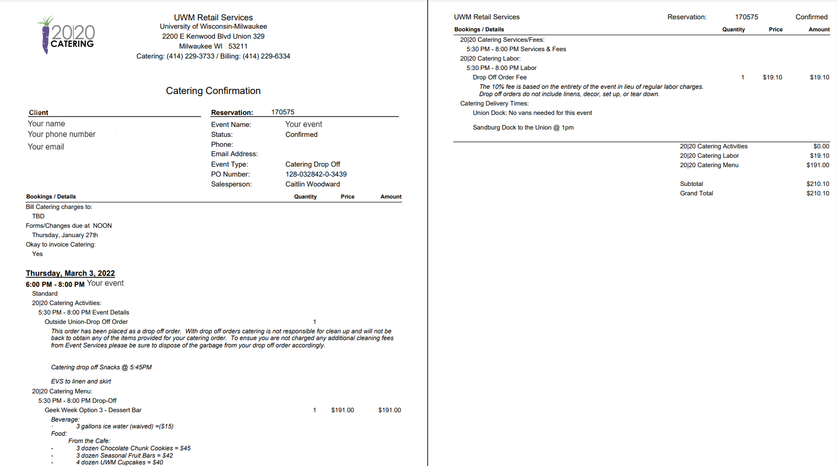

Slide 37
Quotes: Honorariums
To get an honorarium quote....
Email the person you are hoping to have speak (or
their agent)
Work closely with your liaison
Include PDF or screenshot of emails and quotes in grant
submission.

Slide 38
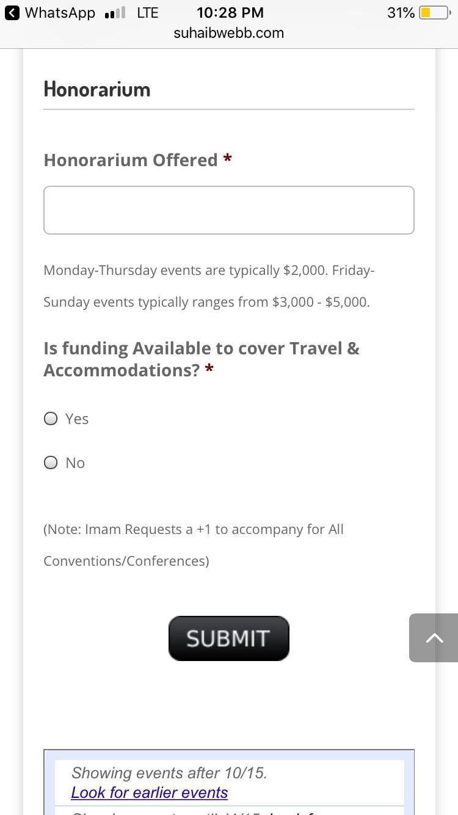
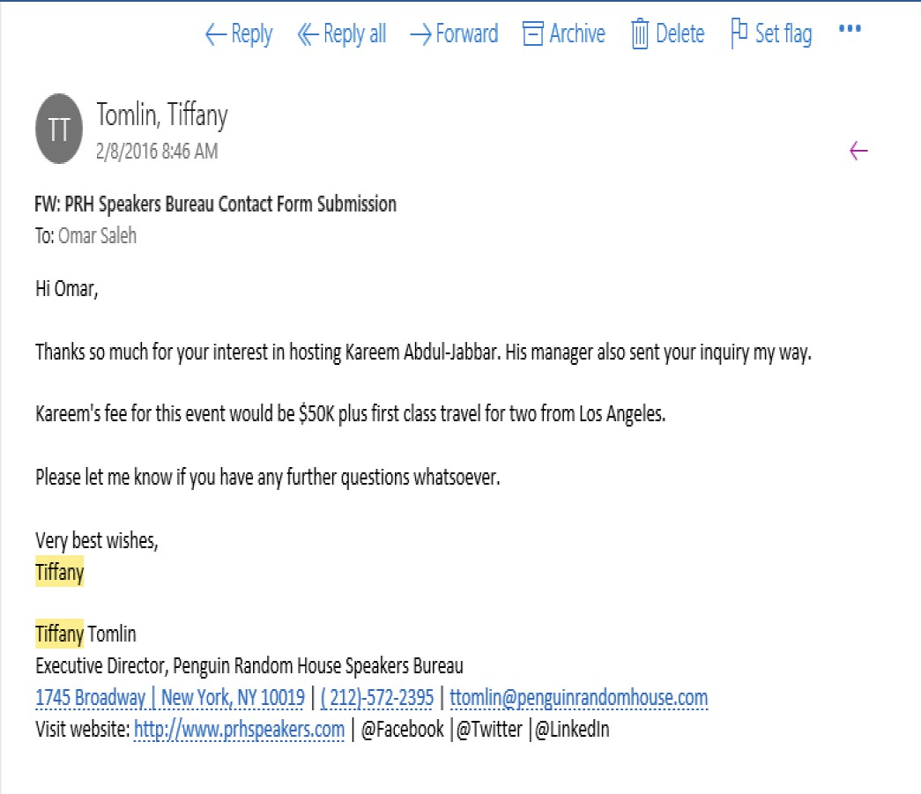
Agent’s name
Your email Your name
VIP’s name
VIP
Agent’s name
Agent’s contact information

Slide 39
Quotes: Hotels
To get a hotel quote:
Go to wisconsin.edu/travel
Use the lodging max and meal per diem calculator
Enter your desired location and dates
Submit a screenshot
Please NO CONCUR
If the site is down, we need a screenshot showing the site is down, the committee will calculate a price for you.

Slide 40
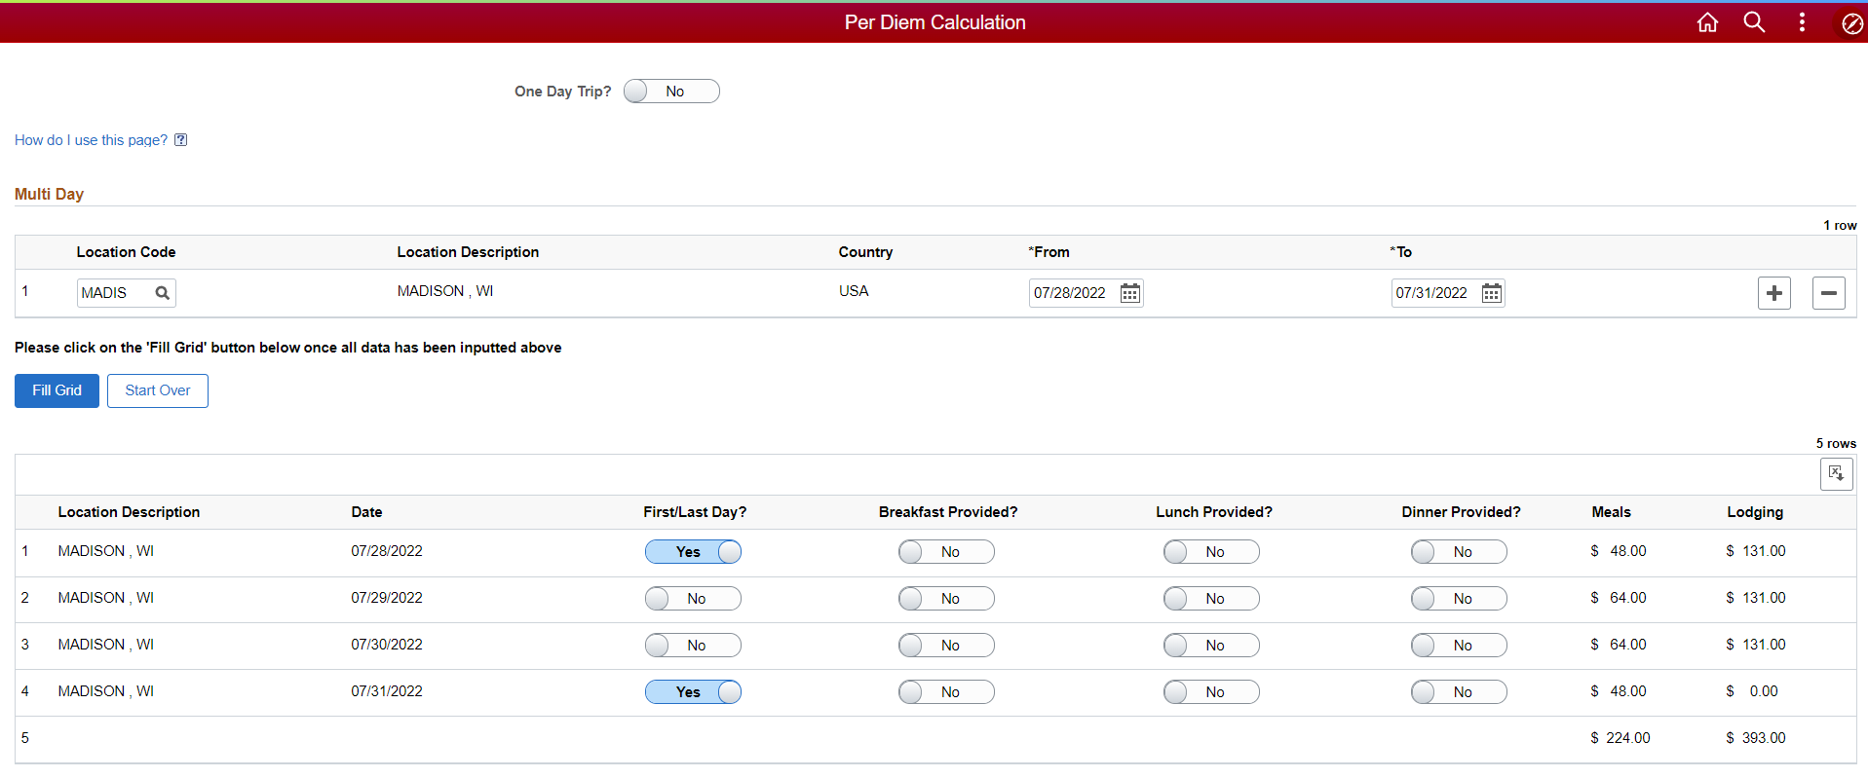

Slide 41
Important Deadlines
“
**All Marketing, Event Services, and Catering Quote REQUESTS are due March 6th at noon.**
**OVERALL GRANT DEADLINE IS Friday, March 20th at noon**
No late submissions accepted.
**HEARINGS WILL BEGIN THE WEEK OF MARCH 30th**

Slide 42
Contact Information
“
Student Appropriations Committee: sac-questions@uwm.edu
Student Involvement: si-busoffice@uwm.edu
Union Marketing: markdesk@uwm.edu
Catering: 2020-catering@uwm.edu
Event Services: reservat@uwm.edu
**General questions? Email sac-questions@uwm.edu**

Slide 43
Thanks!
Any questions?
Email us at sac-questions@uwm.edu!
51

