Slide 1
1
Filling out your grants
Step by Step.

Slide 2
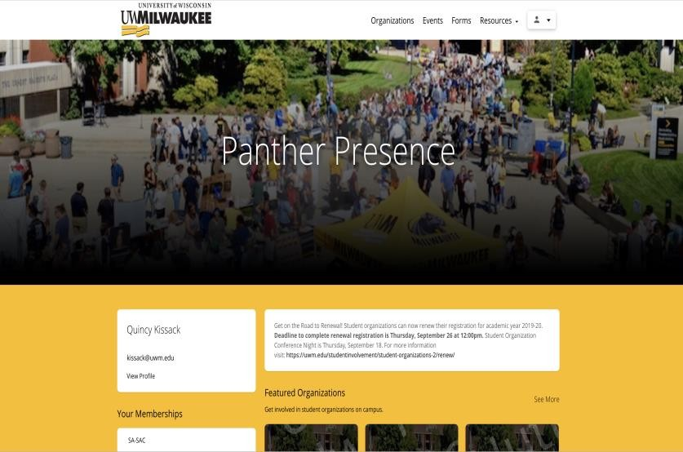
Finding The Form
Log into
Panther Presence (uwm.
presence.io).
Click on the upper righthand corner to sign in with your Panther ID.
Click on your "Person" icon and select "Admin Dashboard."

Slide 3
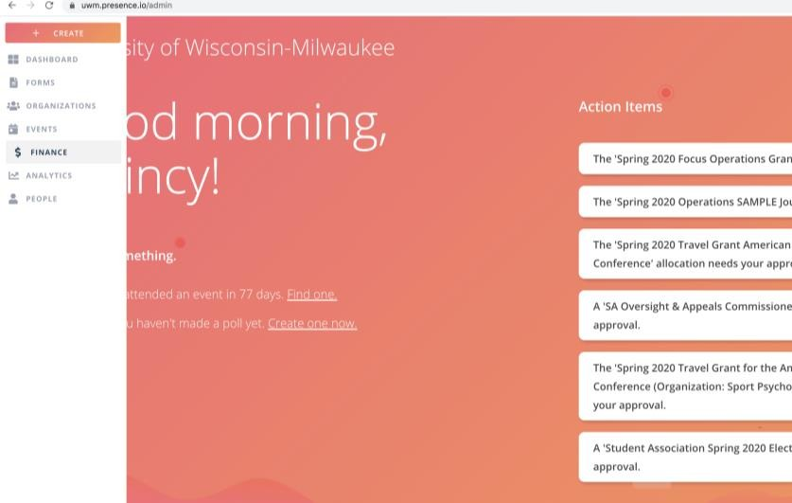
Filling it Out
Once you are in your administrative dashboard, go to the menu on the left side of the screen and select "Manage" and then "Finance."

Slide 4
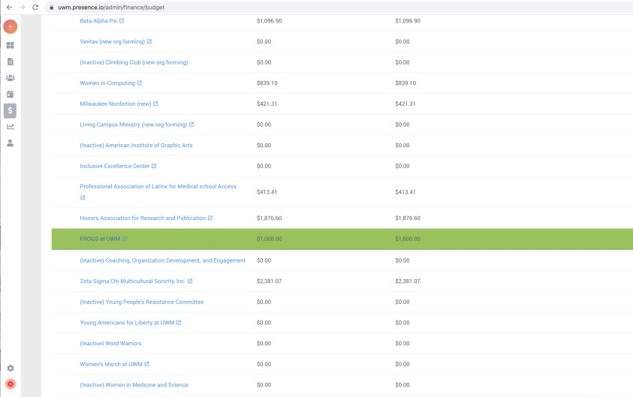
Filling it Out
Click on your organization's NAME. Do NOT click on the little arrow next to it.

Slide 5
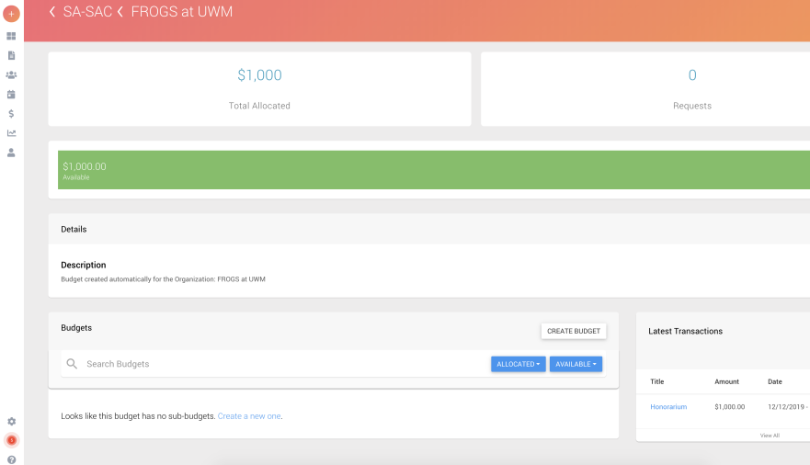
Filling it Out
Scroll to the bottom and click on "Create a new one" to create a sub- budget.

Slide 6
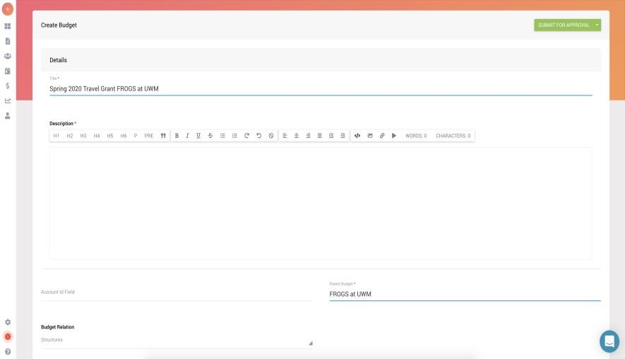
Filling it Out
Name the sub-budget the same title as your grant – a good rule of thumb is to include the SEMESTER it will be used, the TYPE of grant, and the NAME of your organization.
Fill out all required sections to create a sub-budget – don't touch any of the non-required sections!
Don't forget to Submit for Approval!

Slide 7
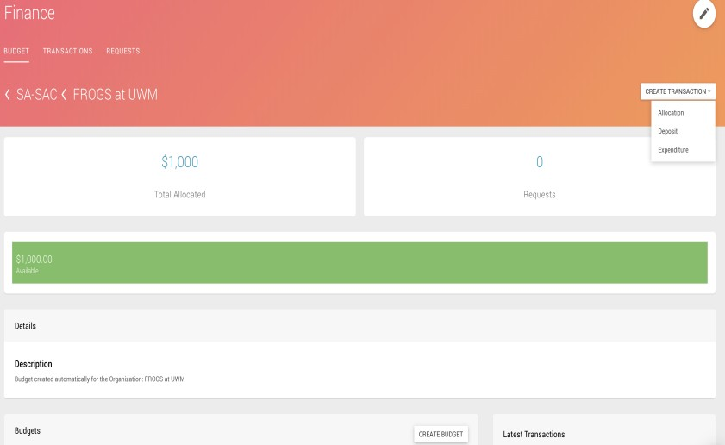
Filling it Out
Go to the upper right corner, click “Create Transaction” and then select “Allocation.”

Slide 8
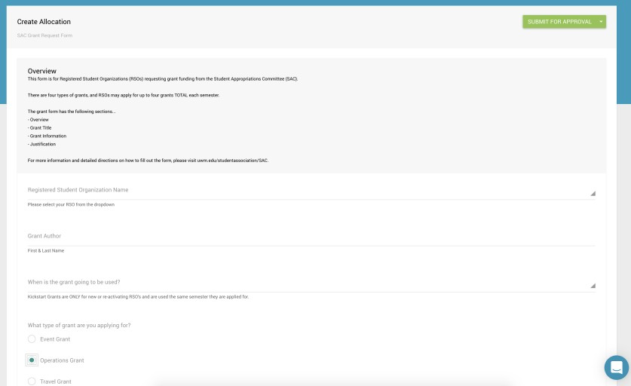
Filling it Out
Fill out the form according to the prompts. Be sure to select the grant type you want!
You’ll need to fill out a different
form for each grant type.

Slide 9
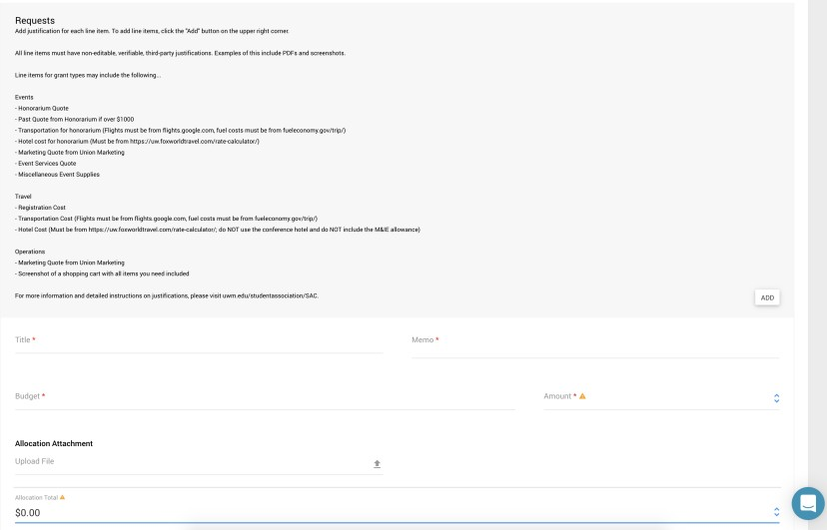
Filling it Out
Justifications will be filled out at the END of the form. You will need an allocation request for EACH line item.
Line items include things like Amazon CARTS (please don't upload individual items one by one) or Lodging.
You will need to upload non- editable, verifiable, third-party justification for each line item.

Slide 10
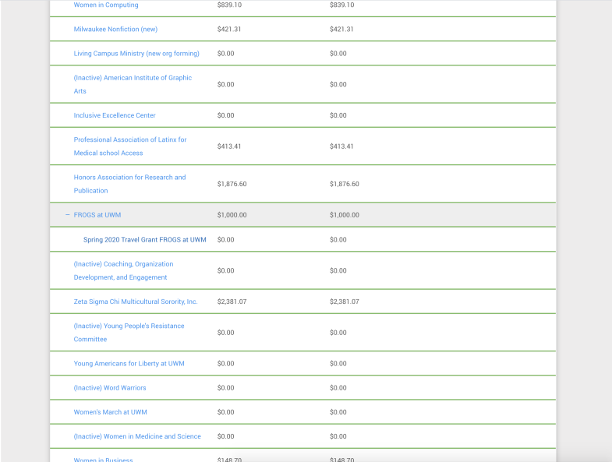
Filling it Out
When selecting a budget, select the plus sign by your organization and the sub-budget you created!

Slide 11
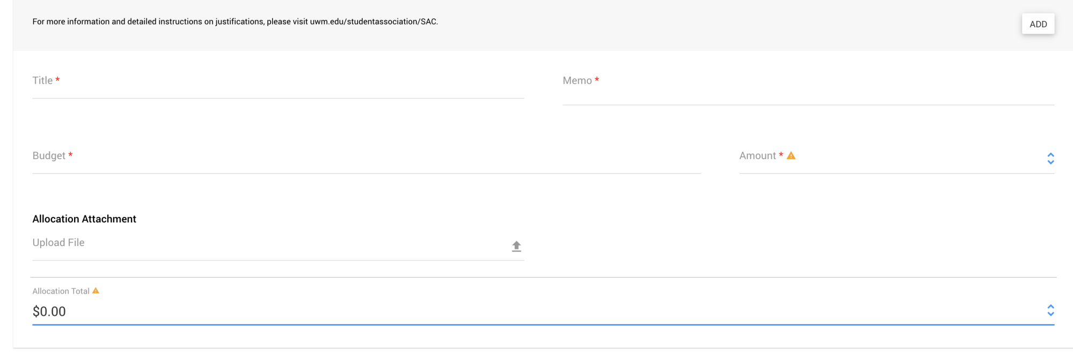
For Example…
Registration
Pond Conference Registration
Spring 2024 Travel Grant FROGS at UWM
$60
PondReg.pdf
$60
11

Slide 12
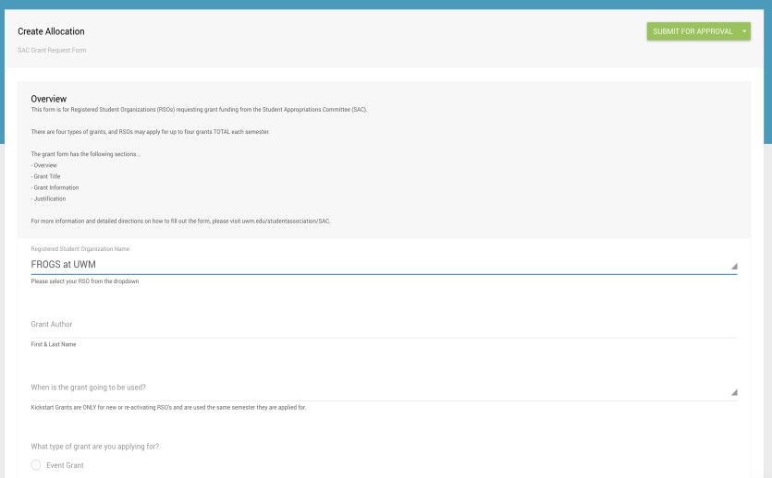
TO SUBMIT
Scroll to the TOP RIGHT and click the green SUBMIT FOR APPROVAL button!
Seriously. Don’t forget this step.
12

