Slide 1

Student Appropriations Committee (SAC) Training for the
Fall 2021 Grant Request Process

Slide 2
Hello!
We are the Student Appropriations Committee (SAC).
We're here to allocate student segregated fee funding through shared governance in accordance with state and federal policies and procedures.
2

Slide 3
What is SAC?
Every semester, students pay segregated fees that fund different things on campus (the Union, Resource Centers, Green Fund, etc.) including SAC
This means that the SAC budget is dependent on a variety of factors, most notably how many students enroll and how much funding RSOs use from the prior semester
SAC is the committee, composed of Student Association representatives and RSO members, responsible for allocating funds to RSO's fairly & in accordance with policy
SAC is the one place where students have a direct say in how their segregated fees are spent!
3

Slide 4
About SAC Funds
SAC is not and never has been intended to be the SOLE source
of funding for student organizations.
Your organization is not guaranteed to receive the full amount you request or even the amount voted on in the hearing.
Your group, even if requesting SAC grants, should continue to pursue and maximize sponsorships and other fundraising opportunities.
Your Student Involvement liaison and faculty/staff advisor can be great resources to help with securing additional funding.
4

Slide 5
Student Association
Student Appropriations Committee (SAC)
Student Involvement
5

Slide 6

SAC funds are state money.
This means that there are a lot of policies, rules, and procedures that the committee (& RSOs!) have to follow throughout the grant process.
6

Slide 7
Guiding policies
Federal
Viewpoint Neutrality as determined in Board of Regents, University of Wisconsin System v.
Southworth shapes what
information can and
cannot be considered in financial decisionmaking.
State
UW System Administrative Policy 820 defines what student segregated fee funding can and cannot be used for within UW System campuses.
UWM
SAC Bylaws and precedence guide the committee on how to fairly allocate money and ensures a consistent process from semester to semester.
7

Slide 8
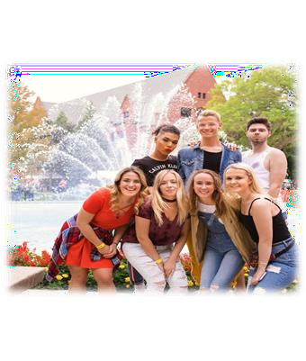
What does this mean for you?
It's really important to follow the policies laid out in this training and use proper websites and justification so we can make sure everything is in accordance at all levels!
8

Slide 9
1
Grants 101

Slide 10
Our process is straightforward
first
second
third
last
Attend Grant Training
Request Justifications
Submit Your Application
Go To Your Hearing
Look at you, you overachiever. You've already crossed one thing off the list!
We'll go over how to do this in a few minutes. You need verifiable, non-editable third- party justification for EVERYTHING.
Use Presence to tell us about your grant. Ensure that all justification is attached and accessible, and be sure you actually click Submit!
Plan to have at least 2 people from your RSO attend your hearing. This is important for the committee to ask your RSO questions.
10

Slide 11

General Rules
Registration
Your RSO must be registered through student involvement.
Training
At least one OFFICER of your RSO must attend grant training & sign in.
# of Requests
You can submit a request for each type of grant – event, travel, and operations – up to the cap for as many things as you'd like.
Mission
All requests must align with the mission of your RSO.
Attendance
Show up to your grant hearing. If you do not, you will be automatically denied. If something comes up, email sa-sac@uwm.edu 24 hours or more in advance.
Disclaimer
SAC Funding cannot be used for academic, personal, political, or commercial gain.
11

Slide 12
Types of Grants
RSO's can request one per type of grant each semester. There are four types of grants that RSO's can request from SAC...
Event (3 per semester)
Operations (1 per semester)
Travel (1 per semester)
Kick Start ( 1 per semester for new groups only)
12

Slide 13
Event Grants
Overall Cap: $2000
Marketing: $150
Honorarium: $2000*
  Housing: $125/day
  Flight: $200 round trip
  Ground transportation:
$20/day, up to two days
Honorariums over $1,000 MUST include a past quote from the performer with their rate listed.
Justifications to include...
Quote from event services, including room set-up, A/V, etc.
Quote from marketing for promotional materials
Quote from honorarium with their rate listed.
Honoraria of more than $1000 require a previous quote from the speaker/performer
Screenshot of flight cost or ground travel prices
Screenshot of wisconsin.edu/travel hotel rate for Wisconsin
13

Slide 14

Operations Grants
Justifications to include...
Quote from marketing for general promotional materials
Screenshot of an online shopping cart that includes all items you want to purchase up to $2000 (make sure all items are shown with individual prices!)
** Please do not upload singular items individually – this will significantly slow the process. Screenshots of shopping carts with ALL items are great. **
Overall Cap: $2000
Marketing: $150
Office Supplies: $60
14

Slide 15
Travel Grants
Justifications to include...
Overall Cap: $2000
Registration: $150 per person
Screenshot of registration cost
  If the cost is not yet listed, you can use a screenshot of last
year's registration cost as justification
Hotel: 125/night max. 3 nights
Flights: 200/ person round trip
Ground travel: 300 total
Wisconsin.edu/travel hotel quote
Google flights estimate
Fueleconomy.gov for gas prices
Screenshots of uber/lift/amtrack quotes
Links for all forms of quotes can be found on uwm.edu/studentassociation/SAC
15

Slide 16


Kick Start Grants
For newly formed or recognized RSOs ONLY.
Consider requesting for...
Overall Cap: $1000*
Caps from the relevant grant type still apply (for example,
$150 for marketing)
Event: Small event to raise awareness on
campus
Operations: General marketing to assist with recruitment
Travel: Funding for a virtual conference
These grants can be submitted after the deadline and are open until the last grant hearing date. Funds will be made available following the subsequent student senate meeting.
Please note that these grants are contingent upon SAC having enough members to
vote. Without enough members, Kick Start grants cannot be allocated.
16

Slide 17
SAC cannot fund...
“
Food
Decorations
Prizes
Helium tanks
Honorarium with a conflict of interest
Gifts for UWM faculty or staff
AirBnB
Individual membership dues
Improvement of spaces (ie. Furniture, cleaning products, appliances)
Personal items (t-shirts, business cards, uniforms)
Anything that has a free alternative on campus
Off-campus facilities (unless the group has confirmed with Student Involvement that there are no adequate on-campus spaces for an event)
Old quotes from performers, Event Services, Marketing, etc. The only exception is for Travel Grants, in which you can use last year's conference price as registration justification

Slide 18
2
Filling out your grants
Step by Step.

Slide 19
Grant Deadline
October 29th, 2021, at noon.
Absolutely no grants will be considered if submitted after
this time
Absolutely no modifications or additions to your submitted
forms can be made after this time

Slide 20
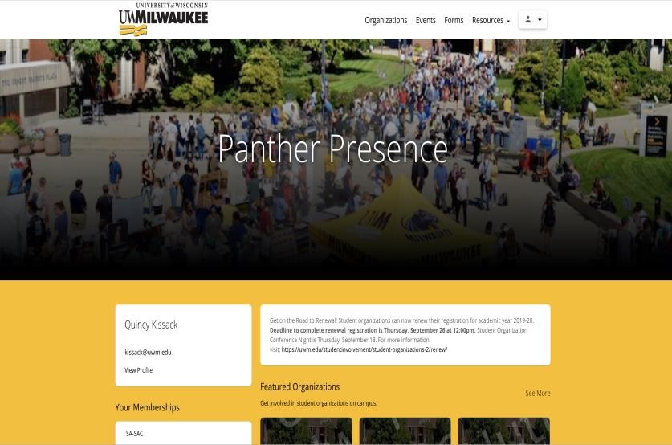
Finding The Form
Log into
Panther Presence (uwm.
presence.io).
Click on the upper righthand corner to sign in with your Panther ID.
Click on your "Person" icon and select "Admin Dashboard."

Slide 21
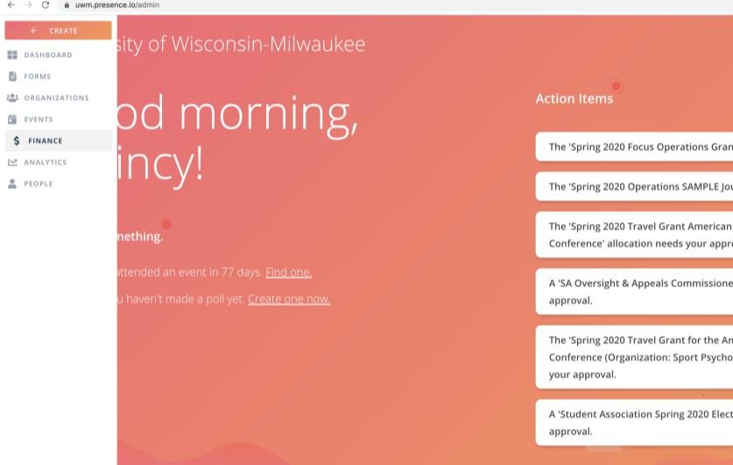
Filling it Out
Once you are in your administrative dashboard, go to the menu on the left side of the screen and select "Manage" and then "Finance."

Slide 22
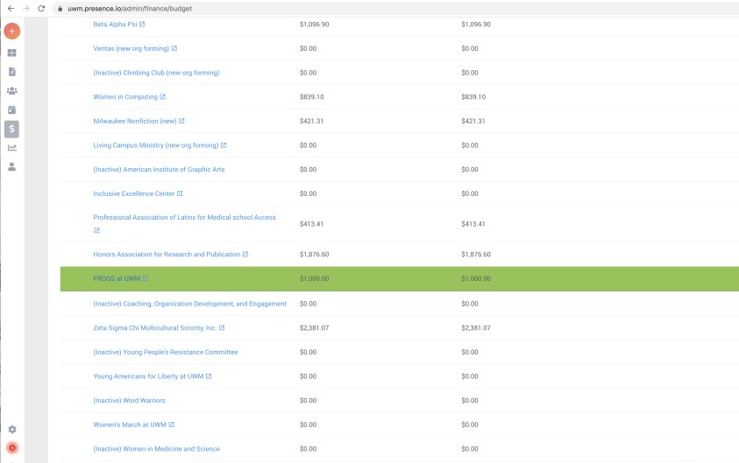
Filling it Out
Click on your organization's NAME. Do NOT click on the little arrow next to it.

Slide 23
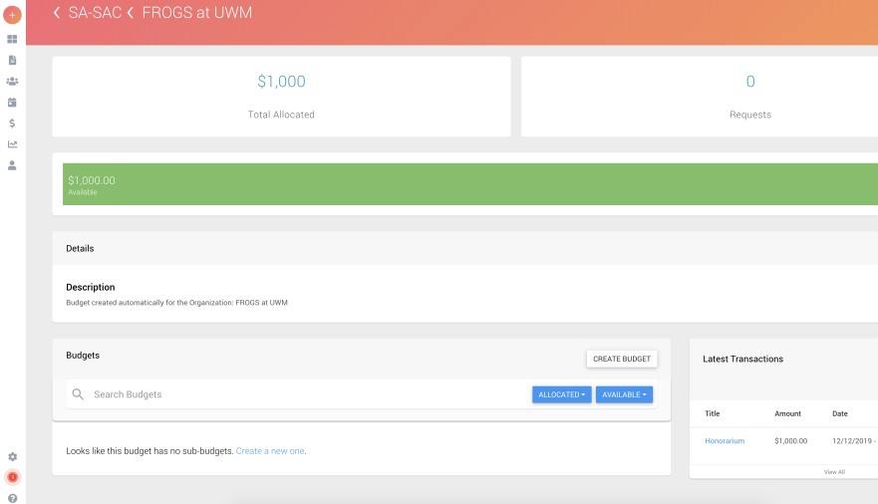
Filling it Out
Scroll to the bottom and click on "Create a new one" to create a sub- budget.

Slide 24
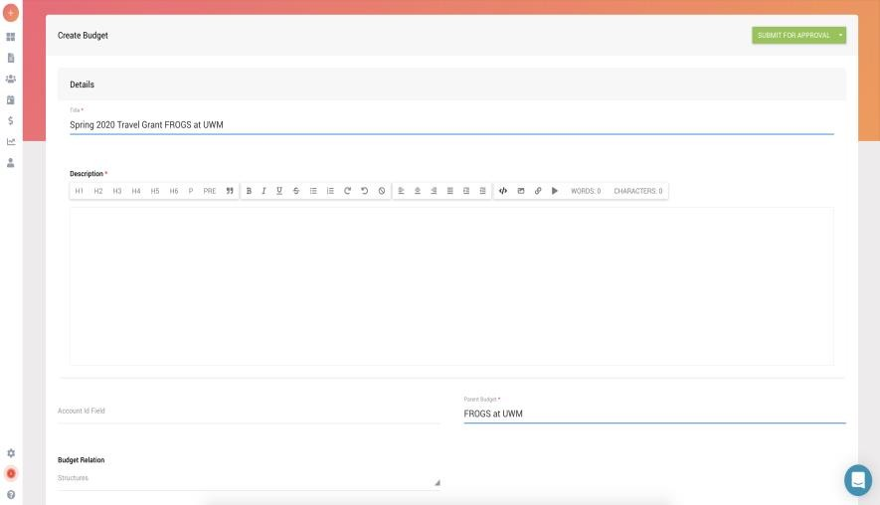
Filling it Out
Name the sub-budget the same title as your grant – a good rule of thumb is to include the SEMESTER it will be used, the TYPE of grant, and the NAME of your organization.
Fill out all required sections to create a sub-budget – don't touch any of the non-required sections!
Don't forget to Submit for Approval!

Slide 25
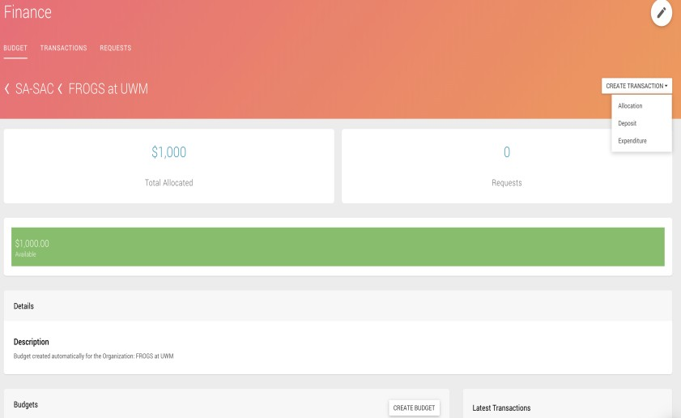
Filling it Out
Go to the upper right corner, click “Create Transaction” and then select “Allocation.”

Slide 26
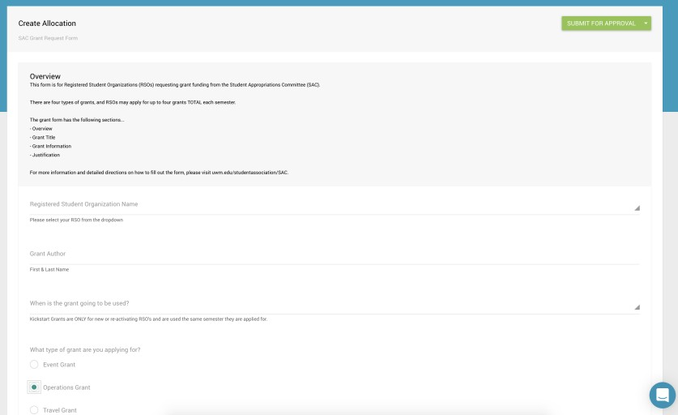
Filling it Out
Fill out the form according to the prompts. Be sure to select the grant type you want!
You’ll need to fill out a different
form for each grant type.

Slide 27
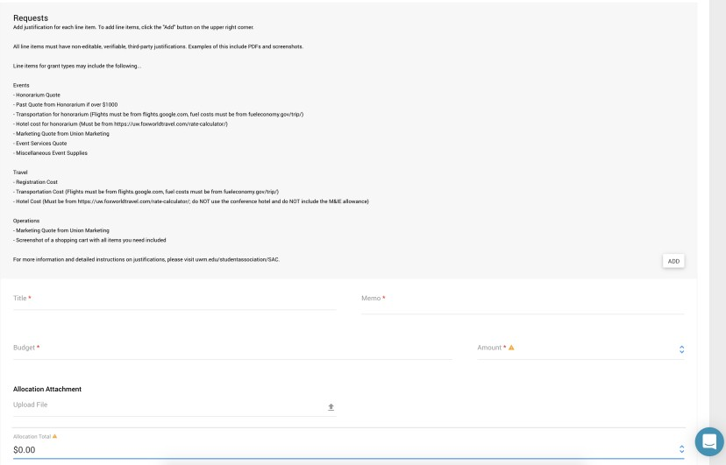
Filling it Out
Justifications will be filled out at the END of the form. You will need an allocation request for EACH line item.
Line items include things like Amazon CARTS (please don't upload individual items one by one) or Lodging.
You will need to upload non- editable, verifiable, third-party justification for each line item.

Slide 28
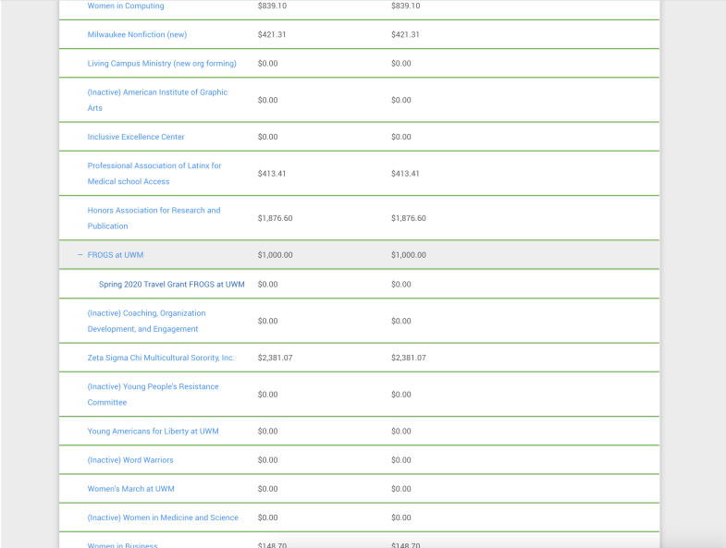
Filling it Out
When selecting a budget, select the plus sign by your organization and the sub-budget you created!

Slide 29
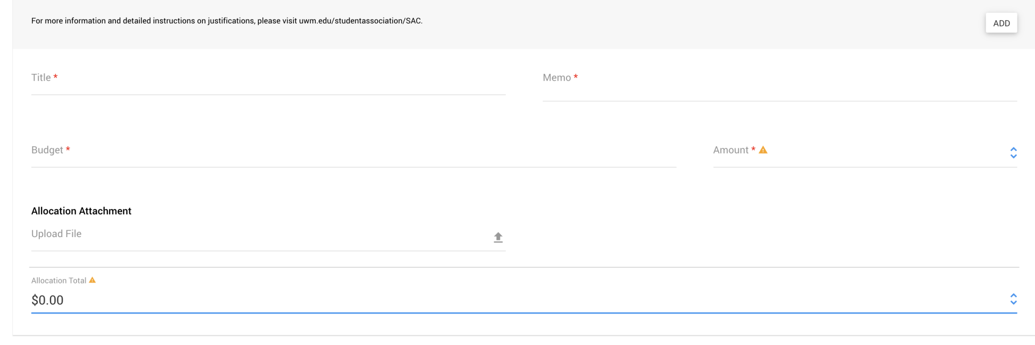
Title – the category of item (ie. honorarium, marketing)
Memo – Title of request (ie. Steve jobs speaking fee, marketing quote)
Budget – Select your organization & the appropriate sub-budget
Amount – the amount that you are requesting for THIS LINE ITEM
Allocation Attachment – this is your non-editable, verifiable, third-party justification
Allocation Total – will total up ALL line items in your request
29
*To ADD a line item, click the ADD button in the upper right.

Slide 30
For Example…
Registration
Pond Conference Registration
Spring 2020 Travel Grant FROGS at UWM
$60
PondReg.pdf
$60
30

Slide 31
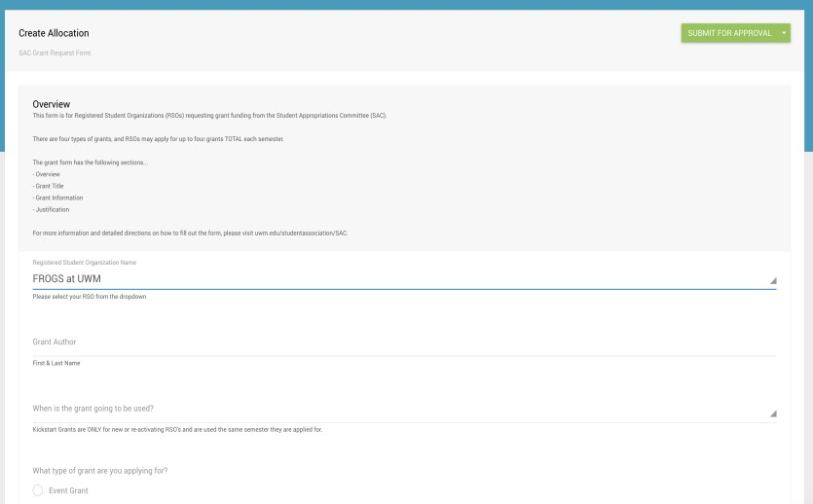
TO SUBMIT
Scroll to the TOP RIGHT and click the green SUBMIT FOR APPROVAL button!
Seriously. Don’t forget this step.
31

Slide 32
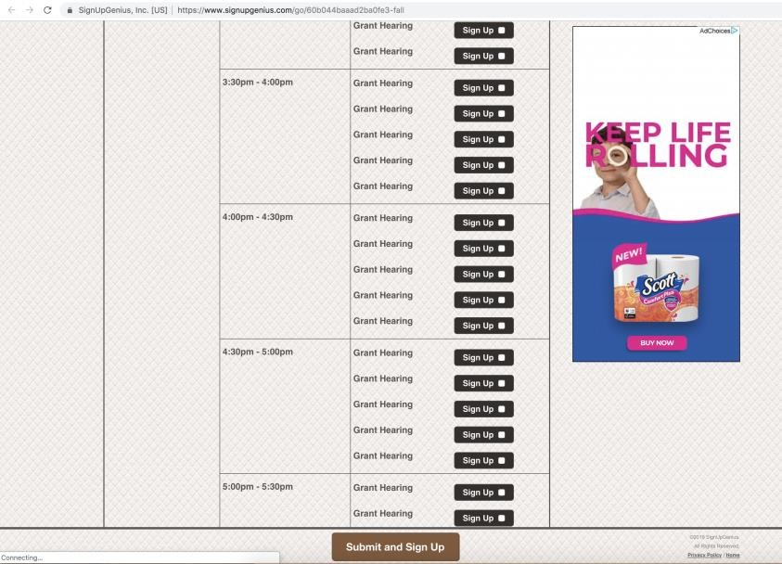
Sign up for A Hearing
Use the link in the application
to go to SignUpGenius.
Sign up for a slot for each grant you are applying for. If you apply for three grants, sign up for three slots.
After selecting your slots, click "submit and sign up" at the bottom of the page.
Add the time to your calendar and ensure that at least two people from your org plan to attend.
32

Slide 33
At your grant hearing
Each hearing takes about 5 minutes. Plan to arrive early.
At least one officer (we recommend two!) of your RSO will present the grant application to the committee. No powerpoints please!
  You'll do this on a tv screen in front of the committee.
  Explain each grant and why it is relevant to your RSO's mission.
  The committee may ask you questions.
The committee will vote on a PRELIMINARY amount, and you are excused.
At the end of the semester, the committee will reevaluate the budget to determine final grant amounts and will make a cut across the board if necessary.
Your RSO will receive an email with the final approved grant amount.
33

Slide 34
After you get the grant
At the end of the semester, you will receive an email with the FINAL
grant amount, which may include a cut.
You can begin spending this money the first day of the next semester. Set up a meeting with the Center for Student Involvement well in advance.
  Travel: Meet at least 3 weeks prior to departure to make travel arrangements. The SI
office will book all travel arrangements directly.
  Operations: Mandatory contracts or vendors are required and proper state purchasing procedures must be followed. The SI office will place all orders and
make all payments.
  Event: Schedule a meeting with Student Involvement at least 6 weeks prior to the
event date. Any person being paid for a service, performance, or to speak must be paid by a contract. Completed paperwork contract must be turned into SI at least 30 days prior to event
**NO REIMBURSEMENTS WILL BE ACCEPTED. DO NOT PURCHASE ANYTHING YOURSELF. YOU MUST GO THROUGH THE CENTER FOR STUDENT INVOLVEMENT.***
34

Slide 35
A note on redistributions
Anything that is justified in the original grant can be purchased using
that grant money. For example, if you have a hotel quote in a travel
grant and decide you want to use the FULL travel grant for the hotel, you can do that without a redistribution.
You really only need a redistribution if...
  You need to purchase something not justified in your original
grant (for example, you asked for a meditation mat but now you need medicine balls instead)
  There is a name change, such as deciding to go with a different speaker or to a different conference
If you need a redistribution, fill out the Presence form.
35

Slide 36
Automatic Denials
“
Submitting your grant after the deadline
Failing to attend grant training
Incomplete organization registration with Student Involvement
Partial Denials
  Inc○omplete or insufficient documentation
All justification must be NON-EDITABLE, follow our published policies, and
include all items needed for the grant
  Incomplete grant application
  Request for a non-fundable item

Slide 37
3
Justifications
Show us where your money is going.

Slide 38
Overall Guidelines
All justifications need...
NUMBERS and amounts
Itemized lists of what you are purchasing
To be current (requested this semester)
Unable to edit (PDF, screenshot, etc.)
Your key to success: non-editable verifiable third-party justification

Slide 39
Quotes: Marketing
To get a marketing quote....
Fill out the form on Presence (will be posted on uwm.edu/studentassociation/sac)
DEADLINE FOR REQUESTS: October 15th at noon

Slide 40
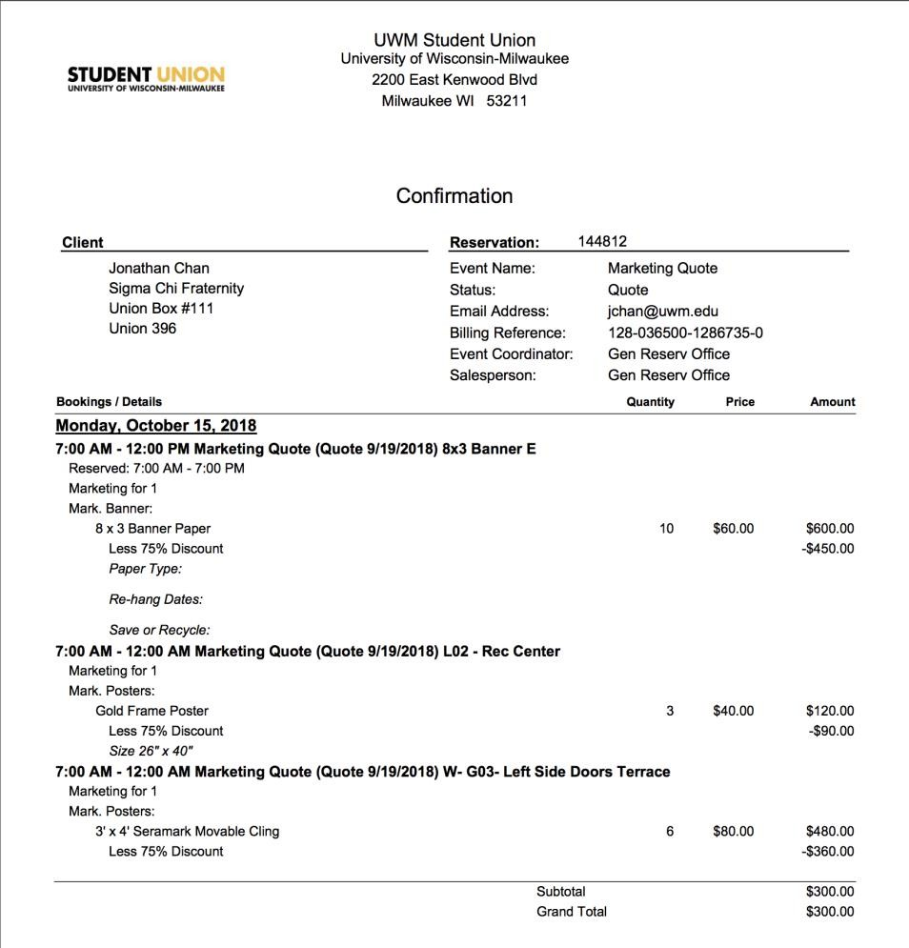
Your name
Your phone number
Your email

Slide 41
Quotes: University Printing Services
This is only relevant for JOURNALS. To get a marketing quote....
Fill out the form on Presence (will be posted
on uwm.edu/studentassociation/sac)
DEADLINE FOR REQUESTS: October 15th at noon

Slide 42
Quotes: Event Services
To get an event services quote....
Utilize the online request form on Presence
DEADLINE FOR REQUESTS October 15th at noon
TIP: Submit early. Late requests will not allow for edits and may
not be accepted.
**This is simply an estimate of cost, NOT a space reservation. Please fill out a space request form at the same time.**

Slide 43
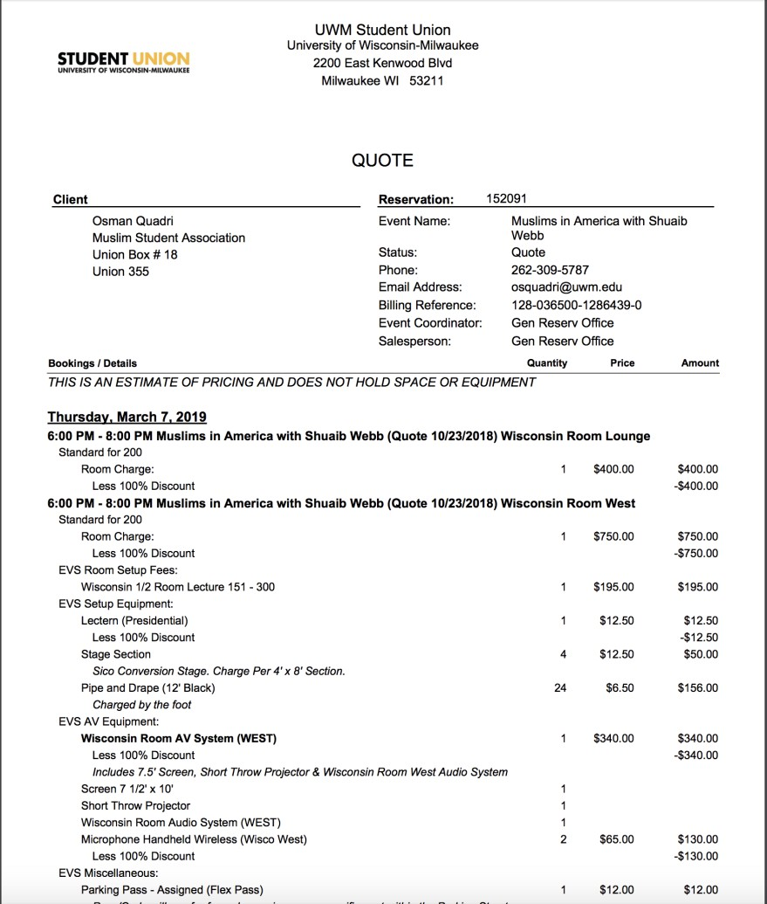
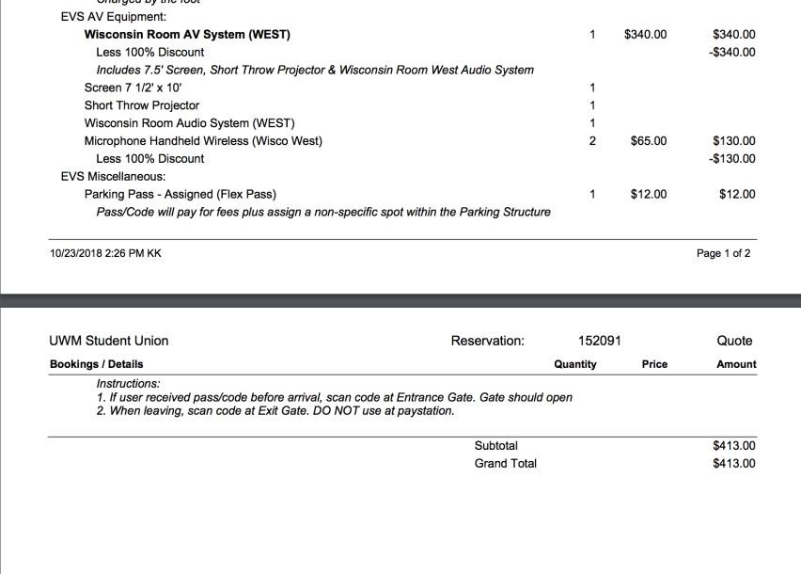
Your name
Your event name
Your phone number
Your email
###

Slide 44
Quotes: Honorariums
To get an honorarium quote....
Email the person you are hoping to have speak (or
their agent)
Work closely with your liaison
Include PDF or screenshot of emails and quotes in grant
submission.

Slide 45
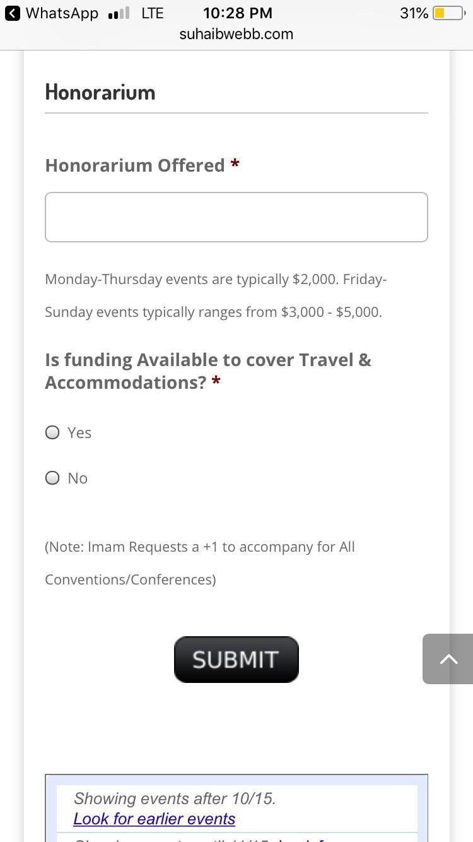
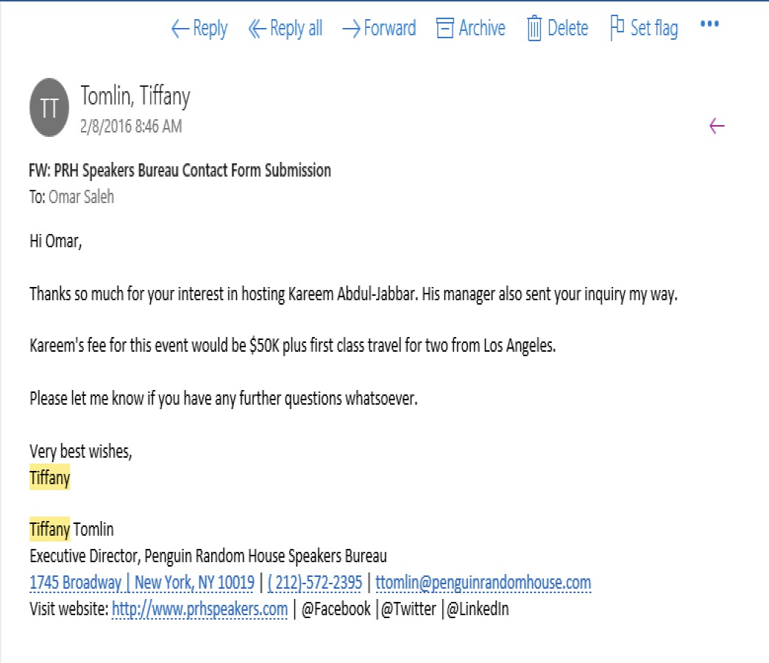
Agent’s name
Your email Your name
VIP’s name
VIP
Agent’s name
Agent’s contact information

Slide 46
Quotes: Hotels
To get a hotel quote:
  Go to wisconsin.edu/travel
  Use the lodging and per diem calculator
  Enter your desired location and dates
  Submit a screenshot
Important:
Only request the lodging amount, as SAC cannot fund
meals

Slide 47
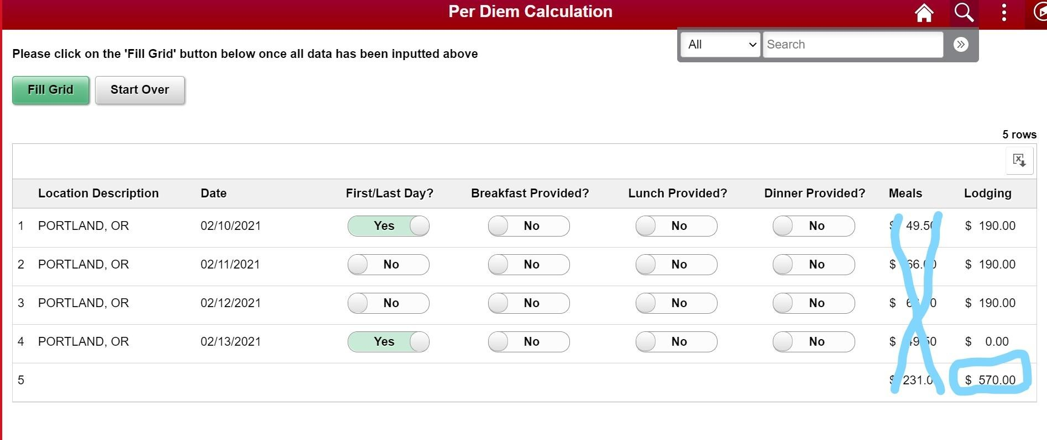

Slide 48
Important Deadlines
“
Grant allocation requests will OPEN Friday, October 8th at noon
Marketing Quote Request due October 15th by noon
Event Services Quote Request due October 15th by noon
**OVERALL GRANT DEADLINE IS Friday, October 29th at noon**
No late submissions accepted.

Slide 49
Contact Information
“
Student Appropriations Committee: sa-sac@uwm.edu
  Event Services: reservat@uwm.edu or 414-229-4828
Union Marketing: markdesk@uwm.edu or 414-229-5538
Student Involvement: csidesk@uwm.edu or 414-229-5780
**General questions? Email sa-sac@uwm.edu**

Slide 50
Next Steps
“
Keep an eye on your email.
Create those sub-budgets.
Begin collecting quotes and justifications from
Marketing & Event Services.
Visit uwm.edu/studentassociation/sac regularly.
**General questions? Email sa-sac@uwm.edu**

Slide 51
Thanks!
Any questions?
Email us at sa-sac@uwm.edu!
51

