Slide 1
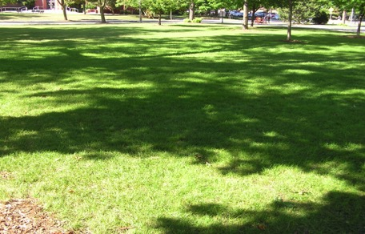
UW-Milwaukee Lawn care
Natural Lawn Care

Slide 2
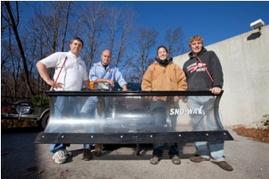
Current RESOURCES
Grounds Crew
Staff- 2 Supervisors, 4 Full Time Staff, ~8 Summer Students
Coverage- ~110 Acres, 23 Acres of Lawn
Soil- Compacted, clay soils
Strained Budgets

Slide 3

PRE- 2014 practice
A Response to unwanted weeds through chemical application
Description: Maintain a monoculture turf grass at about 2-4 inches, through chemical applications of synthetic fertilizer and pesticides (herbicides, insecticides, and fungicides)
Facility Services contracts for three lawn chemical applications per year:
Spring: Chemical fertilizer [Nitrogen, Phosphorus, and Potassium (Potash)] combined with a broad leaf herbicide and a crabgrass herbicide is applied on a weekend morning.
Summer: Chemical fertilizer only is applied. "Spot" applications of broadleaf and crabgrass herbicides are used where weed growth is prolific. Again, applications are made early on weekend mornings when campus population density is low.
Fall: Chemical fertilizer only is applied. No herbicides are used. Applications are made on a weekend morning.

Slide 4
POST 2014 - Natural lawn care
A Proactive prevention of unwanted weeds through building thick turf and healthy soils
Description: Build a thick turf environment where “weeds” are crowded out. Building healthy soils are critical to this type of treatment
-Aerate the lawn 2-3 times/ season. This provides oxygen to the microbial bacteria in the soils. Compacted soil, like that of UWM, requires this.
-Build healthy soils through compost or compost tea applications
-Over seed to grow healthy, thick turf
-Not a guarantee of no “weeds”; Dandelions arise to aerate and clover fixes nitrogen in the soil, culture shift

Slide 5
POST 2014 EXPERIENCE
1 application of herbicide (Spring 2018)
  3 applications avoided
0 applications of chemical fertilizer
  9 applications avoided
Have not fertilized or aerated as much as planned
  Budget reductions

Slide 6
POST 2018 PLAN OF IMPLEMENTATION
Natural lawn care a campus and departmental priority.
  Other Grounds items may have to be deferred
Spot applications of herbicide will, occasionally, need to be applied

Slide 7
IMPACTS
Let’s review the ones presented PEC in 2014

Slide 8
PRE-2014 CURRENT
Environmental Affects
Human Health
-Potential poisoning through touch, inhalation, eyes, or mouth
-Range from mild irritation, nausea, to death depending on the chemical, amount, and contact
-Delayed affects or chronic exposure over time
-Affects are neurological, birth defects, fetal deaths, and neurodevelopmental disorder, as well as asthma, cancer, non- Hodgkin lymphoma, leukemia, hormone disruption, etc.
Animal Health
-Exposure affects fauna in a similar fashion, but it also impacts the insects that birds eat, the bees that pollinate, the microbes that the soil needs, and reduces biodiversity
Water Impact
-A large portion of lawn chemical never makes it to the intended target. The air, soil, and water resources absorb a great deal of the chemicals. This affects human drinking water, toxicity to aquatic organisms, as well as eutrophication in our waterways from excessive fertilizer runoff.
Fossil Fuel Inputs
-Synthetic fertilizers and pesticides require fuel to manufacture and transport
Human Health
-Improved air quality and little to no potential for acute or chronic poisoning
Animal Health
- Improved wildlife, bird, and insect habitat and food resources.
Water Impact
-Improved water retention (longer roots). Organic nitrogen sources are more easily absorbed (less runoff), but it still depends upon the available amount of carbon in the compost and when or how it is applied.
Fossil Fuel Inputs
-Compost is utilized locally. It could potentially be made on site from yard and kitchen scraps. This would also reduce the load on landfills.

Slide 9
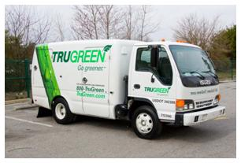
PRE-2014 CURRENT
Economic/Budget
UWM Site Specific, 23 Acres
Mowing- Labor costs to mow 23 acres 4 times/month
Contracted Application (synthetic fertilizer, pesticide, insecticide, herbicide, and fungicide)-
3 applications/year= ~$7,000/year
Mowing- Labor costs to mow 23 acres 2-3 times/month
In-House natural lawn care: (could also be contracted out)
Aeration- Labor costs to aerate 23 acres 2 times/year
Overseed- 2 applications/year= $12,144
Compost- 2 applications/year=$23,184 (Including delivery. If we made our own, this would be greatly reduced but require start up costs and labor)
Or
Compost tea-2-3 applications/year $1,072 per year, +upfront cost of the compost tea machine, $4,100 one time and labor to manage it.
Or
Milorganite- A by-product of the waste water treatment process at the Milwaukee Metropolitan Sewerage District. Milorganite is a natural fertilizer. 2 applications/year= $1,840
Training- New strategies, increase knowledge of staff on proactive & organic responses

Slide 10
PRE-2014 CURRENT
Communications & Aesthetics/Perception
Call list when all chemical applications are spread or sprayed
Post “Right to Know” on website, describing each application
Warnings posted on the lawn by contractor
Strategized, ongoing campaign to inform all campus students, faculty, staff, and visitors regarding the nontraditional approach
A culturally accepted norm of green grass. No other plants interrupt the sheer of lawn.
The history lies in the use of chemicals post WWII that were reapplied to residential use
Less the norm, but acceptable for its reduced environmental and public health impact
The lawn might be composed of grasses and some clover (which fixes the nitrogen in the soil)
“Weeds” are a social label, not a scientific one
The lawn might not always be a consistent sheer of green grass

Slide 11
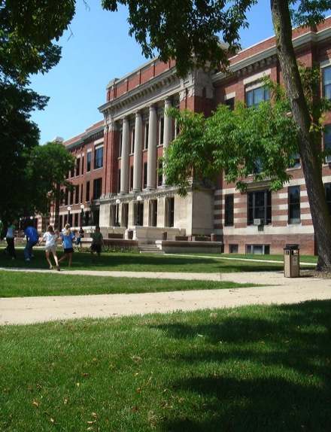
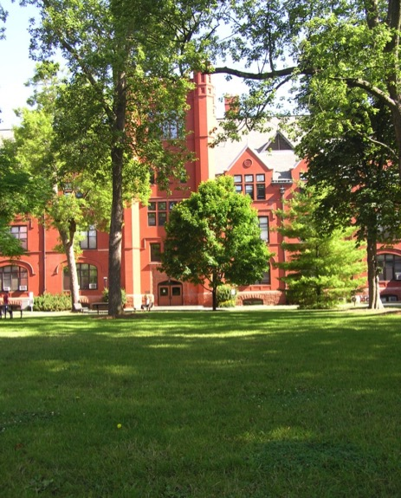
PRE-2014 CURRENT
Communications & Aesthetics/Perception
Merrill Hall “horseshoe”- Under test 2009-2010

Slide 12
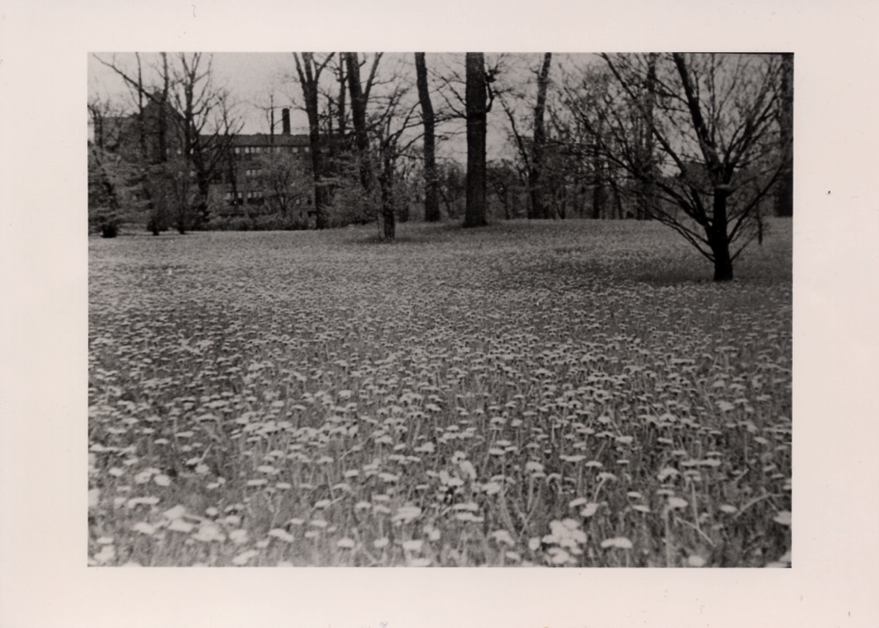
“Carpet of Gold” (as labeled)- Downer College, ~1910-1930

