Slide 1
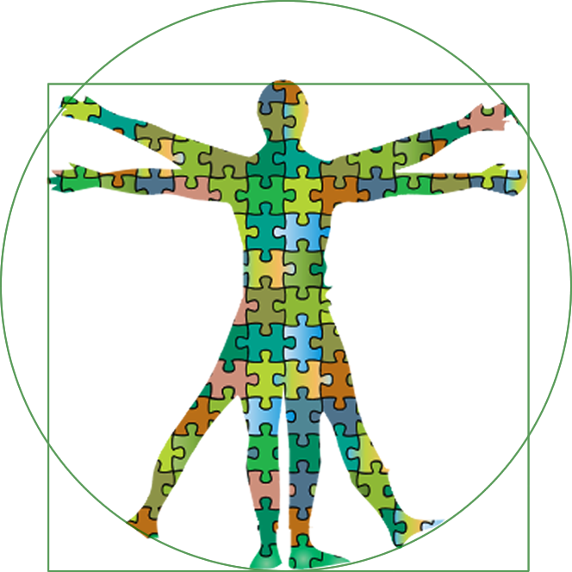
Shared Learning Outcomes:
Writing Learning Outcomes
UWM Student Affairs

Slide 2
Part II
By the end of this session, you will be able to…
Bloom and Fink’s Taxonomies of Learning to write Unit and Program level learning outcomes
Program/event/services with Unit level learning outcomes.
Apply
Align
Notes:
You can see how I used VERBS from multiple levels of learning, from either Fink or Bloom.

Slide 4
UW System Shared Learning Goals (2008)
• Knowledge of Human Cultures and the Natural World including breadth of knowledge and the ability to think beyond one’s discipline, major, or area of concentration. This knowledge can be gained through the study of the arts, humanities, languages, sciences, and social sciences.
• Critical and Creative Thinking Skills including inquiry, problem solving, and higher order qualitative and quantitative reasoning.
• Effective Communication Skills including listening, speaking, reading, writing, and information literacy.
• Intercultural Knowledge and Competence including the ability to interact and work with people from diverse backgrounds and cultures; to lead or contribute support to those who lead; and to empathize with and understand those who are different than they are.
• Individual, Social and Environmental Responsibility including civic knowledge and engagement (both local and global), ethical reasoning, and action.

Slide 5
UW System Shared Learning Goals (SLGs)
Each Student Affairs Unit Aligns with SLGs
DRAFTs UNIT LGs
Programs w/in Units write Program/Event LGs-Match to Unit LGs
Units Revise Unit LGs

Slide 6


Slide 7
Ex: Women’s Ctr.
STUDENT AFFAIRS DIVISION MAP Map Strongly Embedded Moderately Embedded Weakly Embedded
SA UNITS

Slide 8
Unit Level SLG Map Unit A:__________________________________________________
Women’s Ctr.

Slide 9
Two Taxonomies of Learning
    Bloom’s Taxonomy
    Fink’s Taxonomy of Significant Learning Experiences
Intentionality
Congruency
Transparency
Notes:
Tools that help us write intentional and transparent course learning outcomes are taxonomies of learning.

Slide 10
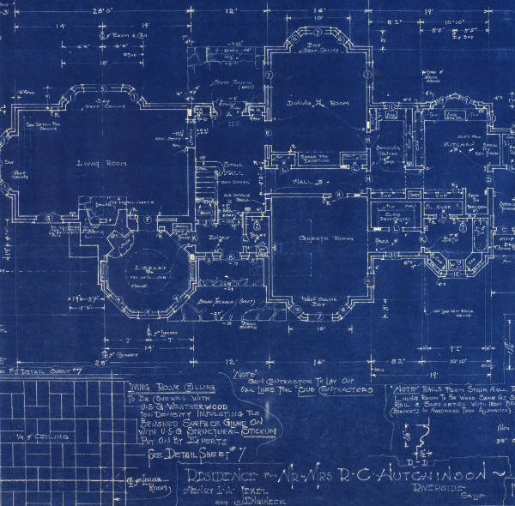
Learning Outcomes
By the end of the program,
what will students
be able to do?
Week 1
Days
Minutes
Your Program Design Blueprint
The learning outcomes set the parameters for the content, activities, experiences. They are the blueprint upon which you will ground the rest of the design decisions.
Notes:
Another way to imagine this, is to visualize a big arch over your course/design…you determine your learning goals and start with them, and end with them, and they are the overall purpose or arch from which everything else drops down, or emerges. If it doesn’t fit with your learning goals, it probably shouldn’t happen.
Next, based on your learning goals, select the major or key assignments, learning activities in which students will demonstrate and learn the main objectives of the course. Place them in the course when it makes sense.
Based on the these major learning events, build in the smaller assignments that will prepare students for the key assignments. What will they need to do, practice, in order to be able to perform the large, important learning activities? This is called scaffolding…compare, compare and contrast, compare, contrast and evaluate. This is where you integrate the material or content, so that the content becomes a means to and end, not an end in itself, and the learning determines the pace.
Now, based on the learning goals and key assignments, I have to still choose, create, design HOW I’m going to teach. Getting students prepared to compare and contrast might mean I chose to have a service learning component, or a research component, or small groups, or lectures followed by discussion…how can I best teach to the learning objectives?
Now, I can place the Assessment both formative and evaluative with confidence, and with learning in mind. It would make sense to assess formatively prior to a graded (summative assessment) – that way I know if they are getting it.
I must also pay attention to the learning environment all along-how will it work physically if I do groups? How will I manage the space, the respect?

Slide 11

Student affairs: Situate the outcome for what “comes out” of the event or program, not what is experienced during it.
Example: Class participants (Audience) in the Alcohol Awareness class (Condition) offered by Health Education will increase their knowledge of alcohol dangers and safety strategies (Behavior) and be able to state three warning signs of problem drinking and three strategies for avoiding alcohol abuse (Demonstration) after attending the class.

Slide 12
By the end of the program or event… students will be able to:
During the event or program…
After the event or program…
Meet a variety of students from other cultures.
Initiate conversation and socialize with students from different cultures and who practice different cultural values.

Slide 13
Unpacking learning
Intentionality
Evaluation
judge, recommend,
critique, justify
The verbs on the right are helpful for writing specific course learning outcomes.
They can help you to determine specific learning outcomes for each program, activity, or event within your Unit or your Unit itself.
Synthesis
create, design, invent,
hypothesize, develop
Analysis
categorize, compare,
contrast, analyze
separate
Application
use, compute, solve,
apply, construct
Comprehension
explain, summarize,
describe, illustrate
Knowledge
write, list, label, name,
state, define
Bloom’s Taxonomy: Very cognition oriented
Notes:
Bloom’s Taxonomy, around since the l950’s, unpacked learning into six levels, beginning with the lowest level, what we might call memory, facts, and students being able to just identify terms, formulas, etc. If we take the lovely words of knowing, understanding, learn, and become more specific, we help ourselves design more intentionally and help students see what our expectations are more transparently. Knowing, for you, might mean compare, or understanding for me might mean understand well enough to argue or support…let’s write outcomes that say what we mean…

Slide 14
Bloom’s Taxonomy
is one of many taxonomies of learning. It can be a helpful tool in unpacking what we mean by “learning.”
Bloom separates learning into six levels of increasing cognitive complexity – starting with the lowest level – knowledge, or what we commonly think of as memorization or rote learning.
The better we are able to articulate what it is we want students to be able to do by the end of the program, event, or experience, the easier it is to select specific programs, identify partners within the unit and across units, and determine methods to assess the student learning.

Slide 15
Creating Learning-centered Outcomes
Use active verbs and start with the phrase:
By the end of the program, students will be able to…
Argue Describe Interpret Compare
Devise Perform Compose Establish
Provide Conduct Evaluate Select
Contrast Examine Solve Construct
Explain Synthesize Define Formulate
Weigh Identify Write Demonstrate
Intentionality
Notes:
Creating learner-centered course goals is MUCH easier if you use active verbs and start with phrases that put students as the subject of the statement.
Bloom’s Taxonomy –
Bad words: “Learn” “know” or even understand…to vague!!
Tease apart what we mean by learn…so we know, AND they know…
Bloom’s taxonomy will help us tease apart the complexity in learning and what we hope will happen.
Story: facts, figures in health care, really wanted students to think critically about the health care system, economics, politics, and inequalities, access….can’t throw in critical thinking like an afterthought on an exam…the coherence isn’t there, students feel tricked, and probably under challenged, you’re frustrated, “Why can’t they think!!!???” You have to move them toward these ends by designing learning process that has in mind at all times, their learning, and specific learning.

Slide 17
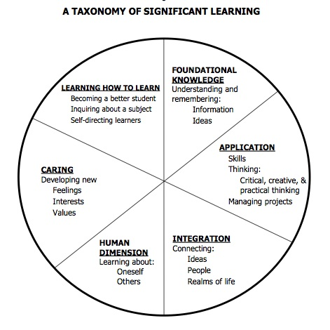
Fink’s Taxonomy of
Significant Learning
Notes:
Fink’s taxonomy

Slide 18
Fink’s Taxonomy of significant learning experiences
Fink’s Taxonomy¹ is a newer effort to capture a wider range of learning experiences that go beyond the cognitively based levels of learning prescribed by Bloom. As you can see, the various levels cognitive learning outlined by Bloom may be similar to the Foundational, Application, and Integration categories on the left side of the diagram.
Many disciplines and institutions are focusing attention to other dimensions of the human experience and learning potential that are better matched to Fink’s Human Dimension, Caring, and Learning How to Learn. Some consider Fink’s dimensions more holistic and better aligned with the recent AAC&U Essential Learning Outcomes.
http://www.aacu.org/leap/documents/EssentialOutcomes_Chart.pdf
Fink, L. Dee. 2003. Creating Significant Learning Experiences: An Integrated Approach to Designing College
Which dimensions of Fink’s taxonomy best capture the kind of learning that you hope students will achieve through your program, event, or experience?

Slide 19
Exercise: Taxonomy of Significant Learning
L. Dee Fink, Creating Significant Learning Experiences
Intentionality
IN PAIRS (5 MINUTES)
How does Fink’s taxonomy compare with Bloom’s?
Which domains of learning from Fink or Bloom does your unit aim for students to achieve?

Slide 20
Learner-centered Teaching:
By the end of the program, participants will be able to…
“…compare female artists to….”
“…solve community problems…”
“…apply the principles of sustainability to their lifestyle decisions…”
Notes:
Instead, if we frame the learning outcome – often called “backwards design” by what STUDENTS’ will be able to do by the END of the course, and when they leave and take other courses, live in the world, go to graduate classes, we select Very

Slide 21
Are these learning outcomes?
“Students will learn the causes of…”
“Students will know several…”
“Students will discuss…”
“Students will explore…”
“Students will be able to understand how…”
“Students will be exposed to…”
“Students will become familiar”
Watch out for vague, passive, and non-specific terms!
Notes:
Let me start by showing you what it is not…what it doesn’t look like…
Content-Centered
In the first statement the goal is to “cover” But, who is doing the covering? The instructor? The student? The student isn’t really very apparent in the goal, and it isn’t very learner-centered, but rather, content centered. What will the students have to do with all that content? We don’t know, do we?
Students assume the instructor will “cover” the content and tell them about the topics – encourages passive learning; they might also assume they don’t need to read, because the syllabus outlines what is going to be “covered” each day.
P. Palmer, to cover, imagines a field of grass, being covered by a tarp, everything under it dies, no one can see under it, and nothing new can grow…ugh….
The second goal actually identifies the course as the subject of the action…”the course will examine…” Who is the course?
Can anyone tell what the students are going to learn? You can’t tell for sure?

Slide 22
Learning Outcomes vs. Learning Activities
A common mistake when trying to write learning outcomes is to confuse outcomes with the learning activities itself during the program or activity.
Activities are means to the learning ends.
Example: Students will present…Students will design…
If you find yourself doing this, ask yourself, “Why do I want them to do this?” or “Why is this task or activity important?” “How will students be different afterwards?”
If you find yourself writing tasks or activities instead of outcomes, look for the learning outcome behind the activity.
Notes:
One important distinction, the course learning outcomes often become confused with the course assignments. The learning outcomes are often hiding behind the assignment – why do you want students to perform the assignment? What do you hope to see?

Slide 23
BREAK

Slide 24
Exercise: Drafting Unit/Event Learning Outcomes
By the end of the program/event, students will be able to:
1.
2.
3.
4.

Slide 25
Rubric for Critiquing Unit or Program/Event Learning Outcomes
Instructions:
Apply the rubric below to review the unit’s or program/event learning outcomes.
Highlight the description of each criterion or portion of the description that matches the student learning outcome statement. Multiple levels may be highlighted for each criterion.
Criteria | Expert | Mastering | Novice
Clarity | Each learning outcome statement is specific and uses action verbs that identify the kind and level of learning for each competency. | Most of the student learning outcome statements use action verbs that identify the kind and level of learning for most competencies. Minor revisions needed to reduce ambiguity. | Few, one, or no learning outcomes are stated using action verbs. The kind and level of learning for each competency is unclear or missing. Vague words obstruct identifying the learning outcome(s).
Measurability | Each learning outcome is stated as a singular student performance that is an attitude, a behavior, or knowledge acquired. | Most learning outcomes are stated as singular student performances of an attitude, a behavior, or knowledge acquired, however, some combine multiple student learning outcomes in one statement. | None of the learning outcomes are stated as singular student performances of an attitude, a behavior, or knowledge acquired.
Alignment | Each learning outcome can be linked to at least one UW System Shared Learning Goal. | Most learning outcomes can be linked to at least one UW System Shared Learning Goal. | None of the learning outcomes can be linked to the UW System Shared Learning Goals.
Notes:
I’ve created a rubric for you to use to analyze your course learning outcomes once you’ve written them all at home.

Slide 27
Notes:
Employers are looking for institutions to be intentional about learning knowledge and skills, as are accreditors.

