Slide 1
Milwaukee 2020
UWM Students and the Democratic National Convention

Slide 2
Participating in the DNC & earning academic credit
THREE EXCITING OPTIONS FOR UWM STUDENTS!
Take a summer course on presidential nominations (under the POL SCI 387 topics number)
Hybrid course with experiential learning component
Professor Hong Min Park
Enroll in POL SCI 489 and we’ll find you a DNC-related internship experience
Let us know if you have specific interests on the sign-in sheet
Enroll for 1-3 credits (1 credit = approximately 40 hours work)
Participate in the Washington Center’s National Conventions Seminar
On-campus academic component Week 1
Fieldwork experience Week 2
TEN scholarships available
Academic credit via enrollment in POL SCI 387 or POL SCI 489

Slide 3
POL SCI 387: Presidential Nominations
Professor Hong Min Park
hmpark1@uwm.edu
June 8 – July 18, 2020

Slide 4
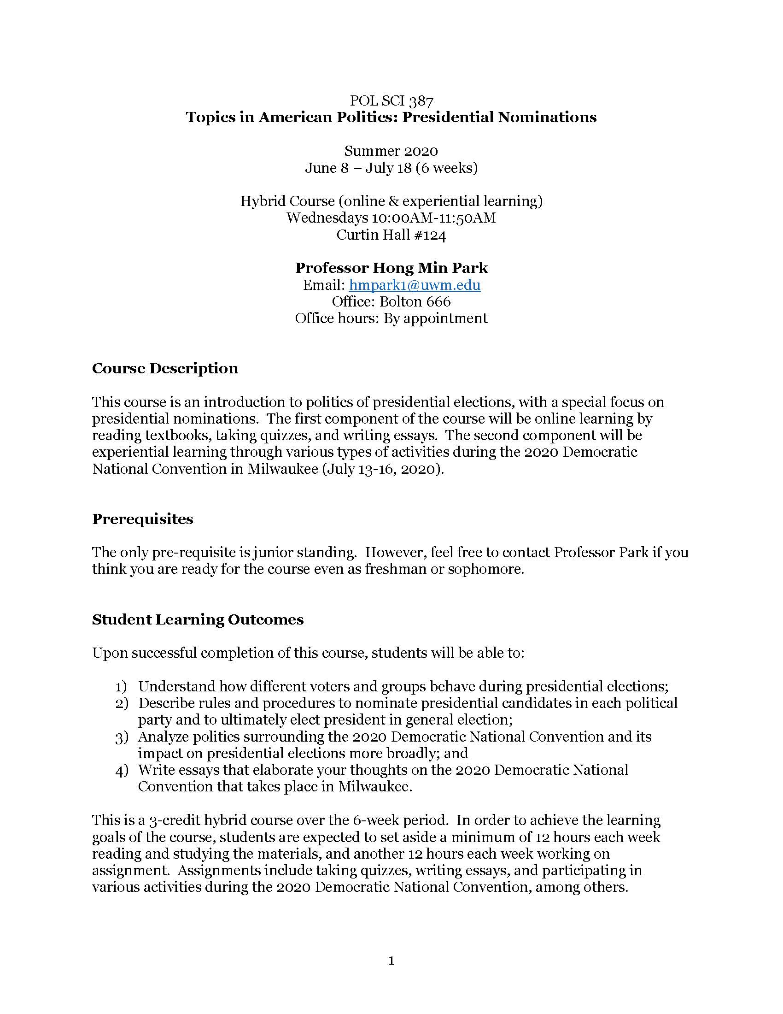
What you can expect
ONLINE LEARNING via CANVAS (June 8 – July 15)
Required Reading and Quizzes
Two Short Essays
EXPERIENTIAL LEARNING via DNC (July 13 – July 16)
Various online/offline activities (TBA)
5-page Experience Essay (due July 18)
If you attend the Washington Center’s National Convention Seminar, work there will satisfy these requirements.

Slide 5
POL SCI 489, Section 101: Internship in pol sci
Professor Sara Benesh
sbenesh@uwm.edu
June 8 – July 18, 2020

Slide 6
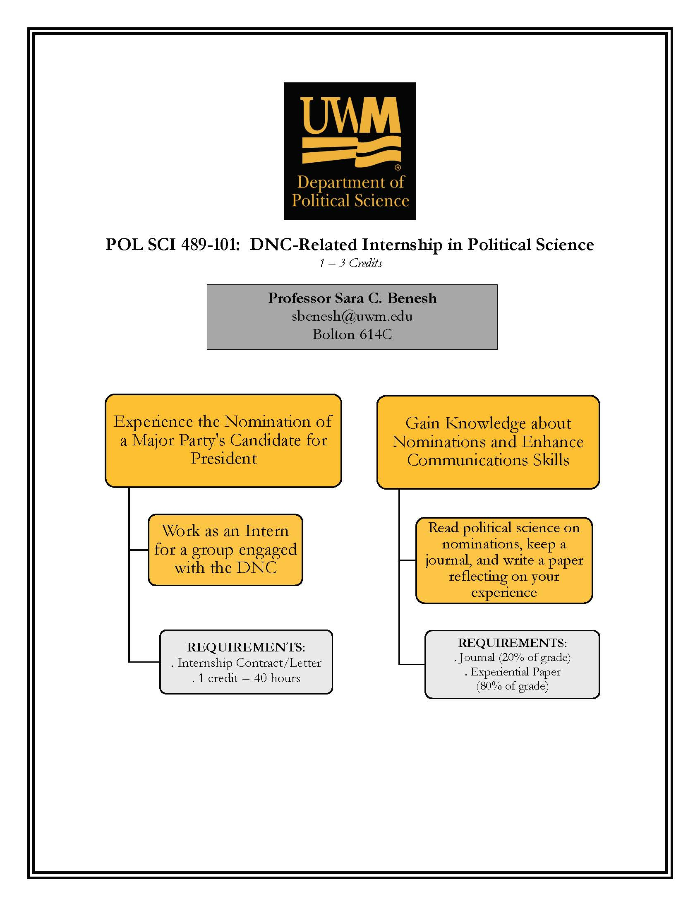
What you can expect
Background required reading (online via CANVAS)
Placement into DNC-related internship
Choose 1-3 credits based on work hours
Required journal and capstone experience paper (due July 18, 2020)
If you attend the Washington Center’s National Convention Seminar, work there will satisfy these requirements. We are happy to match you with a formal internship in addition to the fieldwork via the seminar, if desired.

Slide 7
Internship opportunities
Tailored to student’s interests
WORKING LIST OF OPPORTUNITIES (in progress!)
G Strategies in Milwaukee Fellowship Program (gstrategiesllc.com)
Research, special events coordination, data work, donor development, fundraising
National Client base including Mayoral, Gubernatorial, Senatorial candidates, and DNC 2020
Democratic National Committee Operation 2020 (democrats.org/operation2020/)
Digital Organizing Fellowship
Democratic Party of Wisconsin (bit.ly/BlueWI2019)
Organizing Fellows (unpaid)
Milwaukee 2020 (jobs.lever.co/milwauke2020)
Internships and other Paid Positions (Finance; Diversity, Vendor Accountability, and Vendor Growth; IT)

Slide 8
Or, sign up to volunteer with the dnc
Informational meetings February 4th at 7:30pm in UNION 280 and February 5th at 2:30pm in UNION 191
RSVP at https://uwm.edu/community/premier-events/dnc-2020-info-session-february-4th-or-february-5th/

Slide 9
The Washington Center’s National Convention Seminar
Apply to Washington center
Professor sara Benesh, uwm faculty leader
July 5 – July 17, 2020

Slide 10
Apply for one of ten scholarships, by SUNDAY, FEBRUARY 16th
TO QUALIFY:
Enrolled in any bachelor’s degree program at UWM
Soph, Jr, Sr standing by May 31, 2020
3.0 minimum GPA
18 years or older
Attended UWM in Spring 2020, returning to UWM for Fall 2020
Visit the UWM Scholarship Portal at https://uwm.academicworks.com/ and search for “The Washington Center DNC Scholarship”

Slide 11
What you can expect
Required Readings via Schoology
Plenary Sessions – all students and faculty
Faculty Director to create agenda
Expect panels, interviews, briefings featuring national leaders, media professionals, academic experts, and representatives from advocacy organizations
Small Group Discussions/Activities
Fieldwork
Convention Sessions and Related Events
Assessment will include your engagement, written memos, fieldwork and journal, delegate interviews, capstone essay
Academic Credit via enrollment in POL SCI 387 or 489

Slide 12
Questions? Professor Benesh (sbenesh@uwm.Edu) Professor Park (hmpark1@uwm.Edu)
POL SCI @ UWM encourages you to get involved!

