Slide 1
LibCal Library Calendar/Hours - Group Study Room Booking - Research Consultation Scheduling
Andy Ritter
Head of Library Systems – UWM Libraries

Slide 2
What is LibCal
SpringShare
LibGuides (A-Z List of Databases, Research & Course Guides, Library StaffWeb)
LibAnswers (Ask A Librarian)
LibCal (Appointment Scheduling for Research Consultations, Calendar/Hours and Room Reservations)

Slide 3
Why do we need LibCal
Web ID2 New WordPress Environment
jQuery Calendar (end of life)
D!bs Room Reservation Service (end of life)
Appointment Scheduling for Research Consultations

Slide 4
Results with LibCal
New Hours/Calendar Interface

Slide 5
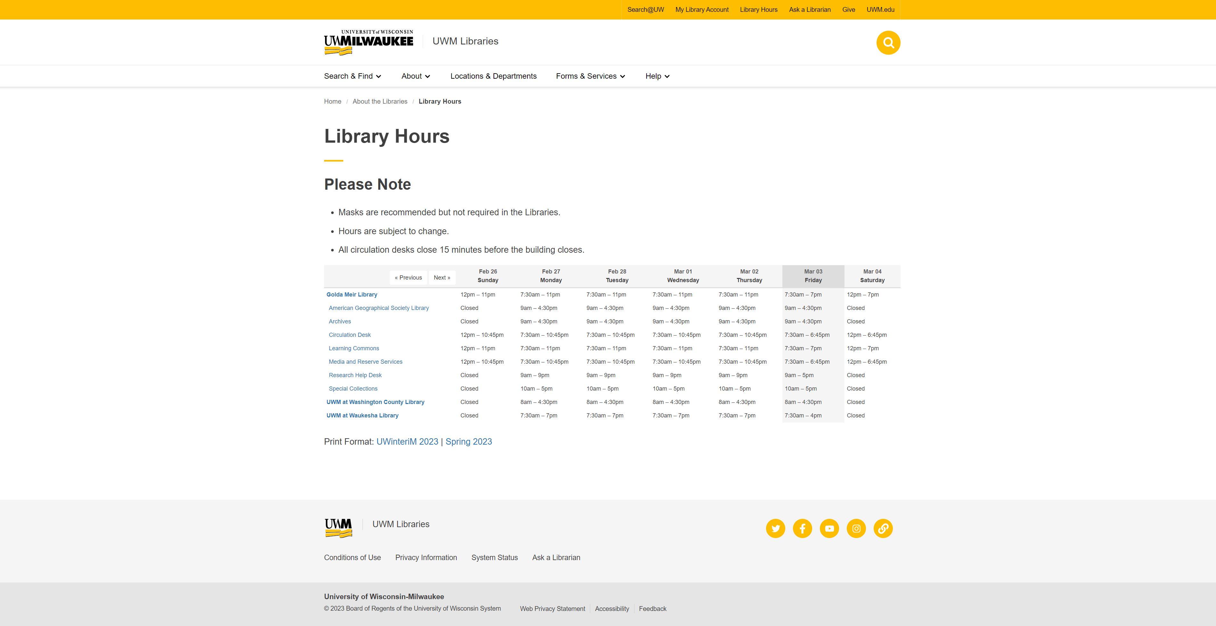

Slide 6
Results with LibCal
New Room Reservations Interface

Slide 7
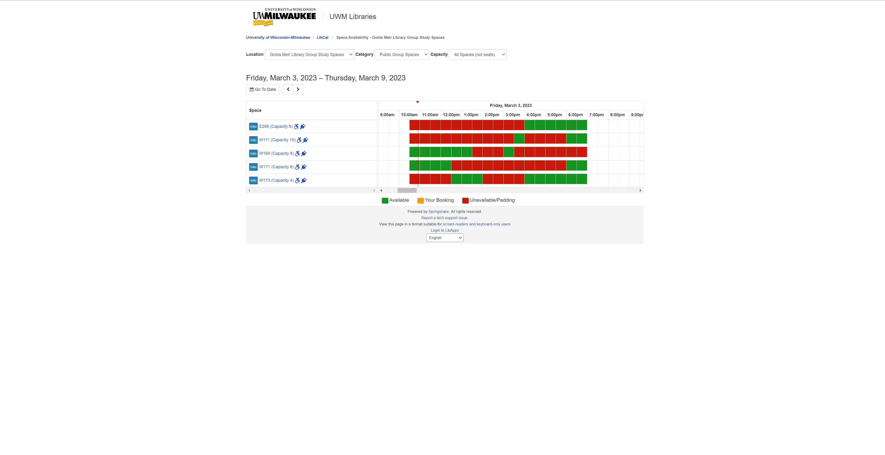

Slide 8
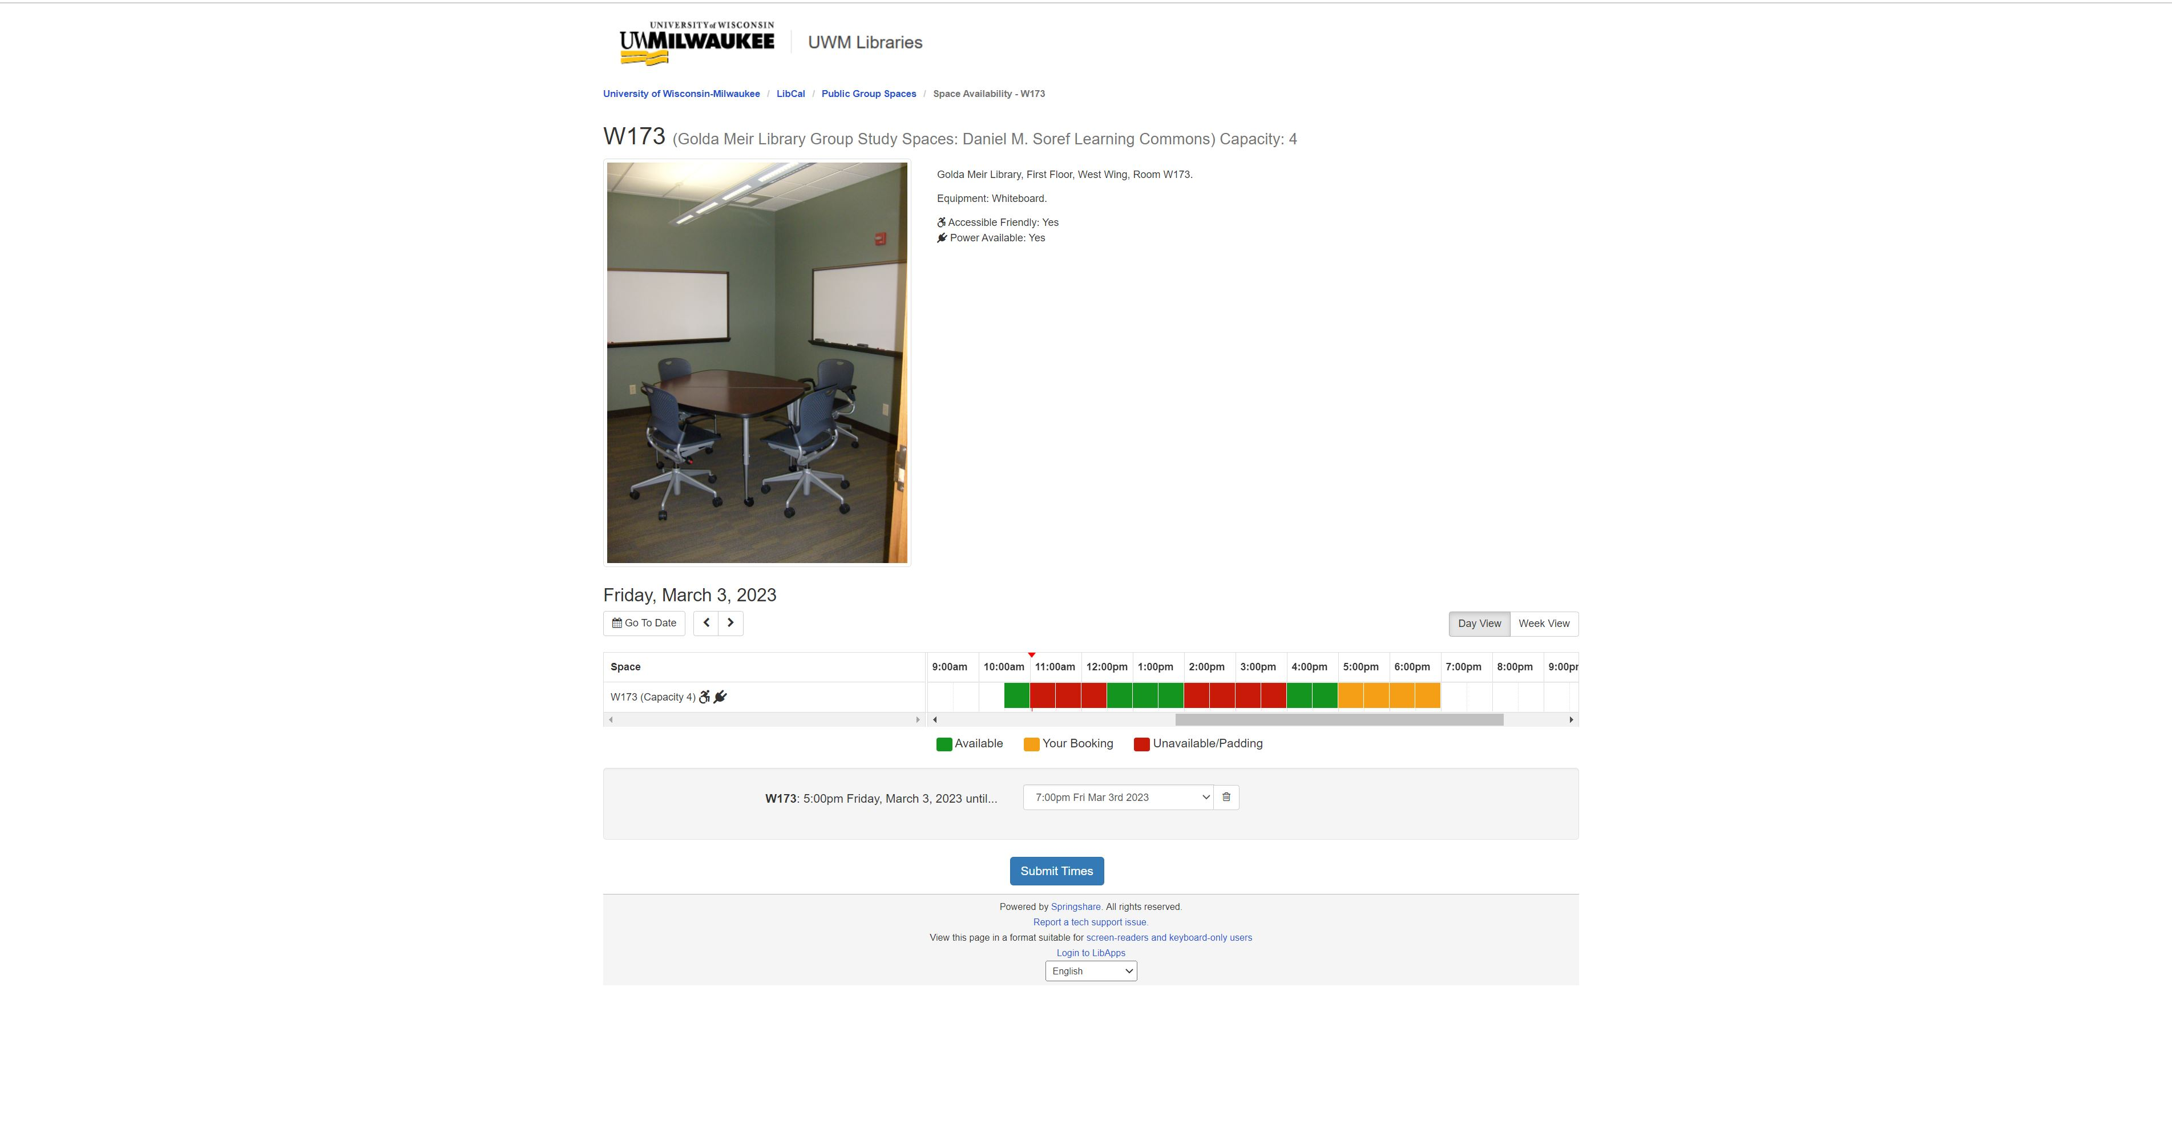

Slide 9
Future with LibCal
Testing Appointment Scheduling for Research Consultations
Mediated Room Reservations

Slide 10
Questions ?
Library Hours
https://uwm.edu/libraries/about/hours/
Group Study Room Reservations
https://uwm.edu/libraries/about/room-reservations/
How to Reserve a Room with LibCal https://youtu.be/dnJ4hPK-pnk

