Slide 1
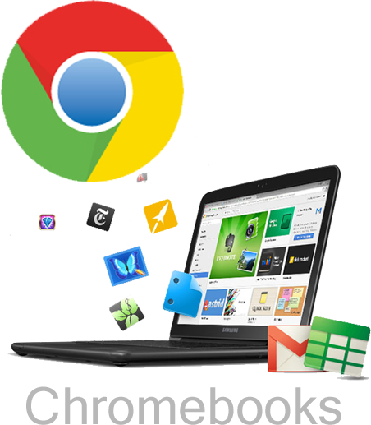
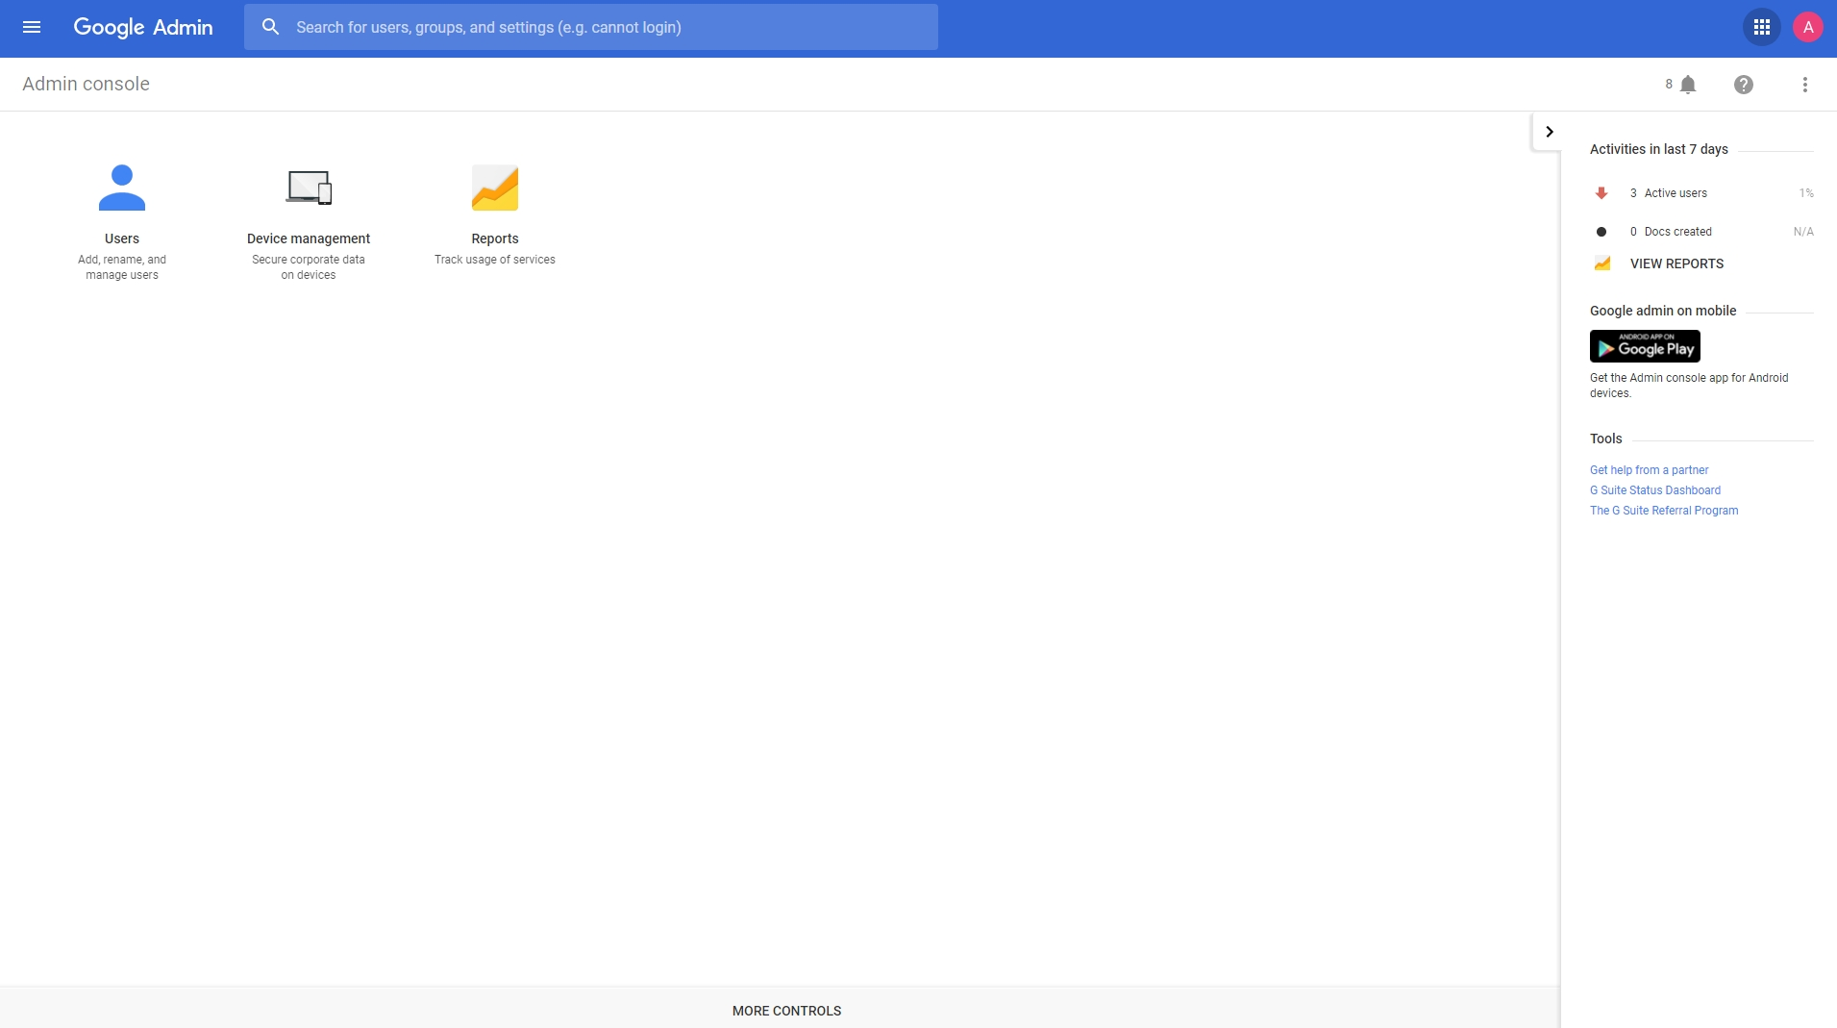
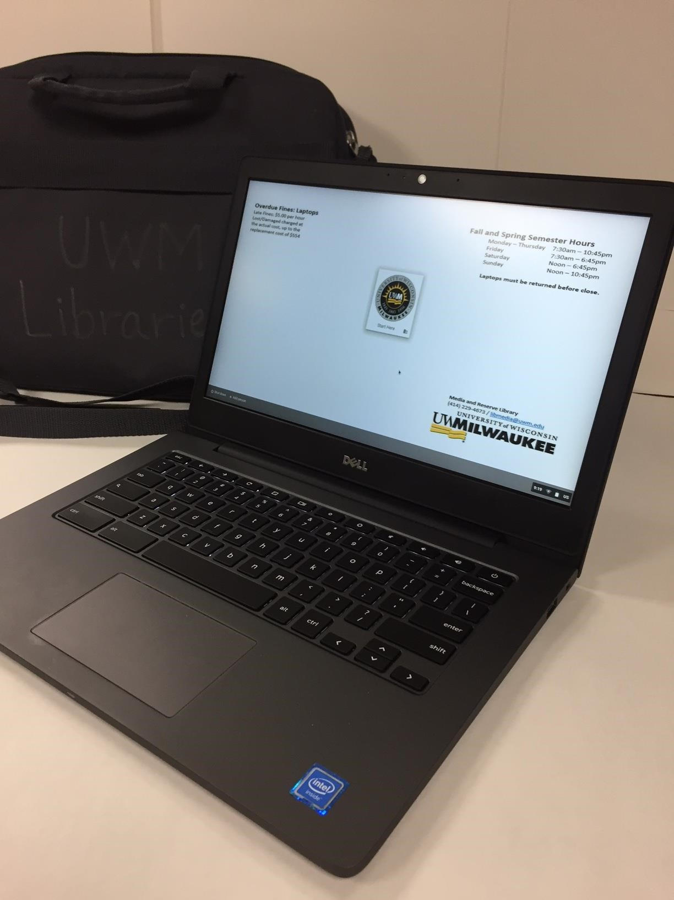
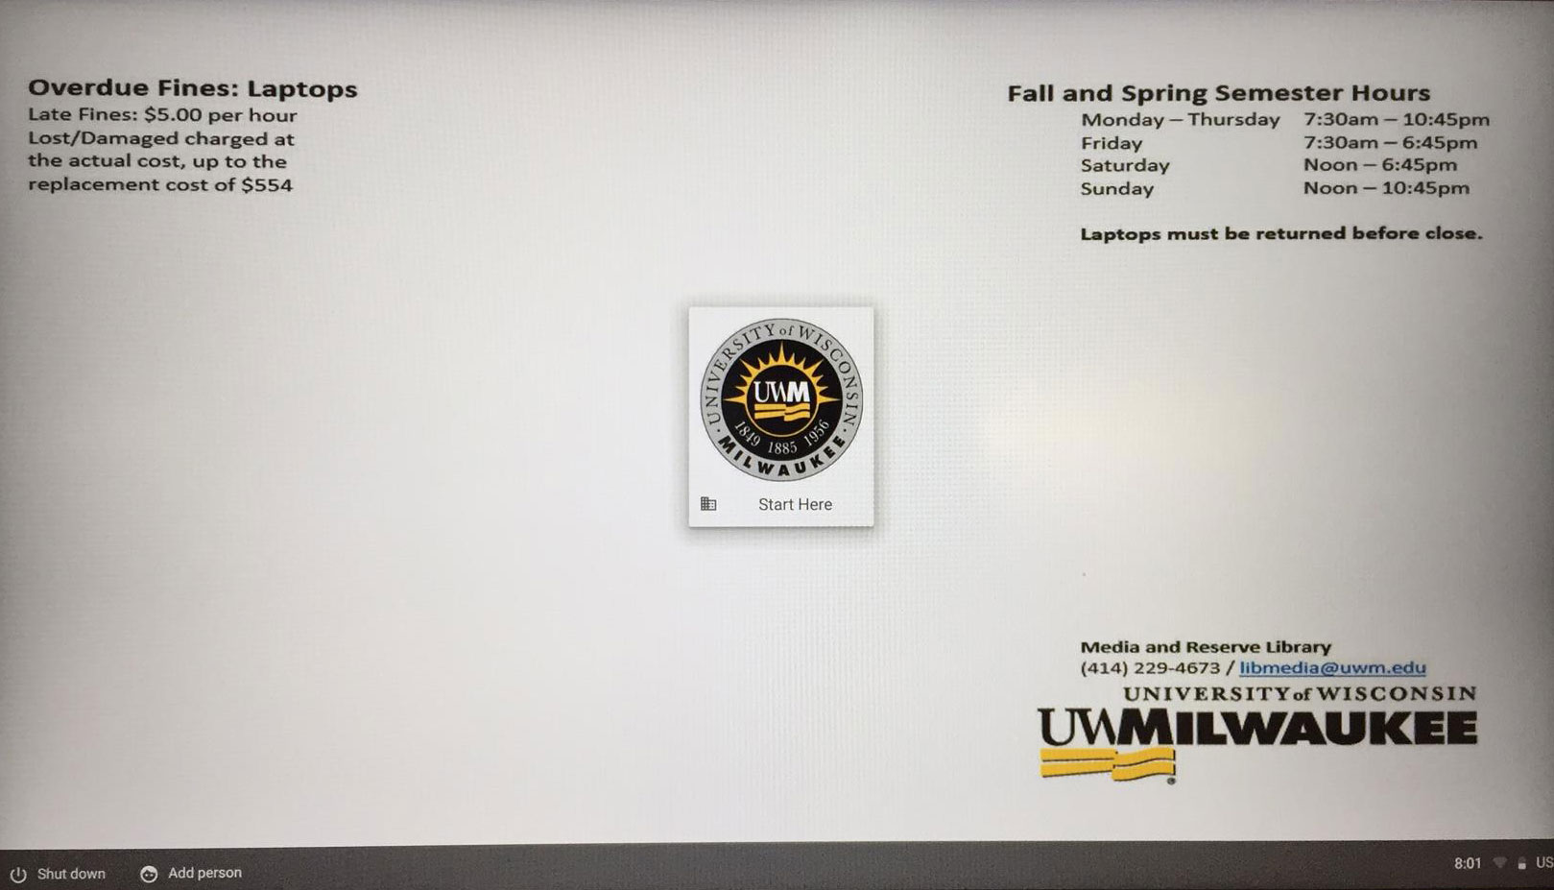
Chromebook Management – Library Laptop Checkout Program
Andy Ritter – Assistant Head Library Systems
UW Milwaukee Libraries
LAPTOP REPLACEMENT PROJECT
CHROMEBOOK HARDWARE
CHROMEBOOK ADMINISTRATION
PUBLIC SESSION KIOSK MODE
Last year the UW-Milwaukee Library Systems department took over the administration of the Library Media Laptop checkout program. Over the past 5 years this program had grown to maintain over 100 units of varying hardware and software configurations. This undertaking required the re-development of the service and its administration. The task also required our office to plan and deploy a new hardware solution for our out-of-warranty laptops. We chose Google Chromebook hardware and administration for this replacement project.
Dell Chromebook 7310 Specifications
Chrome OS
Intel Celeron 3205U (Dual-Core, 1.5GHz)
16Gb Solid State Drive
2GB RAM
Intel HD Graphics GT1
720p Front-Facing Webcam
Dual-Array Microphones
Carbon Fiber Finish with Magnesium Alloy
Backlit Keyboard
Glass Track Pad
1080p 13 in Display
Dual-antennae 802.11ac Wi-Fi
Bluetooth 4.0 LE
Noble Lock Slot
AC Power
12 Hour Battery
Ports include
1x USB 3.0
1x USB 2.0
HDMI out
MicroSD card slot
Headphone Jack
Dimensions
Height: 0.51-0.84“
Width: 12.93“
Depth: 9.03“
Weight: 3.23lbs
3 year Hardware Service Onsite after Remote Diagnosis
Setup User Management Policies
User Policies
Pre-install Specific Apps to the Device
Set Pages to Load at Startup
Enable or Disable Printing
Enable SAML Single Sign-On
Setup Device Management Policies
Simple Operation to Wipe Machines
Allow Google Sign on
Allow Guest Browsing
Disable Device Remotely
Automatically Update Devices to Latest Chrome version and Policy
Chrome Device Monitoring
Device Search and Filtering
WAN IP Address
Status: Provisioned, De-provisioned, Disabled
Enrollment Date and Last Sync Date
Activity Log
CPU Utilization
Memory Use
Disk Space
Deploy in Kiosk Mode
No Individual Log in Required
May Specify Max User Session Length or Idle Logout
Custom Avatar and Wallpaper for Branding
Accept Terms of Use Service Agreement
Set up a Home Page
Ability to Whitelist or Utilize SafeSearch Sites
Allow Access to External storage, Audio and Video Input, etc.
LIBRARY ENVIRONMENT
Requirements For Our Site
Sufficient Public and Affiliated Wifi Access
Majority of Applications Web Based
D2L
Panther Access Web Services (PAWS)
Office 365
USB Connected Peripherals
Policy
Chromebooks may be loaned to current UWM Faculty, Staff and Students Only. Borrowers need valid UWM ID. Chromebooks are not renewable. Only one laptop per person. 7 Day Loan Period.
CONCLUSIONS
Fiscal Year 2016 – 2017 Student Enrollment: 26,037
Undergraduate: 4,116 89%
Graduate: 349 8%
Staff: 155 3%
Visiting Scholar: 4 .%
Total Fiscal Year Loans: 4,624
The Library laptop checkout program became the first UWM Chromebook domain administration group and has become a successful model for further development across campus.
Ease of Web Based Administration
User Satisfaction
Quick Cleanup Between Loans
Fast Turnover Hardware Replacement
DELL CHROMEBOOK PROCUREMENT
Dell Premier Computer Purchasing
Dell Chromebook 7310 (3 Year Service) = $490
Laptop Bag = $23
Laptop AC Replacement = $40 Total: $554 x 70 Units = $38,710
Google Chromebook Management License Vendor (Promevo)
Google Chrome Management Console, Education Perpetual License Total: $30 x 70 Units = $2,100
Google Education Domain License
Yearly Registration Fee = $20 (Covered by UWM Campus)
RESOURCES
Google for Education IT Guide
(https://edu.google.com/it/)
Plan
Deploy
Training/Support
Promevo
(http://www.promevo.com/)
UWM Libraries Media and Reserve Services
(http://uwm.edu/libraries/media/)

