Slide 1
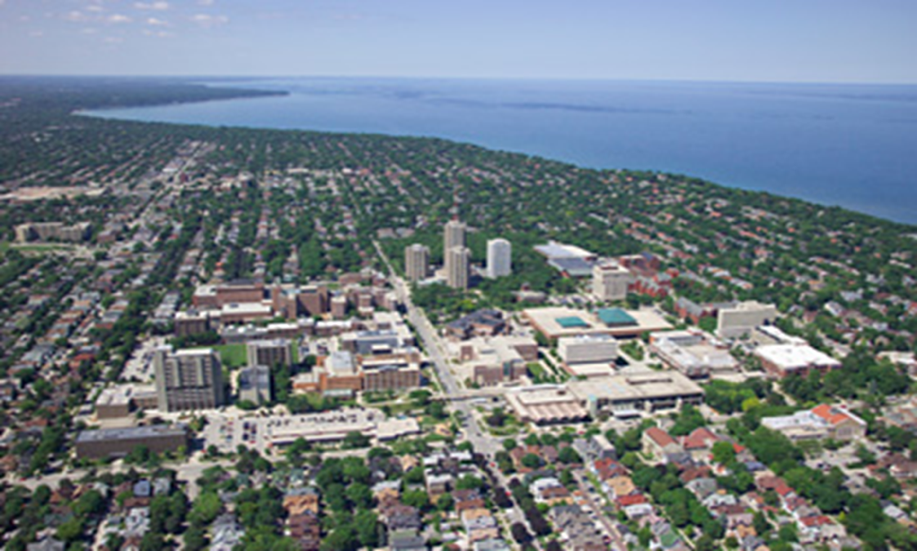
ProQuest- Step by Step
Helpful Screenshots for Submitting your
Thesis or Dissertation to ProQuest
at the University of Wisconsin-Milwaukee

Slide 2
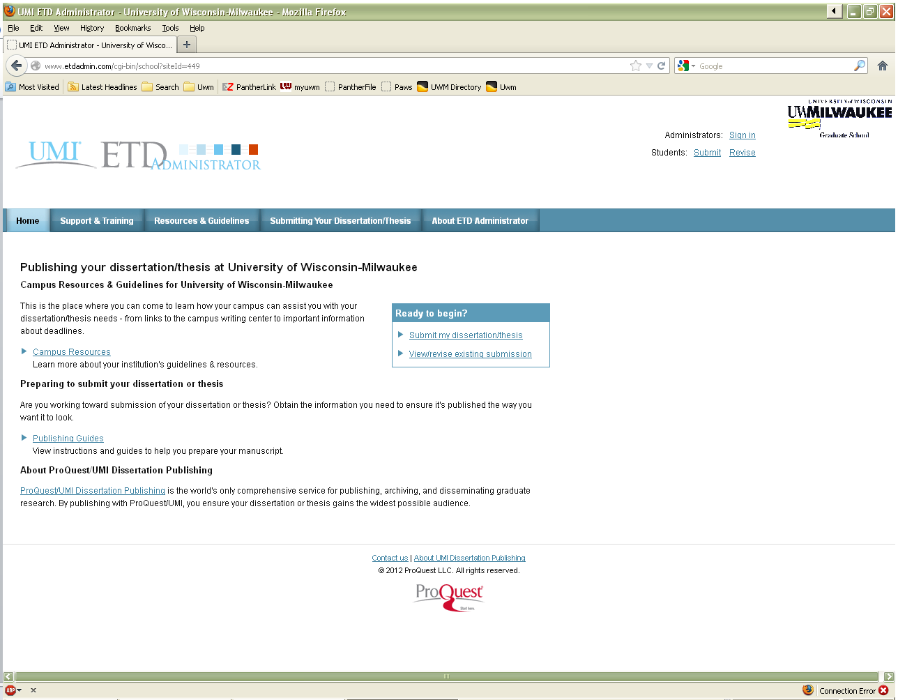
To create an account or sign in, use either of these links.
To create an account or sign in, use either of these links.
To create an account or sign in, use either of these links.

Slide 3
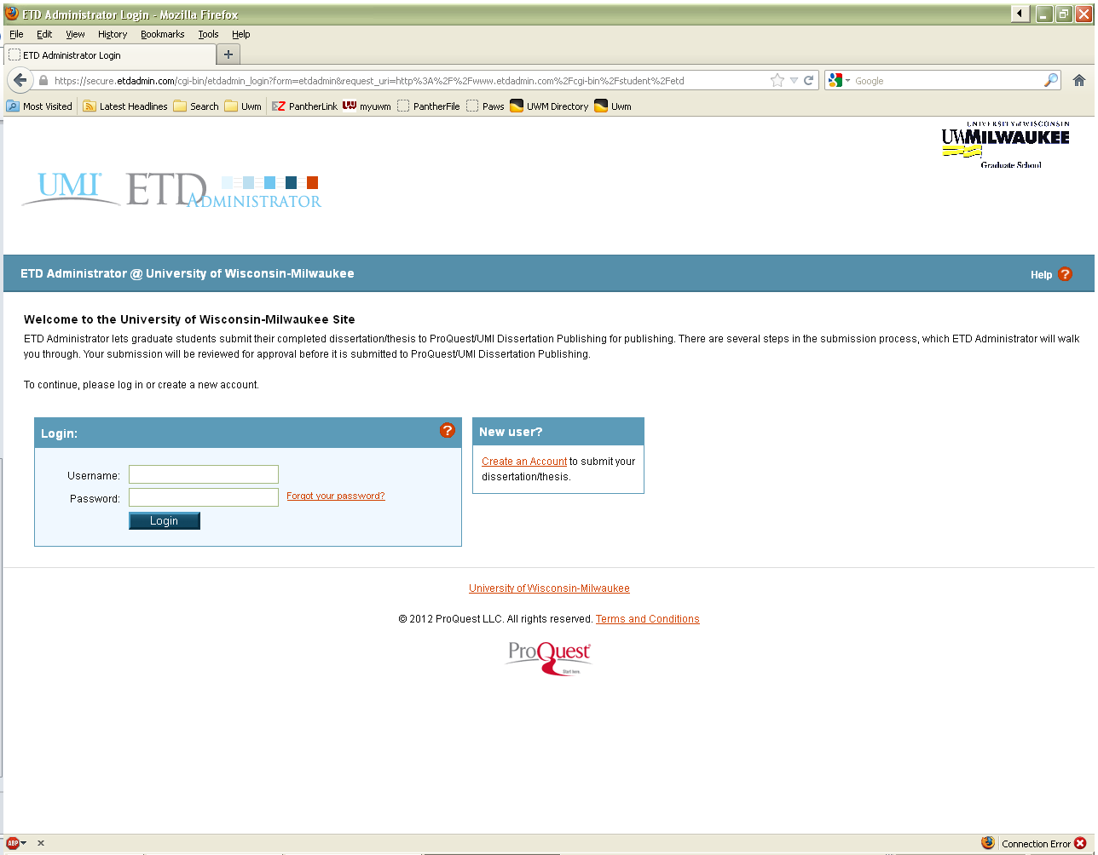
Use this link to Create an Account
Use this spot to Login once you’ve created your account

Slide 4
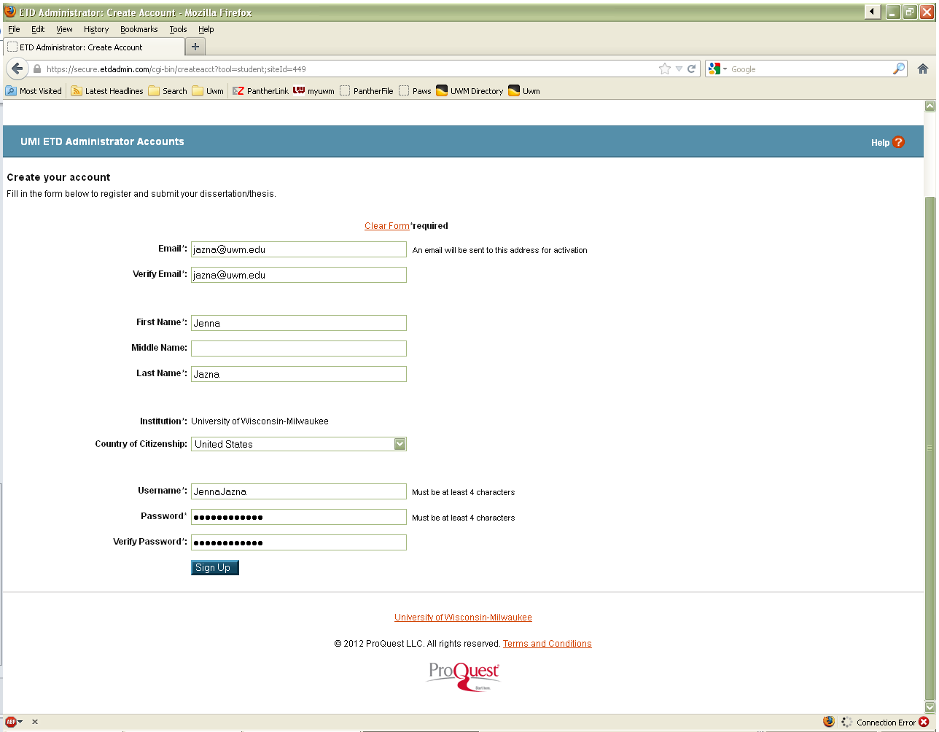
Fill in the required fields
Click to Sign Up when form is complete

Slide 5
You must activate the new ProQuest account using the link sent to your email account

Slide 6
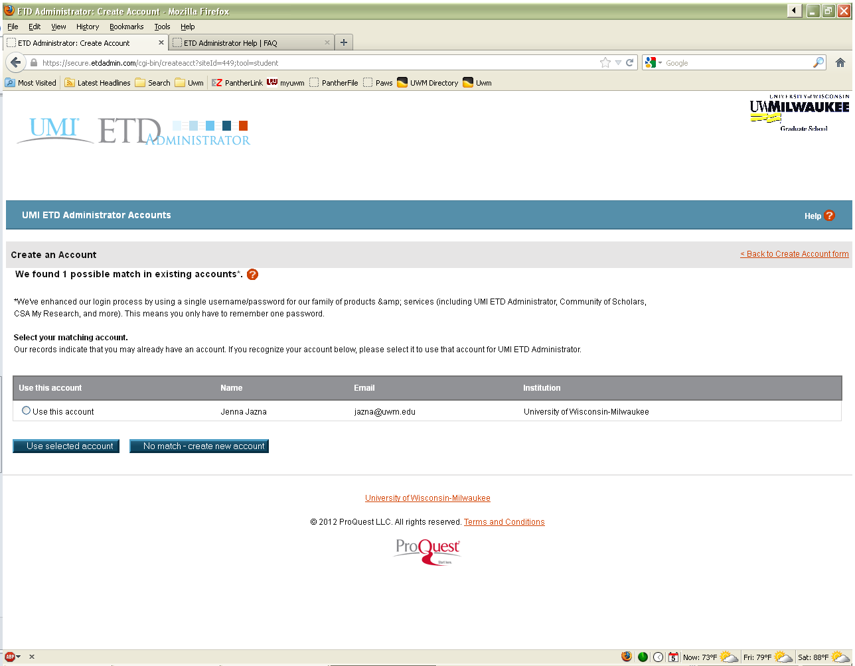
If you get this screen, you may have already created your account!
Please examine the possible matches carefully and then choose the appropriate action!

Slide 7
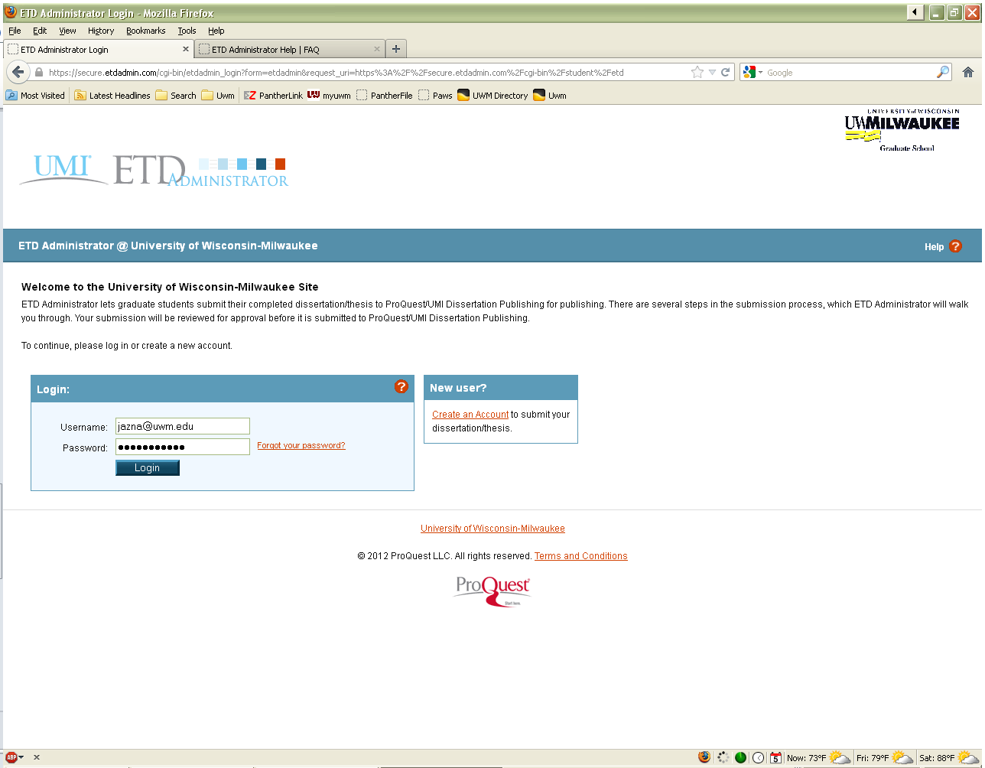
After creating your account, this screen will appear again.
Make sure your Username and Password are entered and click Login

Slide 8
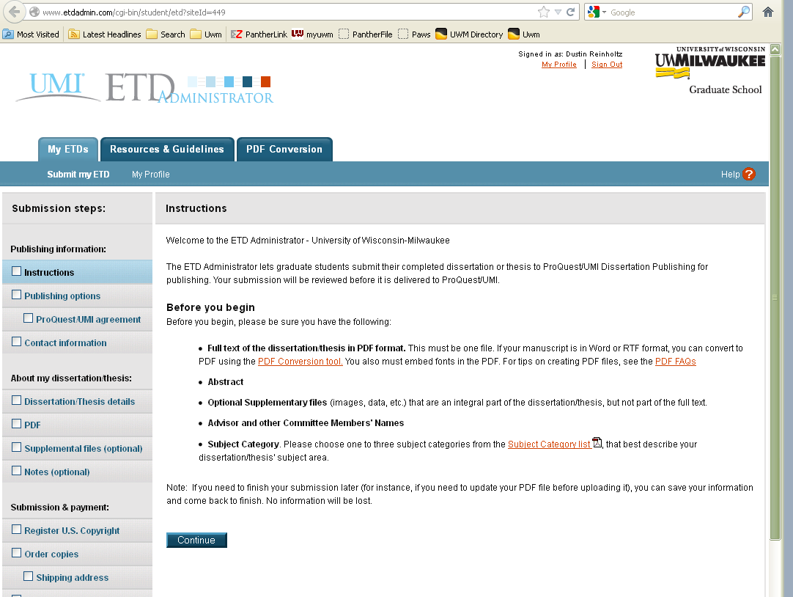
Read the instructions; use any links in orange for more help
Click Continue when you are done reading the instructions

Slide 9
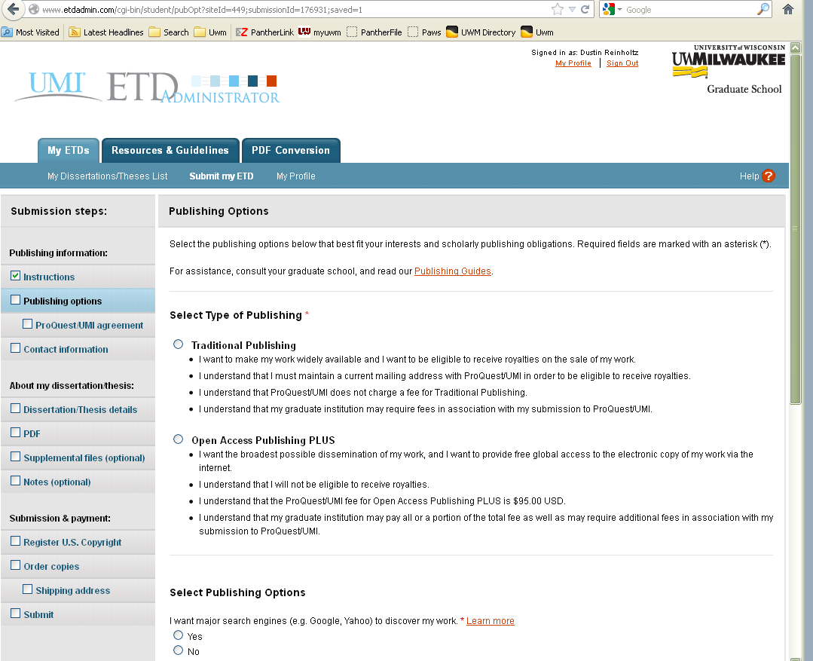
Submission Steps are automatically checked off when complete
Choose type of Publishing

Slide 10
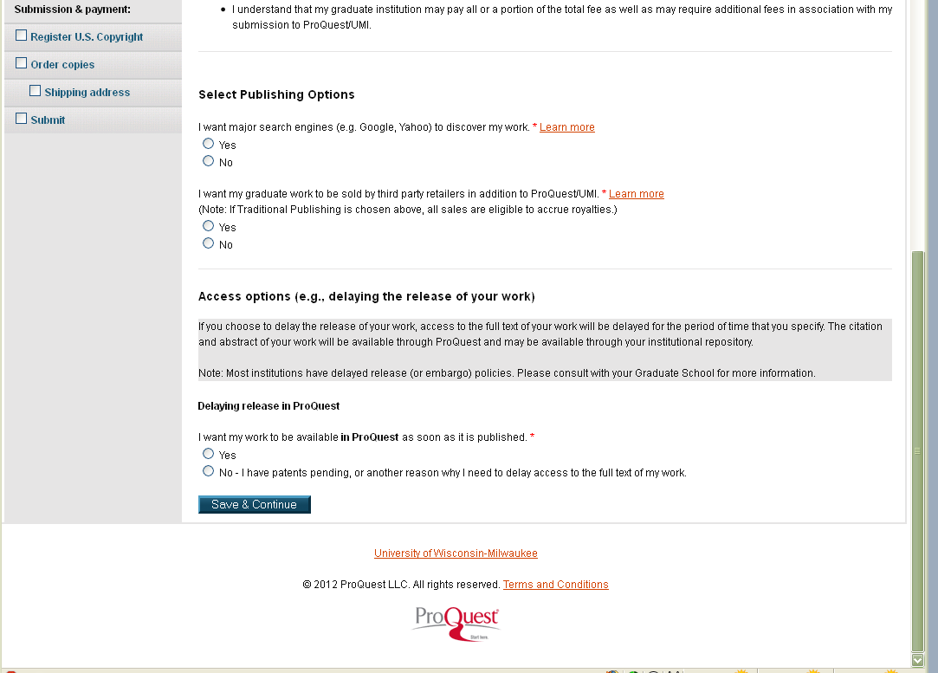
Click here to Save & Continue

Slide 11
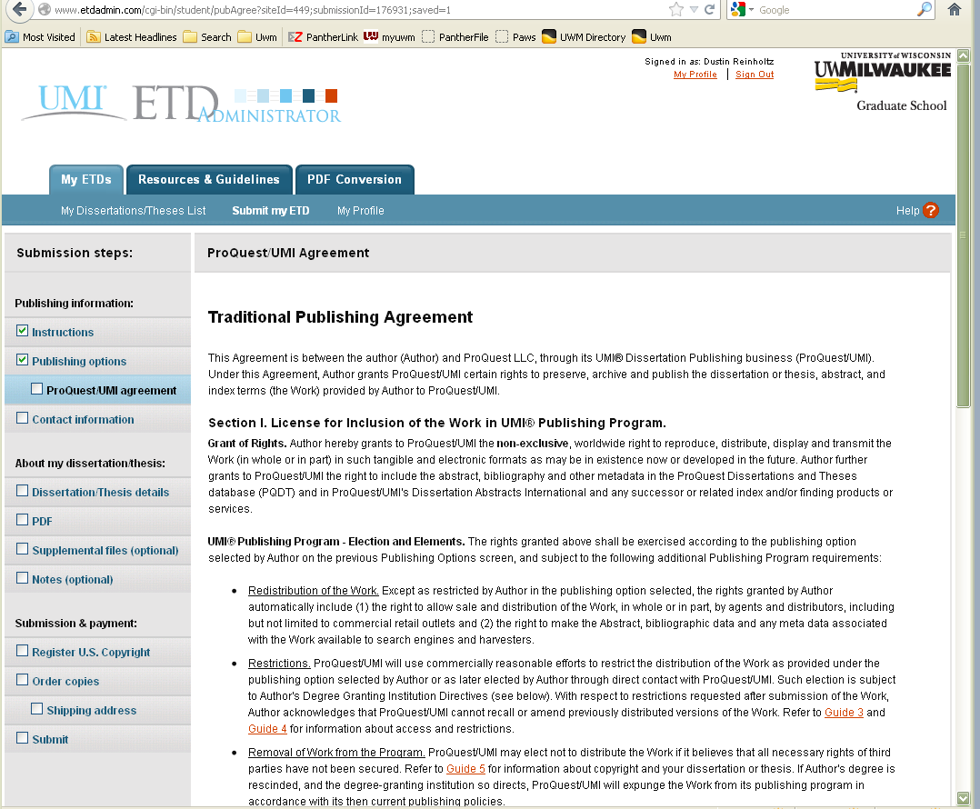
Read about your choice

Slide 12
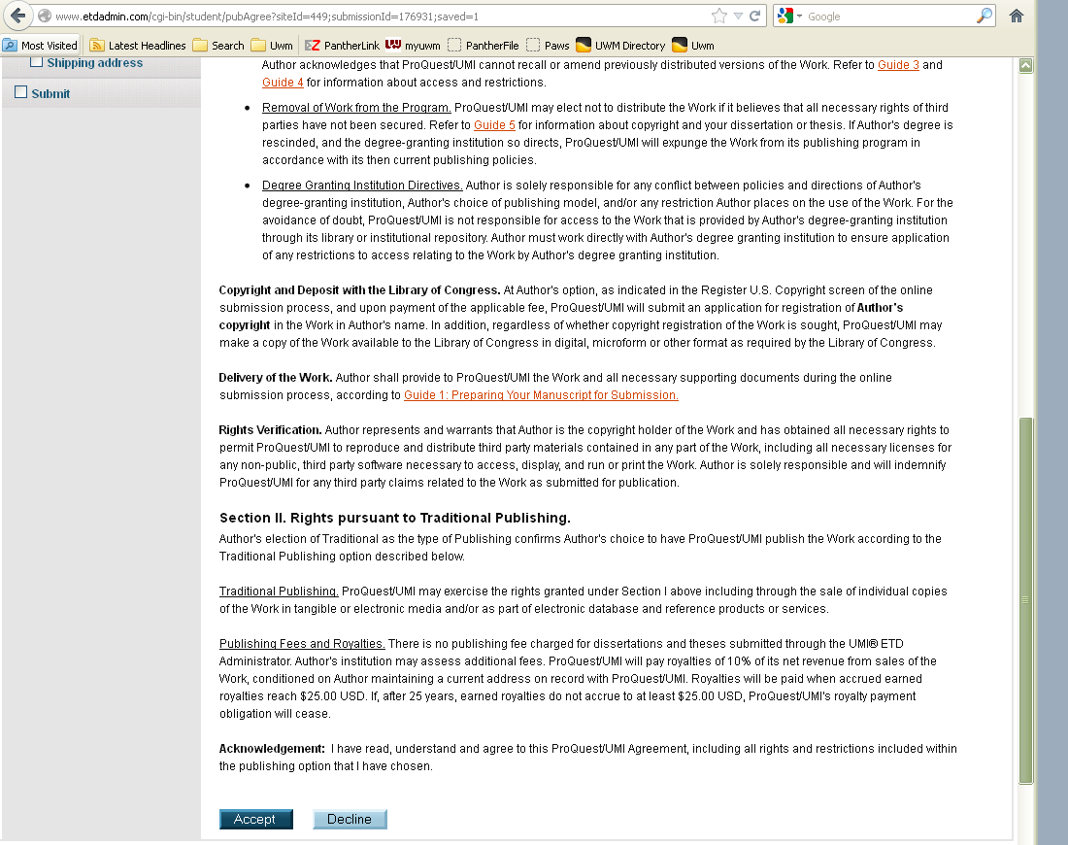
Click here to Accept or Decline

Slide 13
Fill in the required (and optional) fields

Slide 14
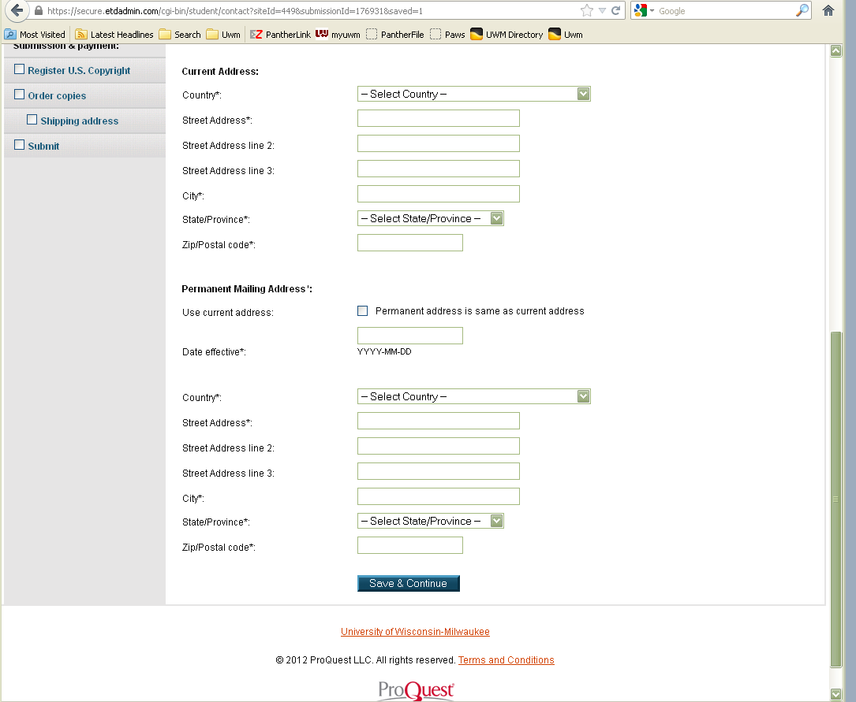
Fill in the required (and optional) fields
Click here to Save & Continue

Slide 15
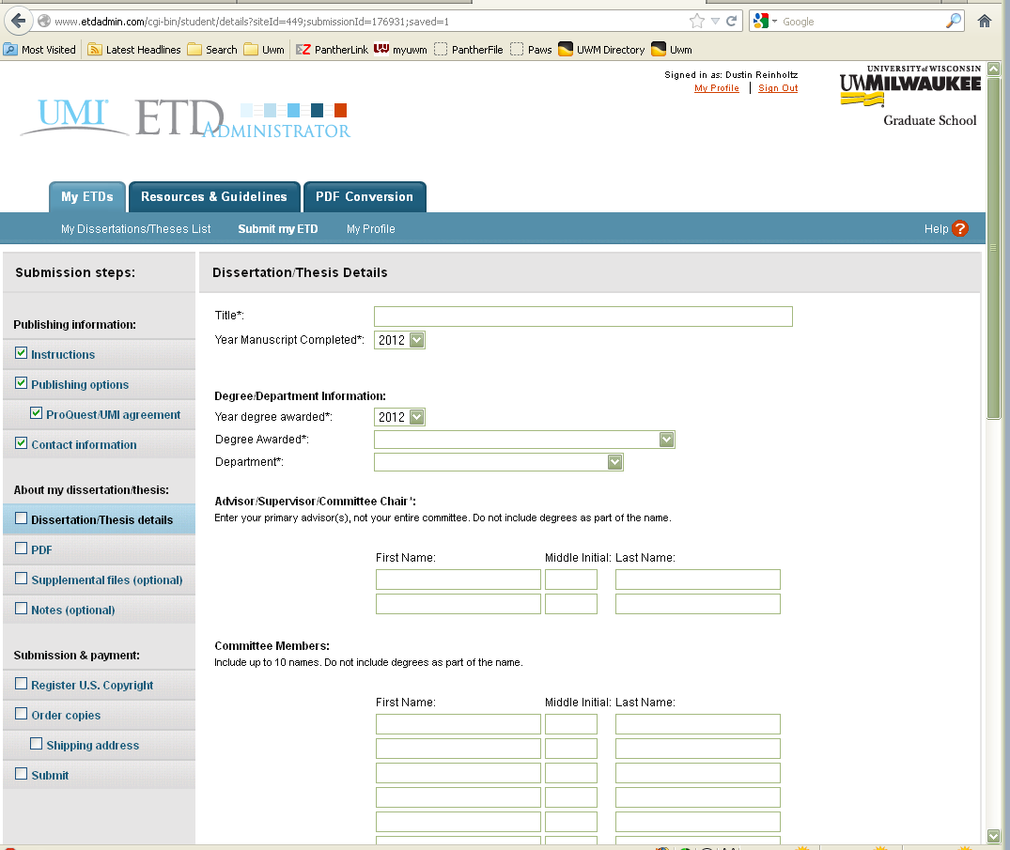
Fill in the required (and optional) fields

Slide 16
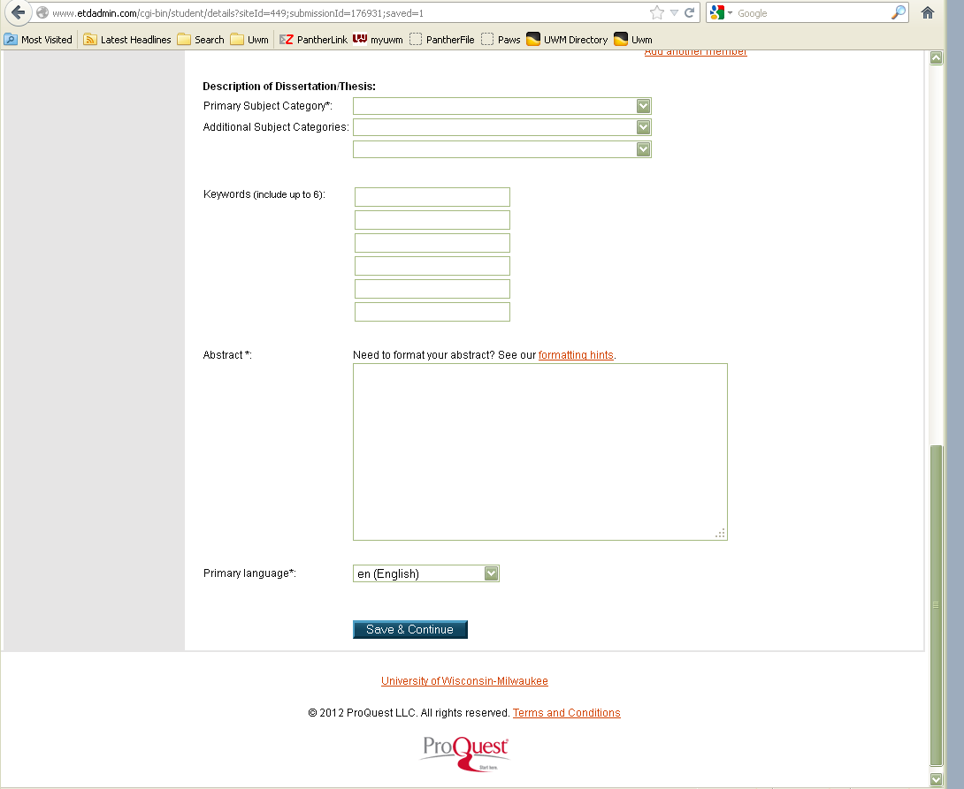
Fill in the required (and optional) fields
Click here to Save & Continue

Slide 17
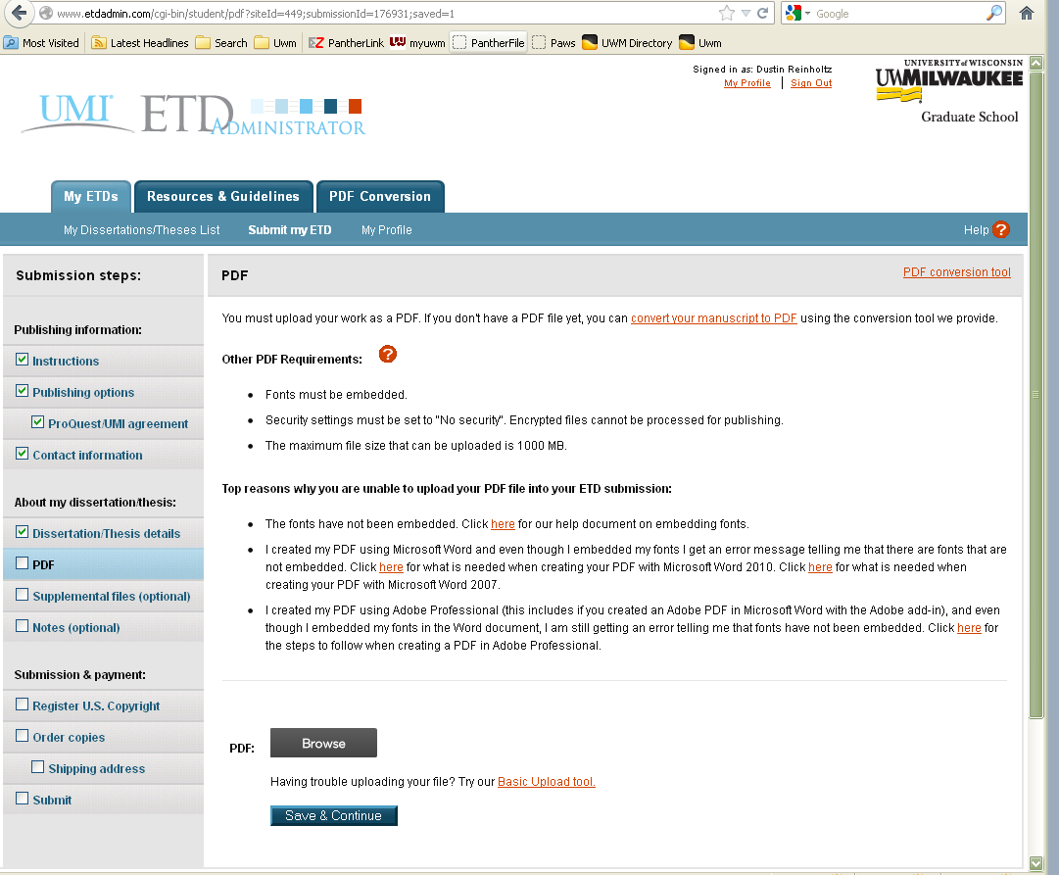
Click here to Browse your computer for the PDF version of your thesis / dissertation to upload.
Click here to Save & Continue

Slide 18
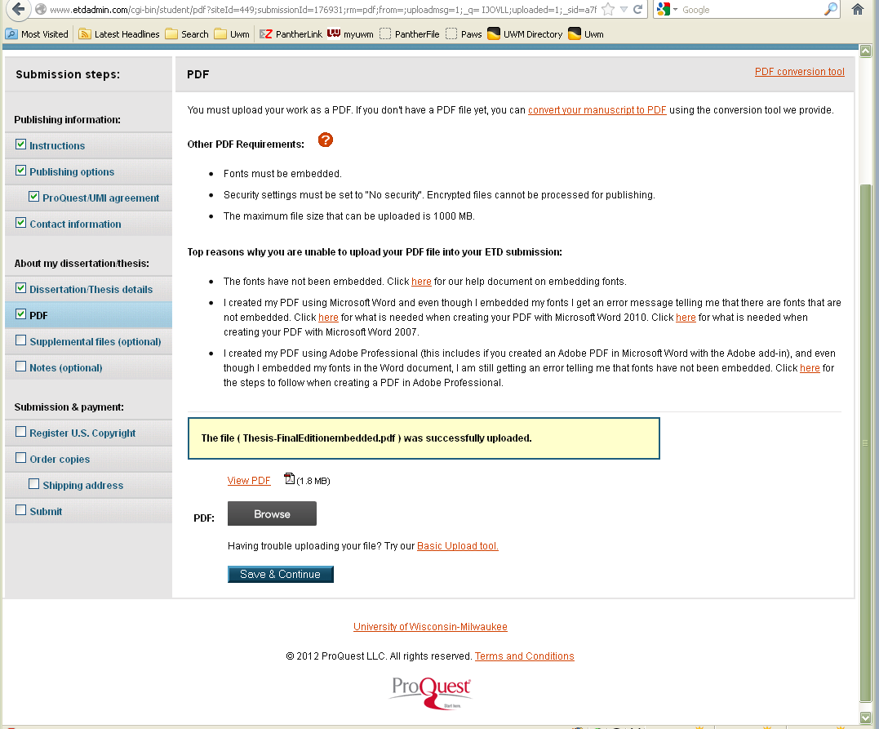
This tells you the upload was successful! ☺

Slide 19
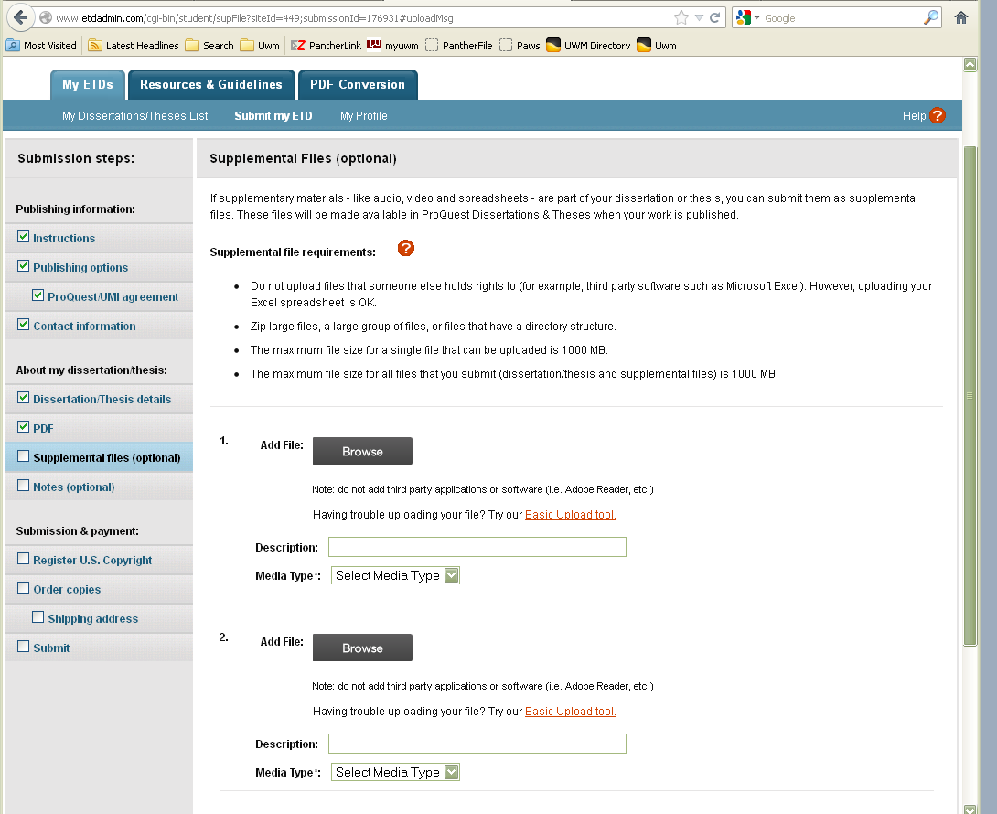
Upload if Desired

Slide 20
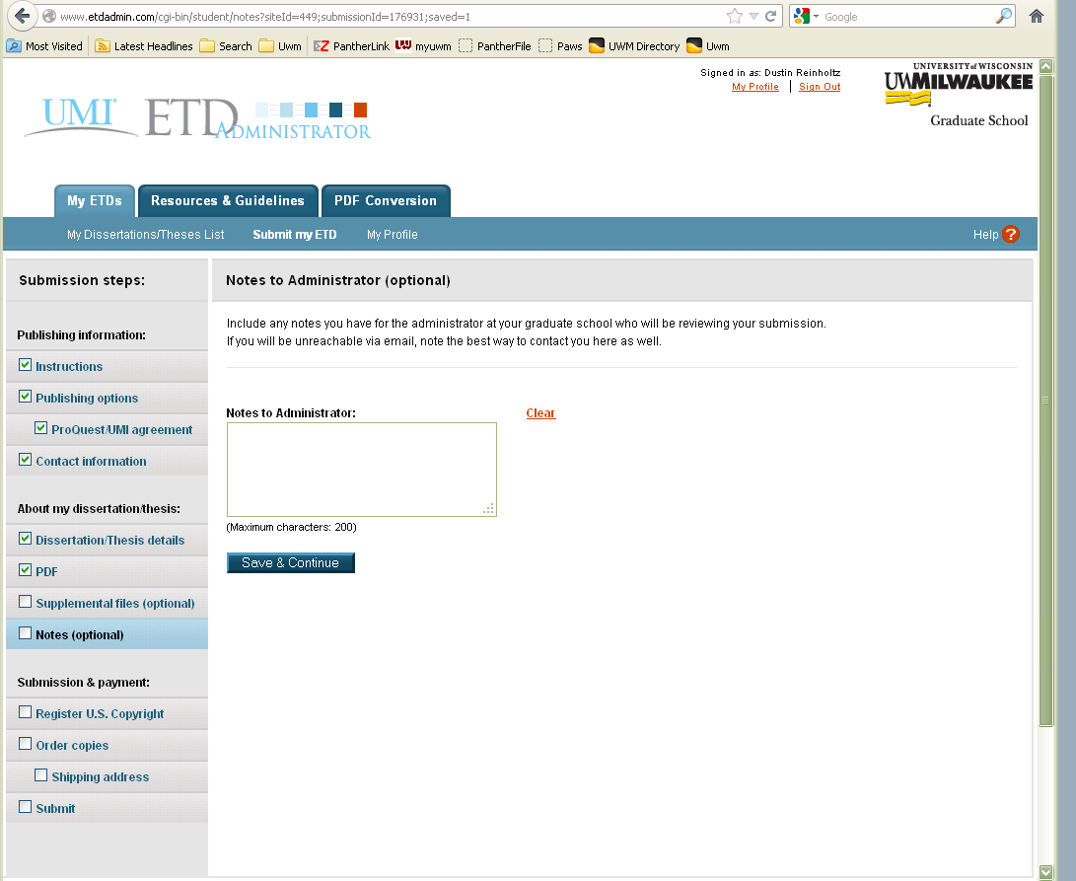
Great Place to Tell Us Information
Contact phone number
Embargo Notes
Click here to Save & Continue

Slide 21
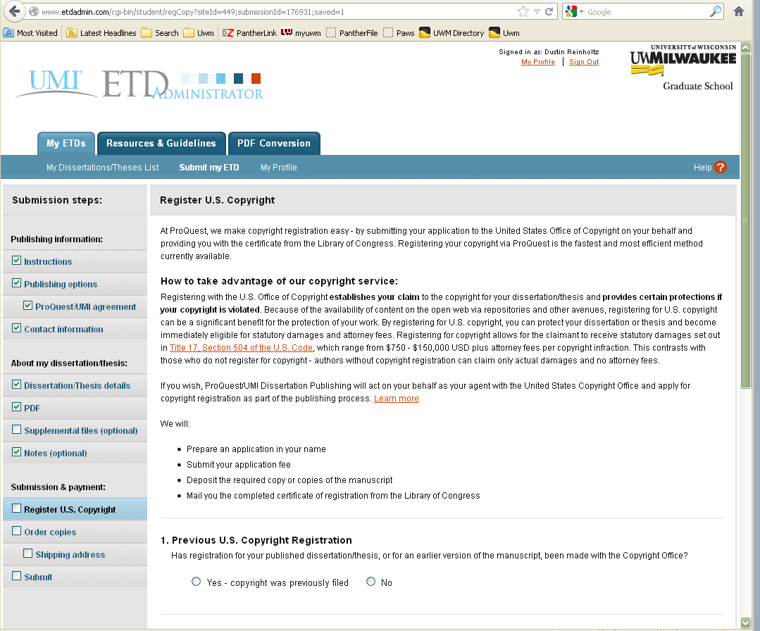
Notice that “Optional” Items get Checked Off only if utilized

Slide 22
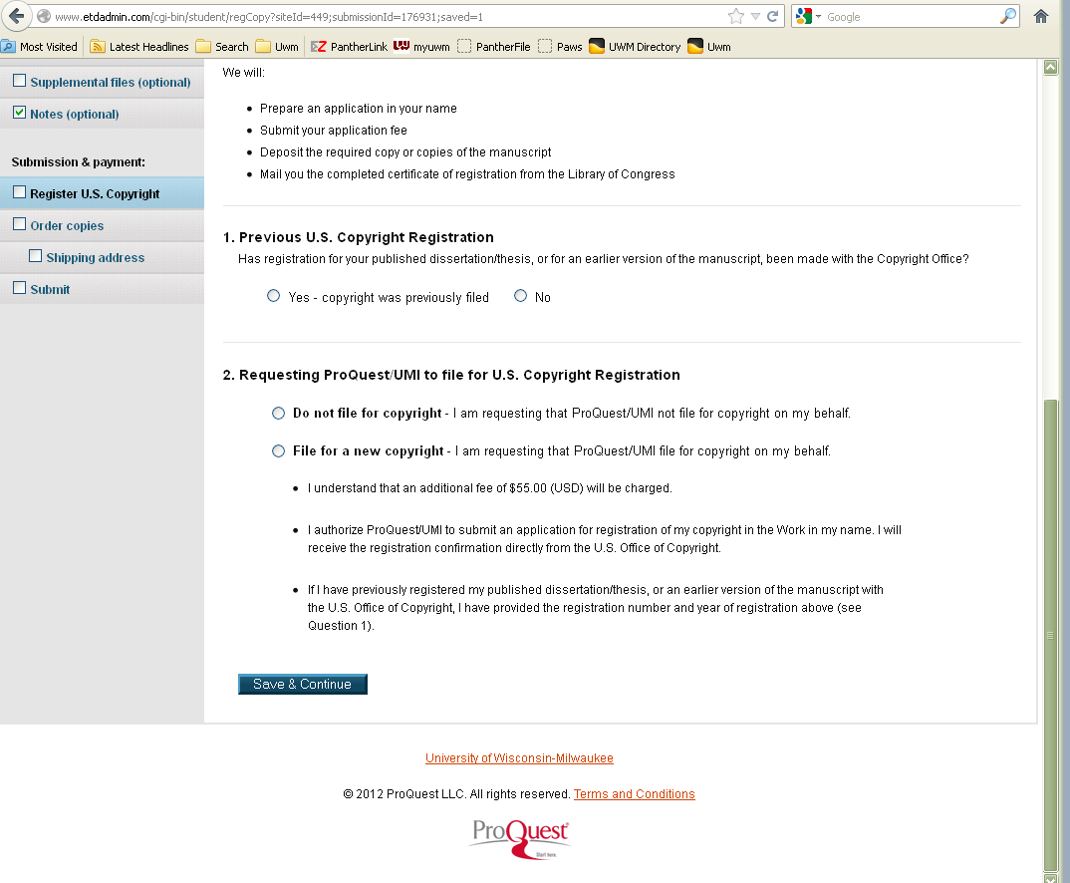
Fill in the appropriate fields
Click here to Save & Continue

Slide 23
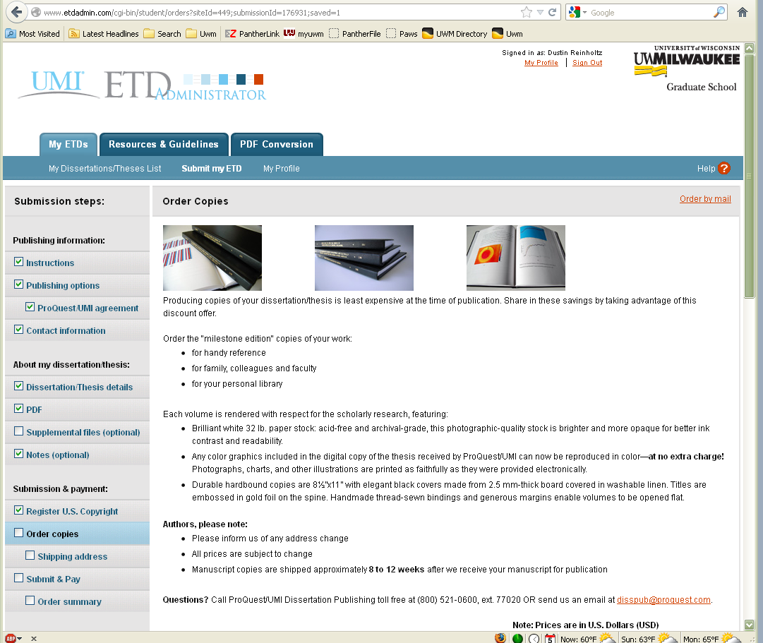
Can be ordered NOW or LATER

Slide 24
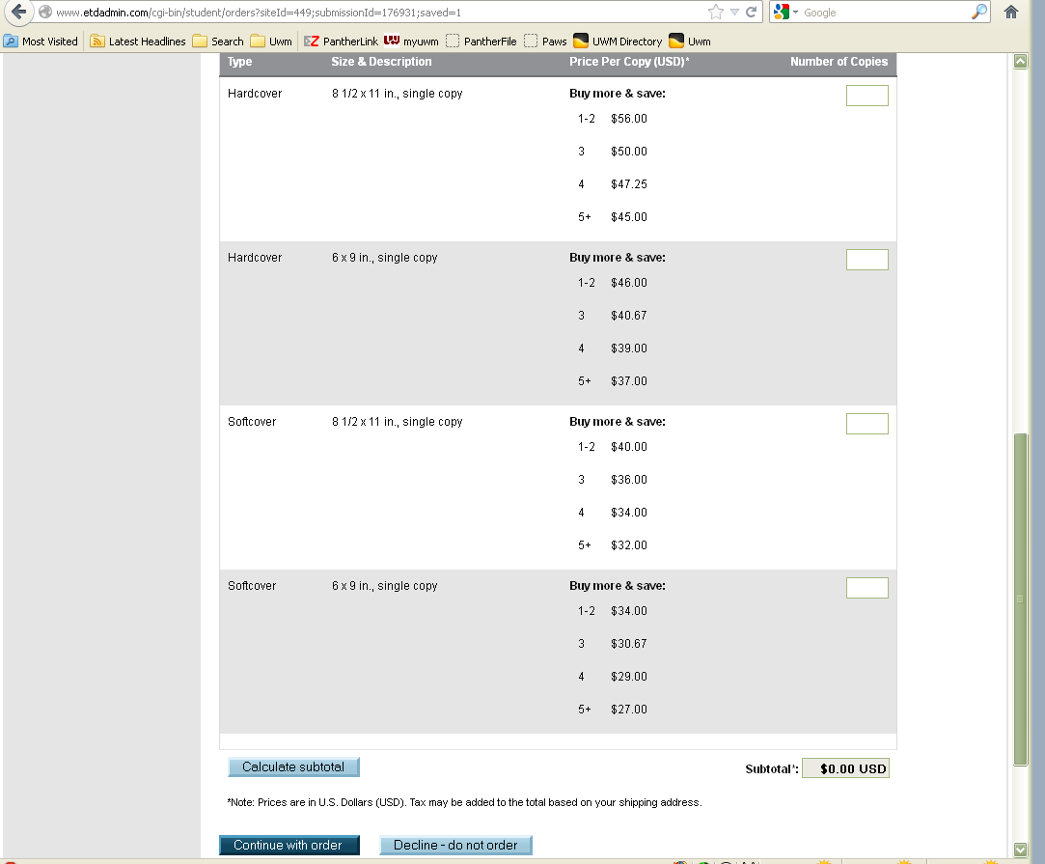
Choose here!

Slide 25
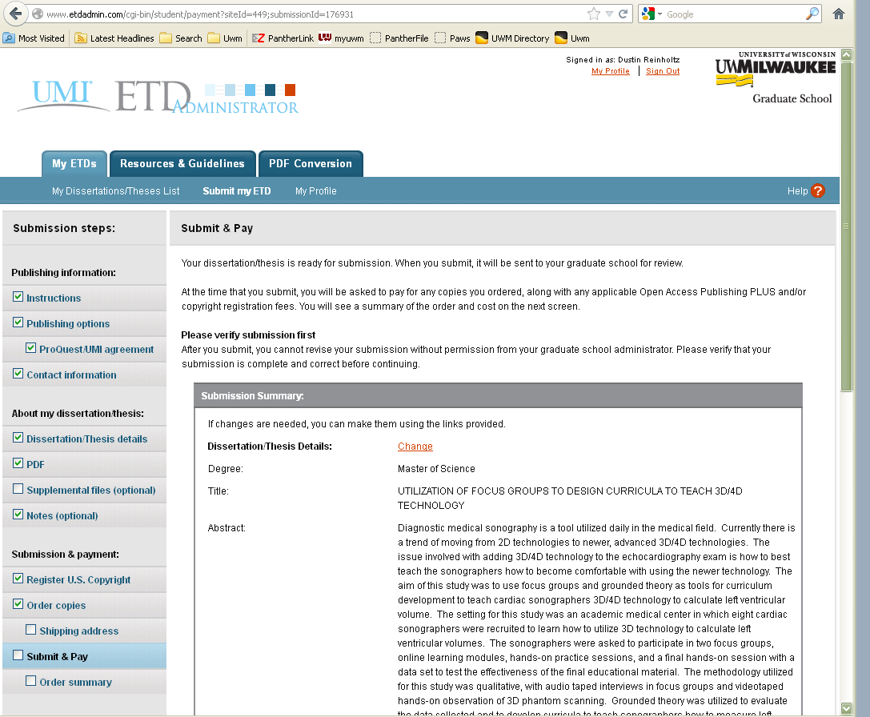

Slide 26
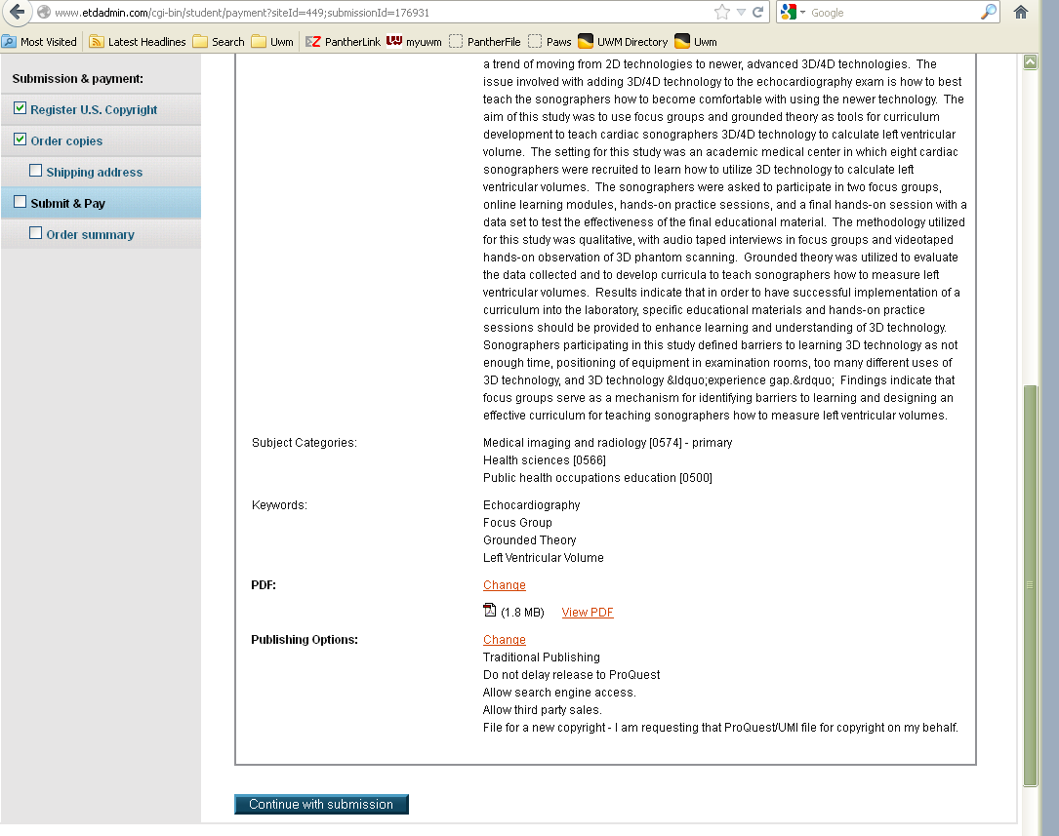
Click here to Continue after checking everything

Slide 27
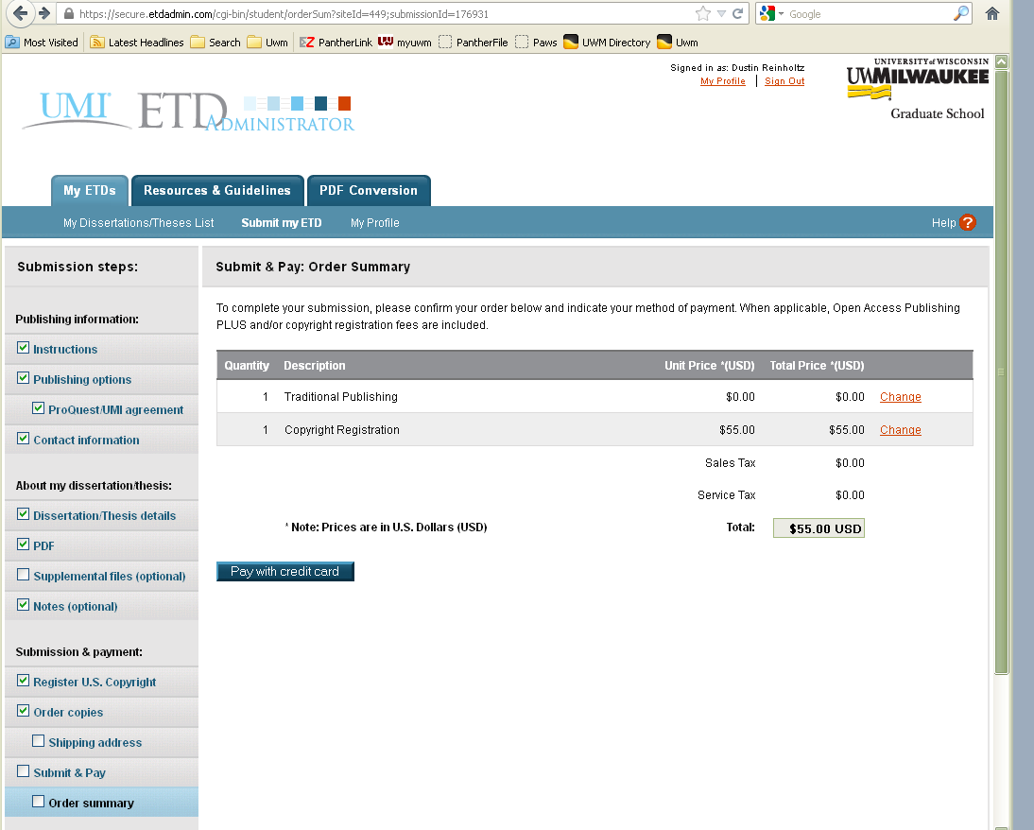
Click here if you have to pay for any products or services

Slide 28
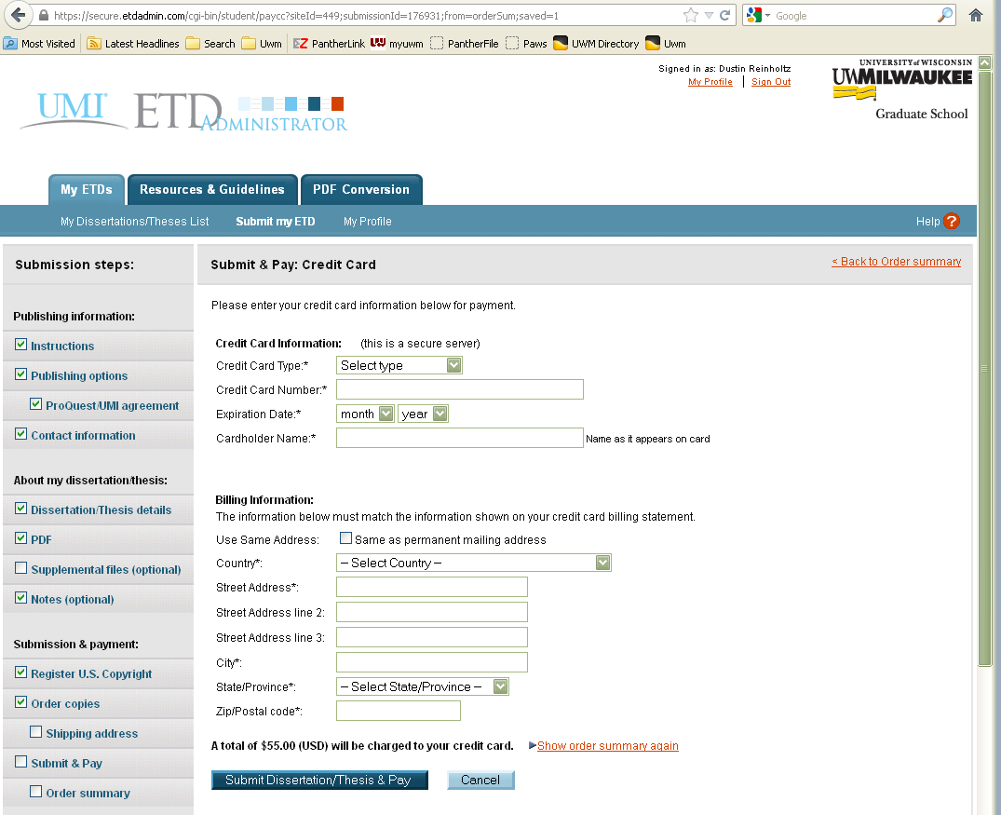
Fill in the required and make sure it is correct before clicking Submit & Pay

Slide 29
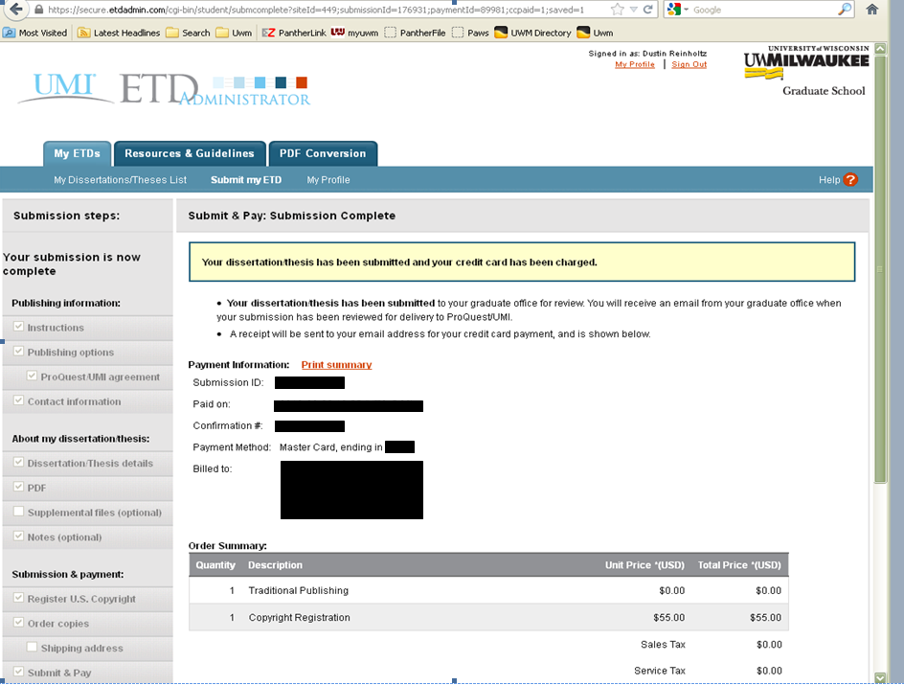
This tells you it was successfully submitted! ☺

Slide 31
This is the screen you WANT to see! ☺
Be sure to Sign Out when you are finished

Slide 32
Thank you for your attention during this PowerPoint Presentation

