Slide 1
Global Water Modules
Module 8:
Water and Global Health
Accessible, vetted, and modifiable learning modules for faculty on global water security, connecting local and global, developed by Jenny Kehl, PhD. Made possible by UWM, CIE, GS, IS
National Resource Center
Center for International Education
Global Studies
International Studies

Slide 2
Global Water Modules
Module 8:
Water and Global Health
National Resource Center
Center for International Education
Global Studies
International Studies

Slide 3
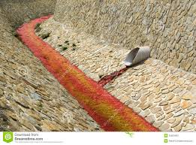
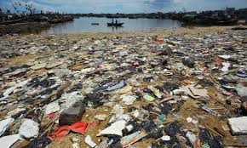
Drinking contaminated water, results in hundreds of types of illnesses, is the leading cause of death worldwide.
Water and Global Health

Slide 4
Water-related illnesses do not discriminate, they can make anyone who consumes polluted or contaminated water painfully sick. or cause a public health crisis.
However, access to clean safe water is not equally distributed.
Recall as an equity issue: the poor are more likely to suffer health crises as a result of degraded environment and lack of access to safe water for drinking, cooking, cleaning and sanitation; and suffer from more frequent water-borne illnesses and cancer clusters.

Slide 5
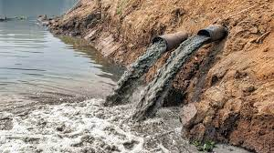
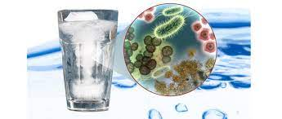
1.5 million deaths per year from diarrhea. 88 percent of diarrhea deaths could be prevented by access to safe water and sanitation.

Slide 6
Case of Intestinal Helminth Eradication Program:
Intestinal worms infect 1 of 3 people worldwide,
about 2.1 billion people.
Worms cause anemia, malnutrition (poor protein absorption), abdominal pain, illness of the liver and spleen.

Slide 7
Intestinal Helminth Eradication Program
in Ecuador:
99% of infection can be prevented by low-cost single-dose pill,
75 schools were given different treatment programs (about 30,000 students).

Slide 8
School Group 1 (25 schools):
Medical – free pills every six months.
Behavioral – teaching children hygiene in school programs, disallowing bathing or fishing in nearby lakes or rivers.
Socio-environmental - getting access to running water, installing toilets and sinks, giving pills to nearby animal farms, employing and training people in the community to administer pills.

Slide 9
School Group 2:
Medical – free pills every six months.
School Group 3:
No prevention or treatment.

Slide 10
Results: No Surprises –
School Group 1 reduced infections by 40%.
School Group 2 reduced infections by 7%.
School Group 3 did not reduce infections.

Slide 11
Results: Surprises: Positive Externalities -
Infection was reduced in nearby areas that were not given pills.
Cost-Effectiveness – the pills cost about 49 cents USD, and improved DALY by 23%.
Cost-Effectiveness – $12-15 per DALY saved.
Cost-Effectiveness – reduced work-days lost by adults, increased overall productivity.

Slide 12
The World’s Largest Mass Poisoning
“The largest mass poisoning of the population in history” World Health Organization (2000).
The use of contaminated tube well water and the health crises of arsenic poisoning.

Slide 13
The World’s Largest Mass Poisoning
Hundreds of millions of people drink untreated surface water polluted with sewage, human and animal waste, toxins, and lethal diseases such as cholera and typhoid.
Deep underground water is almost universally safe, it has not been exposed to human waste and contaminants.
There are tens of millions of tube wells to reach safe underground water. But most of them have deadly failures

Slide 14
Serious Problems:
Many installers decided not to test water – lack of oversight, accountability, responsibility.
Almost all installers claimed to have tested the water but villagers reported they did not.
Many installers did not have the right equipment to test the water.
Many wells were installed to 60-300 feet, the depth at which arsenic can be suspended.

Slide 15
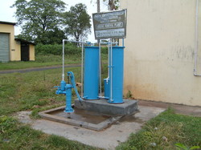
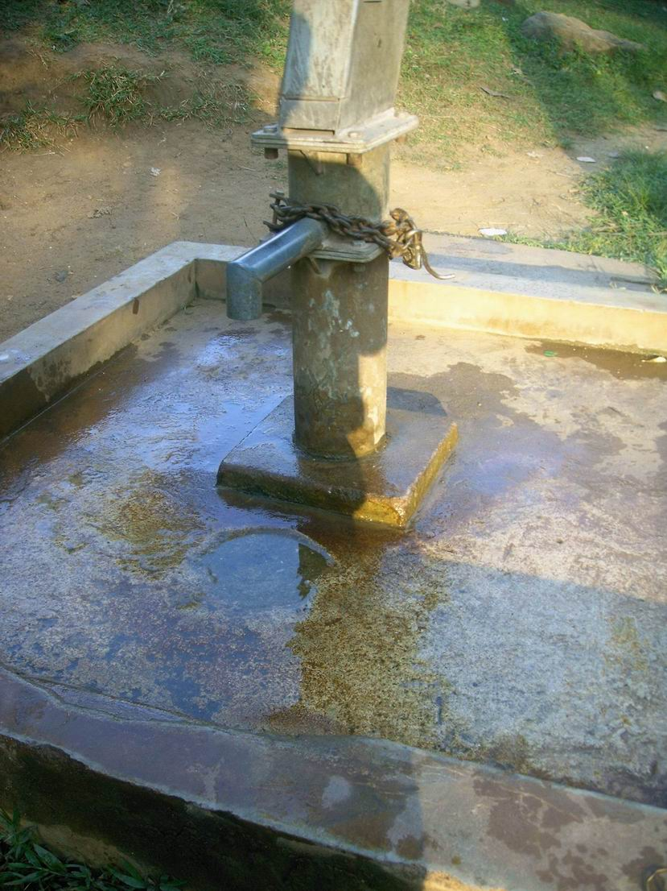
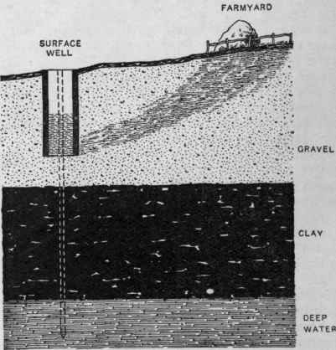
Tube Well

Slide 16
Tens of millions of people are affected by worldwide mass arsenic poisoning.
Arsenic causes illness, organ and tissue degeneration, organ failure, cancer
It is estimated that 60 million people in India are affected
There have already been over 1 million deaths in China as a result of tube well arsenic
A wide variety of countries report large numbers of deaths: India, China, Bangladesh, Vietnam, Uzbekistan, Ethiopia

Slide 17
Ongoing Problems:
Arsenic is a cumulative poison, it builds over time, so many tens of millions more people will die of arsenic poisoning in the future.
Almost any of the tens of millions of tube wells could be delivering lethal concentrations,
each well should have been – and still needs to be – tested. Contaminated wells need to be extended past 300 feet.

Slide 18
There is a simple kit that can test for arsenic in water, has color coding, and costs 10 cents.
As a few villages get ahold of this kit, they are demanding that governments fix the problem.

Slide 19
Corrupt national and local governments steal the foreign aid money given to fix the problem. Example – Bangladesh was given $32 million from WB to fix the wells, but only spent $7 million of it. The rest is missing.

Slide 20
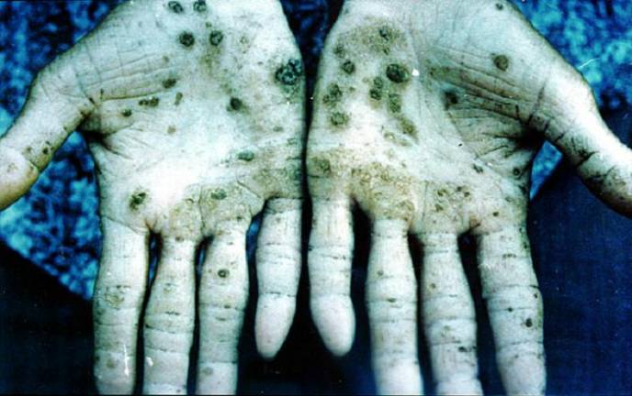
Arsenic in Water

Slide 21
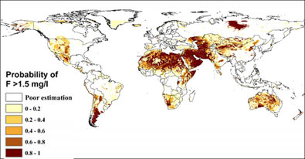
Arsenic in water

Slide 22
Note: Drinking polluted surface water is still worse than drinking arsenic underground water, surface water kills more quickly.

Slide 23
Conclusion
Contaminated drinking water is the leading cause of death worldwide. Drinking polluted surface water or contaminated well water can cause organ damage, organ failure, multiple other effects of poisoning, cancer, neurological damage, and cumulative damage that builds up over years and cannot be treated.
Some of the most common and most deadly water-related illness, such as diarrhea, are medically easy and economically affordable to treat, and widespread treatment could save tens of millions of lives each year.

Slide 24
Global Water Modules
Module 8:
Water and Global Health
Accessible, free, and modifiable learning modules for faculty on global water security, connecting local and global, developed by Jenny Kehl, PhD. Made possible by UWM, CIE, GS, IS
National Resource Center
Center for International Education
Global Studies
International Studies

