Slide 1
Global Water Modules
Module 7:
Water Security in MENA
Part 2:
Yemen and Iraq
Accessible, vetted, and modifiable learning modules for faculty on global water security, connecting local and global, developed by Jenny Kehl, PhD. Made possible by UWM, CIE, GS, IS
National Resource Center
Center for International Education
Global Studies
International Studies

Slide 2
Global Water Modules
Module 6:
Water Security in the MENA
Part 2:
Yemen and Iraq
National Resource Center
Center for International Education
Global Studies
International Studies

Slide 3
Water Crisis in Yemen
“Yemen's water crisis eclipses al Qaeda threat”
Reuters 2019

Slide 4
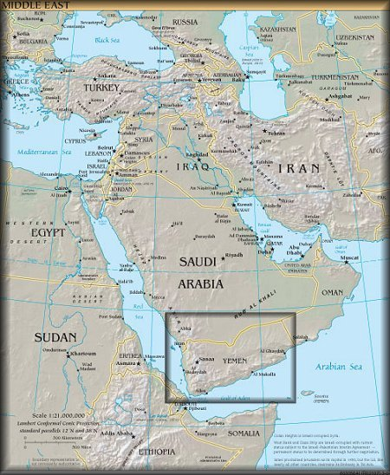
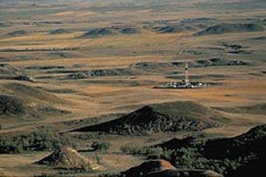
Water Crisis in Yemen

Slide 5
70-80% of violent disputes in Yemen are over water (Sanaa University, Yemen 2009).
Yemen has no surface water other than rain and spate water (temporary water on the surface after a large rain).
All other water comes from ancient aquifers underground, which have been extracted more quickly than recharge.

Slide 6
People in the capital Sanaa get water for 2-4 hours every 1-41 days (average 9 days).
People have to buy water, trucks have water for 3-4 hours every day.
Water costs approx. 30% of total income.
Aquifers / water table has dropped to below 1800 feet in most areas.
Water mining is now done with large oil drill rigs.

Slide 7
"Unlicensed drill rigs are like heavy weaponry in the hands of terrorists," says Water Minister Abdul Rahman al-Iryani.
"They don't kill people immediately, because their impact is delayed, but water shortages will take a deadly toll within the next generation.”
(2010 Pulitzer Center on Crisis Reporting)

Slide 8
Security concerns:
1. Extreme instability from water scarcity, water riots, violent water conflicts,
2. Al Qaeda has had a large resurgence in Yemen, it is gaining ground due to scarcity: A. water scarcity creates the cover of chaos
B. scarcity delegitimizes govt (govt has not capacity to meet needs)
C. desperation makes people vulnerable to Al Qaeda

Slide 9
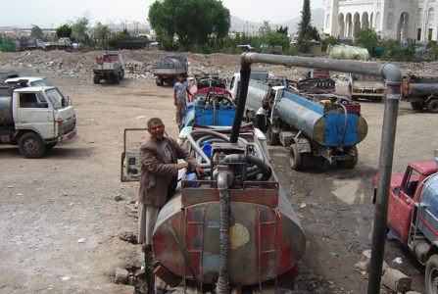
Water Trucks in Sanaa, Yemen

Slide 10
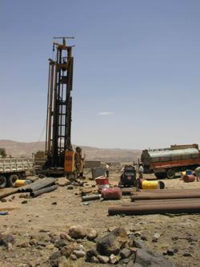
Water Mining, oil equipment to mine water

Slide 11
Water Crisis in Iraq:
2 million people short of water

Slide 12
Iraq gets most of its water from Tigris and Euphrates, which flow from Turkey.
Shortages in Tigris have meant no water or salt water encroachment:
"We can no longer drink this water," said one local woman from the village of al-Fal. "Our animals are all dead and many people here are diseased” (AP Iraq 2009).

Slide 13
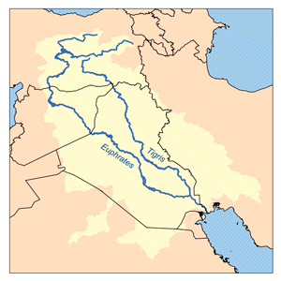
Turkey
Syria
Iraq

Slide 14
One of the main water problems in Iraq:
Marshes are one of the only natural reserve sources of fresh water.
Junction of the Tigris and Euphrates rivers, between Baghdad and Persian Gulf.
Marshes are being altered by: 1. Overuse
2. Decline of flow from Tigris Euphrates
3. Saline encroachment
4. Destruction by Sadaam Hussein

Slide 15
During and after Gulf War I, Iraqis in the Al-Hawizeh marshes (people called Madan) rebelled against Saddam Hussein.
In retaliation for the rebellions, Saddam built large drainage systems to destroy the marshes.

Slide 16
Map of
Al-Hawizeh

Slide 17
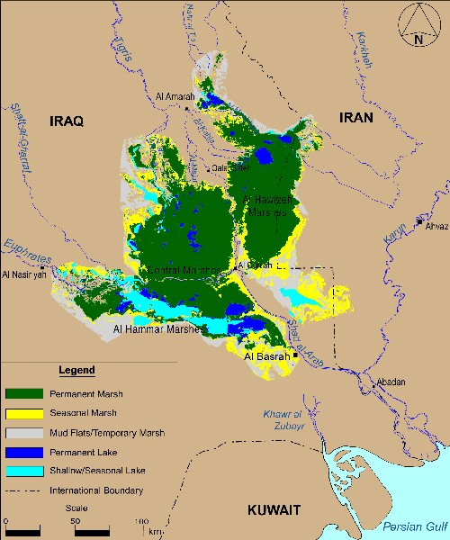
Map of
Al-Hawizeh
1973

Slide 18
Map of
Al-Hawizeh
2000

Slide 19
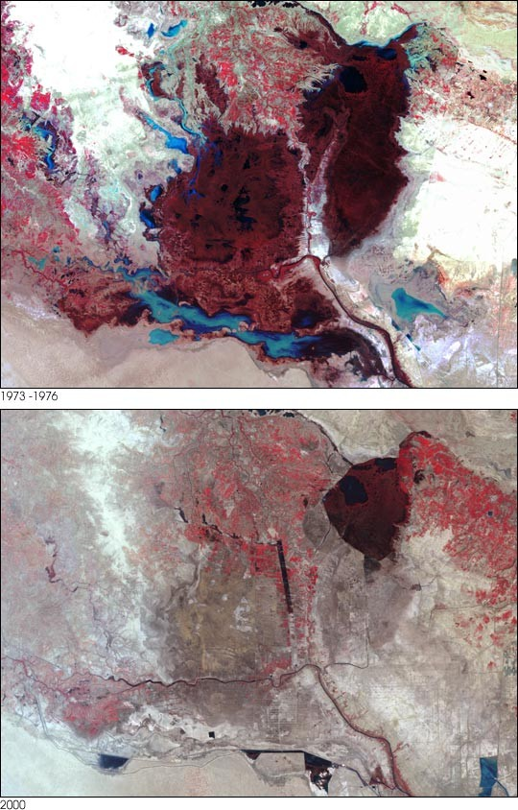
Al-Hawizeh 1970s
Al-Hawizeh 2000

Slide 20
Importance of the Al-Hawizeh marshes:
Provided 60% of Iraq’s fish, most of the rice, and many agricultural goods.
Livelihood of Madan.
Prevented quality soil from eroding and flowing to the sea.
Block salt water from entering.
Decrease the impact of natural disasters (storms from sea, floods, droughts)

Slide 21
Saddam dug drains to empty the marshes, built canals to divert the Tigris and Euphrates.
By 2000, 90% of the marshes were destroyed.
The destruction was “a major ecological disaster, comparable to the deforestation of Amazonia.” (Toepfer, Director of UNEP 2001)

Slide 22
After Gulf War II, U.S., Iraq, Scandinavia, parts of EU are cooperating to revive the marshes.
“They are planning the largest and most ambitious recovery of a lost wetland ever attempted.” (Pierce 2005 through 2021)

Slide 23
Conclusion
Water insecurity leads to political chaos, economic loss, and leaves populations vulnerable to radicalization or desperation. Will these circumstances lead to water wars?

Slide 24
Global Water Modules
Module 7:
Water Security in MENA
Part 2:
Yemen and Iraq
Accessible, free, and modifiable learning modules for faculty on global water security, connecting local and global, developed by Jenny Kehl, PhD. Made possible by UWM, CIE, GS, IS
National Resource Center
Center for International Education
Global Studies
International Studies

