Slide 1
Global Water Modules
Module 3:
Water and Equity
Part 2:
Equity Issues: Who owns the water?
Accessible, vetted, and modifiable learning modules for faculty on global water security, connecting local and global, developed by Jenny Kehl, PhD. Made possible by UWM, CIE, GS, IS
Center for International Education
Global Studies
International Studies

Slide 2
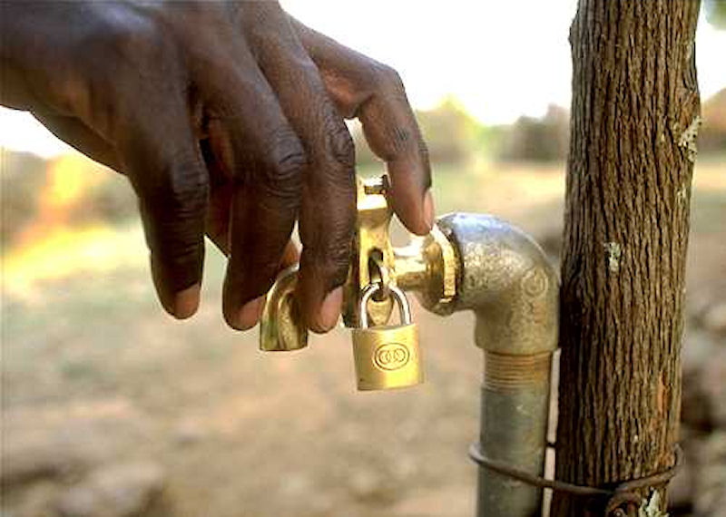
Water and Equity Part 2
The Wide Debate:
Water as a right versus water for profit.

Slide 3
Water as a right: water is a necessity for life, there is no alternative, water is part of the common good, rights incentive to conserve, it is like air.
Water for profit: water is an extractive industry and a service industry, water is not part of the common good, profit incentive – no incentive to conserve because scarcity increases profits, it is a commodity like oil.

Slide 4
The more specific debate: water as a right or a commodity: corporate control of water.
Water is a $1 trillion a year global industry,
1/3 larger than global pharmaceutical industry.
3 corporations control 75% of water service market:
Vivendi-Veolia (French)
Suez (French)
RWE-Thames (German) owns American Water and former Enron holdings.
This information is accurate as of 2020 but the actual revenues of theses corporations has not been reliable or verifiable since 2009.

Slide 6
The largest global concern is access to water. Access is increased if water is considered a right, access is decreased if sold as a commodity – dual dilemma for the poor:
water services and access are not extended to the poor (“follow the money”),
privatizing water sources and delivery makes water more expensive for the poor than the rich (“the poor pay more”).

Slide 7
One of the largest global concerns, next to access to water, is corruption:
A World Bank report “corruption is a systematic feature of privatization processes in water” (World Bank 1999-2019).
“The water privatization process itself can create corrupt incentives. A firm may pay to win a bid, get a low assessment of the property value… obtain kickbacks in subsidies, monopoly benefits, and regulatory laxness in the future” (World Bank 1999-2019).

Slide 8
Another of the largest global concerns is distortion of the capitalist incentives:
Water corporations can determine the amount of profit they want to make, and they can sue the country if they do not make that profit.
Water companies can demand to have monopolies.
Water companies have a perverse incentive – they make more profit if water is more scarce.

Slide 9
There is no accountability for pricing and quality decisions of water corporations. Examples:
In Morocco water prices are three times higher.
In Britain water and sewage bills increased 67% and water cut-offs increased 117%.
In South Africa water became unsafe, inaccessible, and unaffordable, caused a cholera epidemic.
In Chile, Suez demanded a 35% profit.
In Ghana poor people spend 50% of their income on water.

Slide 10
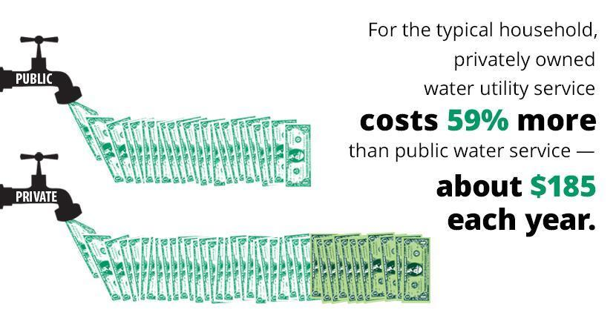

Slide 11
Example: The first major urban experiment in water privatization in the world, the city of Cochabamba.

Slide 12
Issue perspective and case study:
Who can “lease the rain?”
Bolivia was one of the first to “lease the rain,” meaning sell its water system to a private investor.
One firm bid on the privatization of the water system for the country of Bolivia:
Aguas del Tunari, a division of the
U.S. construction firm Bechtel.
The contract guaranteed the company a 17% profit.

Slide 13
In Cochabamba, Bolivia, the population at the time was 800,000people, 80% of them lived in poverty.
Eight weeks into the contract, Aguas del Tunari raised the water rates. The poor were now paying 30% to 80% of their income for water.
Allegations surfaced of political corruption and foreign domination.

Slide 14
Extensive water riots erupted across the country. Tens of thousands were protesting.
U.S. newspapers did not report the story at the time, not a single U.S. newspaper sent a reporter to the scene.
The situation did reach a small audience through the Internet, and newspapers caught up after two years.

Slide 15
Aguas del Tunari left Bolivia after only a few weeks when protests grew and were sustained by tens of thousands of people. Several protestors were injured, a few were killed (and a few died of their injuries), and many were tortured in prison. Bolivian govt announced a State of Emergency.

Slide 16
Aguas del Tunari left Bolivia without installing sufficient water infrastructure in those few weeks, had provided almost no additional water, cut-off many thousands of citizens from water, then sued the Bolivian government for $25 million in compensation for not being able to makes its expected profits in Bolivia.
The case was heard in Washington D.C. in an arbitration court of the World Bank. Aguas del Tunari won $25 million.

Slide 17
Protests for water equity in Cochabamba, Bolivia

Slide 18
A decade later, a 12-month UN investigation of 300 million people in Canada, U.S., Europe, Asia and Latin America shows that the results of water privatization “range from questionable to disastrous.”
It shows how “well-meaning governments …can become vulnerable to the persuasive techniques of these high-powered corporate water giants.” UN Report covered by CBC news.

Slide 19
As a result, many cities (235 cities worldwide) have taken on extensive legal challenges and succeeded in remunicipalizing their water services.

Slide 20
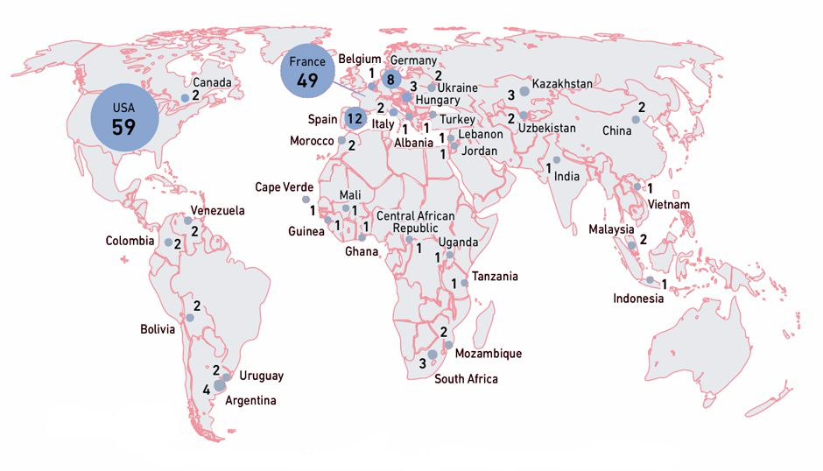
Remunicipalization: cities have reversed privatization of water, 2000-2020, 235 cities in 37 countries have resumed public control of water.
.

Slide 21
Conclusion
There is a large debate at both local and global levels about the equity issues evident treating water as a human right versus a commodity for profit. Widespread privatization of water services has resulted from this initial debate, with a modern and ongoing return to municipalization of water in many citites.

Slide 22
Global Water Modules
Module 2:
Water and Equity
Part 1:
Equity Issues: The Poor Pay More
Center for International Education
Global Studies
International Studies

