Slide 1
Global Water Modules
Module 1:
Introduction to Global Water
Accessible, vetted, and modifiable learning modules for faculty on global water security and connecting local with global water issues. Developed by Jenny Kehl, PhD. Made possible by University of Wisconsin-Milwaukee, NRC, CIE, GS, IS
National Resource Center
Center for International Education
Global Studies
International Studies

Slide 2
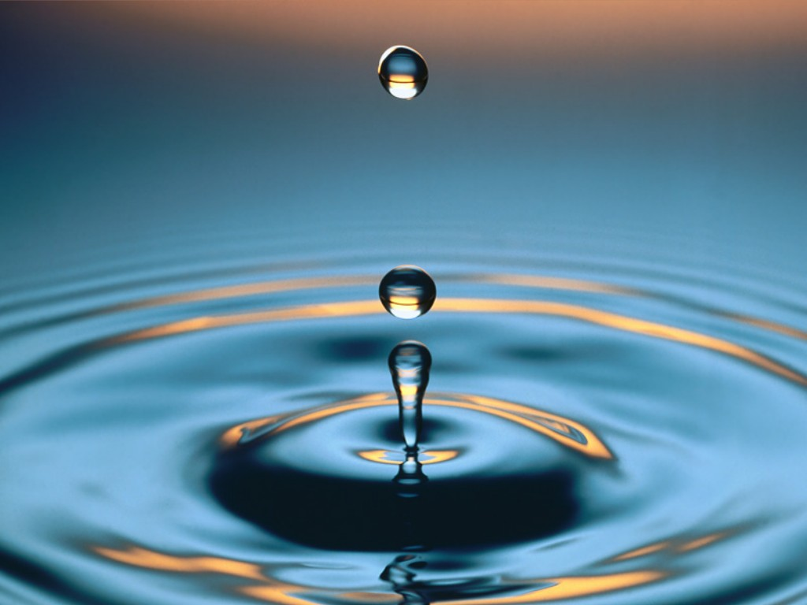
Global Water Modules
Module 1:
Introduction to Global Water
National Resource Center
Center for International Education
Global Studies
International Studies

Slide 3
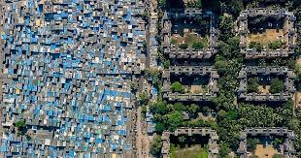
Economic and Environmental Inequality
Student Engagement Activity: Describe the inequalities observed in this photo (green space, water access, water features, running water, activity amenities and entertainment, personal space and property, etc…)
Photo from Oxfam International

Slide 4
“Water promises to be to the 21st century what oil was the 20th century:
the precious commodity that determines the wealth of nations.”
Fortune magazine, 2000

Slide 5
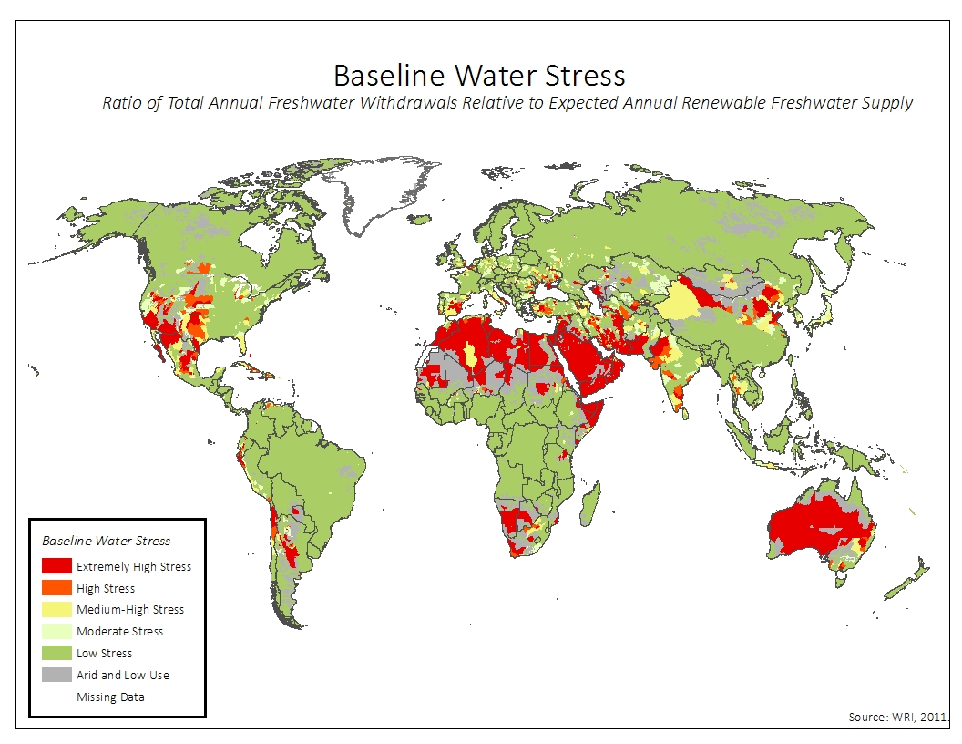

Slide 6
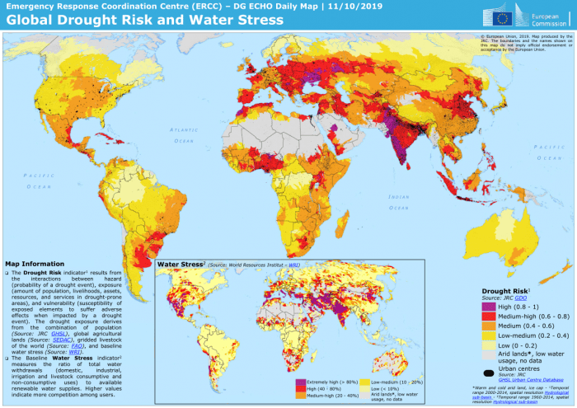
Discuss the most water stressed regions, discuss where water stress and economic stress overlap. Discuss how this relates to global equity issues.

Slide 7
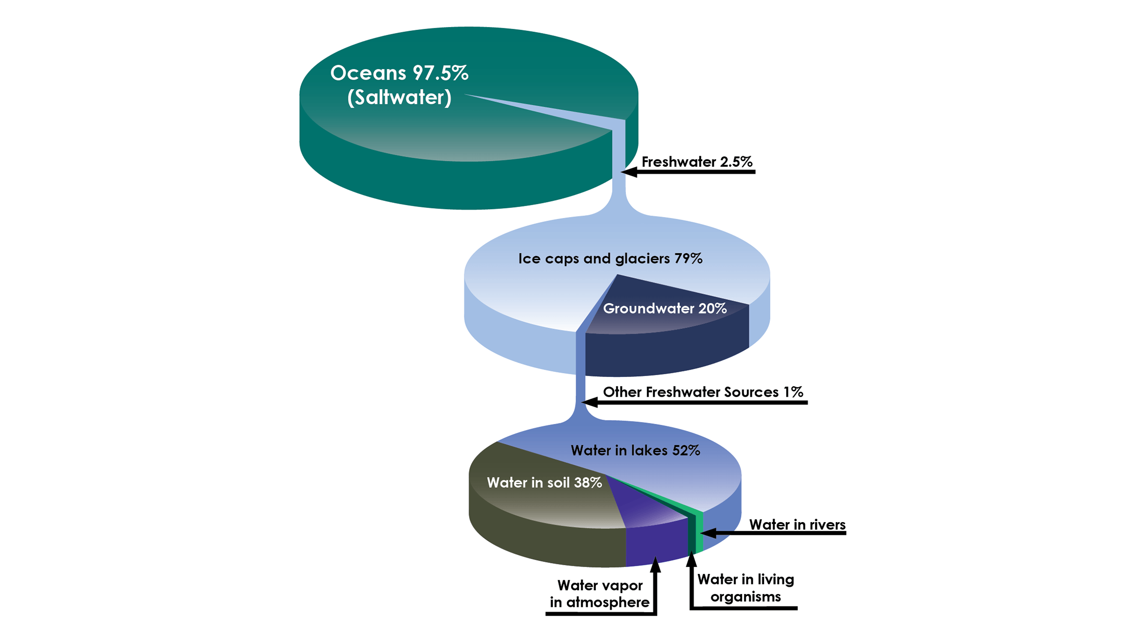
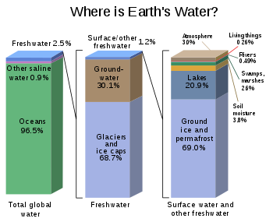
Global Saltwater and Freshwater Resources

Slide 8
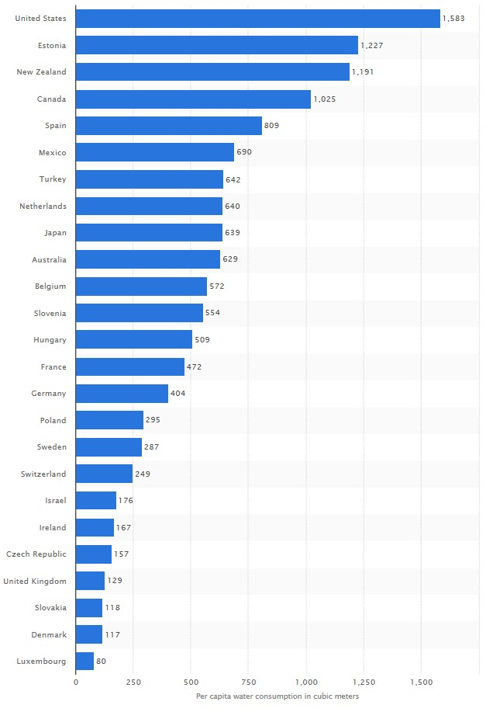
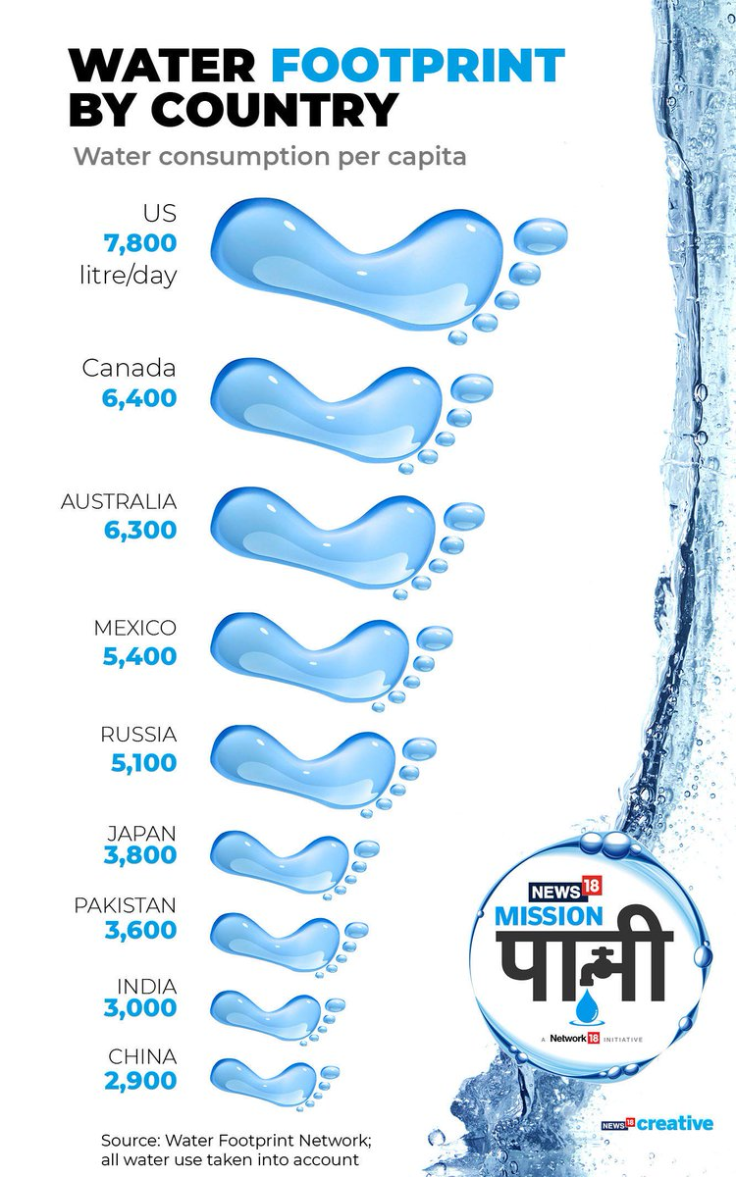

Slide 9
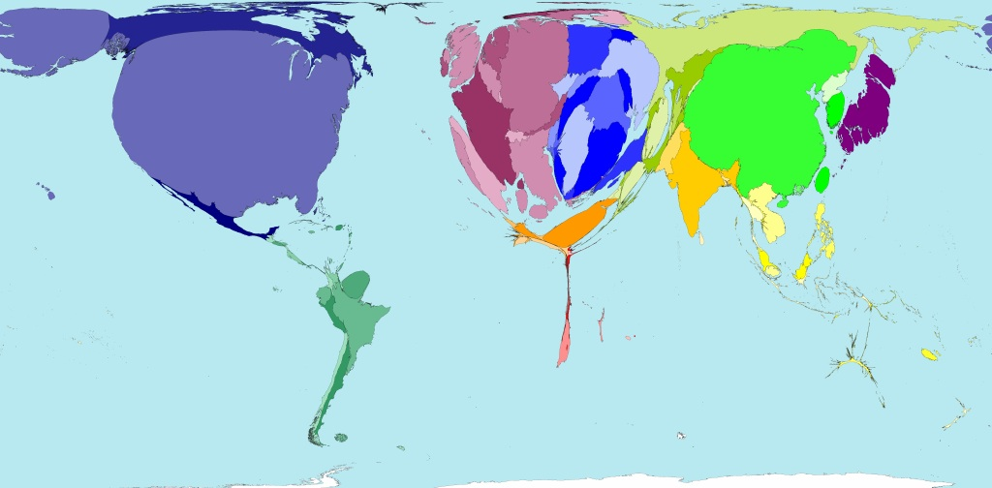
World map drawn according to water level of consumption:

Slide 10
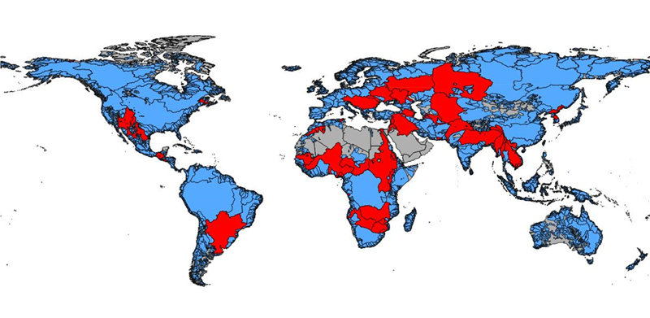
Global and regional water conflicts in which violence has occurred 2000-2020 (WCC 2020)

Slide 11
Why do we care? Statistical perspective on water shortage and contamination:
6,000 children die each day of water-related problems (water scarcity, lack of access, or water-borne illnesses)
25 million people die each year due to water-borne pathogens
48 countries are severely short of water
Currently 1/3 of the world population does not have access to clean water. It is expected to worsen: By 2025, ½ of the world pop will not have access to clean water.
(Source: OXFAM 2020, WHO 2015-2020)

Slide 12
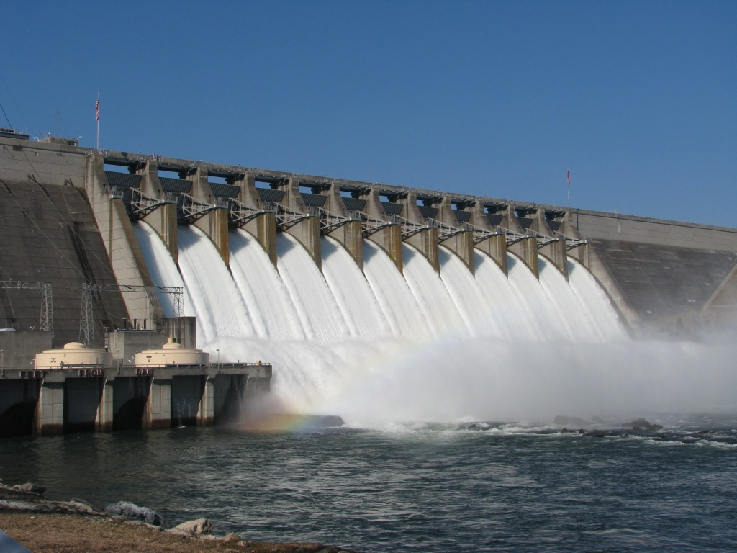
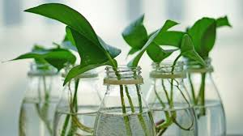
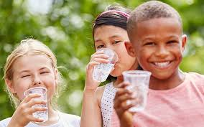
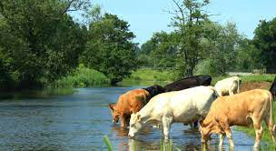
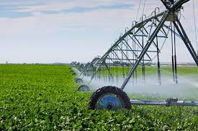
What can we do? (Global Water Careers from Module 10)
Water Careers Water careers include energy, agriculture, human rights, infrastructure, architecture, biology, hydrology, chemistry, engineering, public health, public policy, governance, nongovernmental organization, diplomacy, negotiation, industrial management, sustainability management, system design, ports and logistics, all related Sustainable Development Goals, and many other valuable and varied careers.

Slide 13
Introduction to Modules
The Global Water Modules are vetted and modifiable learning modules for faculty. They are to be used to enhance faculty learning, explore resources, incorporate global water security, and connect local with global water issues in courses.
The modules were conceptualized and developed by Jenny Kehl, PhD. They are made possible by University of Wisconsin-Milwaukee, National Resource Center, Center for International Education, Global Studies, and International Studies.
Please contact Jenny Kehl at Kehl@uwm.edu for access to the modules.

Slide 14
Global Water Modules
Module 2:
Water and Equity
Part 1:
Equity Issues: The Poor Pay More
Accessible, vetted, and modifiable learning modules for faculty on global water security, connecting local and global, developed by Jenny Kehl, PhD. Made possible by UWM, CIE, GS, IS
National Resource Center
Center for International Education
Global Studies
International Studies

Slide 15
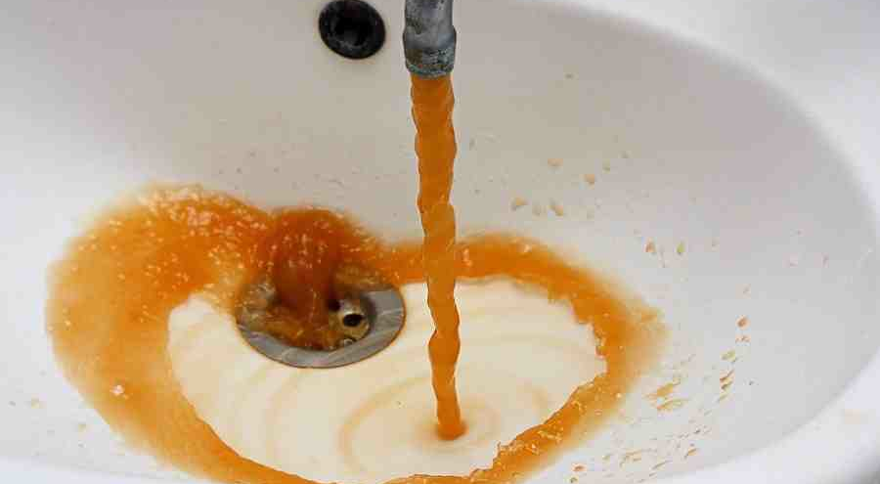
Example from Module 2:
Lead in drinking water in Flint
U.S. Violations of Clean Water Act occur often:
From 2014-2019, over 33% of all public water systems in USA reported health violations, which affected more than 50 million people (EPA 2020).

Slide 16
Global Water Modules
Module 3:
Water and Equity
Part 2:
Equity Issues: Who owns the water?
Accessible, vetted, and modifiable learning modules for faculty on global water security, connecting local and global, developed by Jenny Kehl, PhD. Made possible by UWM, CIE, GS, IS
Center for International Education
Global Studies
International Studies

Slide 17
Example from Module 3:
Water as a Right v. Water as a commodity
Cochabamba, Bolivia

Slide 18
Global Water Modules
Module 4:
Water and Food Security
Accessible, vetted, and modifiable learning modules for faculty on global water security, connecting local and global, developed by Jenny Kehl, PhD. Made possible by UWM, CIE, GS, IS
National Resource Center
Center for International Education
Global Studies
International Studies

Slide 19
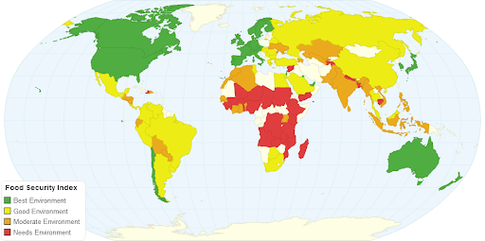
Example from Module 4: Global Food Insecurity
Two billion people living with food insecurity
Another two billion people living with extreme food insecurity (on the verge of starvation)

Slide 20
Global Water Modules
Module 5:
Water and Energy Security
Accessible, vetted, and modifiable learning modules for faculty on global water security, connecting local and global, developed by Jenny Kehl, PhD. Made possible by UWM, CIE, GS, IS
National Resource Center
Center for International Education
Global Studies
International Studies

Slide 21
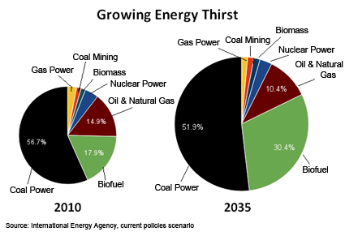
Example from Module 5

Slide 22
Global Water Modules
Module 6:
Water Security in MENA
Part 1:
Introduction and Nile Basin
Accessible, vetted, and modifiable learning modules for faculty on global water security, connecting local and global, developed by Jenny Kehl, PhD. Made possible by UWM, CIE, GS, IS
National Resource Center
Center for International Education
Global Studies
International Studies

Slide 23
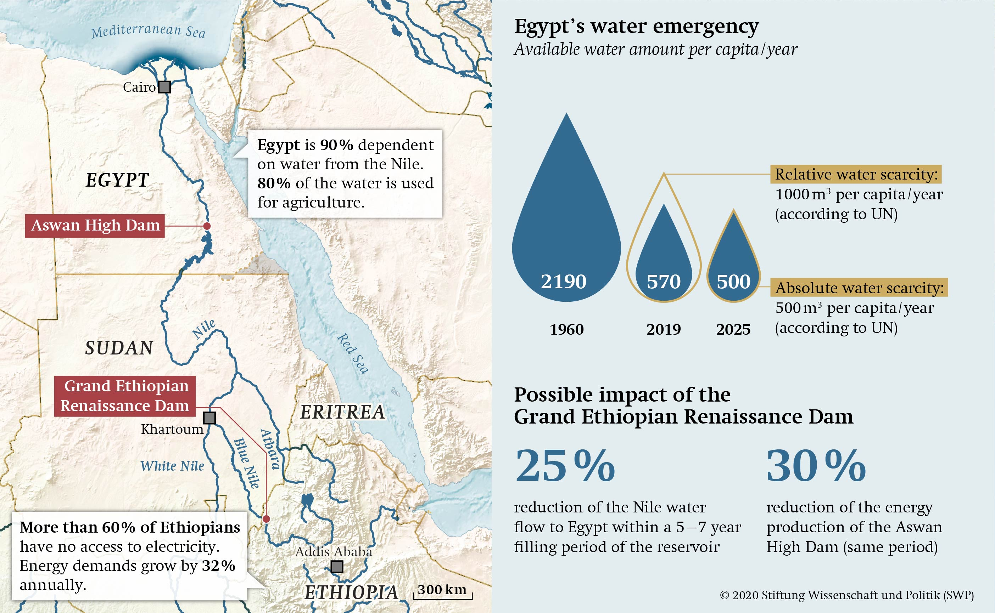
Example from Module 6

Slide 24
Global Water Modules
Module 7:
Water Security in MENA
Part 2:
Yemen and Iraq
Accessible, vetted, and modifiable learning modules for faculty on global water security, connecting local and global, developed by Jenny Kehl, PhD. Made possible by UWM, CIE, GS, IS
National Resource Center
Center for International Education
Global Studies
International Studies

Slide 25
Example from Module 7
The politics of the Al-Hawizeh Marshes

Slide 26
Global Water Modules
Module 8:
Water and Global Health
Accessible, vetted, and modifiable learning modules for faculty on global water security, connecting local and global, developed by Jenny Kehl, PhD. Made possible by UWM, CIE, GS, IS
National Resource Center
Center for International Education
Global Studies
International Studies

Slide 27
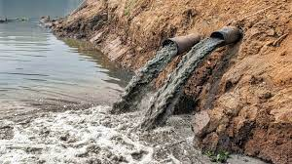
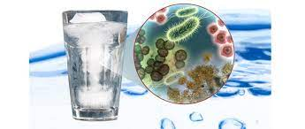
Example from Module 8 Politics and policy of water and public health

Slide 28
Global Water Modules
Module 9:
Examples of Water Wars
Accessible, vetted, and modifiable learning modules for faculty on global water security, connecting local and global, developed by Jenny Kehl, PhD. Made possible by UWM, NRC, CIE, GS, IS
National Resource Center
Center for International Education
Global Studies
International Studies

Slide 29
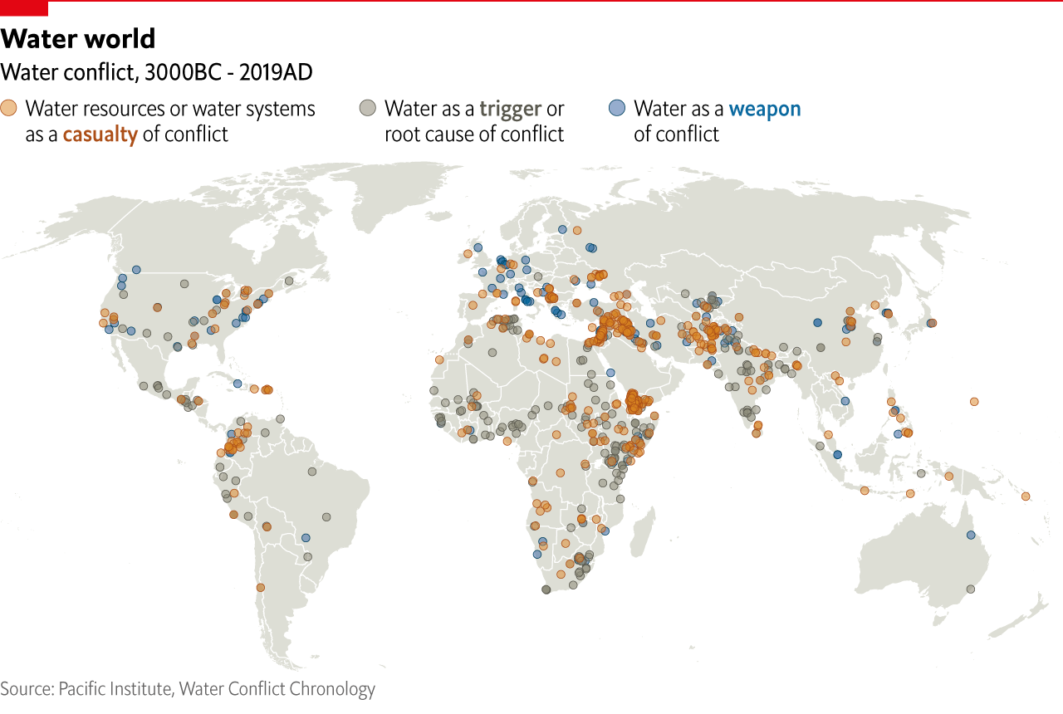
Example from Module 9

Slide 30
Global Water Modules
Module 10:
Global Water Careers
Accessible, vetted, and modifiable learning modules for faculty on global water security, connecting local and global water issues. Developed by Jenny Kehl, PhD. Made possible by University of Wisconsin-Milwaukee, NRC, CIE, GS, IS
National Resource Center
Center for International Education
Global Studies
International Studies

Slide 31
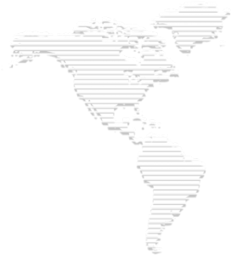
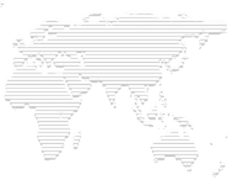
Drinking Water Systems
Wastewater Systems
Water Utility Management
Basins Management
Water Resources
Urban Water Management
Water Governance
Regulation
Career Development
Digitalization
Resources Recovery
Reuse
Treatment Technologies
Industrial Water
Health
Climate Change
Sustainable Development Goals
There are 212 types of water professions listed with the International Water Association, and hundreds more of environmental management jobs that relate directly to water for ecosystem services and environmental sustainability.

Slide 32
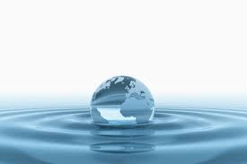
Together, let’s train our students to succeed in the water sector
(Global Water Careers from Module 10)
Water is the world’s most essential resource. Water is important for ecosystem services, food security, energy security, political stability, economic opportunity, human rights, public health, environmental sustainability, international conflict and cooperation, and the basic right to life. Managing water is a matter of survival, equity, and ethics.
“The water cycle and the life cycle are one.” Jacques Cousteau

Slide 33
Global Water Modules
Module 1:
Introduction to Global Water
National Resource Center
Center for International Education
Global Studies
International Studies

