Slide 1
GENERAL

Slide 2
1. When was the Office of Sustainability founded?
1) 1990
2) 2001
3) 2010
4) 2008

Slide 3
2. Where is the Office of Sustainability located?
Curtin Hall
2nd floor Union
Architecture and Urban Planning Building
University Services and Research Building

Slide 4
RECYCLING & WASTE

Slide 5
3. When did UWM start to recycle?
1987- Oil was recycled
1984- Yard waste was recycled
1990- Paper was recycled
1995- Co-mingle was recycled

Slide 6
4. Why is recycling important at UWM?
Conserves resources
Saves energy & decreases greenhouse gas emissions
Prevents pollution & slows landfill expansion
Saves our campus money- At UWM, we spend almost 5 times as much to throw something away as we do to recycle it
Contributes to the creation & expansion of job opportunities within the Milwaukee area
All of the above

Slide 7
5. True/False: UWM is a single sort campus
True
False

Slide 8
6. What plastic numbers can be recycled at UWM
#1 & #2
#1
#1-#5
All numbers #1-#7

Slide 9
7. What is RecycleMania?
Contest between UWM custodians
Friendly competition and benchmarking tool for college and university recycling programs to promote waste reduction activities to their campus communities
Name of Earth Week at UWM
Single sorting on campus

Slide 10
8. What is composting?
A process that breaks down organic materials into a rich soil
A new type of cleaning chemical used throughout campus
Unfiltered water that mixes with pollutants on the ground like oil and pesticides and pollutes Lake Michigan
A non-profit organization in Milwaukee

Slide 11
9. What year was composting implemented at UWM?
1995
2000
2002
2009

Slide 12
10. How many pounds of material does UWM compost/week?
50-100 lbs.
100-200 lbs.
200-500 lbs.
6,000 lbs.

Slide 13
11. Who should be contacted for hazardous waste pickup?
Office of Sustainability: ask-sustainability@uwm.edu
Waste Management
Kim Axtman at (414)229-4999
Your building chair

Slide 14
12. Can printer cartridges be recycled at UWM?
No, they should be thrown in the trash
Yes, put them in the co-mingle recycling bin
Yes, give them to your building chair
Yes, first look for packaging provided by vendor to send cartridges directly back to the company. If no packaging can be found Safety & Assurances will pick up cartridges.

Slide 15
13. Can batteries be recycled at UWM?
Yes, every type of battery can be placed in the co-mingle recycling bins
No batteries are recycled at UWM
Yes, UWM recycles many types of batteries, including Nickel-Cadmium, Lithium Ion, Nickel metal hydride, Lead acid and Lead gel-cell batteries. However, alkaline batteries may be tossed into the normal trash
Yes, but only alkaline batteries may be recycled

Slide 16
14. What does techno trash include?
Computers
Microfiche, CD’s, DVD’s, video tapes, and cassette tapes
Cell phones
Cell phones & Computers

Slide 17
15. How can you recycle techno trash?
Contact Kim Silbersack at kimsack@uwm.edu
Techno trash should be recycled in co-mingle recycling bins
Bring techno trash to the Film Department
Techno trash cannot be recycled

Slide 18
16. What is the goal of the UWM Surplus Program?
Track the campus’ waste and recycling across campus
Maintains campus gardens
Helps manage unwanted furniture, equipment, & computers from campus, by either finding a new use for it in another department, selling it online to the public, donating items to area non-profits, or by recycling it as scrap
Coordinates recycling efforts across campus

Slide 19
17. How can you get rid of unwanted items in your office?
Call your department chair
Put them outside of your office and a custodian will pick them up
Fill out the Surplus Declaration Form and send it to surplusproperty@uwm.edu
Contact Kim Axtman at (414)229-4999

Slide 20
18. Where should you pick up surplus items?
Lobby of Sandburg Dorms
Surplus items are shipped to your university address
University Services & Research Building 115 E. Reindl Way Glendale, WI 53212
Union 3rd floor

Slide 21
19. Who should be contacted for e-waste pickup?
UWM Surplus Program through the surplus declaration form
Custodial staff in building
UITS
Waste Management

Slide 22
ENERGY

Slide 23
20. Approximately how much does UWM spend on utilities every year?
$500,000
$2,000,000
$5,000,000
$10,000,000

Slide 24
21. What is Energy Matters?
UWM’s newest recycling program
Union Theatre’s environmental film series
UWM's energy efficiency project
A world-wide global warming prevention program

Slide 25
22. What is the goal of Energy Matters?
Achieve an energy reduction of 25% by 2013
Provide comfortable study and work space
Reduce campus use of fossil fuels
All of the above

Slide 26
23. What types of upgrades are being made through Energy Matters?
Upgraded lighting, heating and cooling in offices and classrooms
Improved indoor air quality
New digital controls
All of the above

Slide 27
24. What is PC Power Management?
UWM’s computer recycling program
In conjunction with Energy Matters, a system designed to power down computers and monitors during idle time
UWM's newest energy efficiency project
An energy backup system used by UITS

Slide 28
25. Which buildings on campus house solar panels?
Bolton Hall, Golda Meir Library & Riverview
Union & Sandburg Residence Hall
Physics & EMS
Cambridge Commons, Golda Meir Library, and Bolton Hall

Slide 29
26. What is a feature of the Building Dashboard?
An interactive, 24-7 meter that measures kilowatt-hours per building, as well as the amounts of chilled water and condensate used by each building
Users can view the electricity, water, and heating of buildings
Click on a building to track its energy usage by day, month, or even year. See energy consumption in kilowatts, carbon dioxide, or dollars
All of the above

Slide 30
27. How much money has been saved through UWM’s Heat Plant conservation measures?
Over $2,000,000
Over $3,000,000
Over $4,000,000
Over $6,000,000

Slide 31
28. What is vampire load?
When appliances are drawing electricity even when they appear to be off
A highly dangerous current
The energy used to power a computer
An interactive, 24-7 meter that measures kilowatt-hours per building, as well as the amounts of chilled water and condensate used by each building

Slide 32
29. How can vampire load be eliminated?
Vampire load cannot be eliminated
Attach appliances to a power strip
Grow garlic next to appliance
Attach appliances to a power strip, and turn the power strip switch off when the appliances are not in use

Slide 33
30. What are state regulated thermostat setting temperatures for summer and winter?
60 degrees in winter, 70 degrees in summer
68 degrees in winter, 76 degrees in summer
55 degrees in winter, 80 degrees in summer
There are no state regulated thermostat setting temperatures

Slide 34
31. Why should space heaters not be used?
Heating is already on in all buildings
Space heaters can actually make buildings colder because when they are placed near thermostats the system thinks it is already warm enough, and does not properly heat the building
In accordance with Governor Jim Doyle's Executive Order 132 dated November 21, 2005, the Department of Administration states that the use of space heaters and fans is prohibited
All of the above

Slide 35
32. Why should you use CFL bulbs vs. incandescent bulbs?
CFL bulbs are more esthetically pleasing than incandescent bulbs
A CFL bulb uses 75% less energy than an incandescent bulb, and lasts up to 10 times longer
Using CFL bulbs has proven to make people smarter
Incandescent bulbs can explode, while CFL bulbs cannot

Slide 36
33. Why are community appliances important?
Sharing appliances forces everyone to work together
Sharing appliances is a cool trend
Community appliances should not be used
Sharing appliances rather than using your own will decrease energy usage and increase financial savings for your department.

Slide 37
34. Keep all copiers and printers at least how many feet away from thermostats and sensors?
2 feet
4 feet
10 feet
20 feet

Slide 38
35. Why do copiers and printers need to be kept away from thermostats and sensors?
It is not esthetically pleasing to have printers and copiers near thermostats and sensors
Copiers and printers give off heat when they are turned on, and the heat emitted makes thermostats or sensors think the room is warmer than it actually is.
Copiers and printers can be placed wherever you want
The technology within thermostats and sensors can cause copiers and printers to malfunction

Slide 39
ALTERNATIVE TRANSPORTATION

Slide 40
36. Why is alternative transportation important at UWM?
Saves commuters money and time
Reduces the amount of greenhouse gas emissions that are pumped into the air
Reduces the number of cars being brought to our campus
All of the above

Slide 41
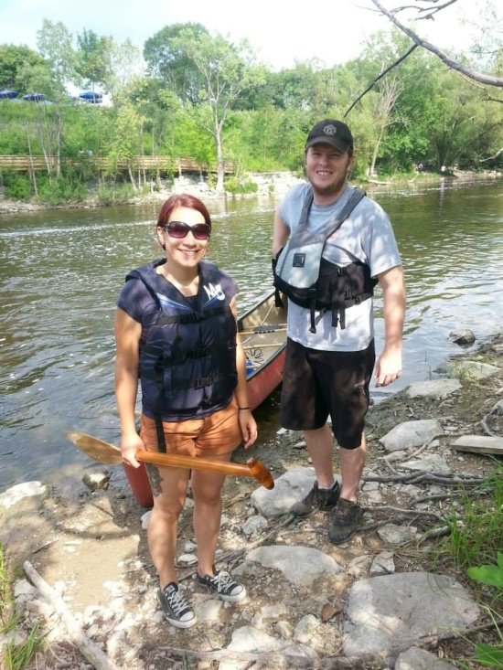
37. What types of alternative transportation are offered at UWM?
Water Skiing
Train & Biking
Trolley
Carpooling, Biking, Bus, & Ride Sharing

Slide 42
38. What is Zimride?
System designed to power down computers and monitors during idle time
Car sharing service, billable by the hour or day
Online ridesharing tool that connects you to UWM friends, classmates, and coworkers going the same way you are
An interactive, 24-7 meter that measures kilowatt-hours per building, as well as the amounts of chilled water and condensate used by each building

Slide 43
39. What is required to access Zimride?
Paid membership
ePantherID
Zimride is open to anyone
Milwaukee residency

Slide 44
40. How can you sign up for Zimride?
Contact your department chair
Check out http://zimride.uwm.edu/, or go to The Office of Sustainability homepage at www.sustainability.uwm.edu.
Fill out signup sheet at Klotche front desk
Send a letter to the Union

Slide 45
41. What are the benefits of biking to campus?
Biking produces no carbon emissions
Biking is good for your health
Free parking
All of the above

Slide 46
42. What bus benefits are offered to students, faculty, and staff?
Free bus shuttle from house
50% off each bus ride
UPASS & Commuter Value Pass
There are no bus benefits offered to students, faculty, and staff

Slide 47
43. What is a feature of Zipcar?
Car sharing service, billable by the hour or day
Nine vehicles are located at campus locations including Sandburg, RiverView, and Kenilworth Square
Offers low hourly and daily rates, and always include gas and insurance
All of the above

Slide 48
44. How can you access Zipcar?
Reserve online at http://www.zipcar.com/uwm/
Sign up through BOSS
Contact your department chair
Visit http://zimride.uwm.edu/

Slide 49
FOOD

Slide 50
45. Why is sustainable food important at UWM?
Sustainable food reduces pesticide use and conserves natural resources
Sustainable food lowers the use of fossil fuels
Switching to sustainable food leads to reductions in greenhouse gas emissions and a healthier Wisconsin
All of the above

Slide 51
46. What sustainable food initiatives are being implemented at UWM?
Campus gardens
Sustainable conveniences stores
Participation in a local produce auction
All of the above

Slide 52
47. Where are campus gardens located?
Spaights Plaza & Garland Hall
Physics South Lawn & Sandburg East Tower Lawn
Sandburg East Tower Lawn & Bolton Hall
Physics South Lawn & Klotche Center

Slide 53
48. What are the benefits of campus gardens?
They are part of an effort to reduce the "food mile“
They create a sense of campus community
They offer students, faculty and staff the chance to directly contribute to sustainability at UWM
All of the above

Slide 54
49. Who can have a campus garden plot?
Students
Students & Faculty
Students, Faculty and Staff
Any Milwaukee resident

Slide 55
50. What sustainable food options are available at UWM?
Organic
Vegetarian
Vegan
Local
All of the above

Slide 56
51. Which store specializes in offering organic, natural and locally sourced foods at UWM?
Union Terrace
The Emporium in Sandburg
Restor
Gasthaus

Slide 57
52. What percentage of food does Restaurant Operations utilize that is local, organic, and fair-trade?
100%
5%
40%
14%

