Slide 1


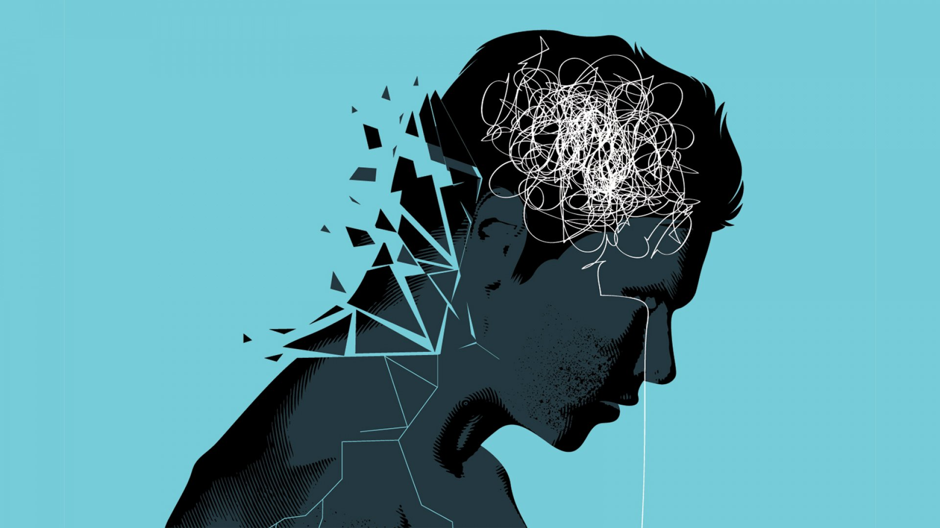
Fully Human: Mental Health Support for the multilingual learner in the classroom & Beyond
Presented by Lindsey Hill
Assistant Academic Director – Intensive English Program
University of Wisconsin-Milwaukee
English Language Academy
April 5th, 2023

Slide 2

Mental health defined
A person's condition with regard to their psychological and emotional well-being (Oxford Languages)
“Mental health is defined as a state of well-being in which people understand their abilities, solve everyday life problems, work well, and make a significant contribution to the lives of their communities” (Karim et al, 2020, pg. 2)
A sense of well-being encapsulates having more overall positive feelings versus having more overall negative feelings (Alharbi & Smith, 2018)
Source: m-imagephotography; Getty Images

Slide 3

Defining the Problem – some statistics
39% of college students experience a mental health issue during their time in college. This number is around 20% when looked at in a global context.
50% of mental health issues begin by age 14; 75% begin by age 24.
The number 2 cause of death amongst young adults is suicide.
50% of us will experience a mental health condition in our lifetimes. 1 in 5 adults has a diagnosable mental illness.
Around 85% of college students will have experienced a traumatic event by the time they reach our classrooms. Around 50% of students will experience a traumatic event within their first year of university.
The most common mental health struggles amongst college students in a global context are anxiety and depression and acculturative stress for international students in particular.
67% of people between ages 18-24 who experience depression & anxiety will not seek out help.
Based on the most recent UWM student health survey, around 40% of UWM students screened positive for PTSD symptoms. Screening positive for symptoms does not indicate an official diagnosis.
Image source: kqed.org
Sources: Active Minds; American College Health Association; Alharbi & Smith, 2018;Angermeyer et al, 2020; Auberach et al, 2020; Dong, Hwang, Hodgson, 2023; Elyamani et al, 2020; Gutierrez & Gutierrez, 2019; Hinton & Good, 2015; Jin & Acharaya, 2021; Ke et al, 2023; Lynch, Gesing, & Cruz, 2023; MacDonald, Jussel, & Topitzes, 2023; Pandaya, 2018; Wilson, 2022; Zhao, Houghton, & Glasgow, 2022; Zhou et al, 2022

Slide 4
Stressors faced by college students
New environment & life experience
Affected student population (domestic students, immigrant/first generation students, refugees, and international students)
Chronic/toxic stress - Develops as a result of continuous exposure to "severe, chronic, [or] prolonged stress...without support" (Jennings, 2019, p. 11)
Student populations affected: domestic students, immigrant/first generation students, refugees, and international students
Social Media use
Student populations affected: Any student that uses social media - domestic students, immigrant/first generation students, refugee students, and international students
Marginalization
Student populations affected: domestic, immigrant/first generation students, refugee students, and international students
Sources: Auerbach et al, 2018; Jennings, 2019; Kim et al, 2022; Liu, Kia-Keating, & Modir, 2017; Mahoney et al, 2022; Bekalu, McCloud, & Viswanath, 2019; Drazenovic, Rukavina, & Polasen, 2023; Evans, 2019; Karim et al, 2020; Mahoney et al, 2022; Prieto-Welch, 2016; The Social Dilemma

Slide 5
Marginalization
Marginalized identities: identities that experience discrimination and structural inequalities; identities that don't align with the status quo. We no longer use the term "minority" because it implies a sense of inferiority.
Race & skin color: Black, Indigenous, Brown, and Asian
Sexuality, Gender, & Gender Expression: Lesbian, Gay, Bisexual, Transgender, Queer, Intersex, Asexual/Aromantic, Pansexual, Non-binary, Demisexual, Woman-identifying, & Femme-presenting
Disability: physical, psychiatric, or mental
Neurodivergence: ADD, ADHD, Autism Spectrum Disorder, Dyslexia, Sensory Processing Sensitivity (Highly Sensitive Person), Sensory Processing Disorder, Tourette's, etc.
Immigrant/Refugee: in particular those from the Global South, those who are undocumented, those from developing countries
Non-native speakers of English
Socio-economic status: working class, low-middle class
Level of education: high school diploma only or no high school diploma
Religion: Muslims, Hindus, Jews, Sikhs, etc. - non-Christian identities
Age: Children, Teens, Young Adults, and those near or of retirement age

Slide 6
Stressors faced by college students
Acculturative stress
Student populations affected: immigrants, refugees, & international students
Covid-19 Stress
Student populations affected: domestic students, immigrants/first generation students, refugees, & international students
Sources: Alharbi & Smith, 2018; Dong et al, 2023; Gomes, 2020; Ke et al, 2022; Lynch, Gesing, & Cruz, 2023; Prieto-Welch, 2016; Zhao, Houghton, & Glasgow, 2022

Slide 7
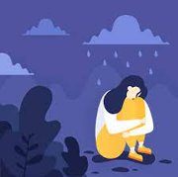
Trauma – additional barrier for students
Exact definitions of trauma are up for debate
Can reference a physical or psychological wound
Individual trauma develops from "an event, series of events, or set of circumstances that is experienced by an individual as physically or emotionally harmful or threatening and that has lasting adverse effects on the individual's functioning and physical, social, emotional, or spiritual well-being" (Substance Abuse and Mental Health Services Administration, p. 1)
How would you define trauma? What do you think counts as trauma? How many of your students do you think have been affected by trauma?
"Trauma comprises the brain area that communicates the physical, embodied feeling of being alive" (Van Der Kolk, 2014, p. 3)
"Trauma is...defined as an overwhelming experience that undermines the individual's belief that the world is good and safe" (Brunzell, Stokes, & Waters, 2016, p. 219)
Image source: highlandspringsclinic.org

Slide 8
Types of Trauma
"Traumas can be classified by the effect on self-, interpersonal-, group-, and world-schemas" (Hinton & Good, 2015, p. 54).
Big/Large "T" Trauma - extraordinary and significant event in which an individual feels powerless and helpless and possesses little to no control in their environment; more readily identified as a trauma by the individual
examples include sexual assault, combat, abuse, a car accident, domestic violence, etc.
Little/Small "t" Trauma – Events that are not life or bodily integrity threatening but that exceed our ability to cope and cause disruption in emotional functioning
Examples include: divorce, infidelity, legal trouble, financial worries, interpersonal conflict, etc.
Complex Trauma – The experience of multiple traumatic events over a period of time, for months or even years; usually results from childhood trauma but is not limited to that; those who develop Complex PTSD (C-PTSD) experience many of the same or similar symptoms as those with PTSD with additional symptoms, such as emotional flashbacks; not yet considered an official diagnoses in the DSM-5. Considered an anxiety condition.
Collective Trauma - Trauma that affects an entire society/group
Examples include: the pandemic, the Holocaust, marginalization
Childhood trauma – Adverse Childhood Experiences (ACEs) - Traumatic experiences that children are exposed to that can deprive children and adolescents of a sense of security & psychological well-being
Sources: Aydin, 2017; Barbash, 2017; CDC; Gutierrez & Gutierrez, 2019; Hirschberger, 2018; Hinton & Good, 2015; Liu, Kia-Keating, & Modir, 2017; US Department of Health & Human Services; Van Der Kolk, 2014

Slide 9
Outcomes of trauma
Trauma reorganizes how the brain works and manages perceptions. It effects how we think, what we think about, and our very ability to think
Difficulty engaging in relationships
Hypervigilance – heightened alarm even to events that seem inconsequential
Increased rates of anxiety & depression – increased likelihood of suicidal ideation & suicide attempt
Dissociation
Memory loss
Loss of executive functioning skills: the ability to plan/make future goals, self-monitoring, self-control, time management, task initiation
Difficulty concentrating
Experience an increase in negative emotions, such as anger, frustration, guilt, loneliness, and shame
Low self-esteem; negative self-image
Emotional numbing – adapting maladpative coping mechanisms such as substance abuse and other risky behaviors, social media addiction, overeating, undereating, etc.
Social isolation
Increased rates of perfectionism
Fractured sense of identity – destroys worldview
Destroyed trust
Hygiene might start to suffer
Increased likelihood of being retraumatized
impairment to verbal processing
Impairment to ability to organize information in logical and sequential order
Sources: American Psychiatric Association; Aydin, 2017; Brunzell, Stokes, & Waters, 2016; Gutierrez & Gutierrez, 2019; Hinton & Good, 2015; Jennings, 2019; Lynch, Gesing, Cruz, 2023; MacDonald, Jussel, & Topitzes, 2023; Tull, 2023; Van Der Kolk, 2014; Wilson, 2020; Wilson, 2022;

Slide 10

Cultural differences in understanding & coping with mental health & trauma
PTSD has cross-cultural validity in most areas, however, some areas might vary in different cultures
Increased likelihood of somatic symptoms & assigning spiritual/religious meaning to mental health challenges
Spirituality/Religion can also function as a coping mechanism
Lower levels of mental health literacy amongst non-Western populations
Different cultural values in Asian, Arab, African, & Latine cultures could lend themselves to higher rates of social stigma around mental health than in the West
Asian & Latine students are the least likely to seek out help for mental health struggles
Sources: Alharbi & Smith, 2018; Angermyer et al, 2020; Al-Noor et al, 2018; Dong et al, 2023; Elyamani et al, 2020; Hinton & Good, 2015; Jin & Acharya, 2021; Pandaya, 2018; Piwowarcyzk et al, 2014; Wong, Wang, & Maffini, 2014; Zhou et al, 2022

Slide 11
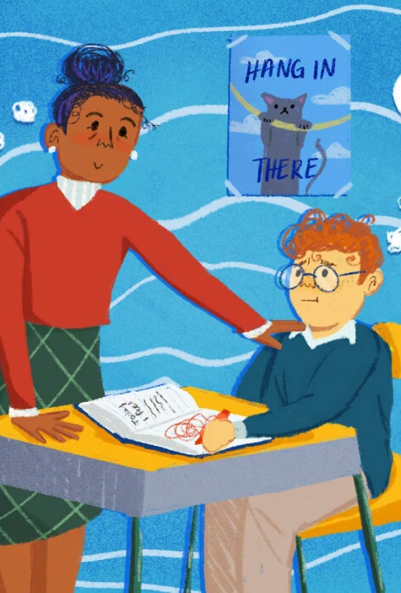
Solutions: Trauma-informed pedagogy
Being trauma-informed means acting from a framework in which you understand the biological, psychological, neurological, and social effects that trauma has on an individual and recognizing how that person has constant intertwined needs that influence each other regarding their security, their connections, and their ability to manage their emotions (Kosturous et al, 2022)
Not all students who experience trauma will develop PTSD/C-PTSD
Not all students experience mental health issues/crises
Trauma-informed Pedagogy is beneficial for all students & should be considered best practice (Wilson, 2020; Wilson, 2022)

Slide 12

TRauma-informed pedagogy for the multilingual classroom
Safety (physical & emotional safety)
Clarity
Community
Agency
Identity (cultural and linguistic)

Slide 13
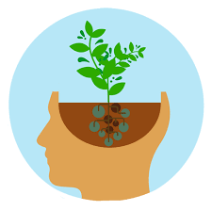
Safety – creating an emotionally (& physically) safe environment
Create frequent opportunities for students to fail at low risk
Give encouraging feedback
Ensure predictable structure of class time & lessons
Embed social emotional learning skills in the content of the course – SEL - "development of information, mindsets, and skills that allow individuals to identity and manage their emotions" (Stocker & Gallagher, 2019)
Flexible attendance policies (when & where you can)
Be a safe emotional space for students
Speak out against social injustice & systemic oppression
Normalize seeking out professional help and eliminate the stigma of mental health in a culturally sensitive manner
Avoid triggering topics in class content/discussions
Incorporate fun, humor, and play into the content & lessons
Do your best to manage your own emotions
Sources: Brunzell, Stokes, & Waters, 2016; Brunzell, Waters, & Stokes, 2021; Dweck, 2016; Jin & Acharya, 2021; Kosturos et al, 2022; Lynch, Gesing, & Cruz, 2023; MacDonald, Jussel, & Topitzes, 2023; Wilson, 2020; Wilson, 2022; Zhao, Houghton, & Glasgow, 2022

Slide 14

Clarity
Repetition
Scaffolding
Transparency
Provide information to important services for students on your Canvas sites & help students build awareness of them
Go through assignment/assessments descriptions together as a class & ensure that students fully understand what is expected of them
Set clear boundaries for students surrounding your availability, your capacities, and your expertise
Provide brain breaks for students
Sources: Brunzell, Stokes, & Waters, 2016; Brunzell, Waters, & Stokes, 2021; MacDonald, Jussel, & Topitzes, 2023; Marangell & Baik, 2022; Wilson, 2020; Wilson, 2022

Slide 15

Community & Identity
Create more opportunities for students to collaborate with each other on assignments and tasks
Gives students the opportunity to share their expertise with their peers when it comes to content
Create opportunities for students to share their cultural background frequently
Emphasize that they are language learners often & that they are equal in that way
Get to know your students on a personal level (within reason)
Share information about your personal lives & experiences with students (within reason)
Incorporate Translanguaging into your classroom
Create community guidelines with the students for the classroom
Use materials that use/emphasize non-native speakers of English & their professional & academic successes
Sources: Gutierrez & Gutierrez, 2019; Ofelia & Wei, 2014; MacSwan, 2017; Park & Valdez, 2018; Washington University in St. Louis; Wilson, 2020; Wilson, 2022

Slide 16
Works cited
Active Minds: Changing the Conversation About Mental Health, 2023, activeminds.org. Accessed 2 April 2023.
Alharbi, Eman S., and Andrew P. Smith. “Review of the Literature on Stress and Wellbeing of
International Students in English-Speaking Countries.” International Education Studies,
Volume 11, Issue 6, 2018, pp. 22-44.
Al-Noor, Zainab, Caroline Selai, Rasha Al Ansari, Ahmad Alhadi, Batoul El Hilo, and Katrina Scior. “The impact of culture on anxiety related cognitions: an exploration with Saudi-Arabian individuals.” Mental Health, Religion, & Culture, Volume 21, Issue 5, 2018, pp. 515-533.
American Psychiatric Association. "What is Post-Traumatic Stress Disorder (PTSD)?" American Psychiatric Association, https://www.psychiatry.org/patients-families/ptsd/what-is-ptsd. Accessed 2 April 2023.
Angermeyer, Matthias C., Mauro G. Carta, Rym Ghachem, Herbert Matschinger, Aurelie Millier, Tarek Refai, Georg Schomerus, and Mondher Toumi. “Cultural Variations in Public Beliefs about Mental Disorders: A Comparison between Tunisia and Germany.” Clinical Practice & Epidemiology in Mental Health, Volume 16, 2020, pp. 70-81.
Auerbach, Randy P., Jordi Alonso, Pim Cuijpers, David D. Ebert, Penelope Hasking, Matthew K. Nock, Dan J. Stein, Alan M. Zaslavsky, Ronald C. Kessler, Philippe Mortier, Ronny Bruffaerts, Corina Benjet, Koen Demyttenaere, Jennifer Greif Green, Elaine Murray, Stephanie Pinder-Amaker, Nancy A. Sampson, Gemma Vilagut, and WHO WMH-ICS Collaborators. “WHO World Mental Health Surveys International College Student Project: Prevalence and Distribution of Mental Disorders.” Journal of Abnormal Psychology, Volume 127, Issue 7, 2018, pp. 623-638.
Aydin, Ciano. "How to Forget the Unforgettable? On Collective Trauma, Cultural Identity, and Mnemotechnologies." Identity: An International Journal of Theory and Research, Volume 17, Issue 3, 2017, pp. 125-137.
Barbash, Elyssa. “Different Types of Trauma: Small ‘t’ versus Large ‘T’.” Psychology Today, 2017, https://www.psychologytoday.com/us/blog/trauma-and-hope/201703/different-types-trauma-small-t-versus-large-t. Accessed 4 April 2023.
Bekalu, Mesfin A., Rachel F. McCloud, and K Viswanath. “Association of Social Media Use
With Social Well-Being, Positive Mental Health, and Self-Rated Health: Disentangling
Routine Use From Emotional Connection to Use.” Health Education & Behavior, Vol. 26,
Issue 25, 2019, pp. 695 – 805.
Brown Yau, Julie. The Body Awareness Workbook for Trauma: Release Trauma from Your Body, Find Emotional Balance, and Connect with Your Inner Wisdom. Reveal Press, 2019.
Brunzell, Tom, Helen Stokes, and Lea Waters. “Trauma-Informed Flexible Learning: Classrooms That Strengthen Regulatory Abilities.” International Journal of Child, Youth and Family Studies, Volume 7, Issue 2, 2016, pp. 218-239.
Brunzell, Tom, Lea Waters, Helen Stokes. “Trauma-informed Teacher Wellbeing: Teacher Reflections within Trauma-informed Positive Education.” Australian Journal of Teacher Education, Volume 46, Issue 5, 2021, pp. 91-106.

Slide 17
Works cited
Dong, Fanghong, Yeji Hwang, and Nancy A. Hodgson. “‘I Have a Wish’: Anti-Asian Racism and Facing Challenges Amid the COVID-19 Pandemic Among Asian International Graduate Students.” Journal of Transcultural Nursing, Volume 34, Issue 2, 2023, pp. 115-122.
Drazenovic, Marija, Tea Vukusic Rukavina, and Lovela Machala Polasen. “Impact of Social Media Use on Mental Health within Adolescent and Student Populations during COVID-19 Pandemic: Review.” International Journal of Environmental Research and Public Health, 2023, Issue 20, 2023, pp. 3392-3411.
Dweck, Carol S. Mindset: The New Psychology of Success. 2nd ed. Ballantine Books, 2016.
Elyamani, R. Sarah Naja, Ayman Al-Dashan, Hamed Hamoud, Mohammed Iheb Bougmiza,
and Noora Alkubaisi. “Mental health literacy in Arab states of the Gulf Cooperation Council: A systematic review.” PLoS ONE, Volume 16, Issue 1, 2020, https://doi.org/10.1371/journal.pone.0245156. Accessed 15 March 2023.
Evans, Sabea. “Systemic Oppression and Trauma: Why Healing-Centered Two-Generation Approaches are Crucial to Poverty Alleviation.” Drexel University Center for Hunger-Free Communities: Policy Brief, June 2019.
Garcia, Ofelia, and Li Wei. Translanguaging: Language, Bilingualism, and Education. Palgrave Macmillian, 2014.
Gomes, Catherine. “Outside the Classroom: The Language of English and its Impact on International Student Mental Wellbeing in Australia.” Journal of International Students, Volume 10, Issue 4, 2020, pp. 934-953.
Greater Good Science Center. "Body Scan Meditation." Greater Good Science Center, https://ggia.berkeley.edu/practice/body_scan_meditation. Accessed 4 April 2023.
Gutierrez, Daniel, and Andrea Gutierrez. “Developing A Trauma-Informed Lens In The College Classroom And Empowering Students Through Building Positive Relationships.” Contemporary Issues in Education Research, Volume 12, Issue 1, 2019, pp. 11-18.
Hinton, Devon E. and Byron J. Good. "The Culturally Sensitive Assessment of Trauma: Eleven Analytic Perspectives, a Typology of Errors, and the Multiplex Models of Distress Generation." Culture and PTSD Trauma in Global and Historical Perspective, edited by Devon E. Hinton and Byron J. Good, University of Pennsylvania Press, 2015, pp. 50-113.
Hirschberger, Gilad. “Collective Trauma and the Social Construction of Meaning.” Frontiers in
Psychology, Volume 9, 2018,
https://www.frontiersin.org/articles/10.3389/fpsyg.2018.01441/full. Accessed 13 March
2023.
Jennings, Patricia A. The Trauma-Sensitive Classroom: Building Resilience with Compassionate Teaching. New York, W. W. Norton & Company, 2019.
Jin, L, and Lalatendu Acharya. “Dilemmas and Coping Strategies of Chinese International Students’ Mental Health Problems: The Parents’ Perspectives.” Journal of International
students, Volume 11, Issue 1, 2021, pp. 216-237.

Slide 18
Works cited
Karim, Fazida, Azeezat Oyewande, Lamis F. Abdealla, Reem Chaudhry Ehsanullah, and Safeera Khan. “Social Media Use and Its Connection to Mental Health: A Systematic Review.” Cureus, Volume 12, Issue 6, 2020, DOI 10.7759/cureus.8627. Accessed 13 March 2023.
Ke, Tianhui, Wenjing Li, Lena Sanci, Nicola Reavley, Ian Williams, and Melissa A. Russell. “The mental health of internationl university students from China during the COVID-19 pandemic and the protective effect of social support: A longitudinal study.” Journal of Affective Disorders, Volume 328, 2023, pp. 13-21.
Kim, Jinyoung. Eun Hee Hwang, Sujin Shin, and Kon Hee Kim. “University Students’ Sleep and
Mental Health Correlates in South Korea.” Healthcare, 2022, 10, pp. 1635 -1645.
Kostouros, Patricia, Bria Scarff, Nathan Millar, and Katherine Crossman. “Trauma-Informed Teaching for Teachers for English as an Additional Language.” Traumatology, 2022, http://dx.doi.org/10.1037/trm0000381. Accessed 29 March 2023.
Linehan, Marsha M. "Taking Hold of Your Mind: 'What' Skills." DBT Skills Training Handouts and Worksheets. 2nd ed., The Guildford Press, 2015.
Liu, Sabrina R., Maryam Kia-Keating, and Sheila Modir. “Hope and adjustment to college in the context of collective trauma.” Journal of American College Health, Volume 65, Issue 5, 2017, pp. 323-330.
Lynch, Jason, Peggy Gesing, and Natalie Cruz. “International student trauma during COVID
19: Relationships among mental health, visa status, and institutional support.” Journal of
American College Health, pp. 1-8, Jan. 2023, Taylor & Francis Online,
DOI: 10.1080/07448481.2023.2166350. Accessed 6 March 2023.
Mahoney, Cindy, Benjaim J. Becerra, Devin Arias, Jacqueline E. Romano, and Monideepa B. Becerra. “‘We’ve Always Been Kind of Kicked to the Curb’: A Mixed-Methods Assessment of Discrimination Experiences among College Students.” International Journal of Environmental Research and Public Health, Volume 19, 2022, https://doi.org/10.3390/ijerph19159607. Accessed 28 March 2023.
Marangell, Samantha, and Chi Baik. “International Students’ Suggestions for What Universities
Can Do to Better Support Their Mental Wellbeing.” Journal of International Students,
Volume 12, Issue 4, 2022, pp. 933-954.
MacDonald, Sarah, Adam Jussel, Dimitri Topitzes. "Trauma-Informed Care and Teaching." CETL Teaching & Learning Symposium, 12 January 2023, online. Concurrent Session.
MacSwan, Jeff. “A Multilingual Perspective on Translanguaging.” American Educational Research Journal, Volume 54, Issue 1, 2017, pp. 167-201.

Slide 19
Works cited
Pandaya, Samta P. “Spirituality for Mental Health and Well-Being of Adult Refugees in Europe.” Journal of Immigrant and Minority Health, Volume 20, 2018, pp. 1396-1403.
Park, Koeun and Veronica E. Valdez. “Translanguaging Pedagogy to Support the Language
Learning of Older Nepali-Bhutanese Adults.” Educating Refugee-background Students: Critical Issues and Dynamic Contexts, edited by Shawna Shapiro, Raichle Farrelly, and Mary Jane Curry, Multilingual Matters, 2018, pp. 49-65.
Piwowarczyk, Linda, Hillary Bishop, Abdirahman Yusuf, Francine Mudymba, and Anita Raj.
“Congolese and Somali Beliefs About Mental Health Services.” The Journal of Nervous
and Mental Disease, Volume 202, Issue 3, 2014 pp. 209 –216.
Prieto-Welch, Susan L. “International Student Mental Health.” New Directions for Students Services, Volume 156, 2016, pp. 53 – 63.
The Social Dilemma. Directed by Jeff Orlowski, Argent Pictures, 2020.
Stocker, Shevaun L, and Kristel M. Gallagher. “Alleviating Anxiety and Altering Appraisals: Social-Emotional Learning in the College Classroom.” College Teaching, Volume 67, Issue 1, 2019, pp. 23-35.
Substance Abuse and Mental Health Services Administration. “Trauma-Informed Care in Behavioral Health Services.” U.S. Department of Health and Human Services, https://store.samhsa.gov/sites/default/files/d7/priv/sma14-4816_litreview.pdf. Accessed 4 April 2023.
The Trauma Practice. "Why Dancing is Good for Trauma." The Trauma Practice, https://traumapractice.co.uk/why-dancing-is-good-for-trauma/#:~:text=Dancing%20aids%20trauma%20release%20by,body%20rather%20than%20shut%20out. Accessed 4 April 2023.
Tull, Matthew. "What is Complex PTSD (C-PTSD)?" Verywell mind, 2023, https://www.verywellmind.com/what-is-complex-ptsd-2797491. Accessed 2 April 2023.
Van Der Kolk, Bessel. The Body Keeps the Score: Brain, Mind, and Body in the Healing of Trauma. Penguin Books, 2014.

Slide 20
Works cited
Washington University in St. Louis Center for Teaching & Learning. "Establishing Classroom Ground Rules." Washington University in St. Louis, https://ctl.wustl.edu/resources/establishing-classroom-ground-rules/. Accessed 4 April 2023.
Wilson, Victoria. “Liberty, Equality, Fraternity: Trauma-Informed English Language Teaching to Adults.” The Paris Conference on Education, Paris, France, The International Academic Forum, 2022.
Wilson, Victoria. “Trauma-informed teaching of adults.” Fine Print, volume 43, issue 2, 2020, pp. 9-14.
Wong, Y. Joel, Kenneth T. Wang, and Cara S. Maffini. “Asian International Students’ Mental Health-Related Outcomes: A Person x Context Cultural Framework.” The Counseling Psychologist, Volume 42, Issue 2, 2014, pp. 278-305.
Zhao, Jian, Stephen Houghton, and Ken Glasgow. “International Students’ Mental Health
Amidst COVID-19 – A Systematic Review Based on Current Evidence.” Education
Research and Perspectives: An International Journal, Volume 49, 2022, pp. 29-62.
Zhou, E, Y. Kyeong, C.S. Cheung, and K.J. Michalska. “Shared Cultural Values Influence
Mental Health Help-Seeking Behaviors in Asian and Latinx College Students.” Journal of Racial and Ethnic Health Disparities, Volume 9, 2022, pp. 1325 – 1334.

