Slide 1


Wisconsin Value Fund
May 14, 2026
Notes:
Cody

Slide 2
Disclosures
Educational Purpose
The Wisconsin Value Fund is a student-managed educational investment fund operated at the University of Wisconsin–Milwaukee. The fund's primary purpose is to provide students with hands-on experience in security analysis, portfolio management, and investment research. The fund operates under faculty supervision as part of the university's finance curriculum.
Not Investment Advice
The content on this presentation is provided for informational and educational purposes only. Nothing on this presentation constitutes investment advice, financial advice, trading advice, or any other type of advice, and you should not treat any of the presentation’s content as such. The Wisconsin Value Fund does not recommend that any securities should be bought, sold, or held by you.
No Offer or Solicitation
The information provided on this presentation does not constitute an offer or solicitation to buy or sell securities or other financial instruments in any jurisdiction. Nothing on this presentation is intended to be, and should not be considered, a solicitation for the purchase or sale of any security or financial instrument.
Accuracy and No Warranties
While we strive to ensure the accuracy of the information presented, we make no representations or warranties, express or implied, regarding the accuracy, reliability, completeness, or timeliness of any information on this presentation. The Wisconsin Value Fund shall not be liable for any errors, omissions, or delays in this information or any losses, injuries, or damages arising from its display or use.
Forward-Looking Statements and Risks
Any forward-looking statements or projections discussed are subject to risks and uncertainties. Actual results may differ materially from those anticipated. Investing involves risk, including the potential loss of principal. Past performance is not indicative of future results.
Conflicts of Interest
Students and faculty associated with the Wisconsin Value Fund may have personal investments in securities that may be discussed or analyzed as part of the educational program. Such holdings are managed in accordance with university policies.
Third-Party Information
This presentation may contain links to third-party websites or references to third-party information. We do not control and are not responsible for the content, privacy policies, or practices of any third-party sites or services.
Contact
If you have any questions regarding these disclosures, please contact the Wisconsin Value Fund through the university’s finance department.
Notes:
Cody

Slide 3







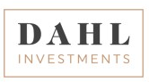
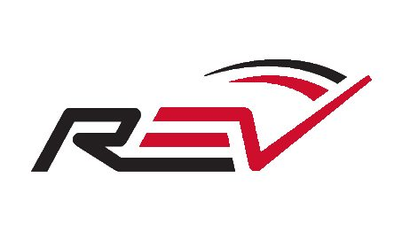
Two Teams Flawlessly Integrated
MARKETING / PORTFOLIO ANALYSIS
FIRMS REPRESENTED
Joe Ehrmann
Cody Nicpon
Jackson Boott
Financial Planning Analyst at Waukesha State Bank
Financial Advising Associate at King, Jenson, & Associates
Research Analyst Intern at Alpha Investment Consulting Group
RESEARCH
Jesse Büttner
Max Curro
Tristan Simkus
Luke Sagone
Corporate Development Intern at REV Group
Fixed Income Intern at BOK Financial
Finance Administrator at PartsBadger
Private Wealth Management Intern at Baird
Jack Linge
Kyler Raube
Jakob Juedes
Equity Analyst at Dahl Investments
Investment Ops & Risk Intern at Northwestern Mutual
Analyst at Northwestern Mutual
2
Notes:
Cody

Slide 4
Mentors Provide Philosophy and Process Durability
Mentors
Dr. Kevin Spellman, CFA
"Coach," named as he coaches students in investments, has over 30 years of experience in investments as an analyst, portfolio manager, consultant, and director of research, which involved managing an analyst team. He’s performed fundamental and quantitative analysis and behavioral research. Coach brings over 25 years of experience teaching investments and 17 years leading UWM’s investment program and 25 years contributing to others.
Kevin Silverman, CFA
Kevin leverages over two decades of experience as a Small-Cap Value Equity Manager, earning Manager of the Decade titles from PSN-Informa for the 10-year periods ending in 2020, 2021, and 2022. Presently, he serves as a Portfolio Manager at Carmel Capital Partners in San Diego, California, and is the Founder of Madison Partners, an investment research partnership established in 1998.
Brian Pinsker
Brian pulls lessons and teaching moments from his 30 years of investment experience. Notably, Brian held senior portfolio manager positions at leading hedge funds including Millennium (11:11 Capital), Viking Global, and Moore Capital. Brian was the head of JP Morgan proprietary
trading desk for N.A. equities, becoming the most profitable trader for the firm in the world.
3
Notes:
Cody

Slide 5


Our Edge
Notes:
Cody

Slide 6
Why a student-led manager
We Believe Our Structure Offers Distinct Advantages in Equity Research and Portfolio Management
Learning mindset may challenge consensus
Students are still developing their frameworks and may be more willing to question prevailing market views
Rapid feedback loop supports skill development
High repetition and frequent peer review can help analysts develop pattern recognition and improve quickly
Structure designed for intellectual honesty
Fewer career incentives can encourage independent thinking and a willingness to admit mistakes early
Process designed to force debate and avoid groupthink
Committee structure and documentation standards surface conflicting views and encourage constructive challenge
Fee structure designed to directly impact students
10% of management fee is allocated to scholarships allowing students to focus more on the fund
Once a year turnover of students ensures fresh eyes on every holding
Fewer biases against selling losers
Great mix of wealth of sector knowledge while still being in tune to trends
Mentors have over 100 years of industry experience and students closely following current trends
5
Notes:
Jakob

Slide 7
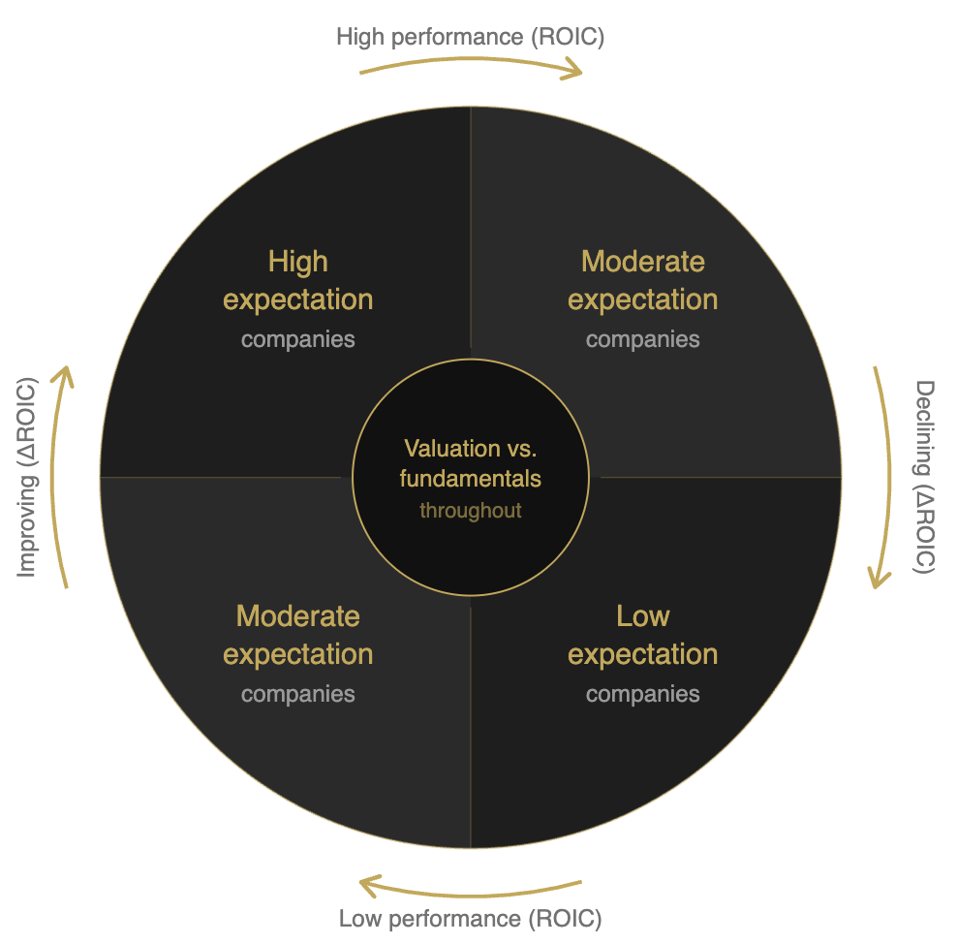
Investment Philosophy
Maximize Return by Buying Improving Companies at Reasonable Valuations
Focus on fundamental improvement and valuation discipline
Seek companies with improving business fundamentals trading at prices that may not fully reflect their intrinsic value
Investing through company cycles
Companies experience reversion, but they beat the fade or accelerate the turn by investing in the future without too much leverage or using their FCF wisely and avoiding overinvesting at the top
Position sizing and risk limits embedded in the process
Portfolio construction balances conviction with risk management through diversification and monitoring frameworks
Fundamental research with a capital allocation focus
Evaluate uses of capital to identify those with a strategy of "hope" by investing during all phases but not being too "greedy" by overspending in peaks; looking for those who are investing but without too much leverage
Prefer identifiable catalysts and conservative underwriting
Investment cases are structured around catalysts that may drive revaluation, with conservative assumptions to preserve downside protection
6
Notes:
Joe

Slide 8
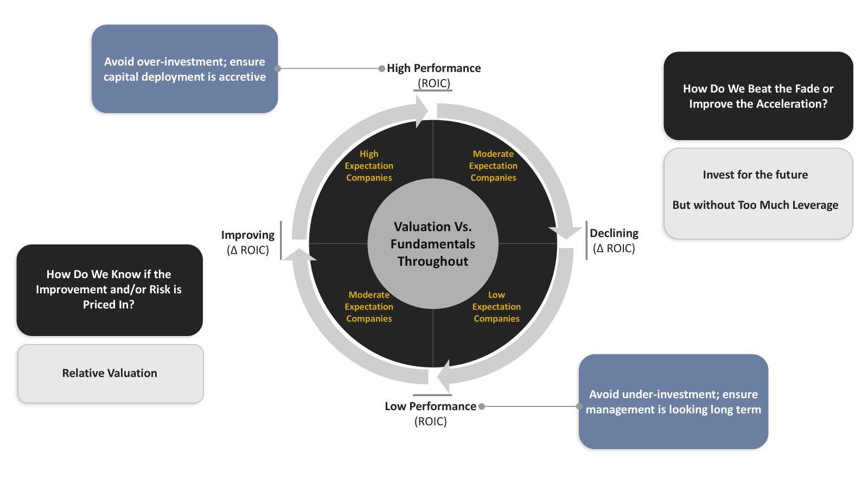
Investing Through Company Cycles
Notes:
Joe

Slide 9
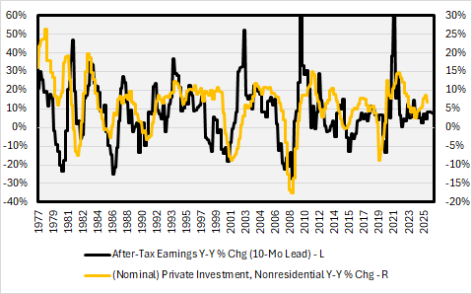
Greedy when fearful and fearful when greedy
Firms tend to overinvest at tops and underinvest at bottoms of the earnings cycle
Cautious at Top
Hope at Bottom
Full range of capital allocation
CapEx, R&D, Brand & Promotions
M&A
Dividends
Share buybacks
Cash
Debt
Investing for the future
Without too much leverage
Ensure management is focusing on long-term results

Slide 10
Investment Process
A Systematic Approach
Screen
Research
Decision & Monitor
Quantitative and qualitative filters on all phases of the cycles to identify potential candidates
Initial screens focus on valuation metrics and historical capital allocation aligned with our philosophy
Fundamental diligence includes financial modeling, competitive analysis, management assessment of capital allocation plans, and scenario planning
Analysts develop investment theses with clear catalysts and risk factors
Investment committee reviews research and makes allocation decisions
Ongoing monitoring includes thesis validation, position management, and disciplined sell criteria to maintain portfolio quality
Systematic filtering • Valuation considered relative to fundamental dynamics
Deep dive analysis • Scenario modeling • Catalyst identification
Committee review • Continuous monitoring • Sell discipline
Notes:
Joe

Slide 11
Portfolio Weight Restrictions
±8%
The maximum percent variance of sector weights between the portfolio and benchmark
Sector allocation is to be determined by our thorough analysis of the economic cycle
±7%
The maximum percent variance of security weights between the portfolio and benchmark

Slide 12
Student control with significant oversight
Four Layers of Professional Oversight
Mentors
Dana Investment Advisors
Three investment professionals with about 100 years of significant experience including in top roles and as portfolio managers
Dana Investment Advisors, which is known in the U.S. as one of the top wealth managers
Large Team of Analysts
Professional Oversight
A university with a team of analysts in their second year of training who’ve had strong performance over the last 16 years under the guidance of a professor
A board of advisors made up of investment professionals who students report to 3X / year
Notes:
Kyler

Slide 13




Sell discipline
A Rules-Based Approach to Managing Position Size
Better Idea
Change in Thesis
May sell to raise capital if a greater opportunity presents itself
If new information suggests we have made a mistake, we immediately liquidate the position
Trimming
Valuation
If a position reaches 7% of invested capital, or the risk/reward ratio is less favorable, we trim the position
If a position reaches our expected return target price or declines 25% relative to the sector, we liquidate the position
Notes:
Kyler

Slide 14
Why value?
Notes:
Kyler

Slide 15
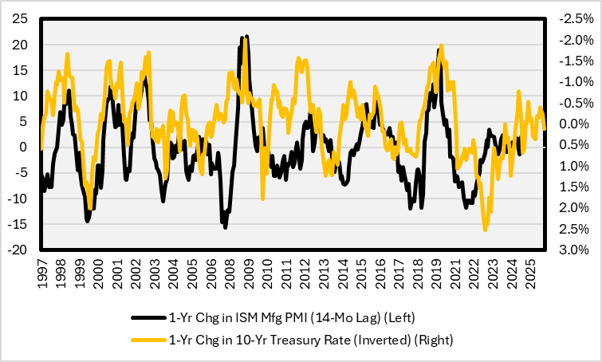
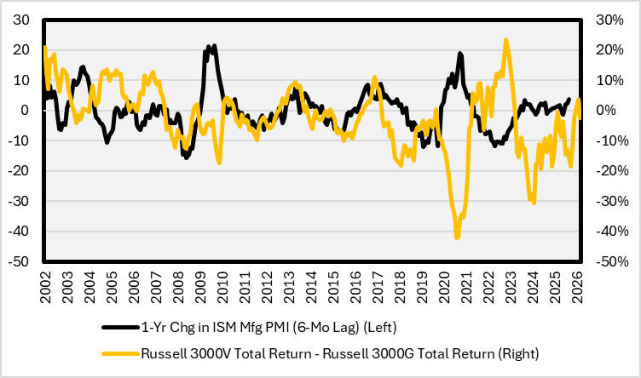
Value typically outperforms when economy improves
Accelerating Economy?
Lower Rates Leads to Rising PMI
When the Fed cuts rates, the cost of capital for capital-intensive businesses (typical value sectors) decreases and stimulates equipment orders, inventory building, and infrastructure investment, which directly drives the PMI higher
PMI Acceleration
When the PMI rises, value tends to outperform and is a beneficiary of an expanding economy
Notes:
Jesse

Slide 16
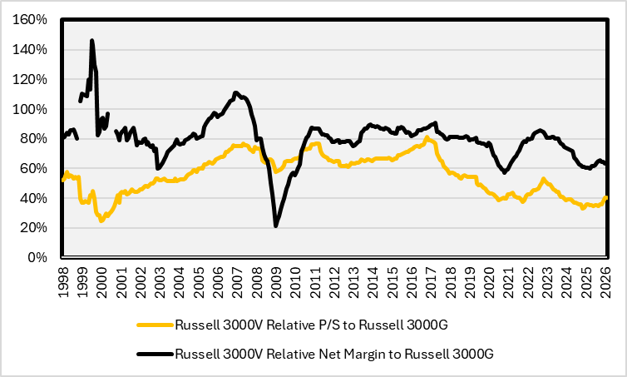
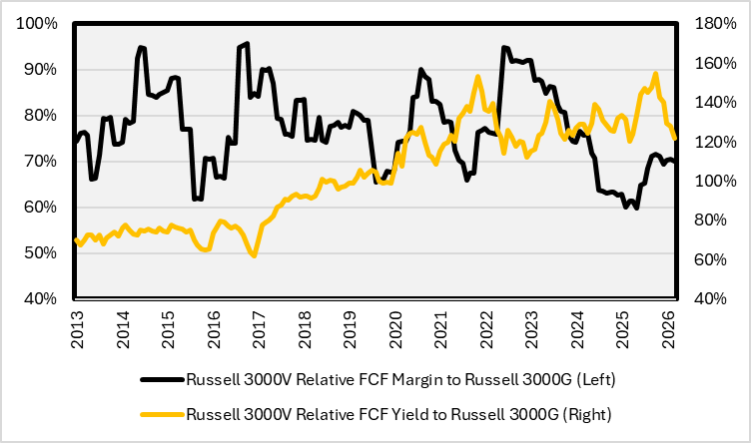
Value is cheaper than normal
Wide Valuation Breadth and AI Changes Competitive Business Landscape
Wide valuation breadth
Value stocks are currently trading at some of the widest discounts to growth in decades, offering an attractive entry point into high-quality companies at discounted prices
Value relatively as cheap as it was during internet bubble
Margin Expansion Opportunity
AI getting introduced to small companies helps their higher fixed costs problem; if AI reduces those costs, the profit drops straight to the bottom line
Large growth companies have had advantage of high profits that they could use to invest into R&D, this advantage may disappear and a level playing field for value
And its FCF margin differential improving
Notes:
Tristan

Slide 17
Value is more diversified
Value is less concentrated and less followed
Diversifying systematic risk
The market is increasingly dominated by a handful of high-multiple growth stocks
Value investing offers a necessary rebalancing toward undervalued sectors with more sustainable valuations
Russell 3000 – Top 10 holdings concentration
18.6%
Top 10 holdings
60.1%
Top 10 holdings
Value less coverage so less efficient pricing and hype?
Value companies on average are smaller and have fewer analysts covering the stocks, so they are less accurately priced
This gives our large team a better advantage
Russell 3000 – Less Efficient Pricing?
 | VALUE | GROWTH
Average Market Value (bil) | $21.9 | $34.8
Weight Average # Analysts | 35 | 48
Analysts for Top 10 | 490 | 597
Number of Stocks | 2,232 | 1,439
Notes:
Jackson

Slide 18
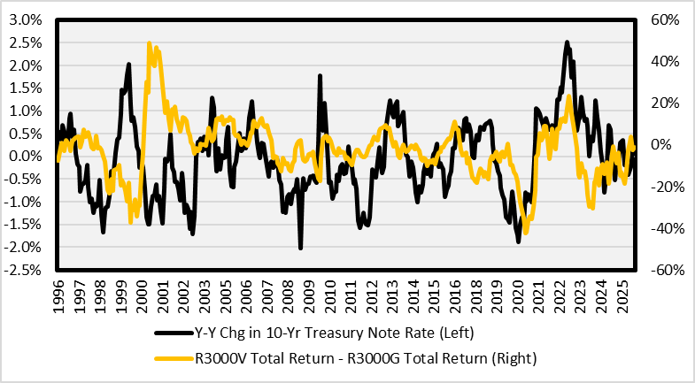
Downside protection
Downside and Rate Protection
Downside protection for investors
Companies with lower valuation multiples and lower expectations tend to outperform in down markets, or at least perhaps more when the valuation spread is wide like today
Russell 3000
Market Down, Odds of Value Outperforming Growth
Period | Monthly | Annual
Since 5/95 | 59% | 62%
5 Year | 65% | 100%
10 Year | 56% | 75%
15 Year | 47% | 55%
20 Year | 48% | 35%
25 Year | 54% | 58%
Protection if rates rise
Growth stocks benefited for much of the 2010s from falling rates as they are the long duration asset
However, what if rates are higher because
  inflation is higher (demand for raw materials for AI investment, Iran conflict, deglobalization),
  rising government debt, and
  decline of the dollar as a reserve currency?
Notes:
Jackson

Slide 19
Current positioning

Slide 20
Portfolio CHARACTERISTICS AS of 5/12/26
Factor | Portfolio | Value Benchmark
Mkt Cap (Wgt Med, MM) | $3949.0 | $2600.0
Yield | 2.16% | 1.73%
P/E (Wgt Harm) | 14.8 | 19.1
P/CF (Wgt Harm) | 9.5 | 10.5
P/B (Wgt Harm) | 1.8 | 2.1
P/S (Wgt Harm) | 1.7 | 1.5
Hist 3 yr Sales Growth | 7.1% | 8.4%
Hist 3 yr EPS Growth | 13.9% | 6.8%
Est. 3-5 yr EPS Growth | 8.1% | 16.5%
Net Margin | 15.1% | 11.1%
ROE | 17.7% | 9.8%
ROIC | 11.8% | 7.1%
LT D/Capital | 32.7% | 35.8%
Portfolio vs. Benchmark
Higher quality than benchmark
  Greater ROE, ROIC, and Net Margin
  P/CF modestly lower than benchmark
Almost balanced, small cap is a little larger
Higher historical growth but lower consensus expected growth
Slightly lower leverage

Slide 21
Overweight quality
Small Cap
Mid & Large Cap
High Performance (ROIC)
High Performance (ROIC)
Improving
(Δ ROIC)
Declining
(Δ ROIC)
Improving
(Δ ROIC)
Declining
(Δ ROIC)
Low Performance (ROIC)
Low Performance (ROIC)
Table of Contents
Notes:
Joey

Slide 22
High roic recently underperformed and a good deal
High ROIC Companies Have Been Underperforming, Until Now?
Value premium much less than quality premium
High ROIC stocks are currently trading at some of the widest discounts to low ROIC stocks, offering an attractive entry point into high-quality companies without paying a premium
Cycle maturation
As of mid-2025, high-quality companies have recently underperformed on a relative 12-month basis, signaling a completed factor rotation
Extreme moves lead to rebounds
Recent underperformance of roughly 20% is normal during economic rebounds but recovery is at least one year underway
Notes:
Jackson

Slide 23
Quality drawdowns are entry points, not exit signals
96%
Hit rate: -10 to -20% drawdown
13x
More return vs chasing rallies
74%
Positive returns after any drawdown
$110.9M
$100M at dip vs. $110.9M at peak
Key Historical Episodes
Episode | Trailing 1-Yr | Fwd 2-Yr
Feb 2000 Dot-com bust | -21.1% | +68.3%
Jan 2021 Post-Covid | -8.9% | +40.7%
Oct 1993 Mid-cycle | -15.8% | +18.9%
Feb 1980 Volcker era | -9.3% | +15.1%
Feb 2004 Junk rally | -20.7% | +3.6%
Feb 1974 Oil crisis | -8.1% | -0.2%
Notes:
Jack

Slide 24
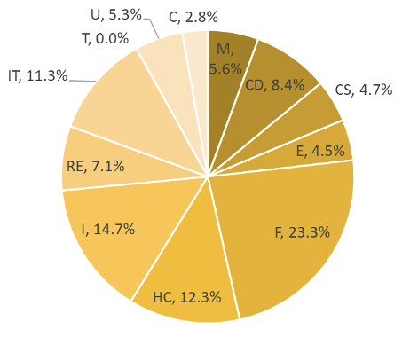
Overweight: F, HC | Underweight: E, IT, T
Table of Contents
Notes:
Kyler

Slide 25
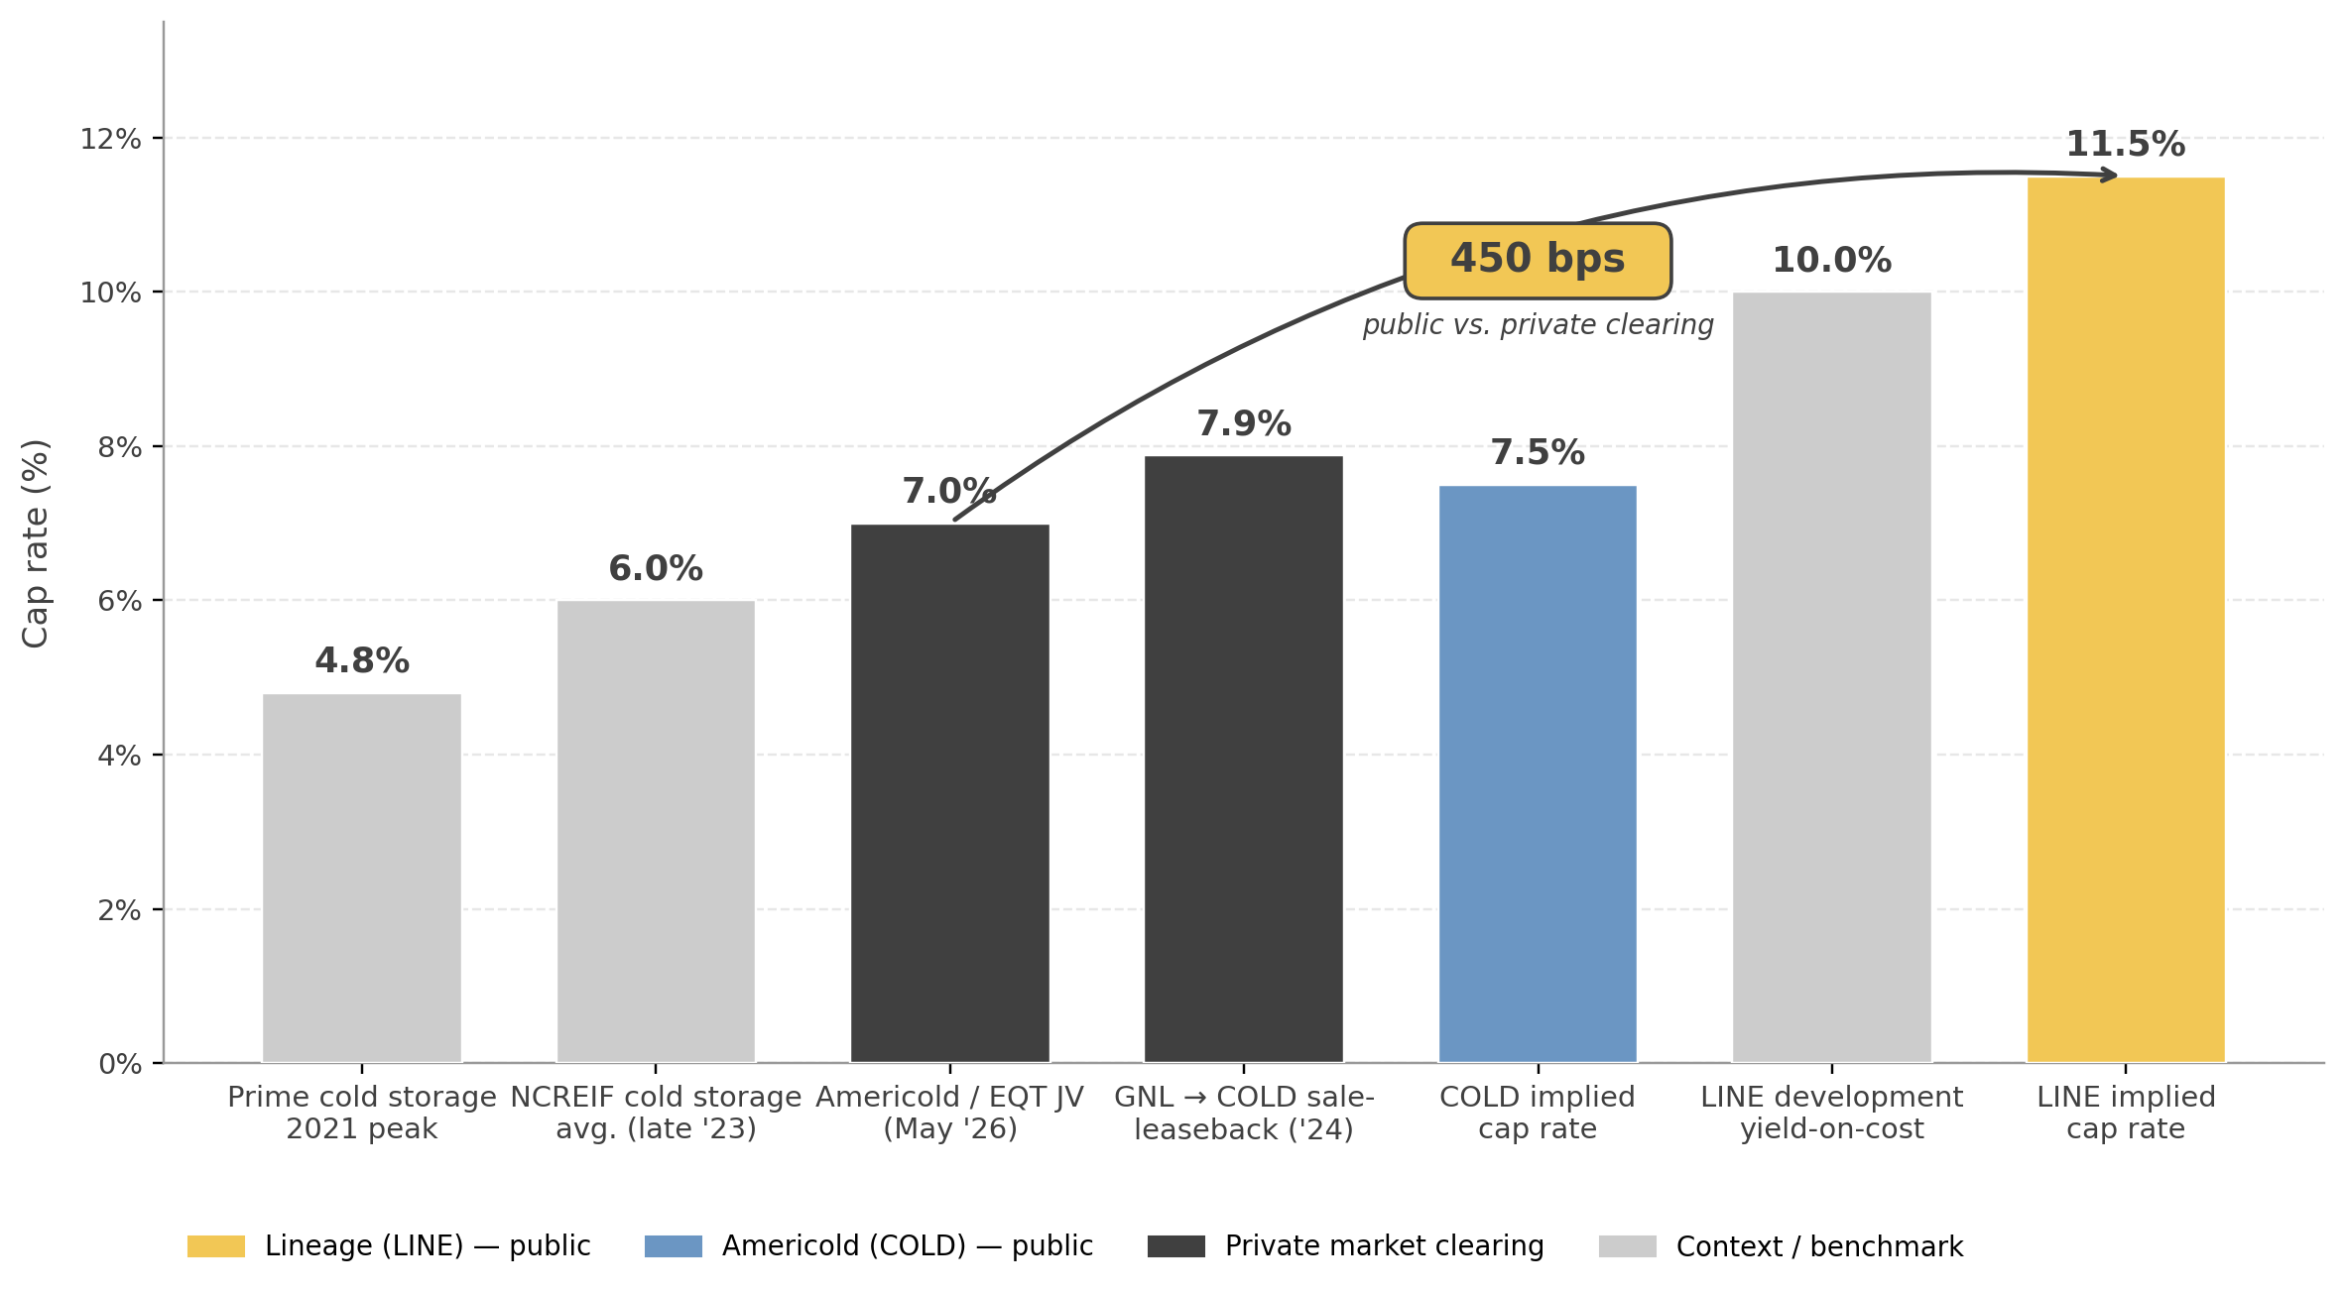
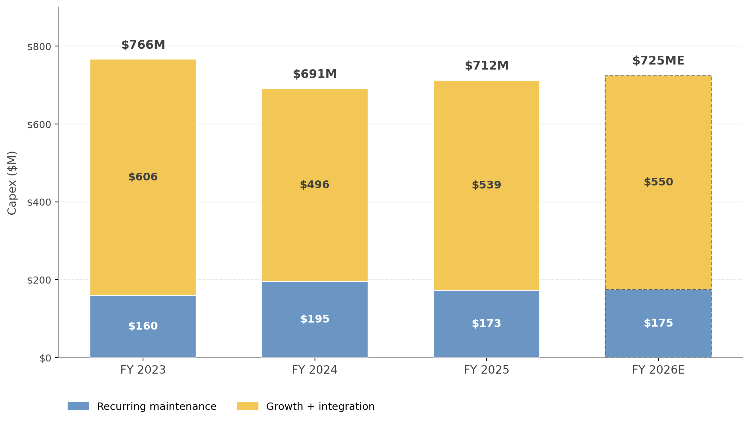
Example 1: Lineage (LINE)
The dominant REIT specializing in cold warehousing and transportation, with an estimated 30% share of the US refrigerated storage industry
Headline Occupancy Understates the Franchise:
  Financial strength masked by a small number of discrete problem assets
Competitive Moat is Real
  Scale and network density creates real switching costs and economies of scale
Disclosures Need to be Fixed, Not the Business:
  Earnings power isn’t broken. Re-rating catalyst is cleaner segmental disclosures
Approaching Macroeconomic Trough
  Inventories have destocked from 2024-2026, now there are green shoots
Oversupply is Cyclical, Business Strength is Structural
  Demand is starting to catch up with supply
Investment Thesis: Lineage is quietly positioning itself for dominance in the cold chain
industry by maintaining a consistent capex budget (increasing through the downturn)
to roll up weaker players and improve operational efficiencies. Lineage is a coiled spring,
not a broken business
Notes:
Jack

Slide 26
Example 1: Lineage (LINE)
Invested Capital
ROIC
Leverage
- Invested Capital continues to grow as Lineage acquires weaker competitors and expands capacity internally.
- Expected to grow at a run-rate $550m per year
Gross Invested Capital is used as a proxy for invested capital
- Expected to grow by 210bps per year as inventories restock and overcapacity resolves
- Projected 20.6% in 2030
Cash NOI Yield is used as a proxy for ROIC
- Lineage is expected to de-leverage its balance sheet down to 6.0x Net Debt to 2026 EBITDA, down from 7.2x
LINE
Notes:
Jack

Slide 27
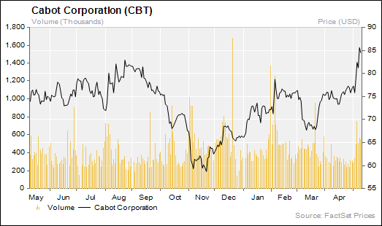
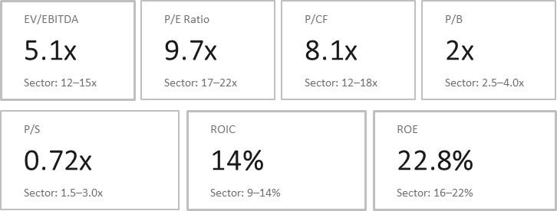
Example 2: Cabot Corporation (CBT)
Current Price: $84.53
Target Price: $99.00
A global specialty chemicals company that produces carbon black, performance additives, and advanced materials used in industries like tires, electronics, and energy
Sustainable Competitive Edge:
  3-5-year lead in technology on competitors with dozens of Patents In
  carbon black technologies
Key Catalyst:
  PowerCo SE’s battery production is expected to ramp up in 2026,
  accelerating growth in the Battery Energy Storage Systems market
Key Risk:
  Asian tire imports are putting pressure on Cabot’s Reinforcement
  Materials segment
  Cabot’s reliance on PowerCo as a major customer
Millions of USD
Source: FactSet, IMCP
Investment Thesis: CBT is the dominant player in carbon black globally, which gives them
real pricing power and predictable cash flows through contracts. It is trading at a discount
we think is unwarranted at 7-8x EBITDA, with lower leverage and consistent
buybacks (150M-200M of shares annually).
Notes:
Cody

Slide 28
Example 2: Cabot Corporation (CBT)
Invested Capital
ROIC
Leverage
- Battery materials is primary IC growth driver – expanding capacity for supply agreement with PowerCo SE (VW Group)
- IC projected to rise by 11.4% over the next 3 years
- ROIC will continue to grow with the PowerCo SE agreement and as BESS market grows (projected 26% CAGR)
- ROIC projected to rise by 6.0% over the next 3 years
- Company maintains a conservative balance sheet with an allocation towards (1) growing capex in battery materials, (2) dividends, and (3) share buybacks
- Debt/IC projected to fall 10.0% over the next 3 years
CBT
Notes:
Jackson

Slide 29
Performance highlights
Notes:
Kyler

Slide 30
Objective: Outperform Blended Benchmark*
Outperform Blended Benchmark* on a Relative Return Basis
Select stocks with relatively improving fundamentals with cautiously optimistic management and attractive valuation
Bottom-up investing across companies with all levels of quality to generate alpha across all market environments
*50% Russell 1000 Value and 50% Russell 2000 Value
Table of Contents
Notes:
Luke

Slide 31
Annualized Outperformance of 0.94% Since Inception
Takeover
Panther Value Fund annualized return: 11.48%
Benchmark annualized return: 10.53%
* Returns are provided by FactSet, which differs from actual due to transaction fees, intraday pricing not taken into account by FactSet, and other factors. Performance attribution and risk figures are also computed using FactSet, and while not exact, they provide a good overall representation of performance attribution and risk
Table of Contents
Notes:
Jakob

Slide 32
Lower Risk Since Inception, Higher Sharpe Ratio
Statistics | Value Fund | Value Benchmark
Annualized Standard Deviation | 19.21 | 21.51
Tracking Error | 7.41 | --
Treynor Ratio | 11.80 | -15.39
VaR | -13.22 | -15.39
Statistics | Value Fund | Value Benchmark
Beta | 0.84 | 1.00
Sharpe Ratio | 0.52 | 0.42
Information Ratio | 0.13 | --
Jensen Alpha | 2.20 | --
Source: FactSet, IMCP
Source: FactSet, IMCP
Table of Contents
Notes:
Max

Slide 33
Appendix
Notes:
Kyler

Slide 34
Table of contents
1. Our Team
4. Buy/Sell Decision Making
7. Characteristics
Marketing/Portfolio Analysis Team
Buy Process
Top 5 Less Bottom 5 - Combined
Research Team
Trim Discipline
Top 5 Less Bottom 5 - Small & Mid/Large
Mentors
5. Holdings
Allocation - Small as of 4/30/26
2. Philosophy
Allocation - Mid/Large as of 4/30/26
Sector Weights
Portfolio vs Benchmark as of 5/12/26
Objective
Weights as of 4/30/26
Portfolio vs Benchmark - Small
Investment Philosophy
Weights as of 5/12/26
Portfolio vs Benchmark - Mid/Large
Investing Through Company Cycles
Small vs Mid/Large Holdings as of 4/30/26
Greedy when Fearful, Fearful when Greedy
Small vs Mid/Large Holdings as of 5/12/26
Top 10 Holdings
8. Risk Statistics
3. Process
Holdings Visualized
Risk Adjusted Returns Since Inception
Bottom-Up Focus
Portfolio Evolution as of 4/30/26
Risk Adjusted Returns Since 1/1/2025
Bottom-Up Focus with Macro Overlay
Portfolio Evolution since 4/30/26
Northfield Risk Statistics
Comprehensive Screening
Axioma Risk Statistics
6. Performance
Long-term and recent performance
Monitoring Process
Since Inception
Portfolio Weight Restrictions
Since Transition

