Slide 1
Business in Eastern Europe: Hungary, Slovakia and Czechia UWinteriM 2027, January 4-14, 2027 Tentative Itinerary
Course Instructor Course Assistant
Dr. Amit Bhatnagar Ms. Liz Baumgarten
Professor of Marketing Academic Advisor
amit@uwm.edu Undergraduate Student Scholarship Coordinator baumga77@uwm.edu

Slide 2
Itinerary
Depart Milwaukee on Jan 3, 2027
Reach Budapest (Hungary) on Jan 4, 2027 (Monday)
Return from Prague (Czechia) on Jan 14, 2027
(Hotel reservation is till Jan 13 night)
Reach Milwaukee on Jan 14, 2027

Slide 3
Structure of Classes
Morning Session – Class Lectures
Afternoon Session – Cultural Visits
Couple of afternoons free for self-study
Most of the evenings free for self study

Slide 4
Grading
298/498 726
Class Participation/Assi 50% 25%
Projects 25 %
Final Examination 50% 50%

Slide 5
Estimated Cost
Estimated Cost: $ 3,500.00
What is covered
Hotel+Breakfast, Travel Pass, Daytrips, etc.
Health Insurance
Tuition
What is not covered
Airfare
Lunch/Dinner
There are 15 scholarships of $500 awarded to the first 15 students whose application are complete and accepted

Slide 6
Accommodation
Twin bedded rooms with private bathrooms
Breakfast is included at the hotel
Public transportation pass for the entire stay in all the cities
Welcome Dinner at a restaurant in Budapest and a Farewell Dinner at a restaurant in Prague

Slide 7
Day 2, Jan 4
Arrive at Budapest Airport
Get local currency
at the airport
Take Public
Transport/Cab
to Hotel Novotel
Budapest Centrum
Welcome Dinner

Slide 8
Day 3, Jan 5
9:00 – 10:30 am Guest lecture on “A Global Economic History of Hungary: from the Austro-Hungarian Empire to State-Socialist and Market Economies”
11:00 am - 12:00 pm Guest lecture on “Economic Effects of European Integration on the Hungarian Economy
12:00 – 2:00 pm: Lunch (on your own)
2:00 - 3:30 pm Guided walking tour of Budapest

Slide 9
Day 4, Jan 6
9:00 - 10:30 am: Guest lecture on e.g. “Differences in Business Practices between Eastern Europe and the USA” by a local expert
10:30 am - 12:00 pm: Guest lecture on e.g. “Advantages and Disadvantages of Joining the Euro and the Process of Joining the Eurozone”
Afternoon: Guided tour of the Budapest Parliament & St. Stephen’s Basilica

Slide 10
Day 5, Jan 7
Morning Corporate Visit
Afternoon free
Evening Danube River Cruise

Slide 11

Day 6, Jan 8
Morning: Visit a vineyard and drive through the wine region
Afternoon: FREE TIME

Slide 12
Day 7 Jan 9
Morning: Bus to Prague. Ticket prices included.
Stopover in Bratislava
In Prague, stay at
Ibis Prague
Old town
Breakfast included

Slide 13
Day 8, Jan 10
Guided walking tour of Prague
Admission to Prague Castle

Slide 14
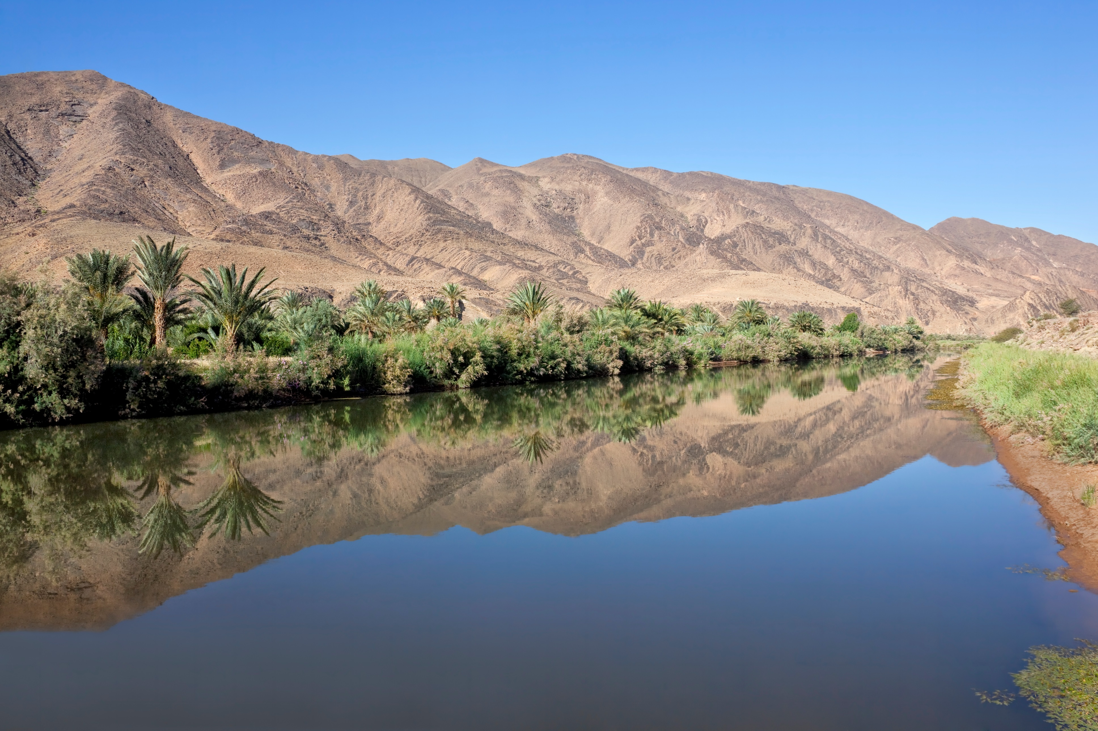
Day 9, Jan 11
9:00 - 10:30 am: Guest lecture on “How the Communist Economy was transformed into a Free Market Economy”
10:30 am - 12:00 pm: Guest lecture on “The Voucher Privatization System”
Afternoon: Free

Slide 15
Day 10, Jan 12
9:00 - 10:30 am: Guest lecture on e.g. “Political Evolution of the Czech Republic incl. a Discussion of the Velvet Revolution”
10:30 am - 12:00 pm: Guest lecture on e.g. “Overview of the Czech Republic and Slovakia Economics”
Afternoon: Visit T Mobile or Cisco Czech Republic

Slide 16
Day 11, Jan 13
Morning: Exam
Farewell dinner
Day 12, Jan 14
Depart for Milwaukee

Slide 17
Wisconsin Study Abroad Grant
Average award is between $500 - $800
To qualify for a Wisconsin Study Abroad Grant you must:
be a Wisconsin resident.
be enrolled in a UWM Associate’s or first Bachelor’s degree program
be participating in a UWM-sponsored study abroad program.
have a Free Application for Student Aid (FAFSA) application on file, and be listed with the Federal Student Financial Aid System.
be enrolled full-time in the preceding semester to qualify for a summer or UWinteriM award (Academic Opportunity Center students must be enrolled for 9+ credits during the fall/spring term).

Slide 18
Lubar Study Abroad Grant
$500
Qualifications for Lubar Study Abroad Grant:
First 15 applicants who apply and are selected
All Scholars and MTP students automatically get this scholarship

Slide 19
How to apply
Click this link
Programs>Center for International Education
Look for Apply Now button and then just fill the form

Slide 20
Questions
Course Instructor Course Assistant
Dr. Amit Bhatnagar Ms. Liz Baumgarten
Professor of Marketing Academic Advisor
amit@uwm.edu baumga77@uwm.edu
Application
Ms. Kate Betka
Study Abroad Program Manager
Center for International Education
kbetka@uwm.edu

