Slide 1
AFSA 2021 Reception: Online
February 25, 2021

Slide 2
Thank you for joining us

Slide 3
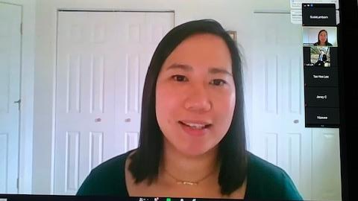
AFSA co-chair Natalie Chin
Natalie is the host of the event. She provides statements of solidarity against racism and xenophobia; invites Asian Faculty and Staff to reflect on our own practices of social justice; and encourages us all to come together to voice our power against racism and discrimination.

Slide 4
The AFSA Student Award Recipients

Slide 5
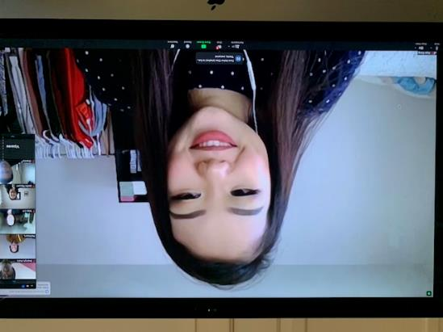
AFSA Student Achievement Award
Hope Xiong, Undergraduate Student, Business Administration, Human Resources Management
Volunteer Work – Milwaukee Consortium for Hmong Health

Slide 6
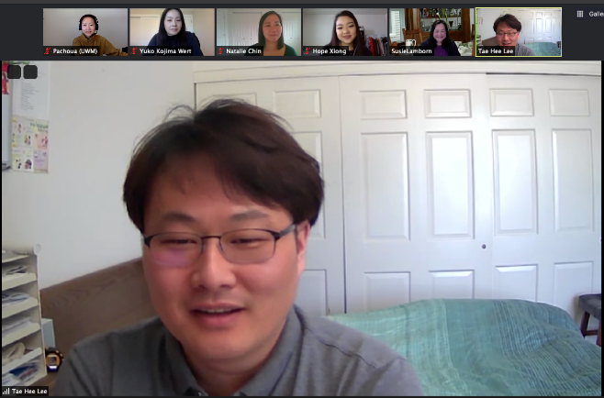
Dr. Swarnjit Aurora Award
Tae Hee Lee, Graduate Student, School of Information Studies
Volunteer Work – Korean Immigrant Church, Korean-American Association

Slide 7
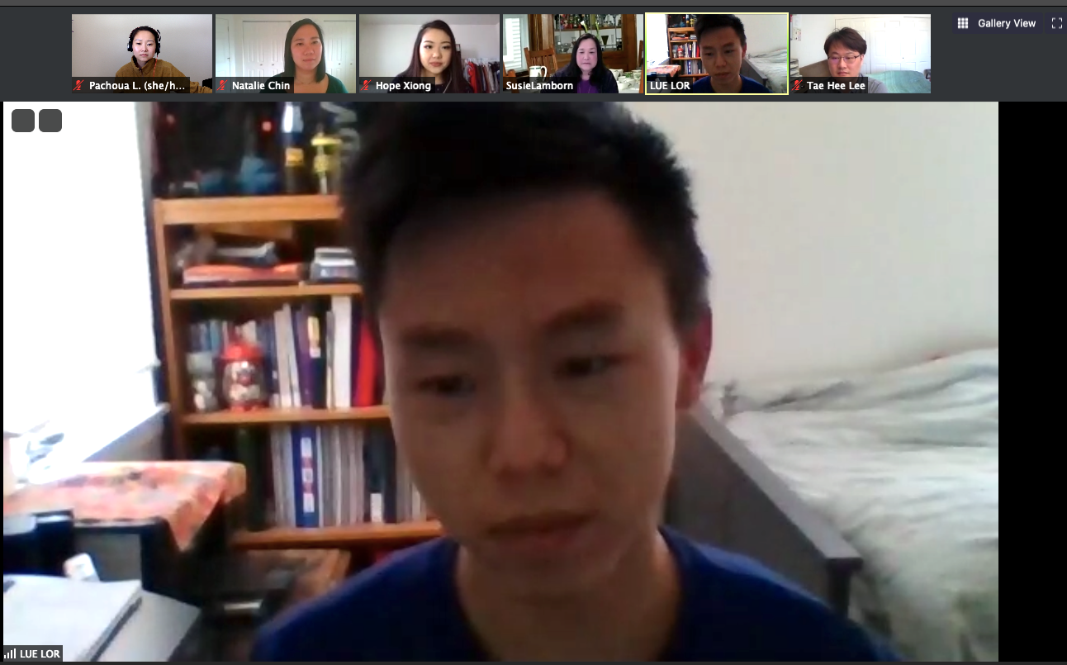
Honorary Award
Lue Lor, Undergraduate Student, Engineering
Volunteer Work: Hmong American Friendship Association

Slide 8
The Award Winners
Hope Xiong
Lue Lor
Tae Hee Lee

Slide 9
Thank you, Award Committee!
Ivy Lu
Pachoua Lor
Paru Shah
Susie Lamborn, Chair

Slide 10
Three UWM Leaders join us with words of hope and inspiration

Slide 11
Chancellor Mark Mone

Slide 12
Provost Yohannes Britz

Slide 13
Vice Chancellor of Global Inclusion & Engagement Joan Prince

Slide 14
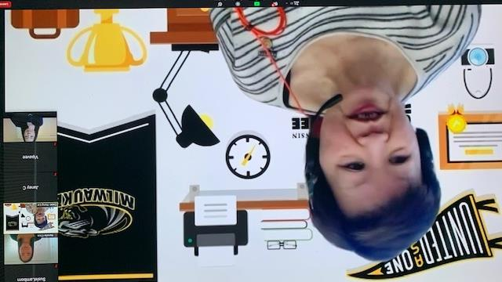
Gwat Lee honors Vice Chancellor Joan Prince’s retirement
Joan Prince has been a tireless supporter of the AFSA Committee, sharing with us in our annual receptions and providing support to the organization. Much thanks Joan for your contributions to our efforts.

Slide 15
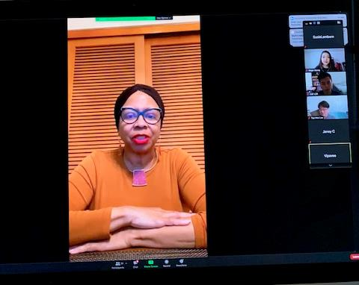
Thank you, Joan!!!
Among many other accomplish-ments, Joan has helped to institute mandatory anti-racist and anti-bias training for all UWM faculty and staff.

Slide 16
Janey partners with Swaye Tea for tea gifts if you registered at the silent auction

Slide 17
Swaye Tea 7326 W. Greenfield West Allis, WI 63214 414-388-2798 swayetea.com

Slide 18
Thanks to Janey and Swaye tea

Slide 19
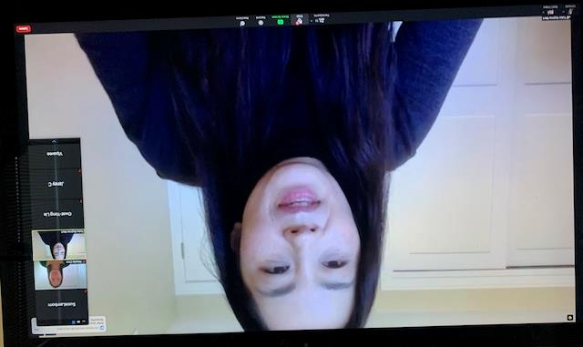
Yuko Kojima-Wert is the AFSA co-chair
Yuko reminds everyone to participate in the Silent Auction and 20-20 Raffle to support further activities by AFSA

Slide 20
AFSA Silent Auction

Slide 21
The 50-50 Raffle and Silent Auction support further work by AFSA

Slide 22
Thanks to AFSA Steering Committee Members for behind the scene efforts to make this event a success

Slide 23
AFSA Steering Committee

Slide 24
AFSA Steering Committee
Yuko Kojima-Wert, Co-Chair, Foreign Languages & Literature
Natalie Chin, Co-Chair, Registrar’s Office
Chia Y. Vang, Global Inclusion & Engagement/History & Hmong Diaspora, L&S
Hanh Trinh, Health Sciences
Vipavee Thongpriwan, Nursing
Paru Shah, Political Science
Channy Rasavong, Central Advising
Jacqueline Nguyen, Educational Psychology, SOE
Karen Miyoshi, Health Sciences
Pachoua Lor, Southeast Asian American Student Center
Gwat-Yong Lie, Social Welfare
Dawn Lee-Vue, Office of the Provost, Academic Affairs
Susie Lamborn, Educational Psychology, SOE
Linda Huang, Emerita
Lingqian (Ivy) Hu, Urban Planning
Janey Christoffersen, Registrar’s Office
Genaro C. Armos, Marketing & Communications
Swarnjit Arora, Professor Emeritus

