Slide 1
Working toward Whole Campus Engagement in Accessibility & Student Success
Diane Reddy
Director, Center for Excellence in Teaching & Learning

Slide 2
Webinars
When the DOJ/OCR Makes a Visit: Lessons Learned in Resolving Complaints About Inaccessible IT
http://www.3playmedia.com/resources/webinars/lessons-learned-02-17-2016/
A Blueprint for Building, Maintaining, and Improving EIT Accessibility

Slide 5
Syllabus Statements
The Ohio State U: Any student who feels s/he may need an accommodation based on the impact of a disability should contact me privately to discuss your specific needs. Please contact the Office for Disability Services at 614-292-3307 in room 150
U of Arkansas at Little Rock: It is the policy of UALR to accommodate students with disabilities, pursuant to federal law and state law. Any student with a disability who needs accommodation, for example in arrangements for seating, examinations, note-taking should inform the instructor at the beginning of the course. It is also the policy and practice of UALR to make web-based information accessible to students with disabilities. If you, as a student with a disability, have difficulty accessing any part of the online course materials for this class, please notify the instructor immediately. The chair of the department offering this course is also available to assist with accommodations. Students with disabilities are encouraged to contact Disability Support Services, telephone 501-569-3143 (v/tty), and on the Web at http://www.ualr.edu/dssdept/ .

Slide 6
Syllabus Statements
UWM: Quiz times have been extended for many students with a recognized disability. I want you to have what you need so you can be successful, so please don’t hesitate or wait to tell me. I am happy to provide whatever special accommodations the Accessibility Resource Center recommends that will allow you to fully participate and perform well in this course.
If you have a recognized disability under the ADA, please provide me with documentation as soon as possible from the Accessibility Resource Center (Mitchell Hall 112, 229-6287, http://uwm.edu/arc/). Please drop your VISA form off ASAP in an envelope to my mailbox (Professor X) in the main office of Y (Northwest Quadrant xxx), or scan and email it to me (xxxxx@uwm.edu).

Slide 9
Portland Community College Accessibility Handbook: http://www.pcc.edu/resources/instructional-support/access/handbook.html

Slide 10
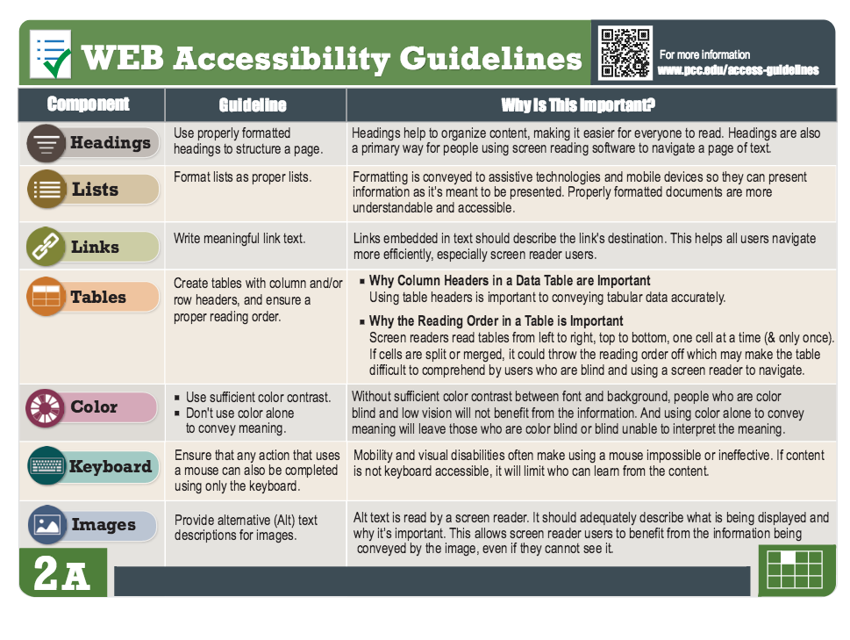

Slide 12
Instructor Responsibilities for Online Courses
As the subject matter expert and the course developer, an instructor:
Designs clear and consistent navigation
Writes alternative text description for images
Creates documents using accessibility guidelines
Retains original files (PowerPoint, Word)
Uses captioned media whenever possible
Writes math and science with MathML (D2L equation editor), LaTeX, MathType, or Libre Office
Checks accessibility of required software and web applications
Supplies ARC with course materials upon request for an accommodation
Prepares accessibility plans for inaccessible content
Portland Community College

Slide 13
How Can We Proactively Increase Whole Campus Engagement in Accessibility?
Resources
&
Tips

Slide 14
CETL Study 2016 Open Textbook Satisfaction by Disability Status

Slide 15
CETL Study 2016 Perception of How Well Open Textbook Facilitated Learning

Slide 16
http://uwm.edu/deta/
National Research Center on Distance Education and Technological Advancements (DETA)

