Slide 1

Tilting for Equity
How simple assignment re-design can improve student outcomes
Susan Stalewski, MBA. MLS (ASCP) , College of Health Sciences, sstalews@uwm.edu

Slide 2

Learning outcomes
Identify equity goals for higher education that can be supported with transparency in assignment design strategies
Compare existing competency assessments to revised assessments using TILT design
Discuss how evidence supporting transparent teaching and learning can be applied to the CBE model of education

Slide 3



Ten UW Flexible Option Programs
UW-Madison
Substance Use Disorders Counselor Certificate
UW-Milwaukee
Nursing – RN-to-BSN
Diagnostic Imaging
Health Sciences
Associate of Arts & Science
Business & Technical Writing Certificate
Information Science & Technology
Healthcare Informatics Certificate
UW-Parkside
Business Administration
Project Management
    Key Data
Launched: January 2014
Current Students: 615
YTD Headcount: 933
Completions: 1104
Retention: 59-81%

Slide 4
Student reported outcomes
confidence...in myself, my life, and my future
enabled me to leave the job I had, more qualified
Got my dream job at the Center for Healthy Minds!
half way done with my MSN
I got a new job with 85% raise within 3 months
I'm a much stronger person now. I feel more self-worth and no longer let anything hold me back from things I want to achieve. I never had that sense of empowerment before. I've been able to do so many more things because of what I learned about myself when going through the program.
I'm currently being recruited for a new position.
Nurse of the year at my institution
Officer in the military
PMP Certification
possible career switch
Prepare for promotion opportunity
Proceed to MBA program
Quit my job to travel the world knowing that my resume would look awesome when I came back!
self-worth
Notes:
UW Flexible option student survey 2019

Slide 5
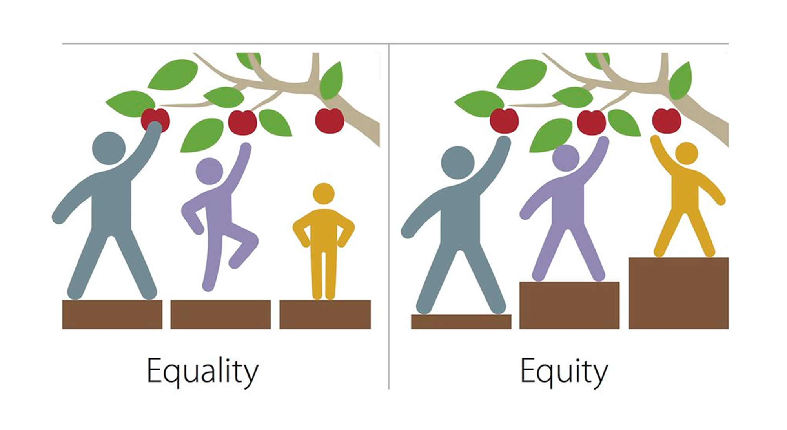
Equity and TILT (transparency in learning and teaching)
Based on Transparency and Problem Centered Learning project
                Winkelmas, Finley, McNair - 2014
  Targeted toward students who are under-represented and first generation
      Simple intervention led to these predictors of success
academic confidence
sense of belonging
mastery of the skills that employers value most when hiring.
CC BY-NC 2.0

Slide 6
Indicators of non-transparency
“what do you want?”
Assignment elements missing from submissions
Multiple resubmissions
Marginal competency
Possible plagiarism and academic integrity issues
Attrition

Slide 7
Key elements of transparent assignment design
Purpose of assignment: what skills are practiced and what knowledge is gained.
The Task: What to do and how to do it.
Criteria: a checklist or rubric for self-evaluation and annotated examples of excellent examples of the assignment.

Slide 8
A learner focused assignment
Positive language and belief in success is evident
Personal pronouns are used
Organized and logical directions
Avoids focus on minor details (such as formatting)
The assignment encourages student interest
The task is similar to the work that professionals/experts might perform

Slide 9
Pre-tilt assignment
What is the purpose ?
What tasks are expected?
What are the guidelines for success?
Define Interprofessional collaboration in healthcare and develop a case for inter professional teamwork in your current or hypothetical workplace
This assignment will address each of the following topics:
Identify evidence- based outcomes for interprofessional practice (what is the improvement to the healthcare system when people work together?)
Describe the essential components of Interprofessional collaboration (what needs to happen for this to work?)
Address barriers and misperceptions related to IPP (why wouldn’t health professions want to do this?)
Create a 15 second case (script) to convince a colleague about the benefits of Interprofessional collaboration (sometimes this is called an elevator speech)
This submission should be approximately five pages including the reference page. You should cite at least five references. No less than two references must be scholarly sources. Format this paper in APA style.

Slide 10
What is missing?
Purpose
  What content knowledge and skills will be gained?
  Is there alignment to the course/assignment learning outcomes?
  What is the relevance to the student’s life?
  Is there student centered and motivating language?
Task
  What are the exact steps or required work
  Is there a recommendation for steps needed to complete the work?
  Are there tips about mistakes or roadblocks to avoid?

Slide 11
Tilted assignment purpose
CC0 Rod McRae 2018
Notes:
1. Purpose statement
Course and learning outcomes
Relation to the course and progress in the course
Contribution to overall academic success
Career connections
“real world” connections

Slide 12
Tilted purpose and alignment
Purpose: The purpose of this assessment is to help you develop and practice the following knowledge and skills essential to your success and to the future of healthcare
Program goal met with this assessment | Course goal(s) met with this assessment | Assignment learning outcomes
Demonstrate commitment to professional growth, ethical values, career development, scholarly activities, and contributions to the profession and post-baccalaureate education. | Describe the concepts and principle of Interprofessional education and advocate for the benefits of Interprofessional practice Evaluate and synthesize information from expert groups and professional literature | Defend the rationale for interprofessional collaboration and practice Evaluate and Integrate IPEC core competencies Demonstrate IPE information literacy

Slide 13
Tilted purpose
Skills: After successfully completing this assessment you will be able to:
  Recommend a plan for Interprofessional education and Interprofessional practice to peers or administrators (exhibiting communication and advocacy)
  Support IPP and IPE with a brief advocacy presentation (elevator speech) where you demonstrate crisp and clear communication
  Identify and assess the literature and expert knowledge in IPE and IPP (information literacy)
Knowledge: After successfully completing this assessment you will know:
1. The principles of the Interprofessional Education Collaborative
2. The purpose and goals of Interprofessional education and Interprofessional practice
Benefits you future and your life outside of the university:
Health care, like many industries, functions better when professionals work collaboratively in a respectful environment. The goal of Interprofessional practice is to enhance quality care and improve patient safety. Your work in this assessment prepares you to advocate for, implement and support IPE/IPP in your work-place.

Slide 14
Tilted tasks
Tasks to complete the assignment
Part one is a written paper. You will use learning resources provided to begin your understanding of the topic. After you have a base understanding, conduct a search of the literature and expert sources to expand your knowledge. You will identify at least five resources, two of these must be scholarly sources.
  Your paper should address these points:
  The improvement to the healthcare system when people work together
  The essential components of interprofessional collaboration
  Barriers and misperceptions related to interprofessional practice
  Tips for conducting your information search:
  Begin with the College Level Research Tutorial (UWM libraries)
  Consult a librarian to refine your strategy (ask a librarian function – UWM Libraries)
  Search the UWM libraries databases
  Investigate expert resources referenced in the assessment learning materials
Try asking yourself these questions
  How can you assess the value or importance of IPP?
  What would you recommend?
  What evidence can you find for the value of these practices?
  What would you predict would be the outcome of IPP for patients and professionals in the healthcare sector?
Your paper should be approximately 1200 words (five double spaced pages not including the reference page) Format this paper in APA student paper style.
  Consult assessment learning materials, the UWM Writing Center or the NetTtutor English and Writing tutor. All are available to you online.
  You should be sure to analyze and synthesize the information you learn, using your own words and avoiding excessive direct quotation or paraphrase

Slide 15
Tilted tasks..
Part two is a brief argument
  Create a 15 second argument to convince a colleague about the benefits of Interprofessional collaboration (sometimes this is called an elevator speech)
    The minimum expectation is a written script.
    You could create an audio or video presentation
    Write only in your own words
  Tips for completing this assignment
    You can investigate YouTube, TedEd and IPE/IPP expert sources to see what others are saying
    Consider the benefit to the patient and to the healthcare workforce
    Remember: this is a short communication. You must demonstrate clear and concise argument. Your audience should know precisely the key points of your argument.
    You will evaluate other cases in this course, so the background work for this assignment is good practice!

Slide 16
Tilted tasks…
What to avoid
  Procrastination – you will not be able to do a quality evaluation under time pressure
  Conducting your entire search via a search engine (Google, etc)
  Excess direct quotes. A goal is for you to formulate an analysis and make an argument
  Improper format. You should take advantage of available resources if you need these

Slide 17
Assessment for transparency
Criteria for assessment are in a checklist, rubric, or text description
Characteristics of high quality work are specified
  Sources, audience, writing style, etc
Criteria support the assignment’s purpose
Annotated exemplars are provided

Slide 18
Observed gains
Reduced confusion about requirements and more focus on content of assignment
Overt focus on impact outside of the class itself (avoids the checking the box phenomena)
Purpose statements help us to focus assessment design
Helps with authentic nature of assessing
Improved retention (multi-factor)
Future: quantitative analysis of retention, PR grades
Future: qualitative analysis of student experience, questions to coaches and instructors, other?
Notes:
Coupled with demonstrated evidence of the student outcomes (Winkelmes et al., 2016),

Slide 19
Resources
Palmer, M., Gravett, E., & LaFleur, J. (2018). Measuring Transparency: A Learning-Focused Assignment Rubric. To Improve The Academy, 37(2), 173-187. doi: 10.1002/tia2.20083
Wilkemes, M., 2014. TILT Higher Ed. [online] Tilthighered.com. Available at: <https://tilthighered.com/
The Unwritten Rules of College
http://www.chronicle.com/article/The-Unwritten-Rules-of/233245
Volk, S. (2015). Revealing the Secret Handshakes: The Rules of Clear Assignment Design [Blog]. Retrieved from https://steven-volk.blog/2015/09/27/revealing-the-secret-handshakes-the-rules-of-clear-assignment-design/

