Slide 1
Student Employment
Where Learning Happens

Slide 2
Today’s Agenda
Overview of Learning Outcomes
UWM Employment Experience – What our data says
Student Employment Survey
Project CEO
Developing our outcomes
Next Steps

Slide 3
What are Learning Outcomes and Why are we doing this?
Our commitment to being intentional about the student experience at UWM
State our intended outcome
Measure if we’ve achieved our goal
Consistent, high quality learning experience
Example: Students who participate in Sophomore Springboard will be able to identify at least one behavior of each of the Leadership Practices.
Notes:
Talk about what is happening at the unit level
Why we are doing this process for student staff

Slide 4
Our Student Interactions

Slide 5
Student Employment Experience Survey

Slide 6
Background

Slide 7
Created in Spring 2014
258 respondents in 2014 vs 413 respondents in 2015
25 departments/offices in the division were represented by student staff
Changes made to the 2015 survey to reflect what students are learning and whether or not their training on the job was sufficient

Slide 8
Data

Slide 9
Skills assessed
• Quality Customer/Patron Service
• Accountability/Reliability
• Productivity: Organizing/Prioritizing/Effectively managing time
• Teamwork
• Respectful of others
• Communication (verbal)
• Communication (written)
• Professionalism
• Critical Thinking/Problem Solving
• Initiative
• Resiliency
• Integrity
• Self-Confidence

Slide 10
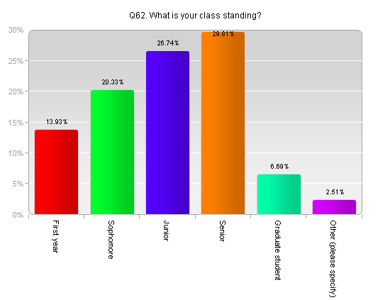
Class Standing vs skills learned
The 413 respondents indicated their class standing as:

Slide 11
Class Standing vs Skills Learned cont.
Top 3 skills improved upon the most by class standing
First Year:
Communication (Verbal), Quality Customer/Patron Service, and Productivity: Organizing/Prioritizing/Effectively managing time
Sophomore:
Communication (Verbal), Productivity: Organizing/Prioritizing/Effectively managing time, and Quality Customer/Patron Service
Junior:
Teamwork tied with Communication (verbal), and Productivity: Organizing/Prioritizing/Effectively managing time
Senior:
Communication (Verbal), Quality Customer/Patron Service, and Productivity: Organizing/Prioritizing/Effectively managing time tied with Teamwork

Slide 12
Class Standing vs Hours worked
The survey asked students to choose the number of hours they work in a week:
Less than 5 hours
5-10 hours
11-15 hours
16-20 hours
21-25 hours
26-30 hours
More than 30 hours
The highest response rate for First Year students, Sophomores and Juniors was 11-15 hours and Seniors answered 11-15 hours tied with 16-20 hours.

Slide 13
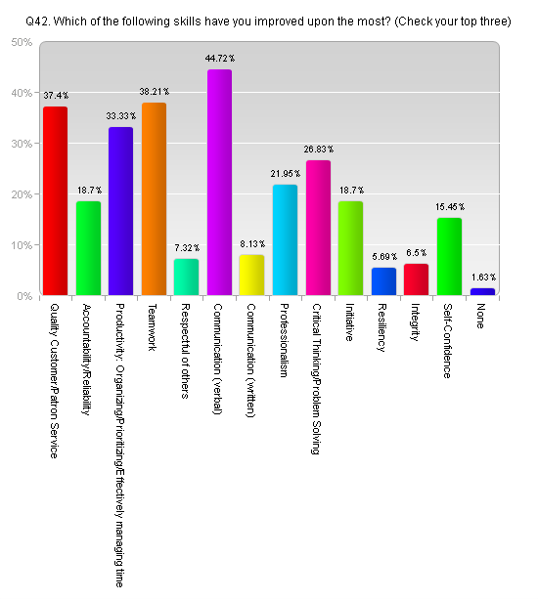
Skills Learned vs Hours worked
Students that work 11-15 hours a week said that the top 3 skills that have improved the most are: Communication (Verbal), Teamwork, and Quality Customer/Patron Service

Slide 14
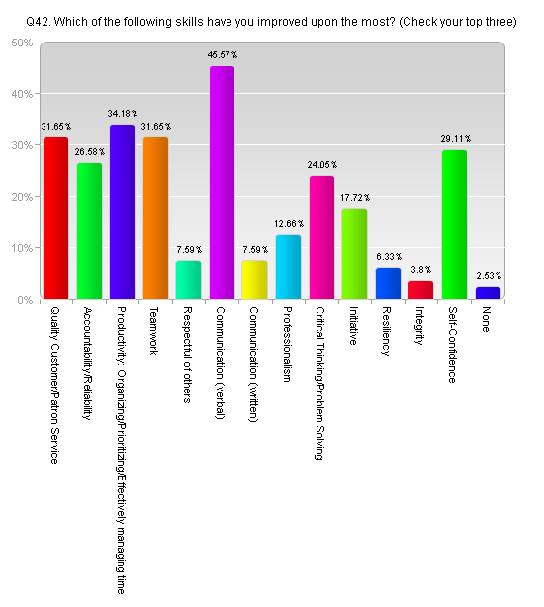
Skills Learned Vs Hours Worked cont.
Students that work 16-20 hours said that the top 3 skills that have improved the most are: Communication (Verbal), Productivity: Organizing/Prioritizing/Effectively managing time, and Teamwork and Quality Customer/Patron Service were tied in 3rd place.

Slide 15
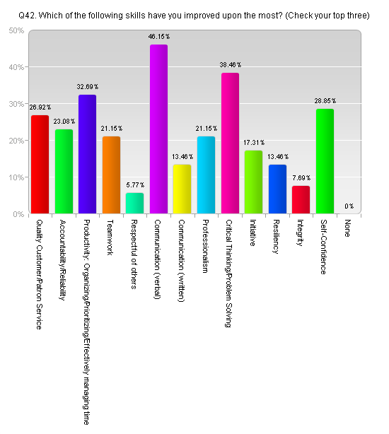
Skills Learned vs Hours Worked Cont.
Students that work 21-25 hours said: Communication (Verbal), Critical Thinking/Problemsolving, and Productivity: Organizing/Prioritizing/Effectively Managing time
Communication (Verbal) was the most improved skill regardless of the hours worked
Students that work more hours indicated a higher improvement rate in their skills.

Slide 16
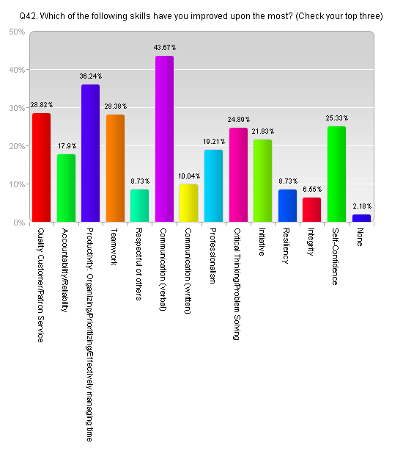
Skills Learned vs Length of time in position
Over 60% of students that worked for their department for less than a year responded that 12 out of the 13 skills questioned in the survey either improved considerably or a great deal.
50% of students stated that written communication improved considerably or a great deal.
Communication (verbal), Productivity and Quality Customer/Patron Service were the top three skills improved within that first year of work.

Slide 17
Job Satisfaction vs Skills Learned
Students very or moderately satisfied with their job they indicated a 5-6% higher improvement of skills
Students very dissatisfied with their job indicated much lower improvement of skills compared to their peers.
They also indicated they feel are having to teach themselves their job responsibilities

Slide 18
Optimal Hours vs Skills Leanred
Students working between 21-25 indicated the highest improvement rate in their skills.
EX: Increase from 33% - 50%

Slide 19
Feedback vs Skills Learned
Students who have had the opportunity to receive feedback indicated a 1-2% higher improvement of skills

Slide 20
Praise vs Skills Learned
Students who had received recognition of praise for doing a good job indicated a 2-5% higher improvement of skills

Slide 21
Take Aways To HELP OUR STUDENTS LEARN
We are helping our students learn to communicate (verbal)
Regardless of class standing, hours worked, and supervisory vs non-supervisory roles it is the most improved skill
Satisfied students learn more
Optimal hours to work for learning: 21-25/week
Provide regular feedback
Praise/recognize students for a job well done

Slide 22
Project CEO Benchmark

Slide 23
Project CEO
Survey of 501 students at UWM in the Spring of 2015 that explored students self-perceptions of where current college students believed they were developing the skills desired by employers and to what degree they had developed these skills. The national survey was completed by 17,137 respondents across a diverse set of institutions.

Slide 24
Top 9 Soft Skills as Rated by Employers
Ability to work in a team structure
Ability to make decisions and solve problems
Ability to verbally communicate with persons inside and outside the organization
Ability to obtain and process information
Ability to analyze quantitative data
Technical knowledge related to the job
Proficiency with computer software programs
Ability to create and/or edit written reports
Ability to sell or influence others

Slide 25
What did we learn?
27% of responding students indicated that they had held an on-campus job in the last year.
How long had they been working on campus?
42% 1 year
33% 2 years
25% 3 or more years

Slide 26
Developing Out Outcomes

Slide 27
Student Employment – From the Student Perspective
Notes:
In case the embedded video doesn’t work: https://www.youtube.com/watch?v=ynhxdANBY-c

Slide 28
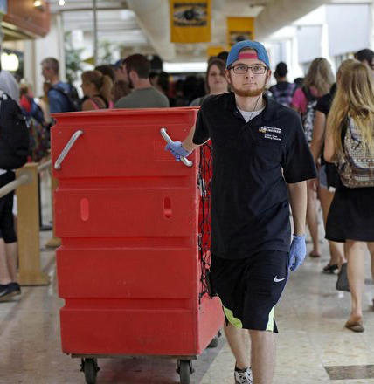
Student Employment: What are you proud of?
One-two experiences you are most proud of
What do students take away?
Notes:
Becca

Slide 29
Using Campus Labs Respond
1. Go to srs.campuslabs.com
2. Use Connect ID 4279
3. You must enter something for the first and last name, but you do not need to use your real name
4. Answer the question in less than 140 characters
Notes:
Respond Question: What experiences of student employees are you most proud of?

Slide 30
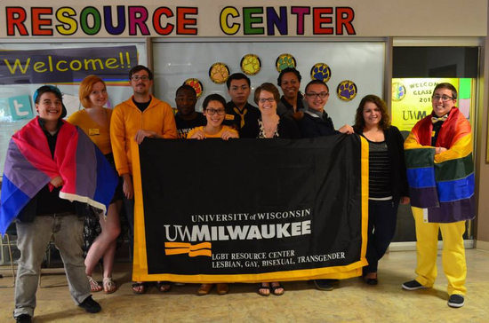
What is your “take away”?
Go to
srs.campuslabs.com
Use Connect ID
4279
Notes:
Ellie. Respond Question: What stands out to you about student learning, from the conversation you just had? (i.e. skills, meaningful experiences, etc.)

Slide 31
Helping our students improve
Think about the areas that you do a lot of coaching in to help student staff improve their performance.
What are your common conversation topics?
What knowledge, skills, and abilities are you frequently coaching them on?
Notes:
New groups - Ellie

Slide 32
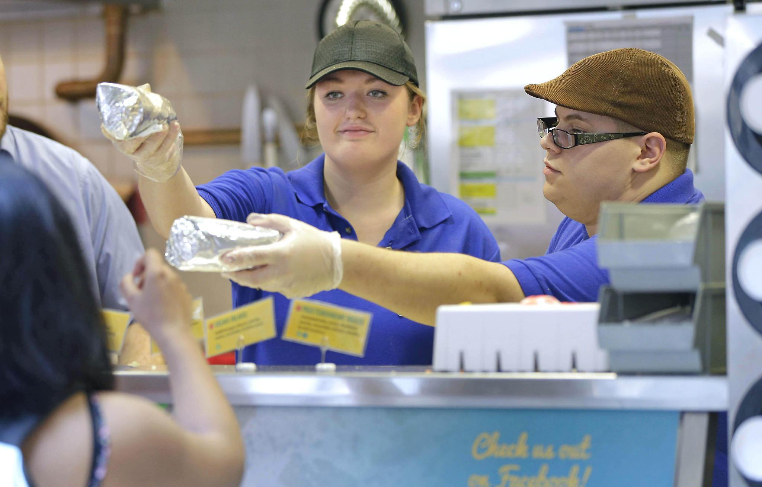
Preparing for the future
When writing their resume, what skills, knowledge, and abilities should they be including that they gained from working for you?
What should they
be highlighting about
their experience?
Respond (ID 4279)
Notes:
Becca

Slide 33
Our Student Leaders
Focus on your student leaders, managers, and supervisors
What is different about how those positions are structured?
What skills do you specifically train those students in?
Respond (ID 4279): When writing their resume, what skills, knowledge, and abilities should they be including that they gained from working for you?
Notes:
Ellie

Slide 34
Next Steps
Synthesize the data
Date for next discussion:
Thursday, March 31
9 a.m.
Sandburg Flicks
Topics
Review today’s responses and data
Talk about specialization by unit
Degree of learning
Notes:
Becca – Ask for handouts

