Slide 1
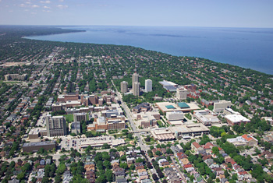

THESIS & DISSERTATION FORMATTING
WORKSHOP

Slide 2

Formatting Guidelines
Entire Document

Slide 3
Spacing
Double space throughout the document
  Exceptions:
    Abstract
    Table of contents
    Captions, table, or figure headings
    Extensive quotations
    Footnotes or endnotes
    Entries in reference section

Slide 4
Font
Any standard font is acceptable
  This is in Arial; Microsoft Word default is Calibri
Use the same font throughout
Most commonly used font size is 12 point
Captions (not smaller than 9 point)
Headings (not larger than 20 point)
Suggestion: Use sans serif for online work
      (like this) abcdef (not this) abcdef

Slide 5
Margins
All pages must have at least:
  Top, bottom, left, and right margins
        = 1 inch
        The only exception: page numbers (They are automatically placed within the margin, ½ inch from the proper edge of the page.)

Slide 6
Formatting Guidelines
Preliminary Pages

Slide 7
Preliminary Pages
Numbering
  Lower case Roman numerals ( ii, iii, iv, v…)
  Centered at the bottom of the page
  Numbers at least ½ inch from bottom edge
  Title page counted, but number not displayed

Slide 8
Sequence
Preliminary Pages
Title Page (Required)
Abstract Page (Required)
Copyright Page (Optional)
Dedication Page (Optional)
Table of Contents (Required- *except creative works)
List of Figures (Required if figures appear)
List of Tables (Required if tables appear)
Acknowledgments (Required if permission to reproduce copyright is necessary)
Frontispiece or Epigraph (Optional)

Slide 9
Preliminary Pages
Type and Sequence
Title Page Required
  Counted, but number not displayed
  Name of degree must be accurate. Example: Engineering vs Mechanical Engineering
  Use Month & Year of the degree conferral date
    (May, August, or December)

Slide 10



Slide 11


Slide 12
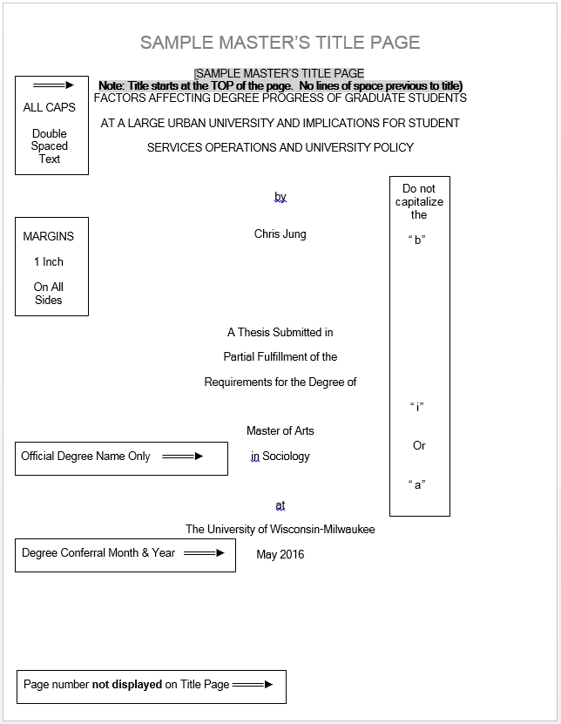

Slide 13


Slide 14


Slide 15
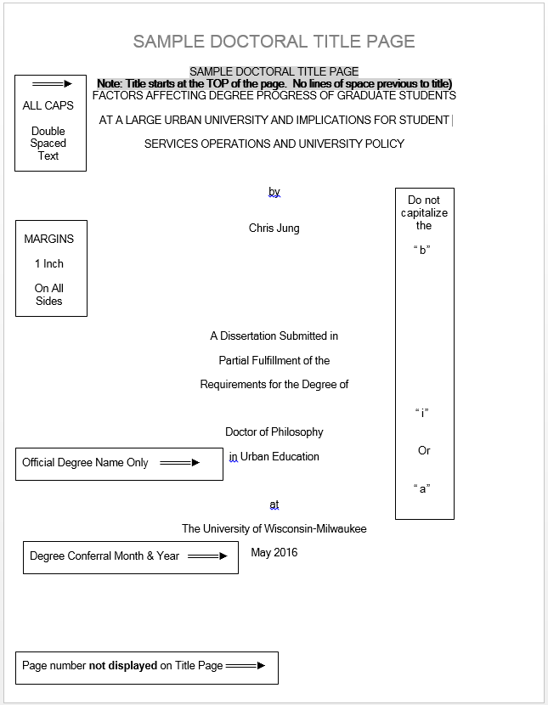

Slide 16
Preliminary Pages
Type and Sequence
Abstract Required
  Notice the required abstract heading
    Single-spaced Title
  No Word Limit, but see Print Index information on the next page within the Abstract text.
  Double Space the Abstract Text
  This will be page “ii”
  DO NOT place a “SIGNATURE LINE” on this page

Slide 17
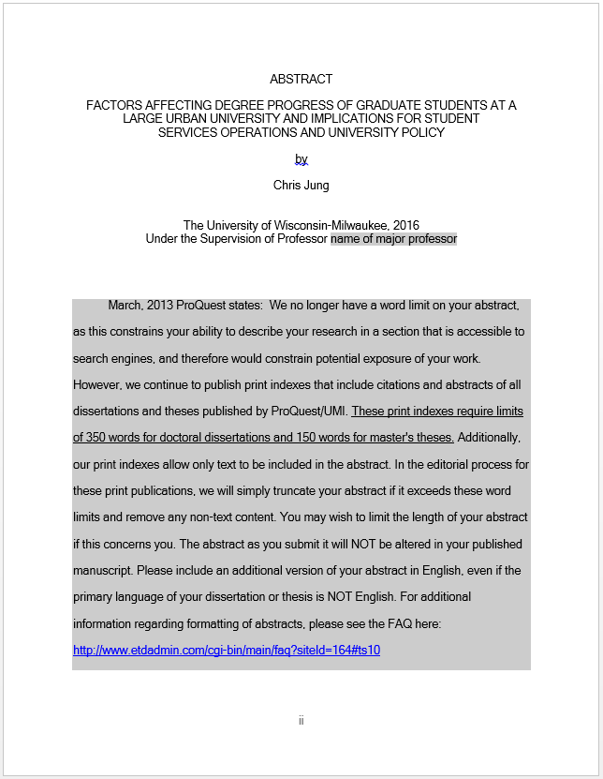

Slide 18
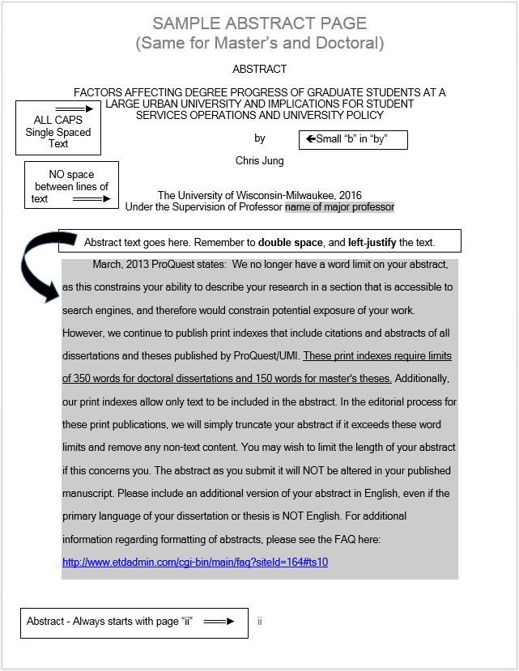

Slide 19
Preliminary Pages
Type and Sequence
Copyright page Optional
  You may include this page even if you will not be formally registering for copyright with the Library of Congress.
  Single space the text
  Center the text both vertically and horizontally
  Same for Master’s and Doctoral theses

Slide 20


Slide 21
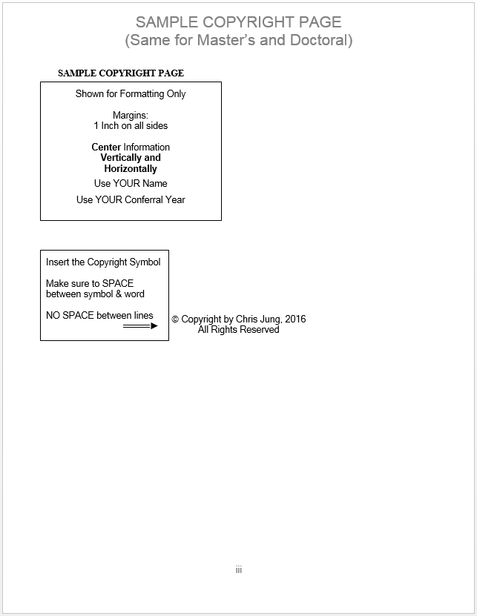

Slide 22
Preliminary Pages
Type and Sequence
Dedication Optional
  No required heading
  May be combined with acknowledgments.
    If combined with acknowledgments, dedication should be located on acknowledgments page
    Acknowledgments page(s) = last page(s) before main body starts

Slide 23


Slide 24
This is a sample page number. Use the correct page number as it applies to your document.

Slide 25
Preliminary Pages
Type and Sequence
Table of Contents
    Centered, in ALL CAPS at the top of the page
  Required for all except creative work
  List sections with page numbers
  Double space between entries
  Single space within entries

Slide 26
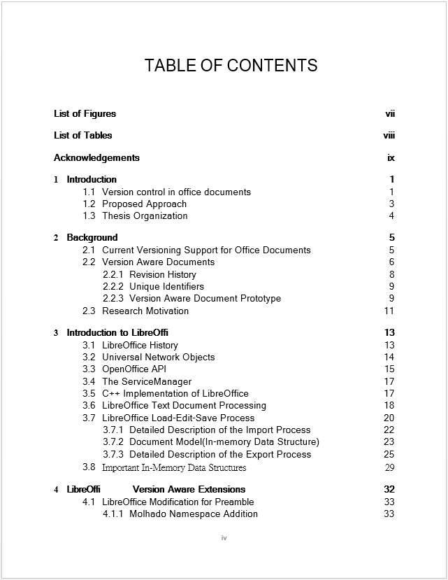

Slide 27
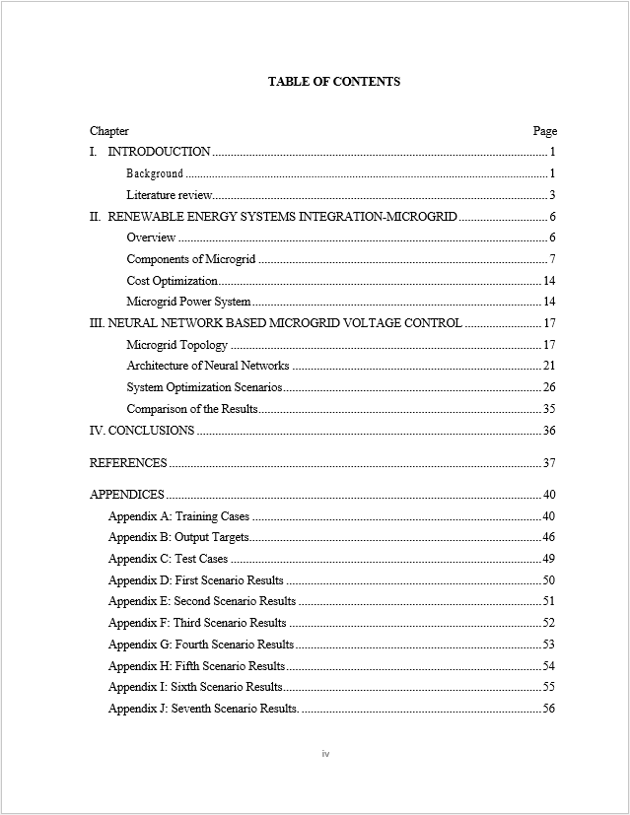

Slide 28
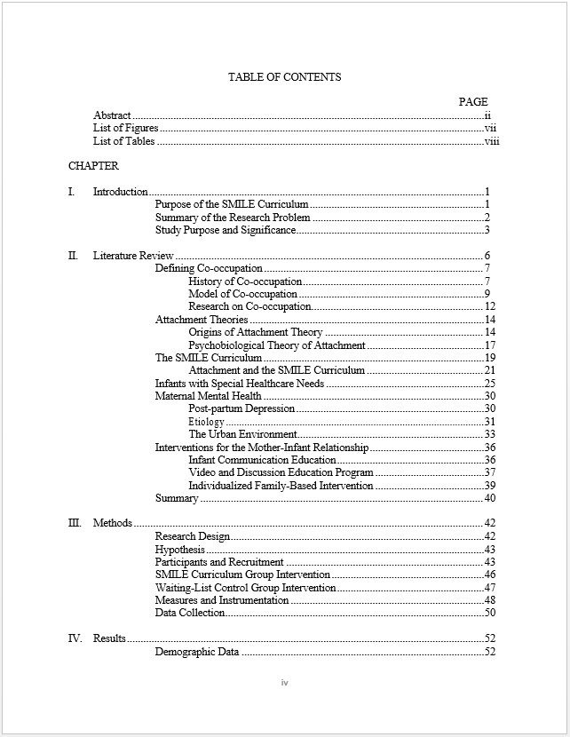

Slide 29
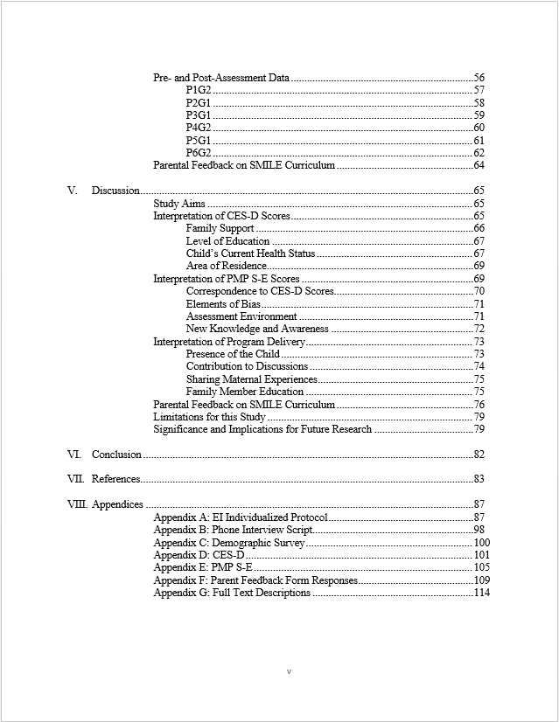

Slide 30
Preliminary Pages
Type and Sequence
List of Figures
      Centered, in ALL CAPS at the top of the page
  Required if figures appear in thesis
  Non-text items
  Numbered consecutively throughout

Slide 31
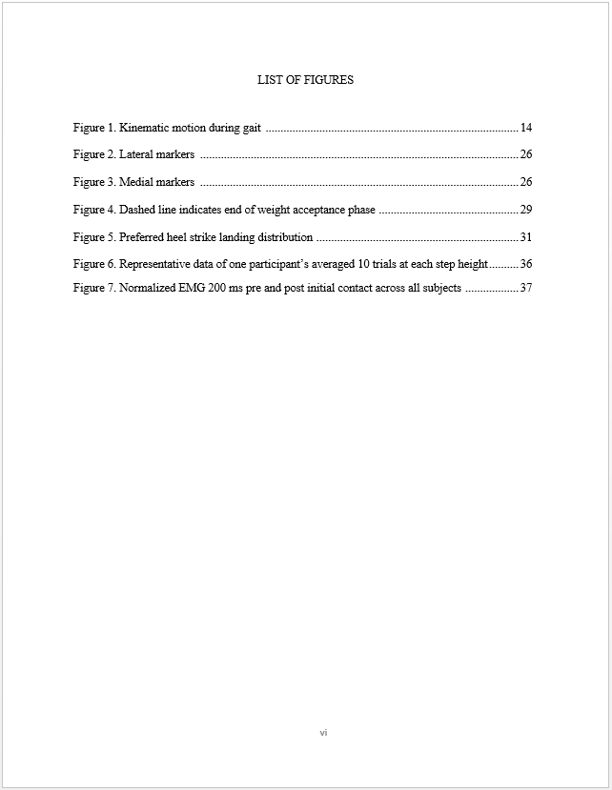

Slide 32
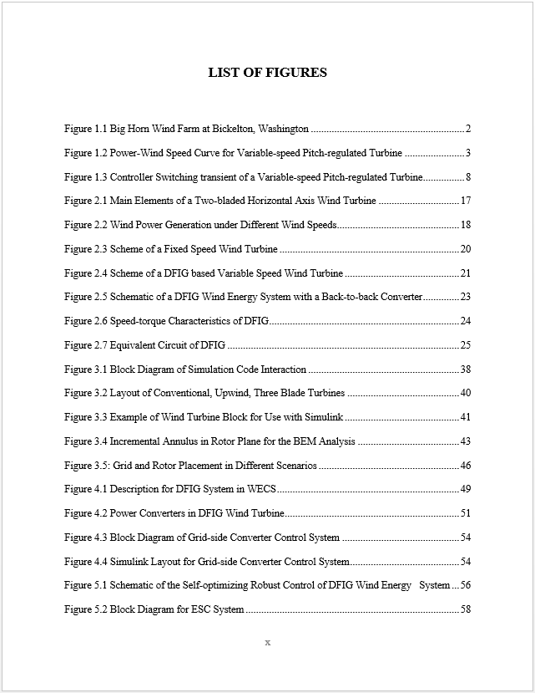

Slide 33
Preliminary Pages
Type and Sequence
List of Tables
        Centered, in ALL CAPS at the top of the page
  Required if tables appear in the thesis
  Tables should be numbered consecutively throughout

Slide 34
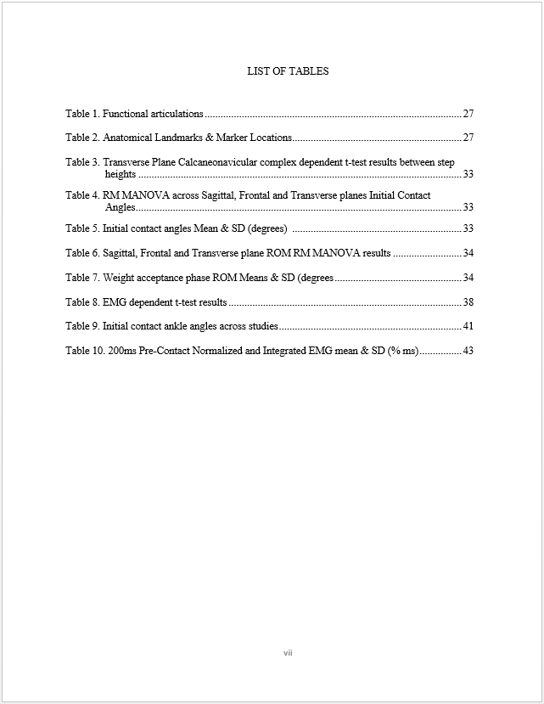

Slide 35
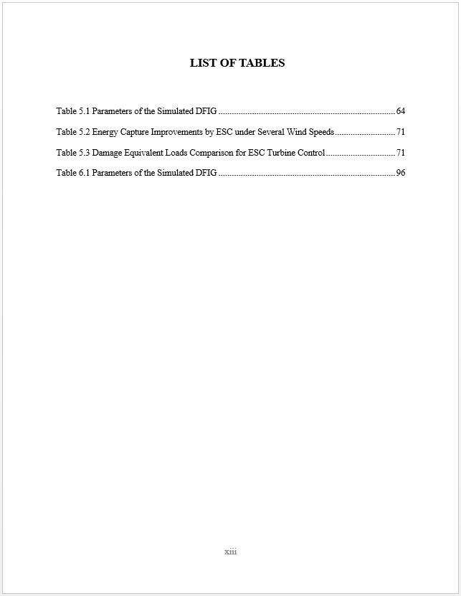

Slide 36

Preliminary Pages
Type and Sequence
List of Abbreviations Optional
  or List of Symbols
  or List of Nomenclature
  No matter what the name of the list, each would be centered, in ALL CAPS at the top of the page.
  No page number listings

Slide 37
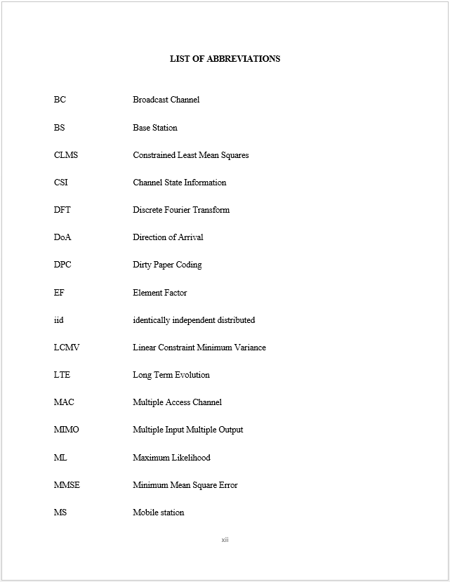

Slide 38
Preliminary Pages
Type and Sequence
Acknowledgments
        Centered, in ALL CAPS at the top of the page
  Required if permission to reproduce copyrighted material is necessary
ACKNOWLEDGMENTS
Thank you, UWM Libraries, for letting us use pictures from the UWM Photo Collection on our slides for this presentation

Slide 39
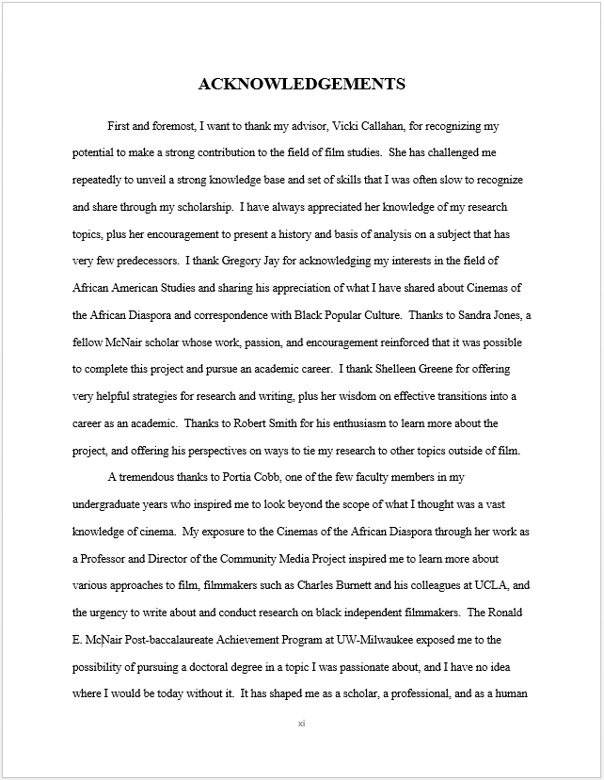

Slide 40
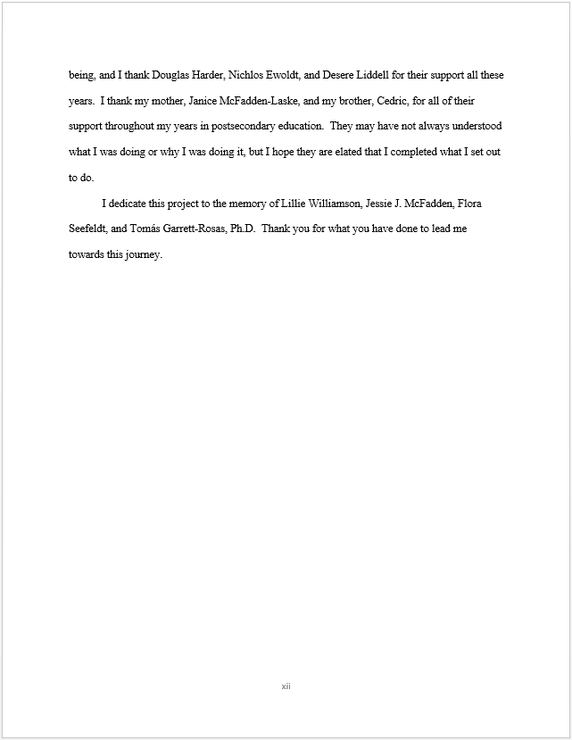

Slide 41
Formatting Guidelines
Main Body

Slide 42
Main Body
Page Numbering
  Arabic numerals (1, 2, 3, etc..)
  Centered at the bottom of the page
  At least ½ inch from edge

Slide 43
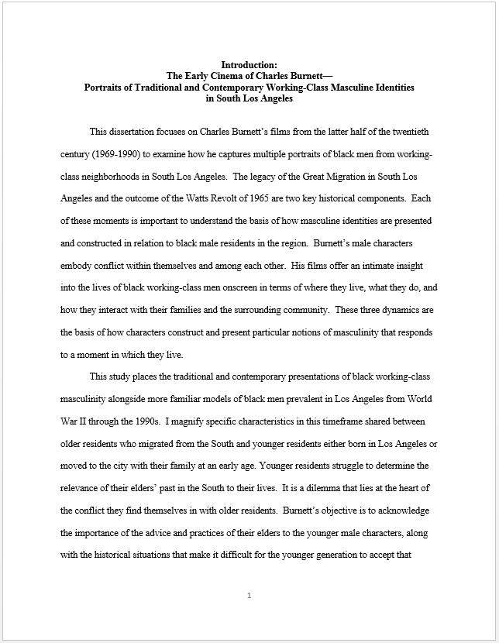

Slide 44
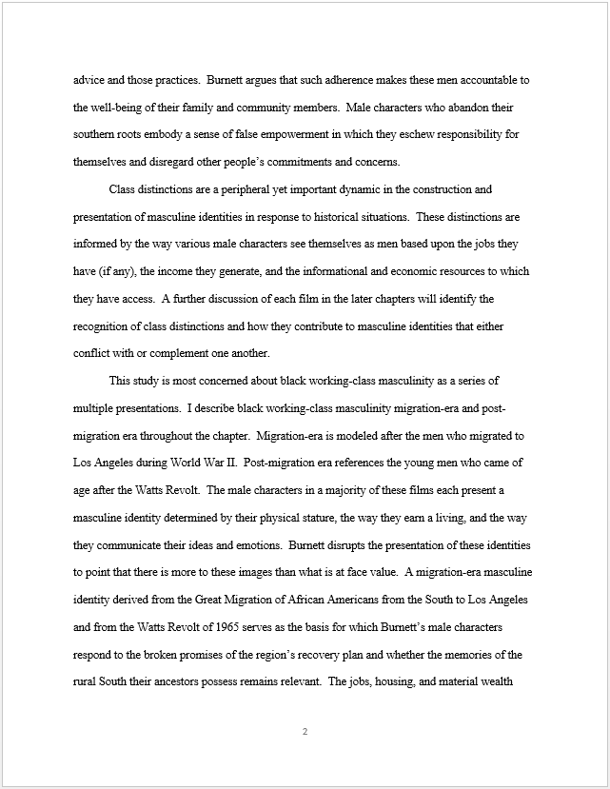

Slide 45
Tables and Figures
Landscape format
  “Top” is on the left, and has 1 inch margin
  Page number must still appear in the middle on the bottom as though the page was in portrait format*
  *If you are looking at the landscape page:
  The page number will be in the middle of the left edge, with the text direction rotated 90°

Slide 46
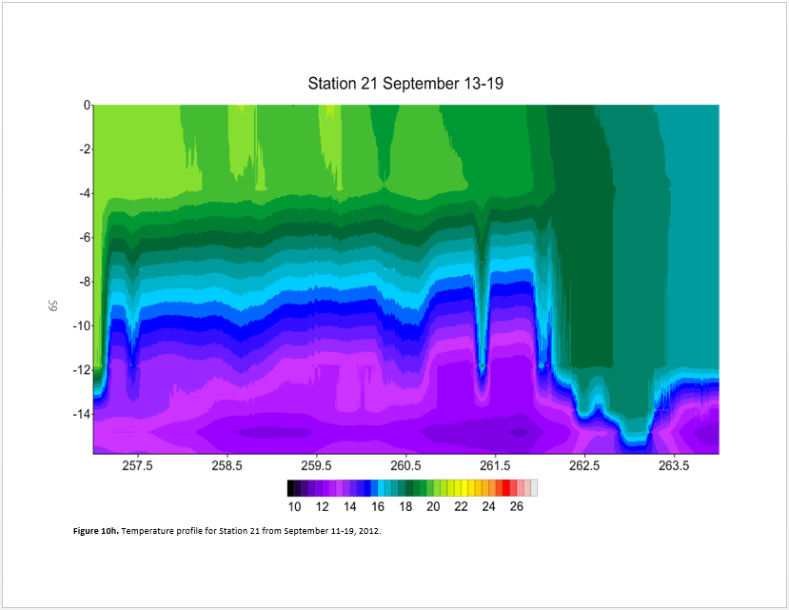

Slide 47
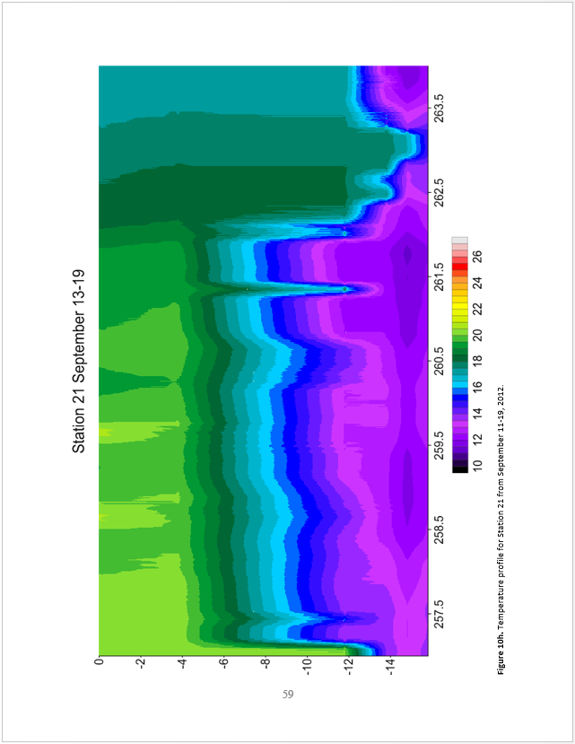

Slide 48
Tables and Figures
­- Landscape help
Create Sections
On the last page of your Portrait pages:
  Click after the end of the content
  Go to the’ Page Layout’ menu
  Choose the ‘breaks’ tab
  Add a section break ‘next page’.

Slide 49
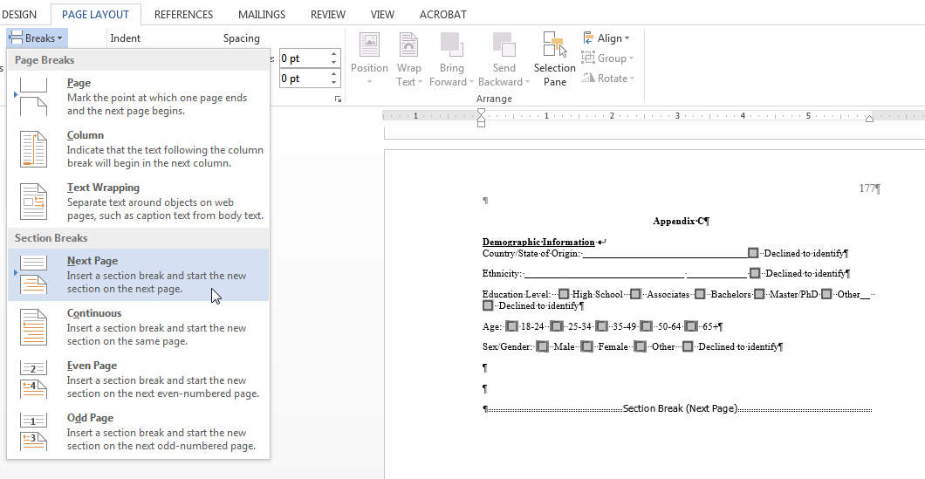

Slide 50
Tables and Figures
­- Landscape help
Creating sections
(continued)
On the last page of your Landscape pages:
  Click after the end of the content
  Go to the’ Page Layout’ menu
  Choose the ‘breaks’ tab
  Add a section break ‘next page’.

Slide 51
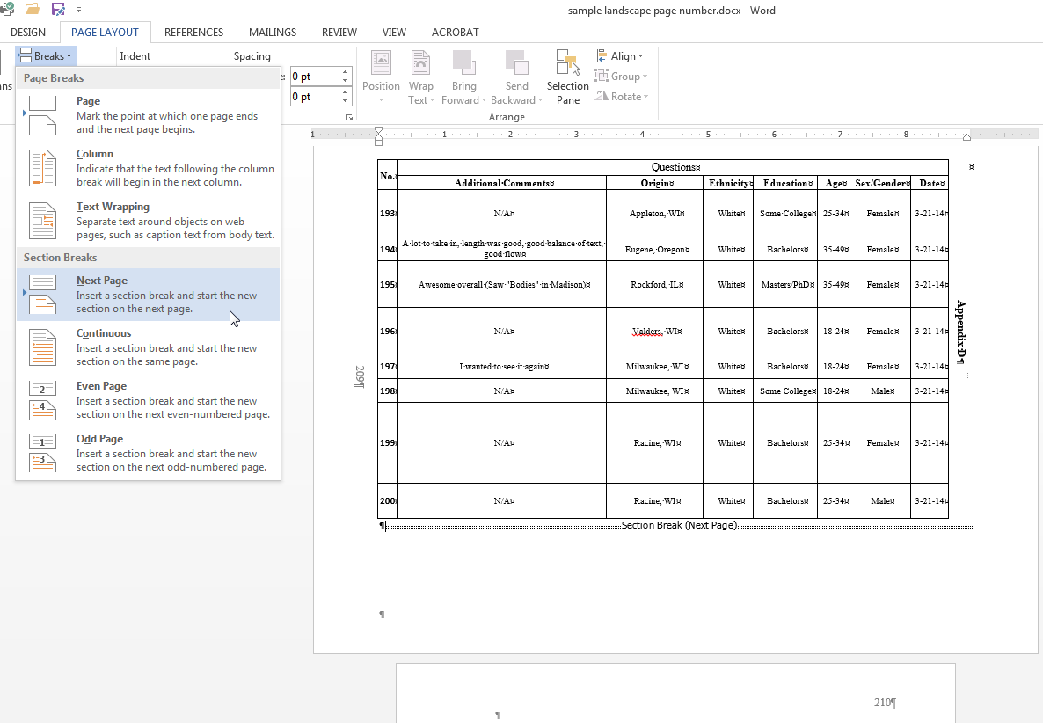

Slide 52
Tables and Figures
­- Landscape help
Creating sections
(continued)
De-select “Link to Previous”
  Double click into the header of the first page of each new section created
  HEADER & FOOTER – DESIGN tab
    ‘Navigation’ menu
      De-select ‘Link to Previous’ button
  Repeat steps A & B in footer of the first page of each new section created

Slide 53
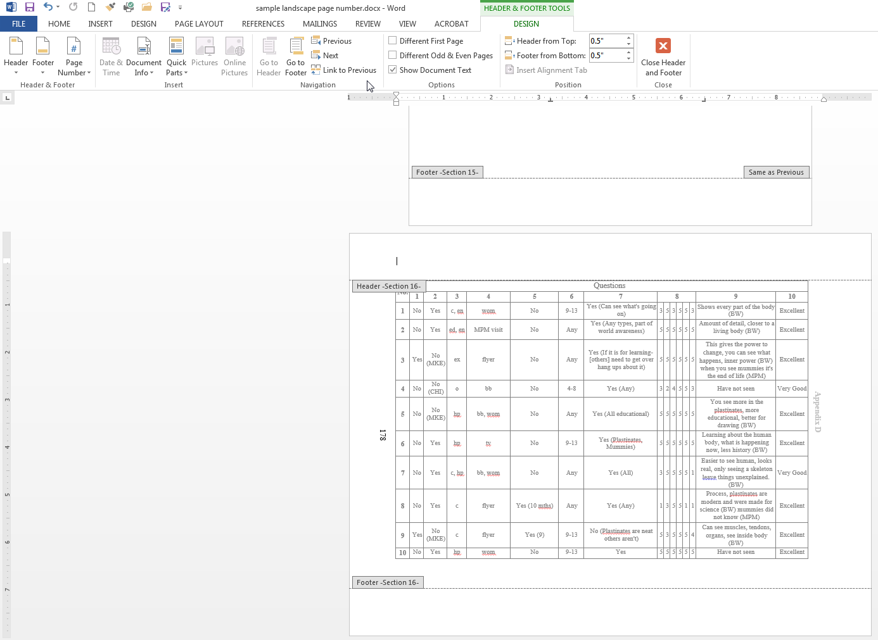
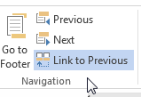

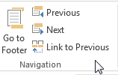

(0811342)
Link to Previous “button” has been deactivated by clicking on it.
(It will change in appearance: no longer “highlighted” when it has been deactivated.)
ON
OFF

Slide 54
Tables and Figures
­- Landscape help
Create sections
This will make a separate section for your portrait pages, landscape pages, and the next portrait pages section.
You can continue doing this for as many sections as you need should you continue to have alternating portrait and landscape pages.

Slide 55
Tables and Figures
­- Landscape help
Adding the page numbers
Click into the footer
In the HEADER & FOOTER – DESIGN tab
  Select the ‘Page Number’ menu
    Choose ‘Page Margins’ and ‘Large, Left’

Slide 56
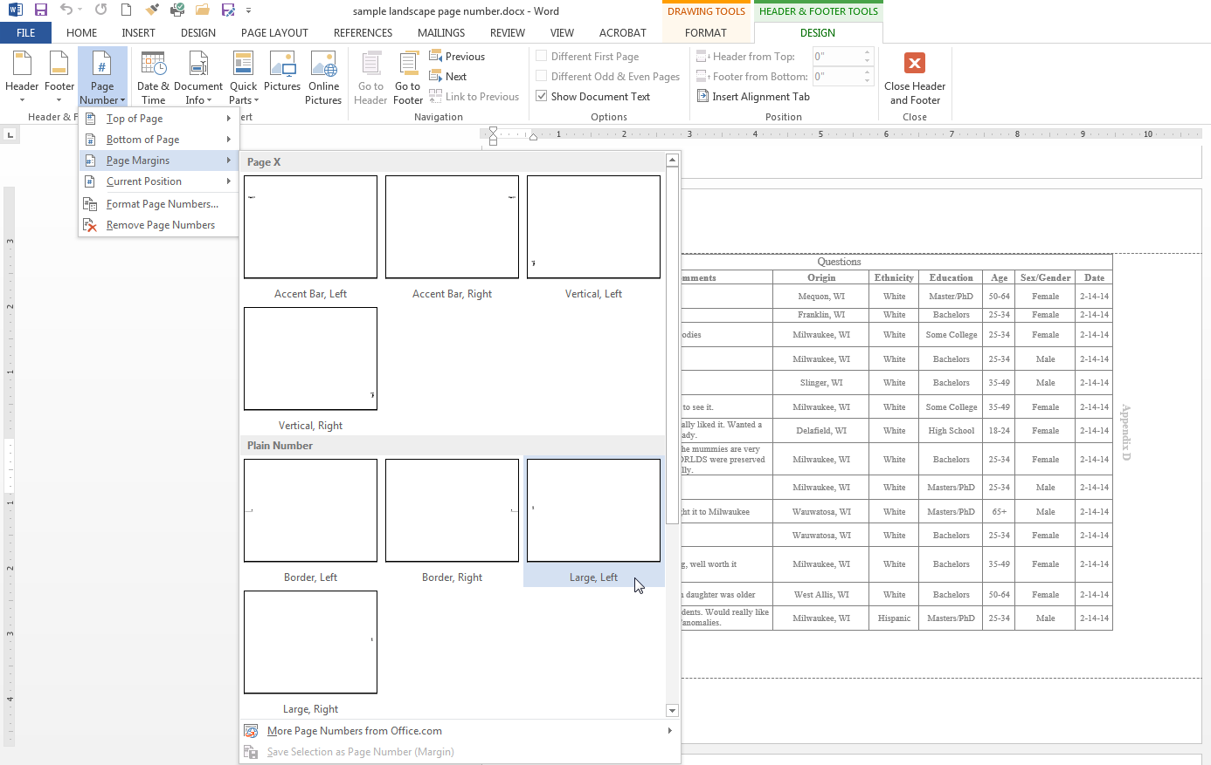

Slide 57
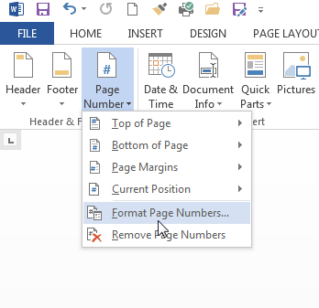
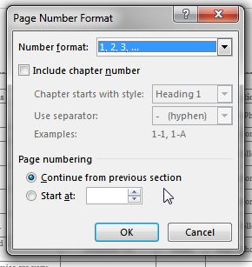
Tables and Figures
­- Landscape help
Add the page numbers
If a page number does not populate, open Page Number menu, choose Format Page Numbers, and select Continue from previous section.

Slide 58
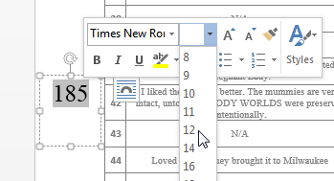
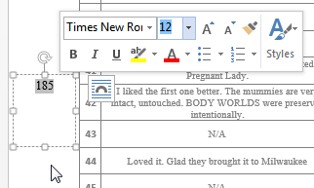
Tables and Figures
­- Landscape help
Add the page numbers
    Right-Click into the new page number location to change the text size (and font if necessary) to match the portrait page numbers.

Slide 59
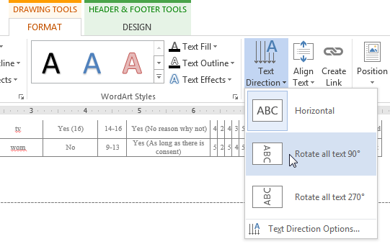
Add the page numbers
In DRAWING TOOLS – FORMAT tab
  In Text menu, choose Text Direction
    Rotate all text 90°
Tables and Figures
­- Landscape help

Slide 60
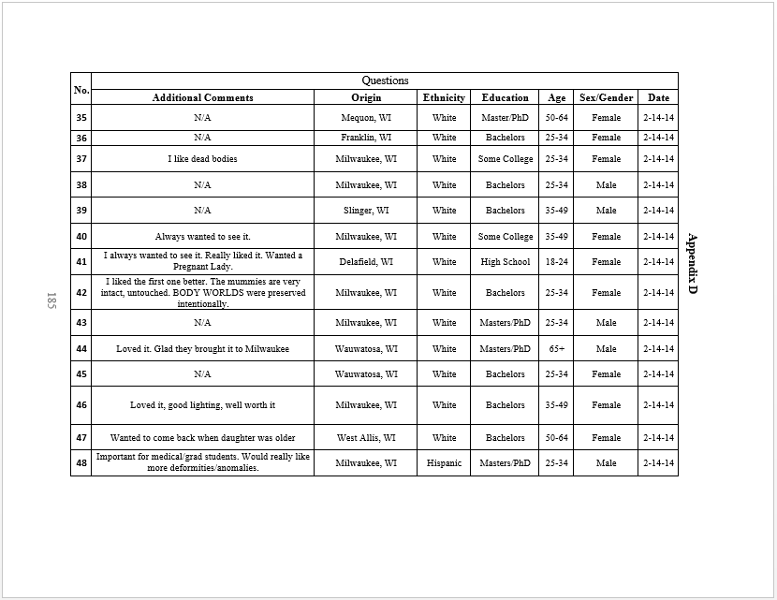

Slide 61
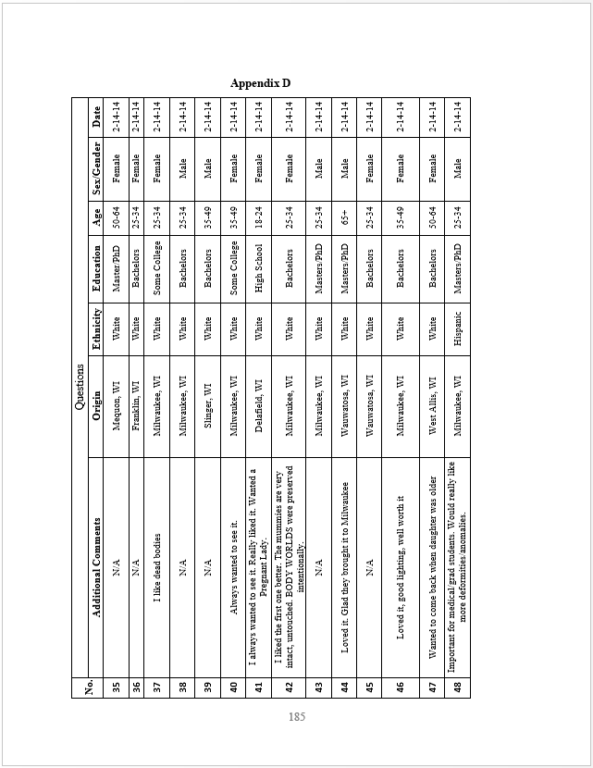

Slide 62
References
Use any standard style manual
  May be placed at the end of the main text, or at the end of each chapter
  If you are not using a style manual, single space within each entry and double space between the entries

Slide 63
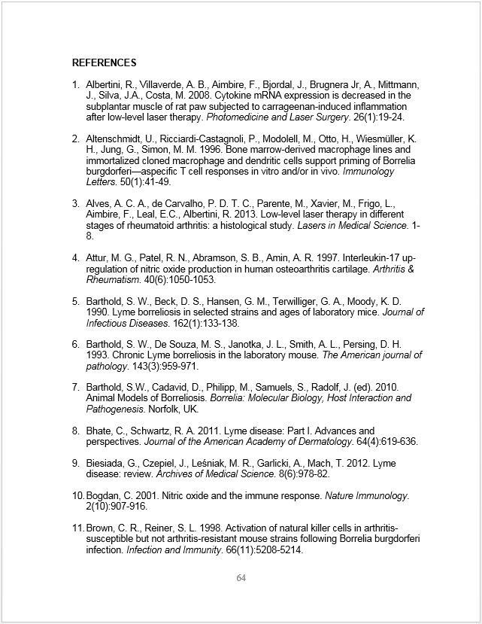

Slide 64
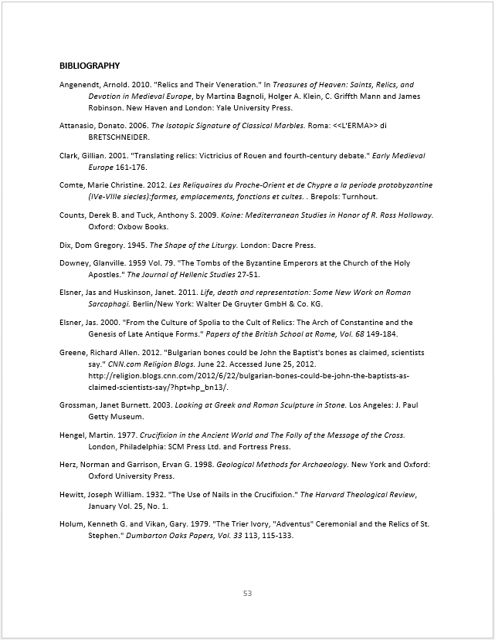

Slide 65
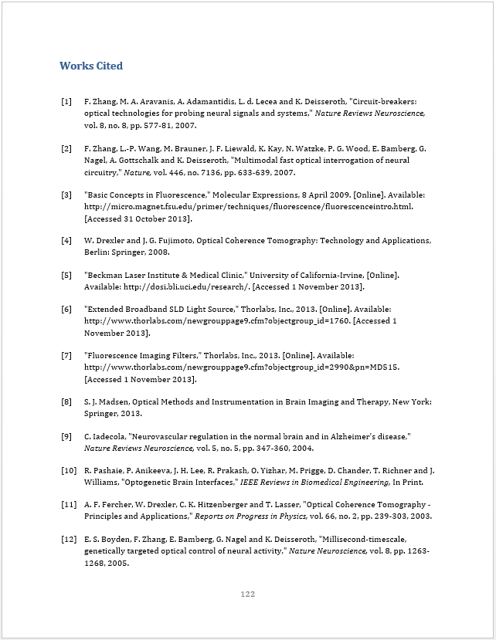

Slide 66
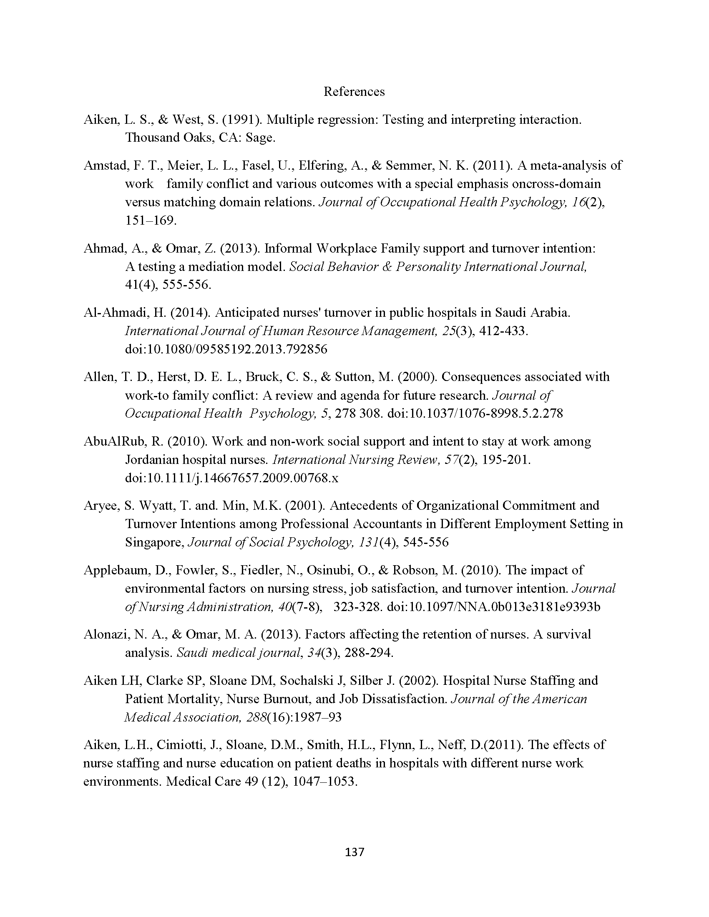

Slide 67
Appendices
Not required for every thesis or dissertation
Material that supports the research but is not essential to an understanding of the text
Must be labeled as appendix
  Appendix: Raw Data
  Appendix A: Raw Data
  Appendix B: Survey
  Appendix C: Visual Analog Scale
Placed AFTER (final) references
only one
more than one

Slide 68
Appendices
Can have Appendix Title(s) inserted directly on first page of appendix material
or
  Can have separate page with (each) Appendix Title preceding appendix material
  See following slides for examples of each.

Slide 69
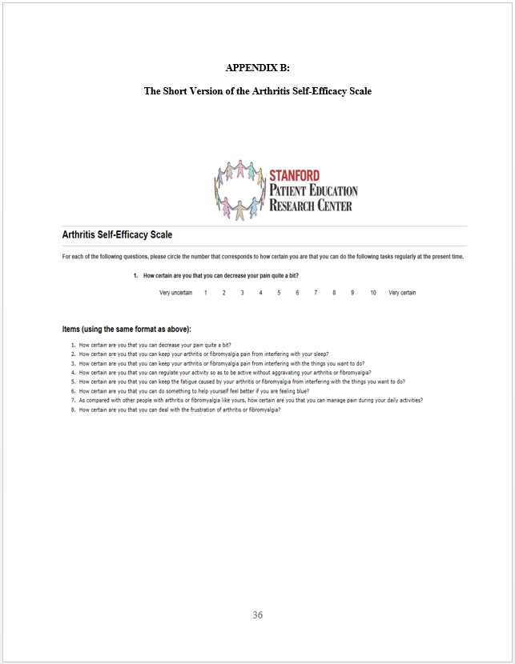

Slide 70


Slide 71
THESIS & DISSERTATION FORMATTING
The End
W
O
R
K
S
H
O
p
Thank You!

